Slide 1
Directional Coupler Passive Run Mask Splits
7/15/15

Slide 2
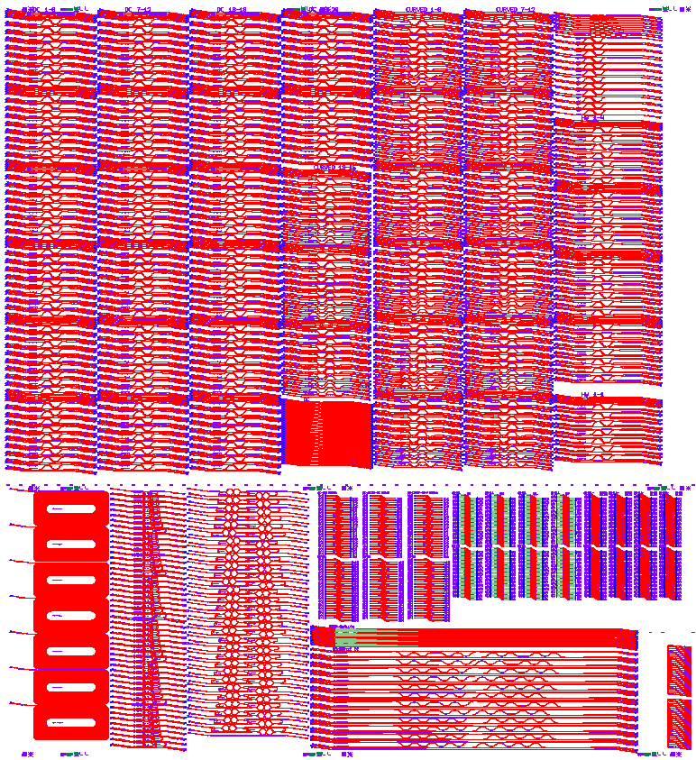
Straight Directional Couplers
Curved Directional Couplers
Y-branch
Half-wave couplers
Single
DC
Teardrop Fabry-perot
Low Reflection GC
Ellipse
GC
Ring Filters
Grating Coupler
Waveguide loss spirals
Nitride Coupling

Slide 3
Straight DCs UMZI
WG_w = 0.4, 0.6, 0.7, 0.8
Gap_w = 0.3, 0.35, 0.4, 0.6, 0.8
Coupler_L = 10, 15, 20, 25, 30, 35, 40, 50, 60, 70, 80, 90, 100, 120, 140, 160, 180, 200
Grating couplers
DC loss structures
Dice Line for
angled facet
UMZI

Slide 4
Straight DCs Single device
WG_w = 0.4, 0.8
Gap_w = 0.4
Coupler_L = 10, 15, 20, 25, 30, 35, 40, 50, 60, 70, 80, 90, 100, 120, 140, 160, 180, 200

Slide 5
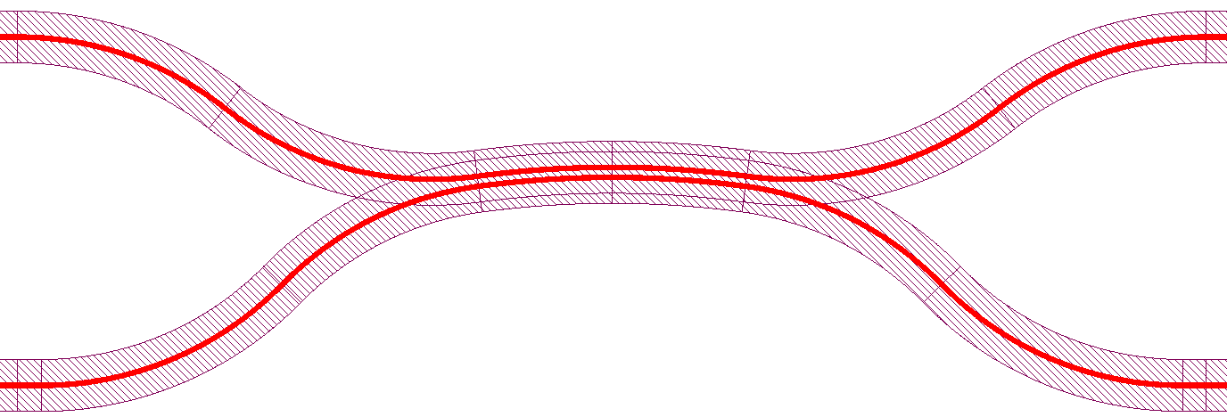
Curved DCs UMZI
WG_w = 0.4, 0.6, 0.8
Gap_w = 0.3, 0.35, 0.4, 0.6, 0.8
Coupler_L = 10, 15, 20, 25, 30, 35, 40, 50, 60, 70, 80, 90, 100, 115, 130, 145, 160, 180
Grating couplers
DC loss structures
Dice Line for
angled facet
UMZI

Slide 6
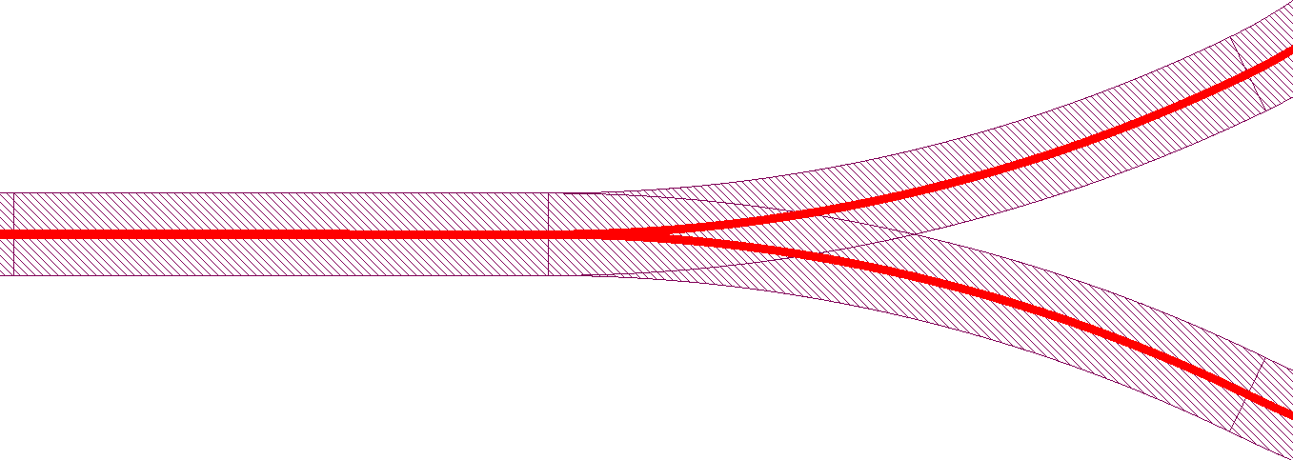
Y-branch splitters UMZI
WG_w = 0.4, 0.6, 0.7, 0.8
Bend_radius = 25, 50, 75, 100, 125, 150
Grating couplers
Y-branch loss structures
Dice Line for
angled facet
UMZI

Slide 7
Half-wave Couplers UMZI
WG_w = 0.4, 0.6
Gap_w = 0.4, 0.5
Coupler_L = 50, 60, 70, 80, 90, 100, 110, 120, 130, 140, 150, 160, 180, 200
Grating couplers
Half-wave coupler
loss structures
Dice Line for
angled facet
UMZI

Slide 8
Adiabatic Coupler UMZI
WG1 = 0.5, 0.6; WG2 = 0.7, 0.8
Gap_w = 0.3
Input_L = 100, 200, 400 (based on simulations with input sbend)
Coupler_L = 400, 600, 800, 1000
Input length/2
Coupler length
Input length/2
WG1
(WG1+WG2)/2
WG2
(WG1+WG2)/2

Slide 9
Deep Shallow
WG_w = 0.4, 0.8
Number_transitions = 2, 4, 6, 8
Trench_w = 3.5, 7
Transition from deep to shallow
Transition from shallow to deep

Slide 10
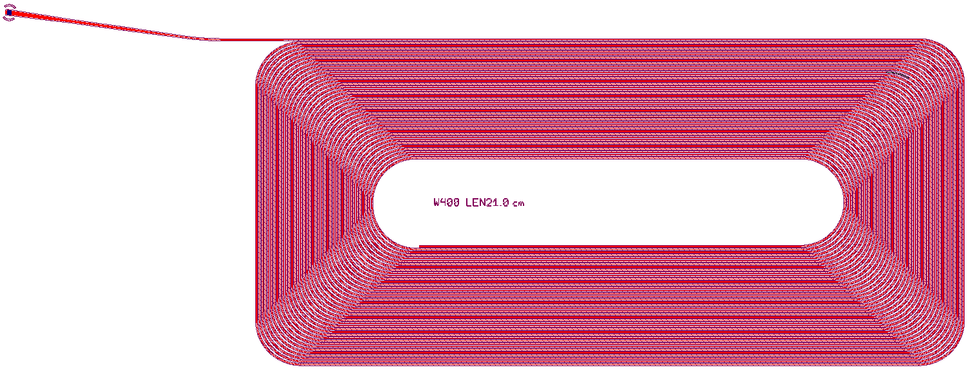
Waveguide loss measurement structures
WG_w = 0.4, 0.5, 0.6, 0.7, 0.8, 0.9, 1.0
Length = 21 cm
Grating coupler

Slide 11
Loop Mirror
WG_w = 0.4, 0.6
Gap_w = 0.35, 0.4, 0.5
Coupler_L = 10, 20, 30, 40, 50, 60, 70, 80, 90, 100, 125, 150
Fabry-perot with teardrop mirrors
Grating couplers
Dice Line for
angled facet

Slide 12
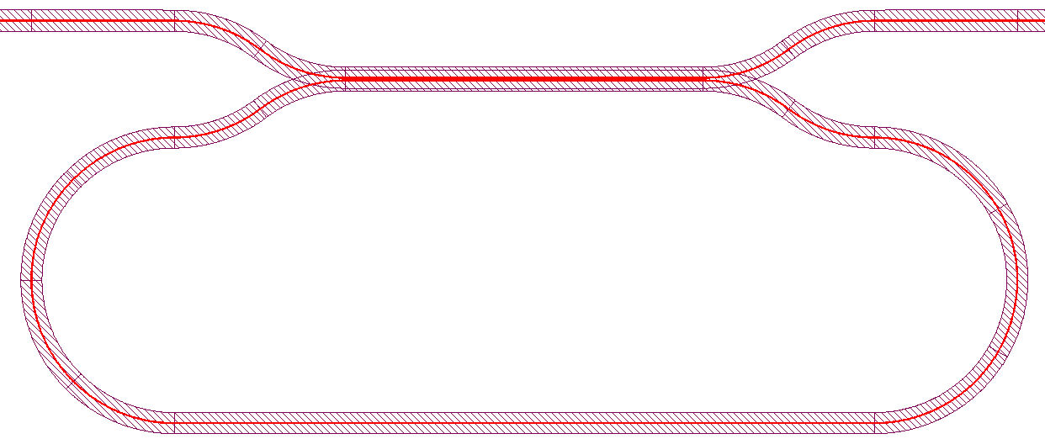
Coupled Ring Resonators
WG_w = 0.4, 0.6
Gap_w = 0.35, 0.4, 0.5
Coupler_L = 10, 15, 20, 25, 30, 35, 40, 45, 50, 55, 60, 70, 80, 95, 125, 150
Grating couplers
Coupled Ring Resonator
Dice Line for
angled facet

Slide 13
Output Grating Couplers
Coupler_w = 12
WG_w = 0.4, 0.8
Pitch = 470, 480, 490, 500, 510, 520, 530
DutyCycle = 0.50, 0.55, 0.60, 0.65, 0.70, 0.75
Grating couplers

Slide 14
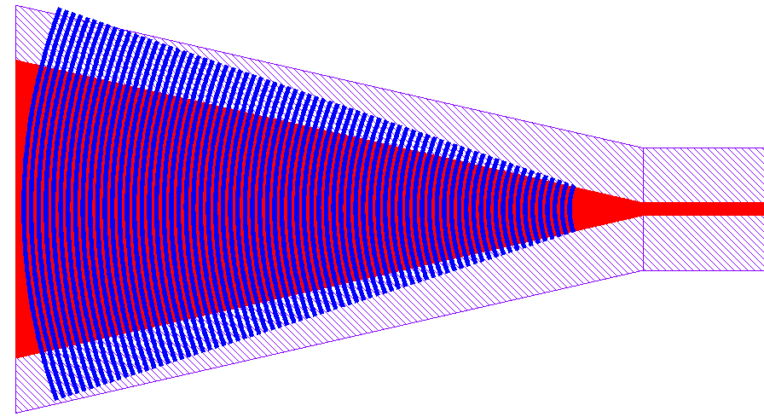
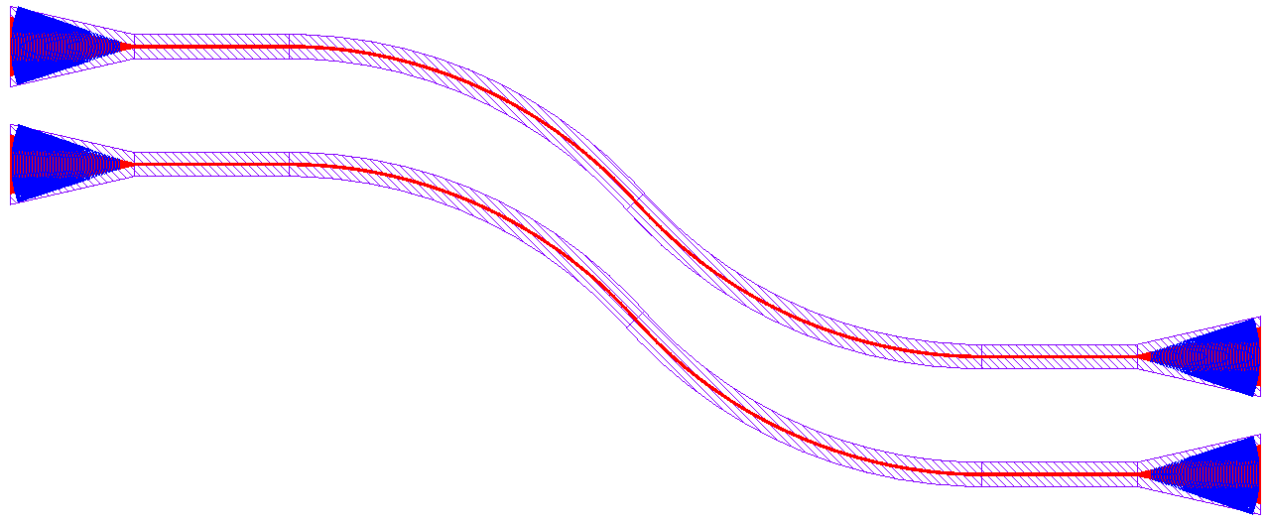
Ellipse Grating Couplers
WG_w = 0.4, 0.8
Q0 = 10, 20, 30, 40 (first period of grating)
Pitch = 470, 480, 490, 500, 510, 520, 530
DutyCycle = 0.50, 0.55, 0.60, 0.65, 0.70, 0.75

Slide 15
Low reflection Grating Couplers
WG_w = 0.4, 0.8
Q0 = 25 (first period of grating)
Pitch = 470, 480, 490, 500, 510, 520, 530
DutyCycle = 0.50, 0.55, 0.60, 0.65, 0.70, 0.75
Offset angle from ellipse = 0, 45, 135
Deep to shallow transition
Reflection reduction Flare
Gratings

Slide 16
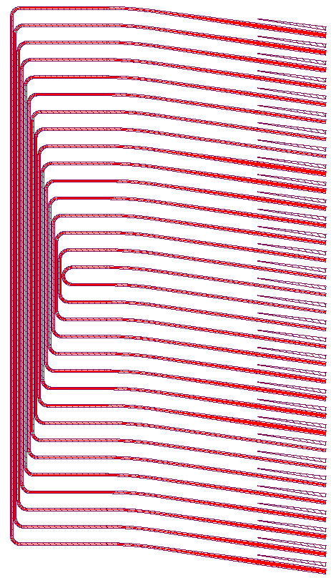
Nitride butt-coupling test
WG_w = 0.8
Facet_w = 1, 2, 3, 4, 5, 6, 7, 8
Additional split on nitride chip

