Slide 1
Dev2 III-V Mesa Etching
M Davenport, S Jain, S Srinavasan, M. Heck

Slide 2
Process overview
P-mesa etch
  Deposit SiN hardmask
  Pattern SiN hardmask
  Dry etch P-mesa
Taper Q etch
  Pattern PR mask
  Wet etch Q layer
  Strip P-mesa hardmask (CF4 etches AlGaInAs?)
N-layer etch
  Deposit SiN hardmask
  Pattern SiN hardmask
  Dry etch N-layer

Slide 3
P-mesa etch
Hardmask Deposition
Pattern Hardmask
Etch Hardmask
Etch Mesa

Slide 4
Hardmask deposition
Solvent clean: It’s dirty from substrate removal. ACE/ISO/DI. No sonic (Ultrasonic possible).
O2 descum. PE2 because there’s no signup, fast, easy
Dehydration bake, 5min @150C to drive water out of trench, channel
Deposit SiN in PECVD1. No glass slide.
  Use 300nm
  Measure film thickness with dummy Si on Nanometrics or ellipsometer
Output metric: Film thickness

Slide 5
P-mesa lithography
Solvent clean: Purely out of paranoia
Dehydration bake, 5min @150C to drive water out of trench, channel
Spin PR (Use blue tape, always)
  Spin HDMS: Allow to puddle for 20”. Spin at 4k RPM (recipe 7).
  Replace wipe in spinner bowl
  Spin SPR 955CM 0.9 for 30” at 2.5k (recipe 5)
  Remove from tape and bake. SPR recommends 90” at 90C.
  Place on blue tape again. Dispense CEM. Use syringe and filter, spin at 4k RPM (recipe 7)
Expose in stepper for 0.4s. HP, Hui used this value
DI Rinse to remove CEM
Bake. SPR recommends 90” at 110C.
Develop: MF726 for 60s.
O2 descum to remove residue from pattern
Flood expose in contact aligner for 1’. This will make PR easier to remove
Output metric: Dektak PR? At least the first time. Microscope of nonius marks

Slide 6
CEM
Non CEM
30um scale
30um scale
After P-mesa etch. Height of mesa=1.8um+300nm SiN hardmask
SiN hardmask still remains
Notch on CEM sample is 110nm deep – not through SiN hardmask
Notch on non CEM sample is 500nm deep – etched through hardmask and InGaAs contact.

Slide 7
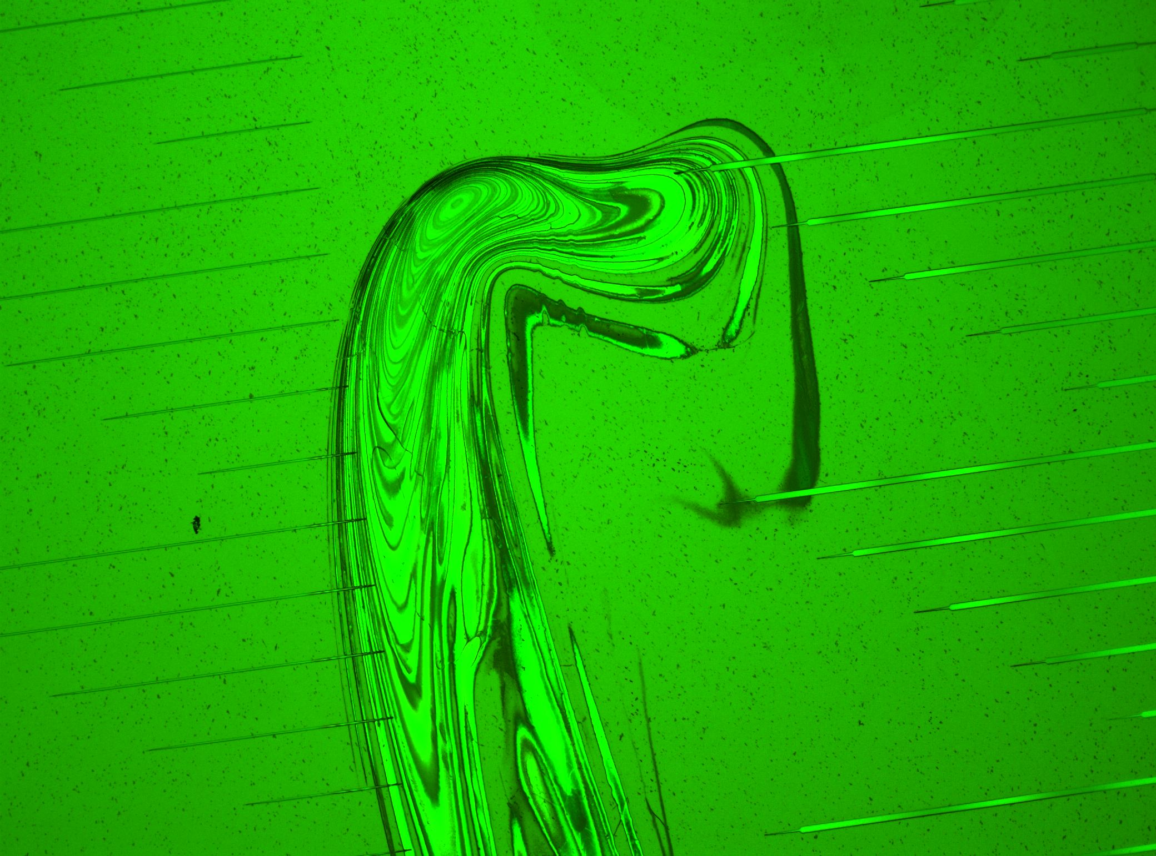
HMDS re-deposition

Slide 8
P-mesa etch
Pattern hardmask in ICP2 CF4 etch
Strip PR: O2 ash for as long as etch (PE2), then 30’ in 1165 at 80C
Etch mesa in RIE#2
  Uniformity across ¼ InP bonded dies was 20-50nm
  Scrubbed electrode, increased clean to 60’, etched 1 chip at a time
  No grassing observed during this run
O2 descum in RIE#2
Output metric: Dektak of mesa patterns

Slide 9
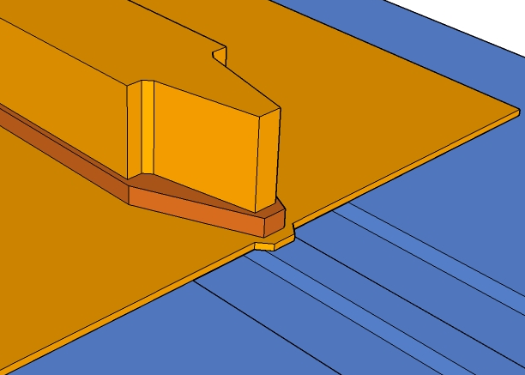
SEM after P-mesa dry etch
Note: SiN hardmask still present

Slide 10
P-mesa dry etching
Resolution test structures
Resolution test structures: within 10% of target (500nm pattern is 450nm wide)
1um wide line etched 1.8um deep
50um scale
50um scale

Slide 11
Q litho
Solvent clean, O2 descum, dehydration bake as above
Spin PR
  Spin HDMS: Allow to puddle for 20”. Spin at 4k RPM (recipe 7).
  Spin SPR 955CM 1.8 for 30” at 2.5k (recipe 4) for 2um thickness
  Remove from tape and bake. 90” at 90C.
  Expose in Autostep 0.5sec (best resolution)
  Post expose bake: 90” @110C
  Develop: MF726 for 60s.
  O2 descum 30s
Check taper patterns in microscope

Slide 12
Q etch
Wet etch in H3PO4:H2O2:DI (1:5:15)
  Color should change from grey to pink; ~30”
Strip PR in 1165
Output metric: Dektak
Remove p-mesa hardmask
  BHF dip, 10s
  Dry etch SiN in ICP2 (recipe 181)

Slide 13
SEM of post-QW etch devices
Note smooth n-InP layer, ridiculously sharp QW taper tip

Slide 14
Post Dry Hardmask Removal
This is what you get with just CF4
This is what you get with BHF dip then CF4

Slide 15
N-layer etch hardmask deposition
Solvent clean: Certainly necessary after PR strip. ACE/ISO/DI. No sonic.
O2 descum. PE2 because there’s no signup, fast, easy
Dehydration bake, 5min @150C to drive water out of trench, channel
Deposit SiN in PECVD1.
  Use 300nm (Used sputtered SiO2 on one chip)
  Measure film thickness with dummy Si on Nanometrics or ellipsomter
Output metric: Film thickness

Slide 16
N-layer etch litho
Solvent clean, O2 descum, dehydration bake as above
Spin PR
  Spin HDMS: Allow to puddle for 20”. Spin at 4k RPM (recipe 7).
  Spin SPR 955CM 1.8 for 30” at 2.5k (recipe 4) for 2um thickness
  Remove from tape and bake. 90” at 90C.
  Expose in Autostep 0.5sec (best resolution)
  Post expose bake: 90” @110C
  Develop: MF726 for 60s.
O2 descum 30s
Check taper patterns in microscope

Slide 17
n-mesa etch
Pattern hardmask in ICP2
Strip PR: O2 ash for as long as etch (PE2), then 30’ in 1165 at 80C
Etch n-layer in RIE#2
Used etch monitor; etch was ~3 minutes every time

Slide 18
Etch monitor on N-layer etch
Total etch time: 188”
Over-etched by about 18”
(Chip A)

Slide 19
Conclusion
Use CEM for p-mesa etching
Must be aware of HMDS buildup in spinner bowl
Crystallographic InP etch can produce really sharp taper tips
BHF must be done before removing deep RIE hardmask

