Slide 1
GCA AutoStep 200 Guide
Jared Hulme
4/12/13

Slide 2
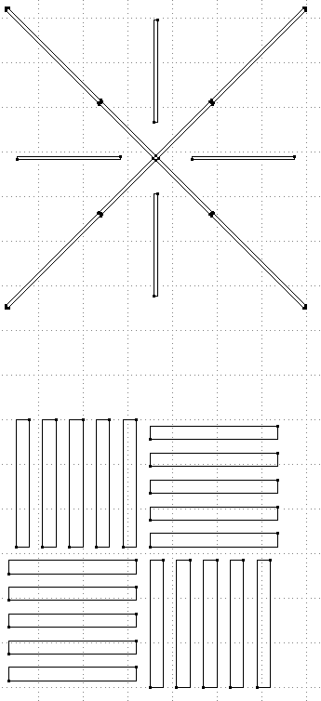
Alignment Marks
Global Mark
Choose global alignment marks on the left and right side of the die, separated horizontally.
Choose some DFAS marks, (4 on the corners of the die works)
Get the coordinates of the center of the mark.
When entering the mark into the stepper all Y coordinates have a reversed sign for both Global and Local marks
Enter coordinates for the wafer, not the mask (ie choose a 16mm die, not an 80mm die)
Local Mark
(DFAS)
+x,-y

Slide 3
Loading Masks
Load mask into mask holder such that the top of your die in the mask is the same orientation as on the wafer. IE the top of both the mask and the wafer are closest to the wall.
WAFER
MASK HOLDER
MASK
TOP
TOP
TOP

Slide 4
Shutters
Shutter values are mask level. IE, choose wafer level in mm and multiply by 5.
50 is halfway across the die
Example for quarter size die:
Die size = 16mm
YF
YF = 50
Shutter size = 20mm (Wafer level)
XL
XR
XL
=50
XR =5
Die
YR
YR = 5

