Slide 1
BCB Development Jared Hulme
3/30/12

Slide 2
Wafer Descriptions
Wafer 1
40nm Si02
Wafer 2
40nm Si02
Wafer 3
40nm NiX
Wafer 4
40nm NiX
Wafer 5
S1 – 1038Å SiO2
SiO2 Ash Rate = 18.5nm/min
S2 – 943Å NiX
NiX Ash Rate = 90nm/min
S3
S4

Slide 3
Wafer 2 40nm SiO2

Slide 4
Sample 3

Slide 5
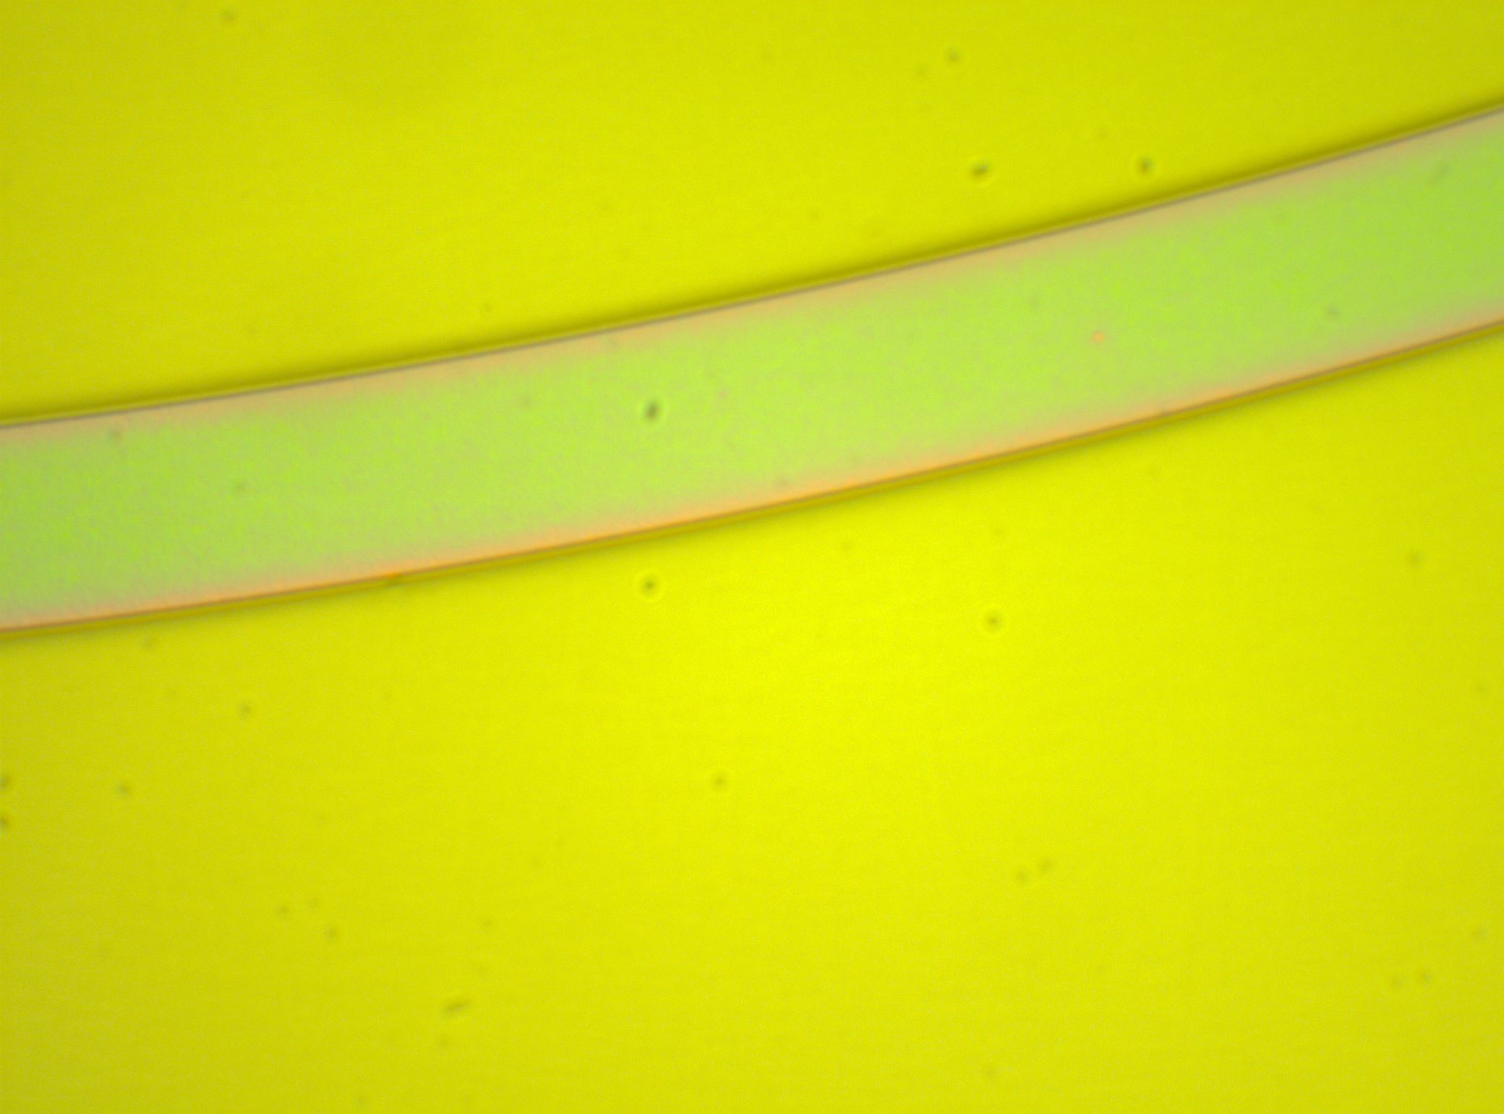
Wafer 2 – Sample 3 – 4’ash

Slide 6
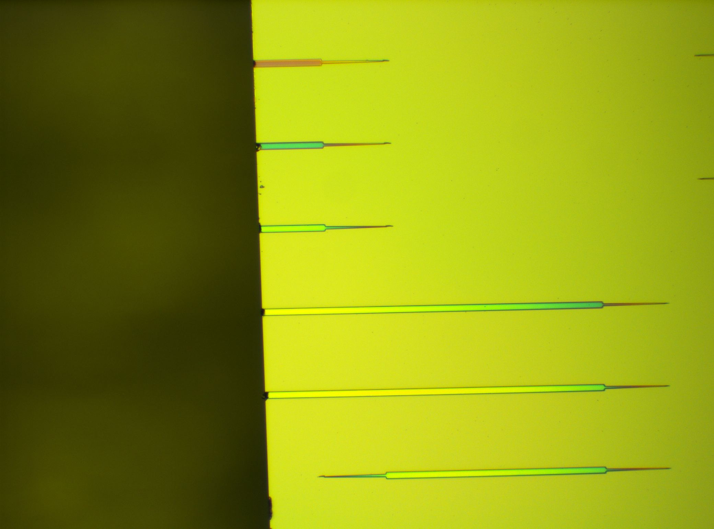
Wafer 2 – Sample 3 – 4’ash - Cleave

Slide 7
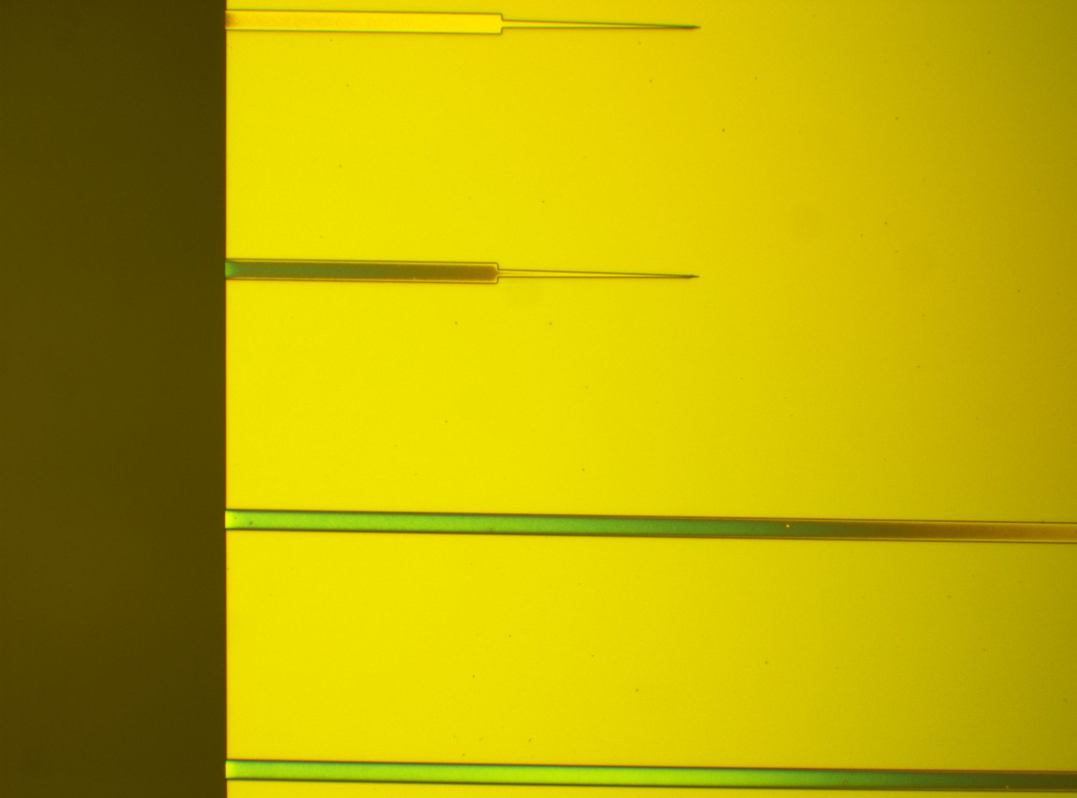
Wafer 2 – Sample 3 – 4’ash
Almost planarized
Notice the small layer of BCB on top of the mesa

Slide 8
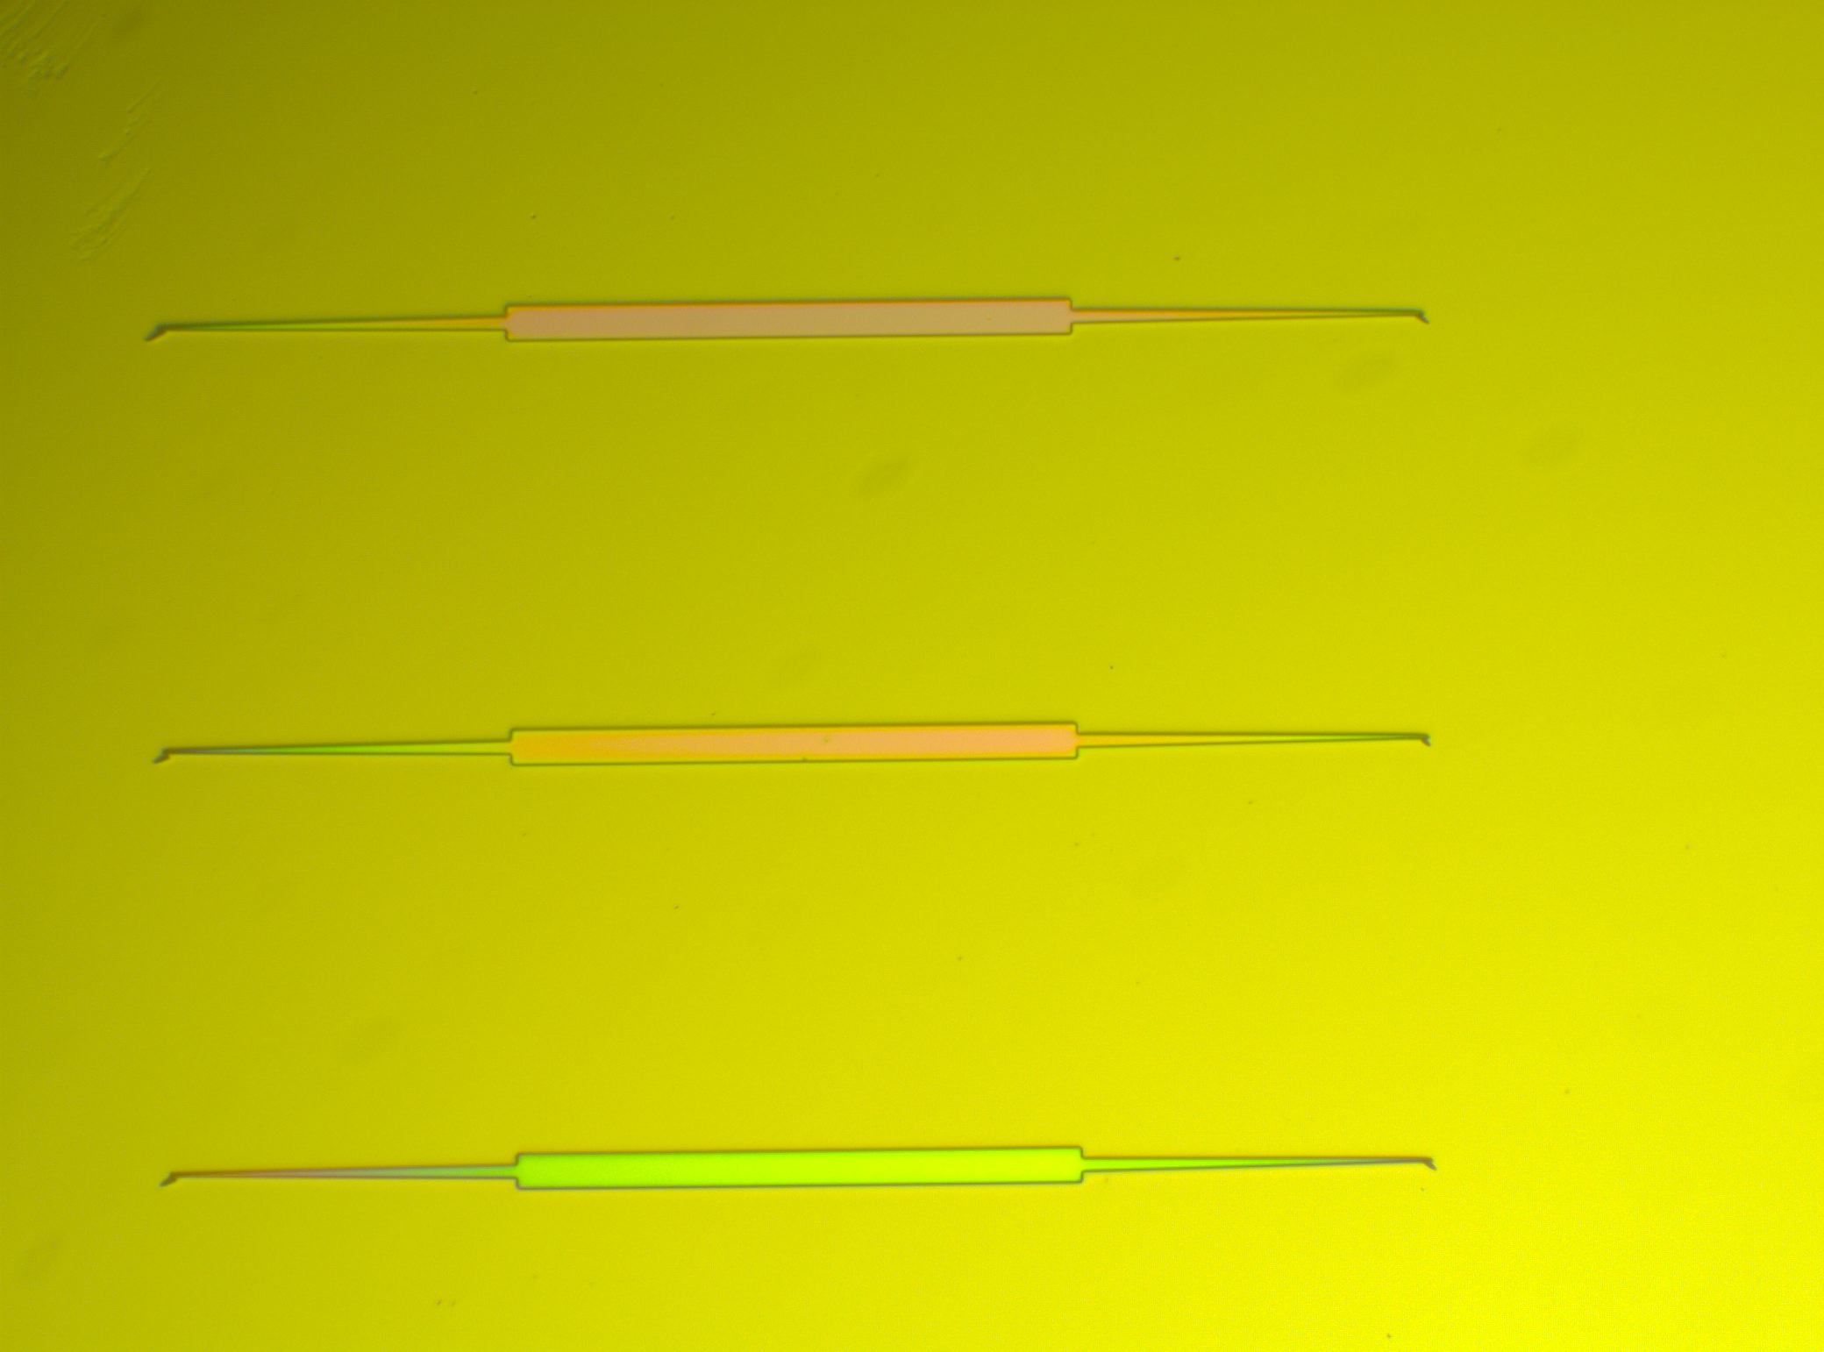
Wafer 2 – Sample 3 – 4’ash

Slide 9
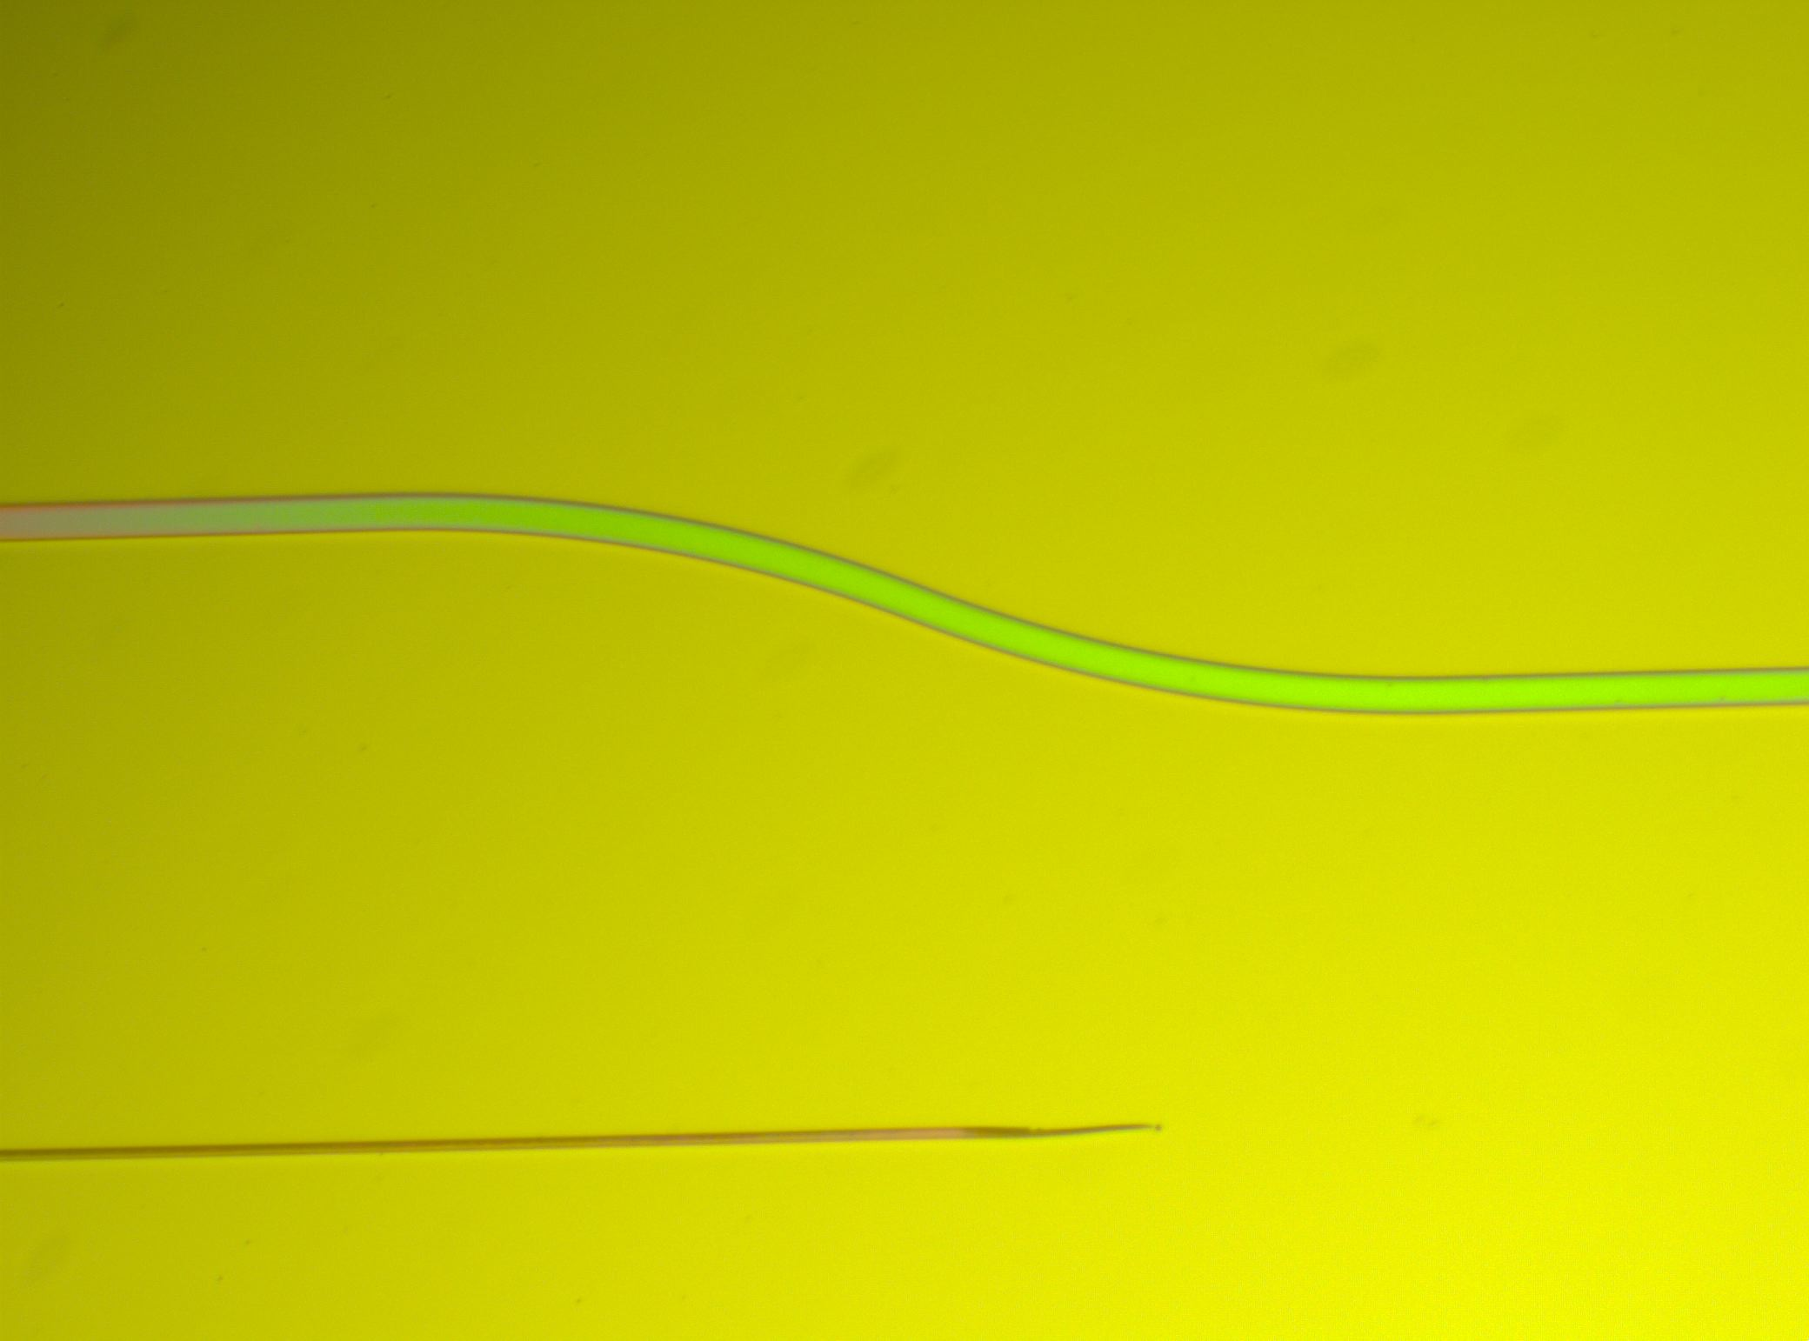
Wafer 2 – Sample 3 – 4’ash

Slide 10
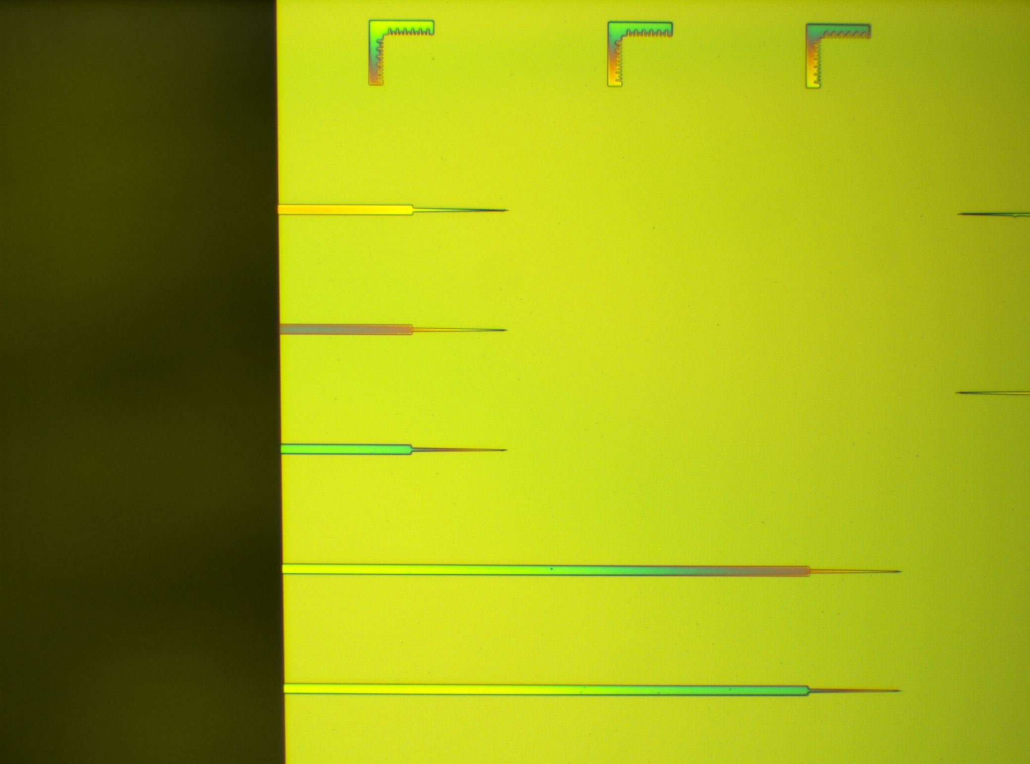
Wafer 2 – Sample 3 – 4’ash

Slide 11
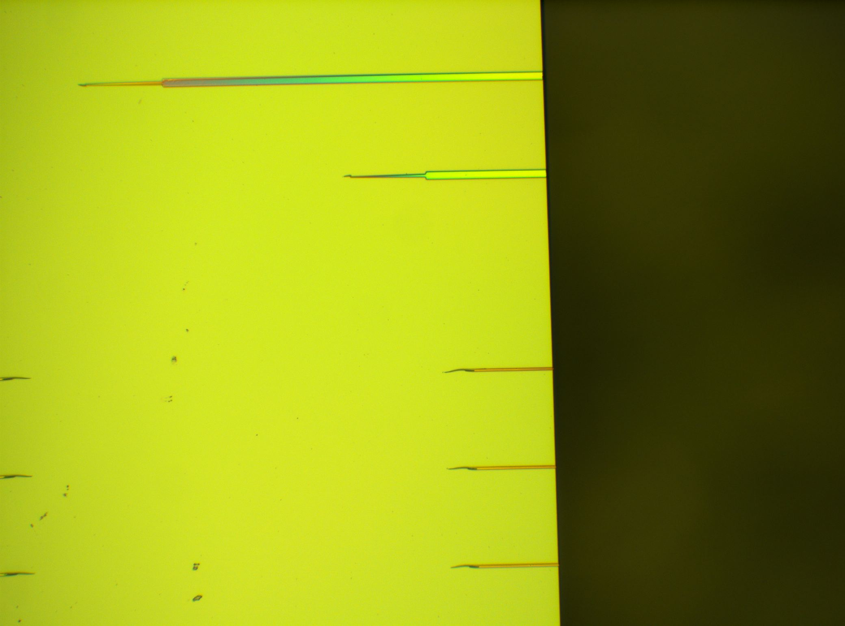
Wafer 2 – Sample 3 – 4’ash

Slide 12
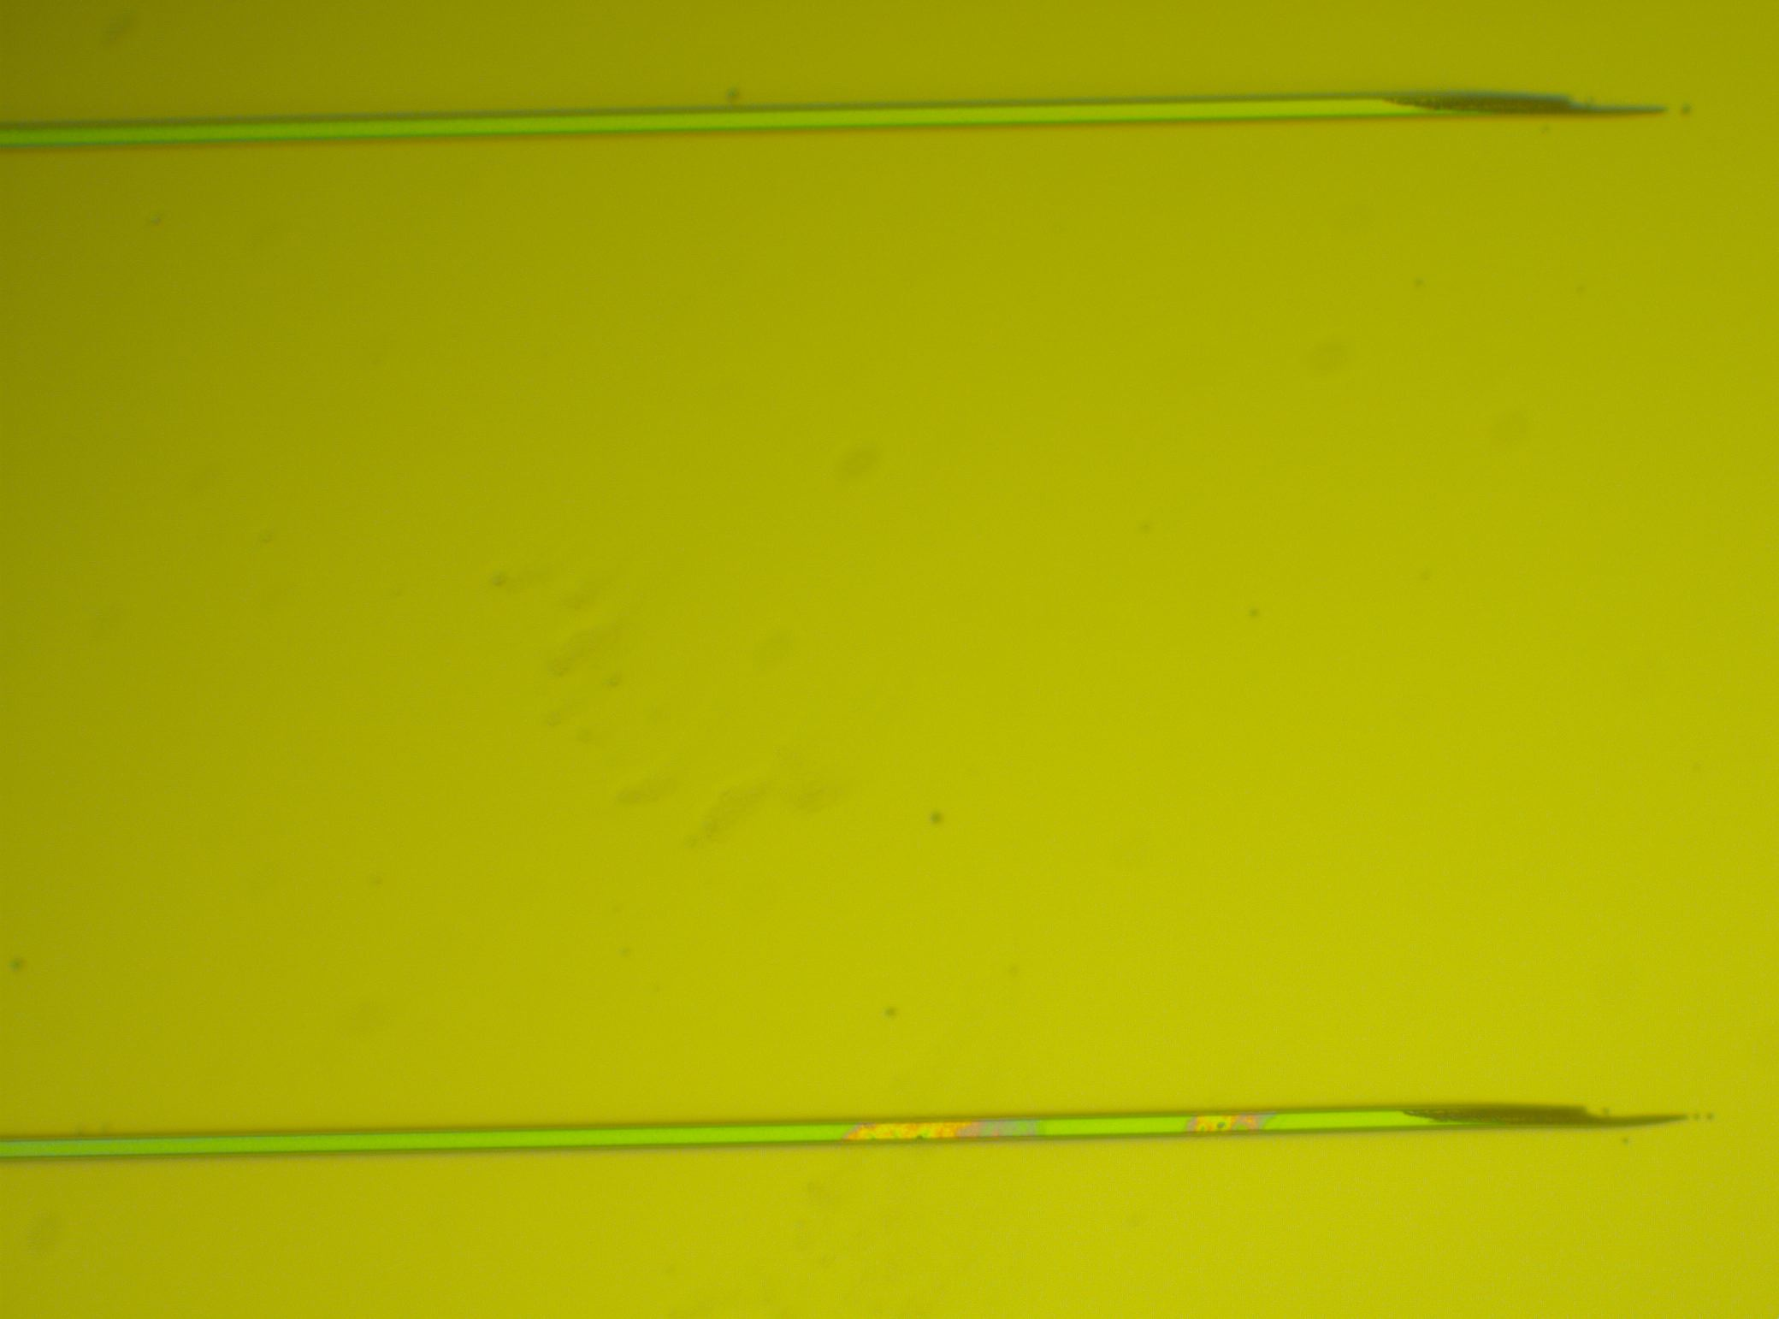
Wafer 2 – Sample 3 – 4’ash

Slide 13
Wafer 2 – Sample 3 – 4’ash
Almost planarized
Notice the small layer of BCB on top of the mesa

Slide 14
Wafer 2 – Sample 3 – 4’ash
Almost planarized
Notice the small layer of BCB on top of the mesa

Slide 15
Wafer 2 – Sample 3 – 4’ash
Almost planarized
Notice the small layer of BCB on top of the mesa

Slide 16
Wafer 2 – Sample 3 – 4’ash
Almost planarized
Notice the small layer of BCB on top of the mesa

Slide 17
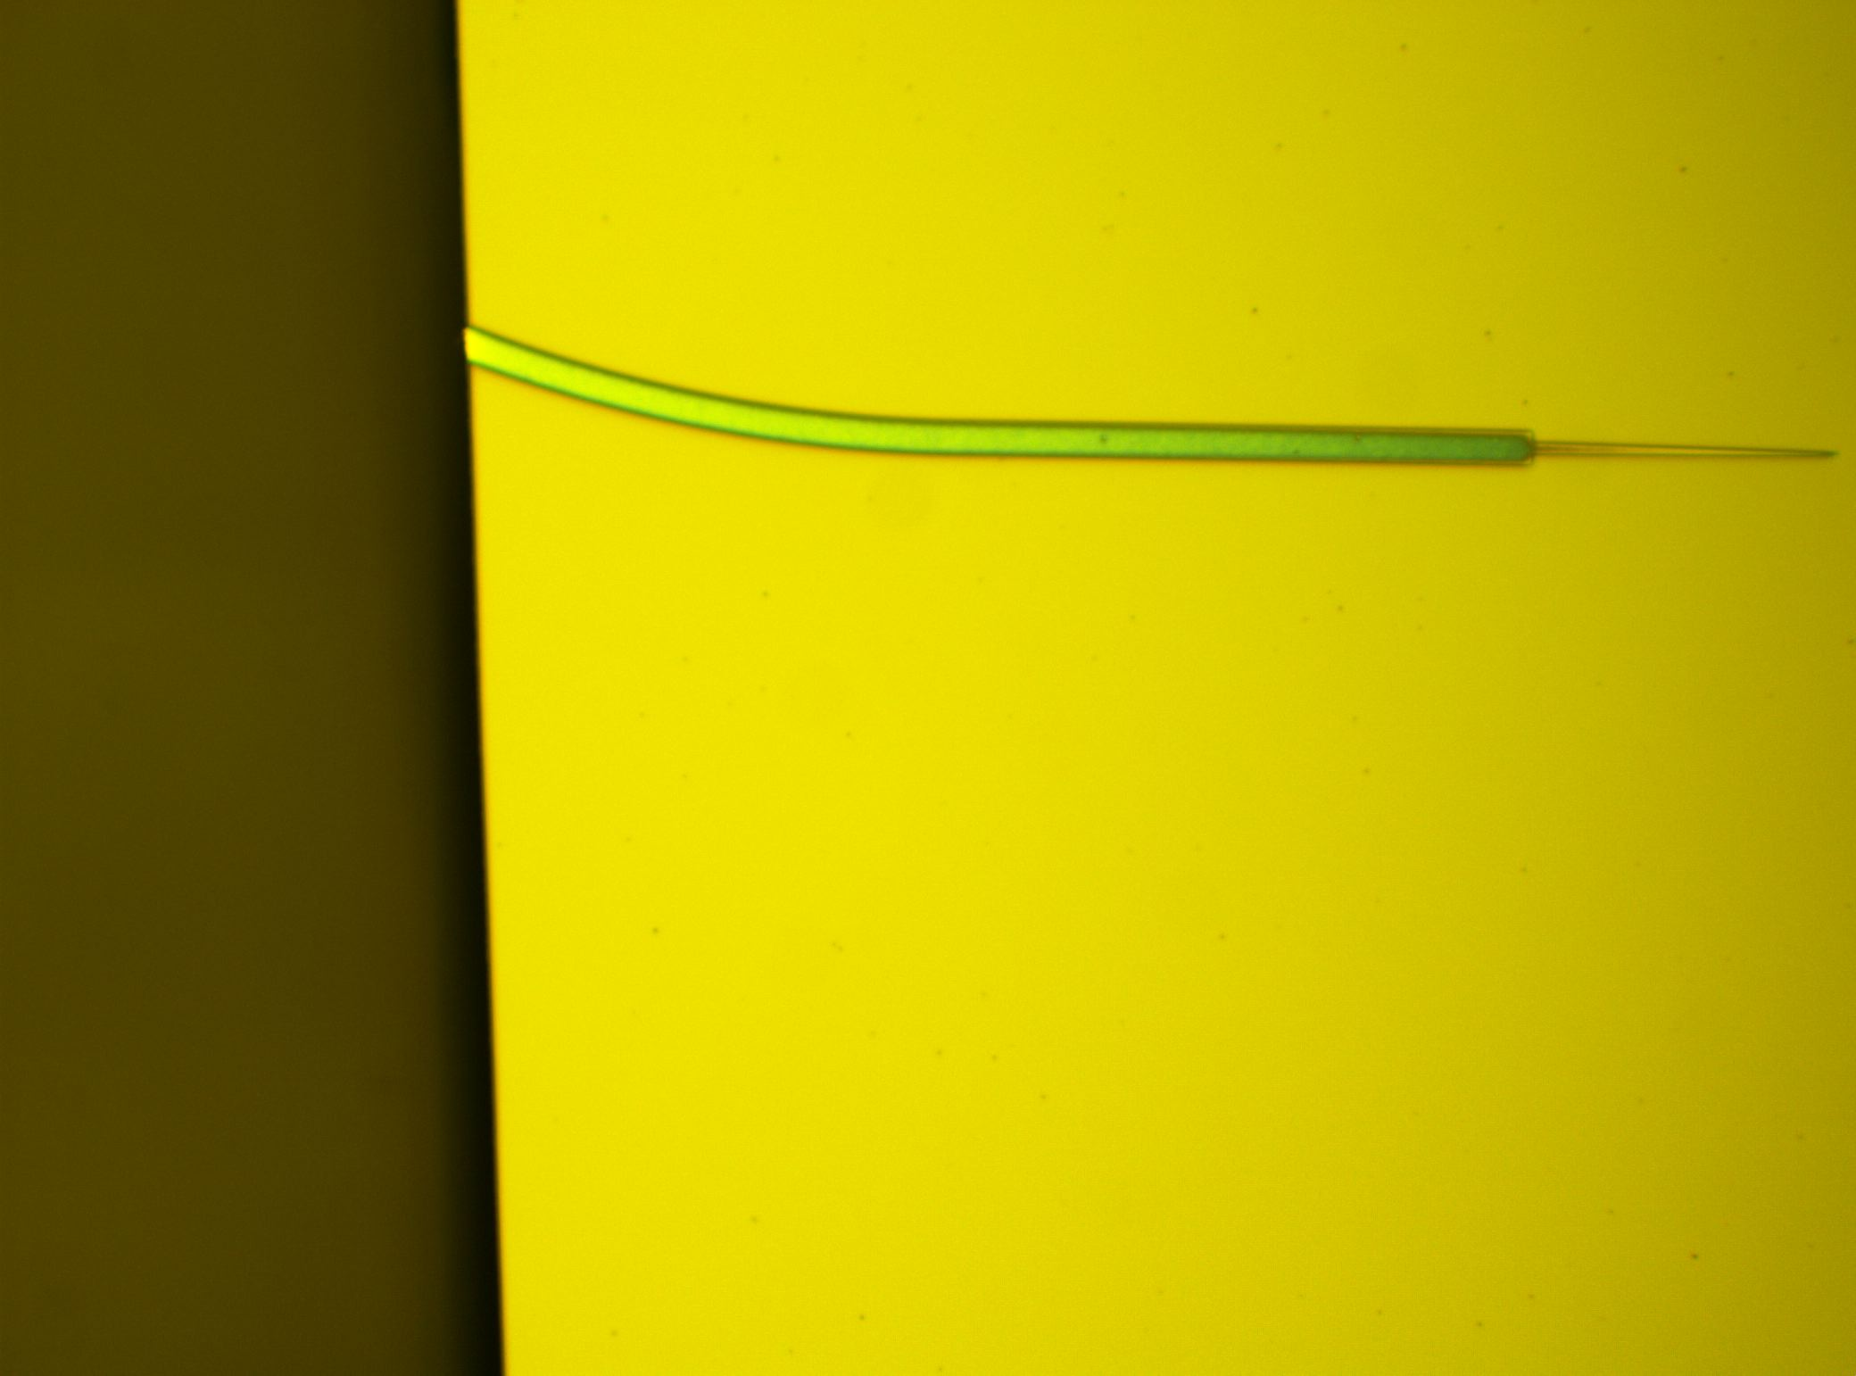
Wafer 2 – Sample 3 – 4’30” ash
4’ + 30”
BCB overhang still means it’s not completely ashed?

Slide 18
Wafer 2 – Sample 3 – 4’30” ash
4’ + 30”
Edge where BCB is pulled away

Slide 19
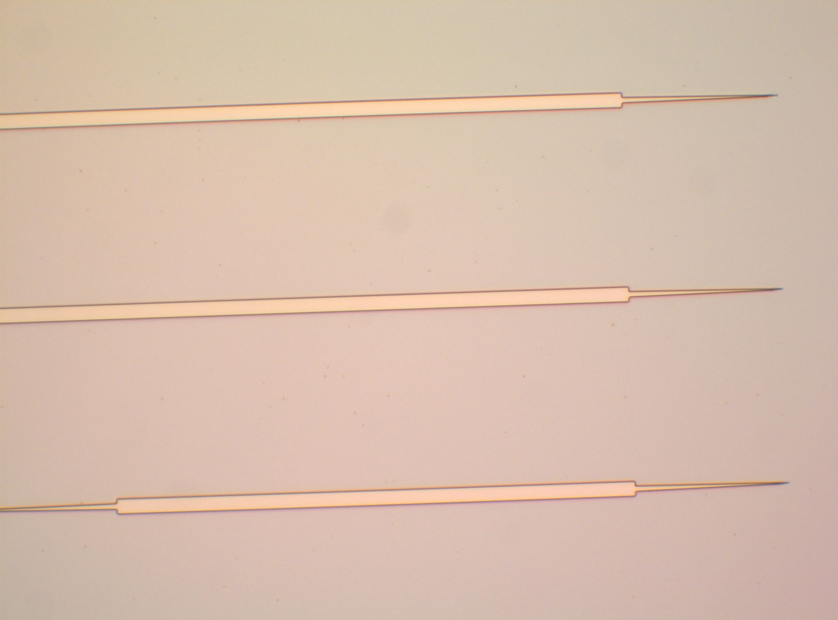
Wafer 2 – Sample 3 – 4’50” ash
4’ + 30” +20”

Slide 20
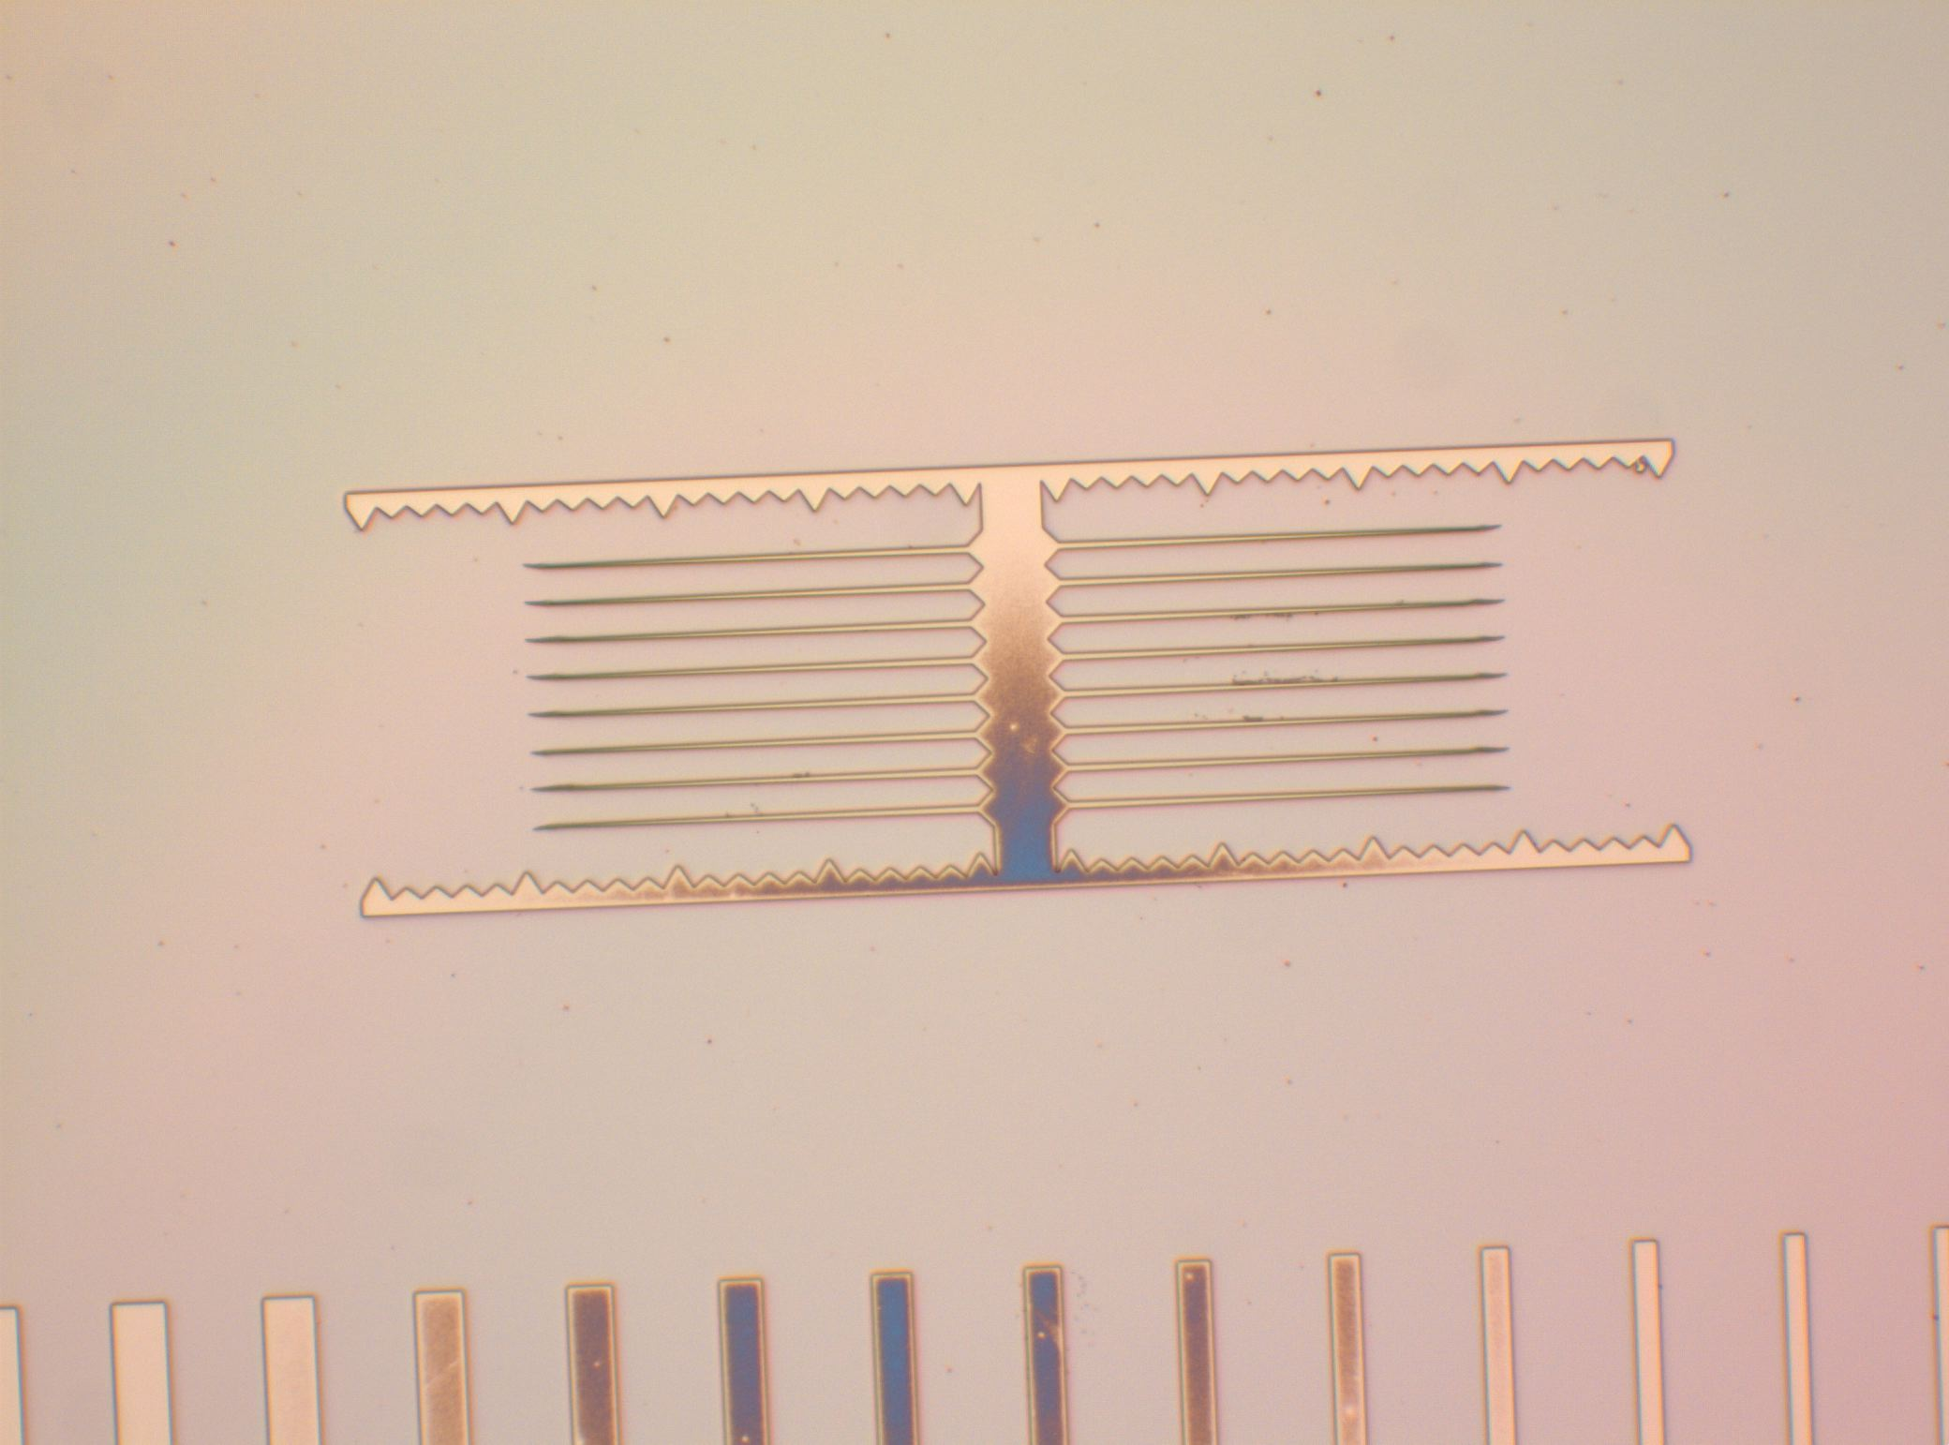
Wafer 2 – Sample 3 – 4’50” ash
4’ + 30” +20”

Slide 21
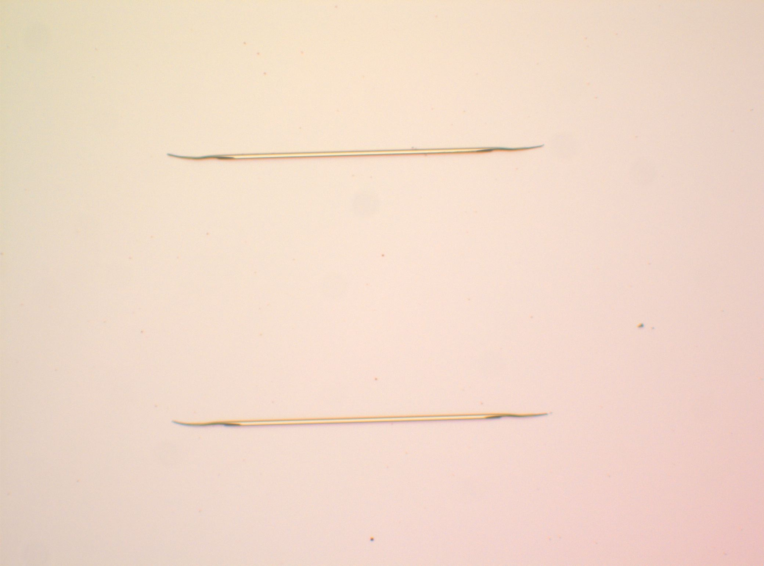
Wafer 2 – Sample 3 – 4’50” ash
4’ + 30” +20”

Slide 22
Wafer 2 – Sample 3 – 4’30” ash
4’ + 30”
There might still be some sort of residue or that could just be roughness due to the etch

Slide 23
Wafer 2 – Sample 3 – 4’50” ash
4’ + 30” +20”
Exposed, residue on the top

Slide 24
Wafer 2 – Sample 3 – 4’50” ash
4’ + 30” +20”
Exposed, residue on the top

Slide 25
Wafer 2 – Sample 3 – 4’50” ash
4’ + 30” +20”
Exposed

Slide 26
Wafer 2 – Sample 3 – 4’50” ash
4’ + 30” +20”
Between dies - BCB hill

Slide 27
Wafer 2 – Sample 3 – 4’50” ash
4’ + 30” +20”
Exposed, residue on the top? Or SiO2?

Slide 28
Wafer 2 – Sample 3 – 4’50” ash
4’ + 30” +20”
Exposed, residue on the top

Slide 29
Sample 4

Slide 30
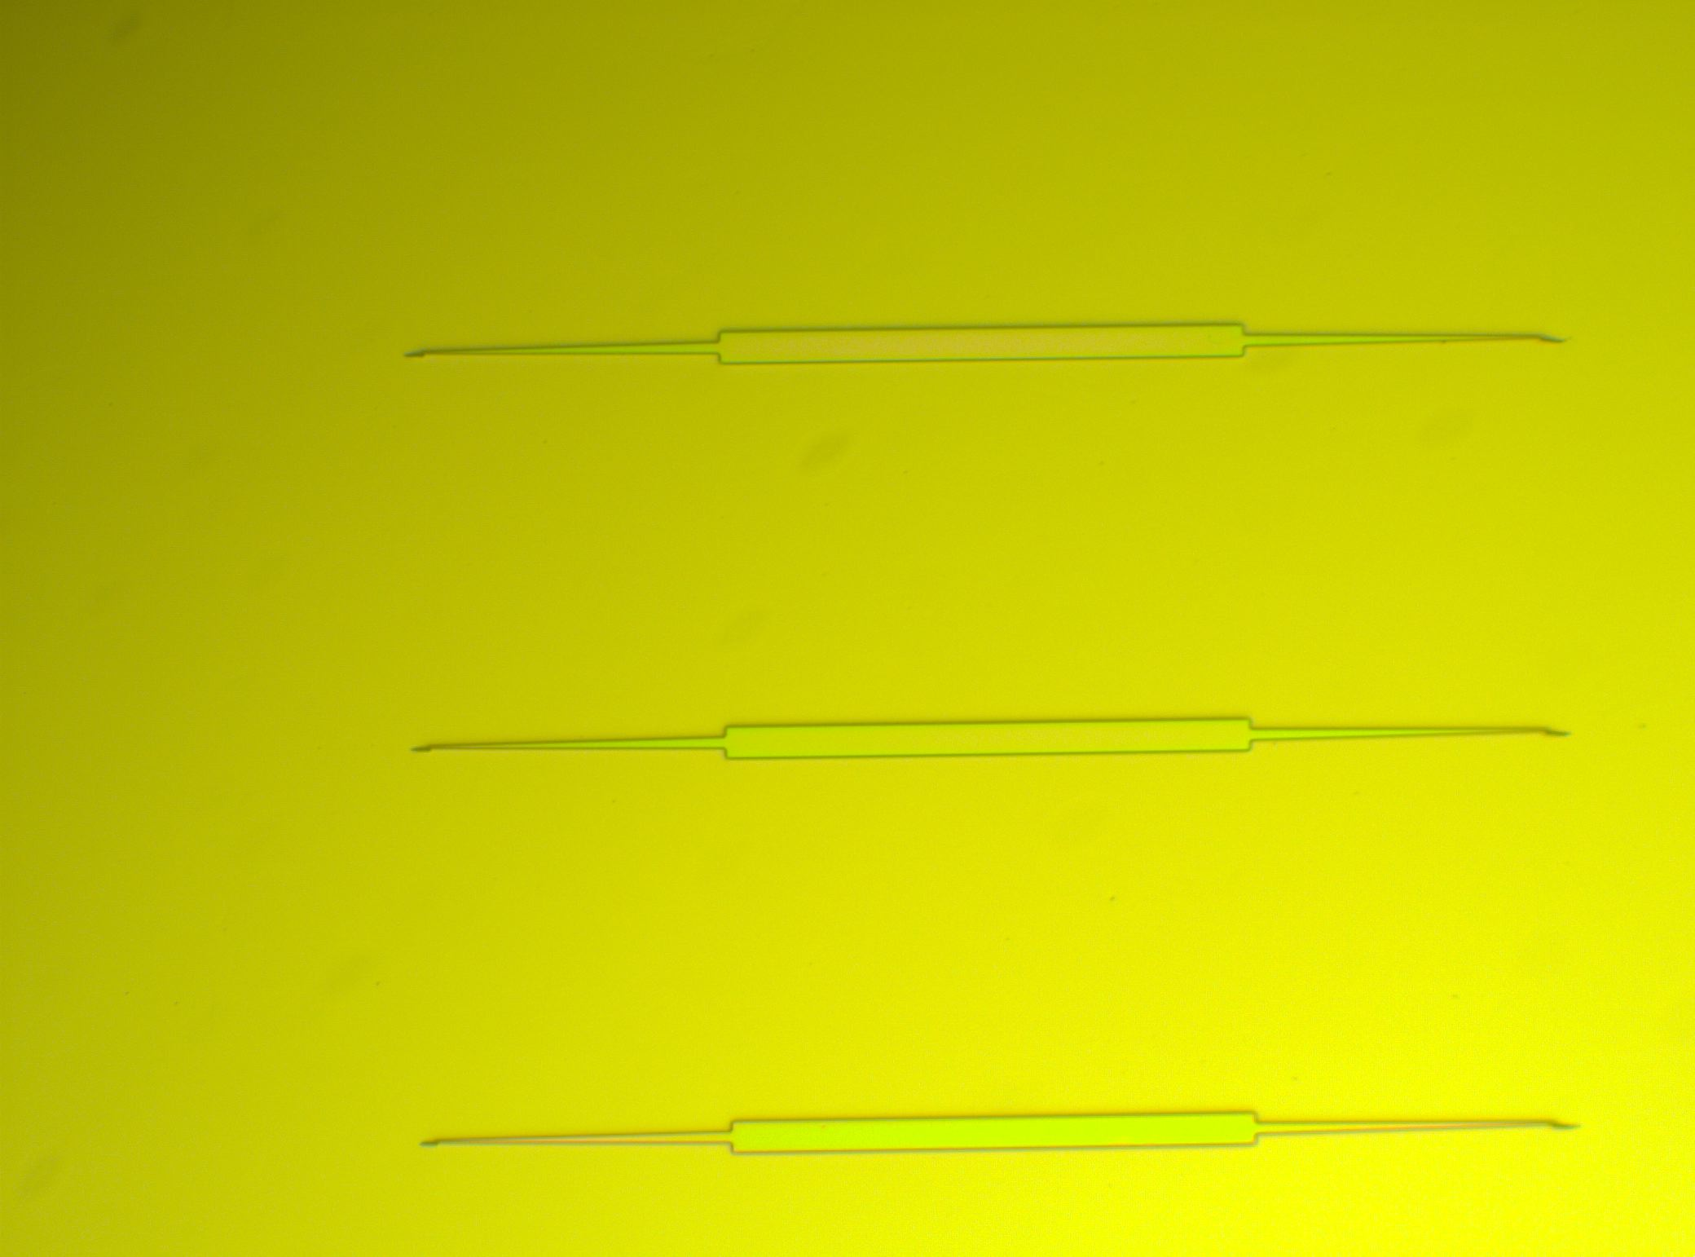
Wafer 2 – Sample 4 – 3’ash
Mesa’s are slightly different colors

Slide 31
Wafer 2 – Sample 4 – 3’ash
Mesa’s are slightly different colors

Slide 32
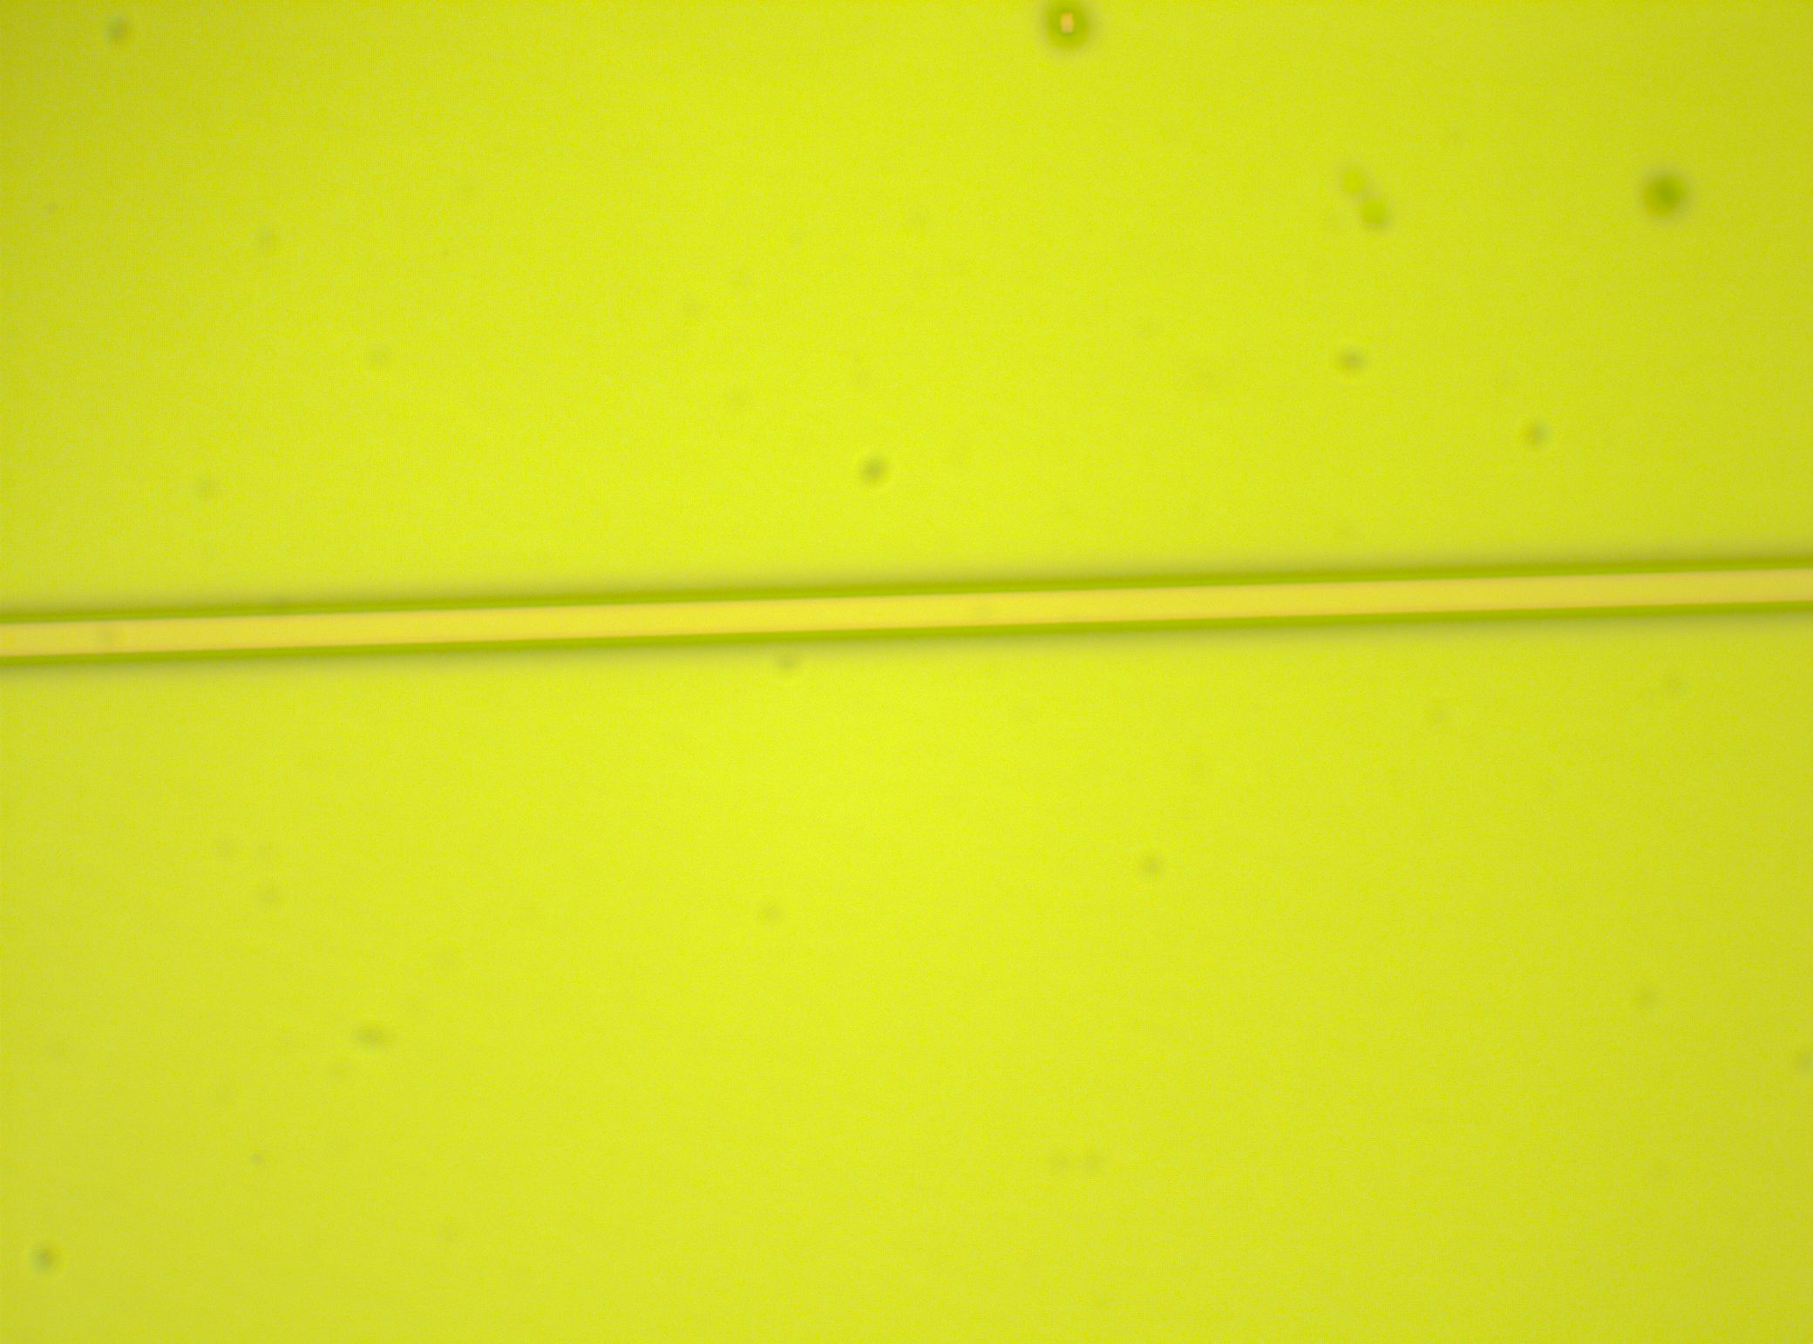
Wafer 2 – Sample 4 – 3’ash
Mesa’s are slightly different colors

Slide 33
Wafer 2 – Sample 4 – 4’45”ash
3’ + 1’45”

Slide 34
Wafer 2 – Sample 4 – 4’45”ash
3’ + 1’45”

Slide 35
Wafer 2 – Sample 4 –4’45”ash
3’ + 1’45”

Slide 36
Wafer 2 – Sample 4 – 4’45”ash
3’ + 1’45”

Slide 37
Wafer 2 – Sample 4 – 5’45”ash
3’ + 1’45” + 1’

Slide 38
Wafer 3 40nm NiX

Slide 39
Sample 1

Slide 40
Wafer 3 – Sample 1 – 3’45”ash
Obviously not fully ashed

Slide 41
Wafer 3 – Sample 1 – 3’45”ash
Obviously not fully ashed

Slide 42
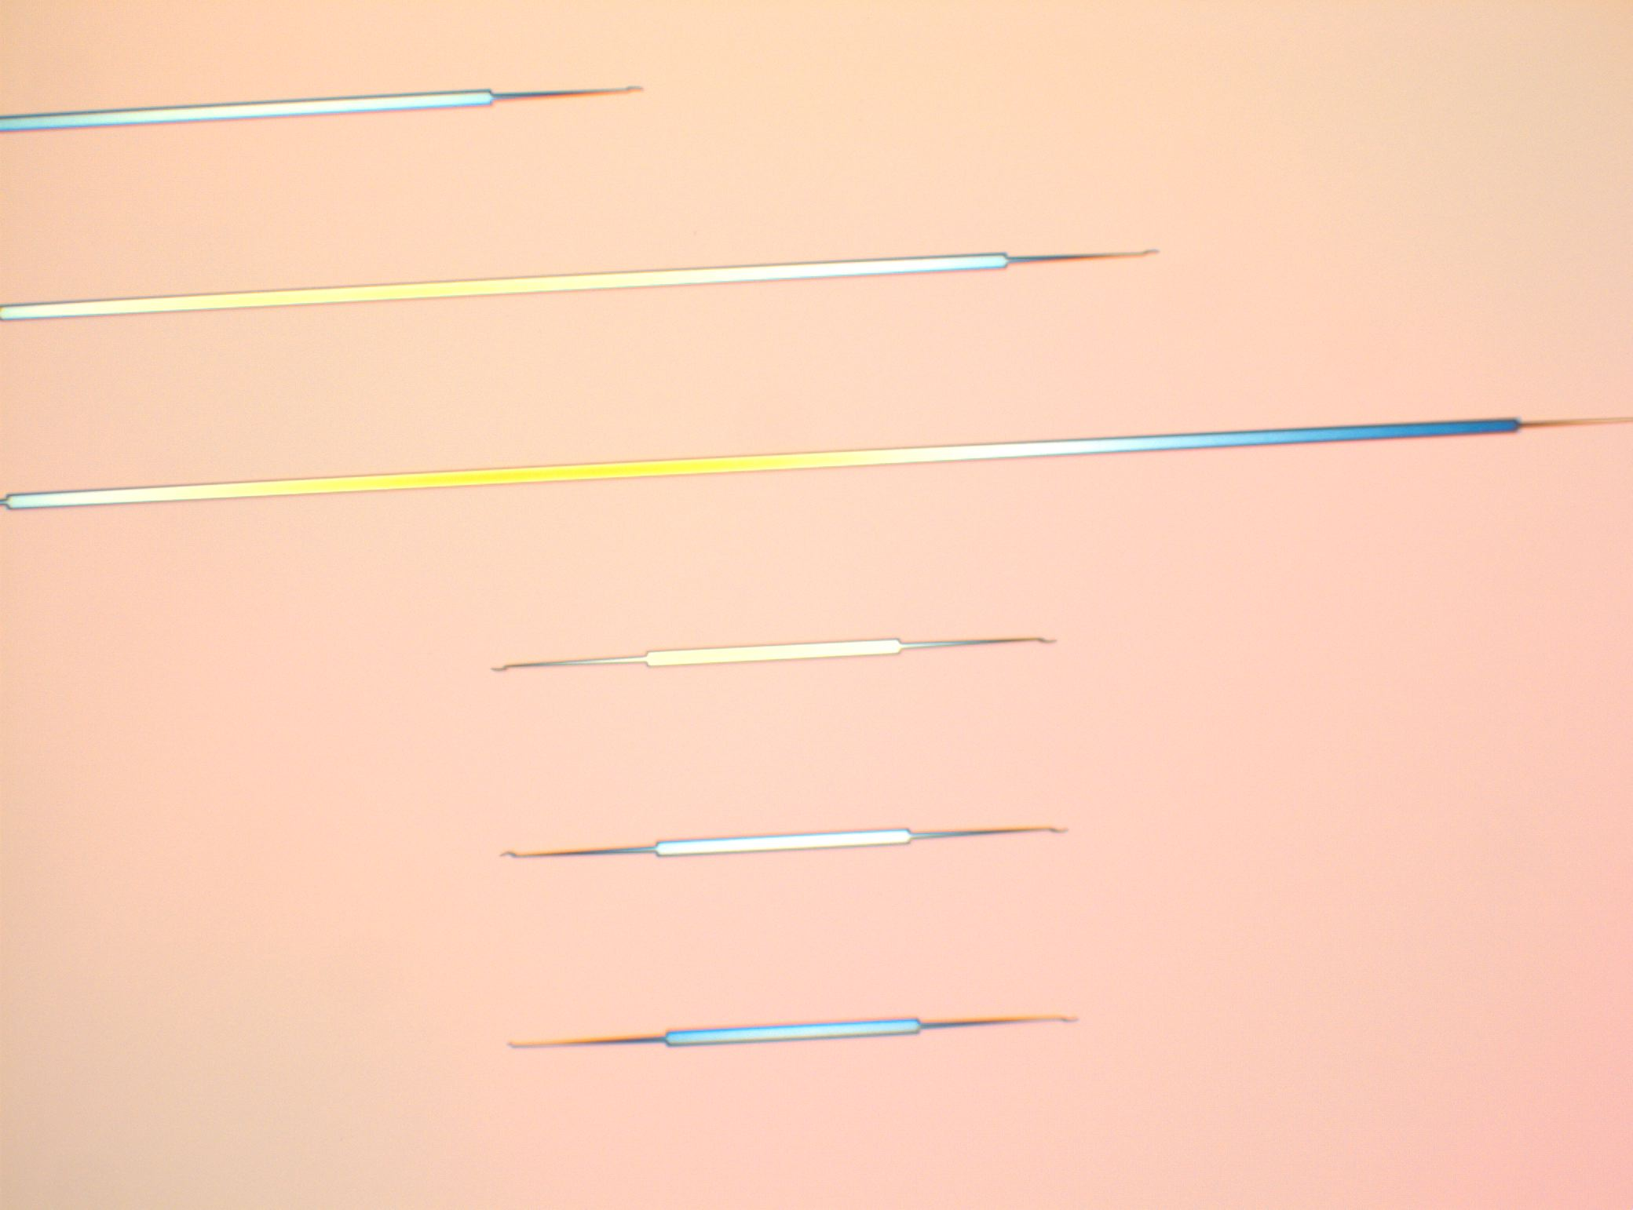
Wafer 3 – Sample 1 –5’ash
3’45” + 1’15”

Slide 43
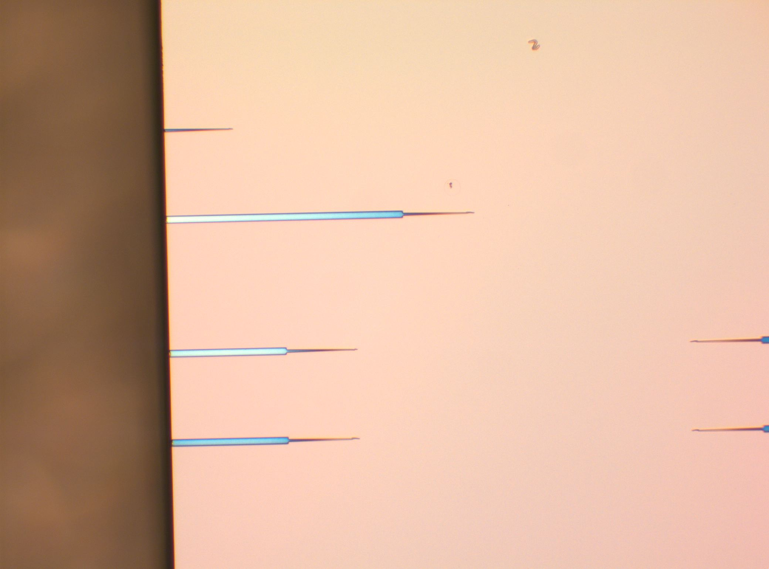
Wafer 3 – Sample 1 –5’ash
3’45” + 1’15”

Slide 44
Wafer 3 – Sample 1 –5’ash
3’45” + 1’15”
This is the cleaved area after the ash

Slide 45
Wafer 3 – Sample 1 –5’ash
3’45” + 1’15”

Slide 46
Wafer 3 – Sample 1 –5’ash
3’45” + 1’15”

Slide 47
Wafer 3 – Sample 1 –5’ash
3’45” + 1’15”

Slide 48
Wafer 3 – Sample 1 –5’ash
3’45” + 1’15”

Slide 49
Wafer 3 – Sample 1 –6’ash
3’45” + 1’15” + 1’

Slide 50
Sample 2

Slide 51
Wafer 3 – Sample 2 – 3’ash
Obviously not fully ashed
– 4’ash

Slide 52
Wafer 3 – Sample 2 – 3’ash
Obviously not fully ashed

Slide 53
Wafer 3 – Sample 2 – 3’ash
Obviously not fully ashed

Slide 54
Wafer 3 – Sample 2 – 3’ash
Obviously not fully ashed
Notice that the BCB is pulled back

Slide 55
Wafer 3 – Sample 2 – 5’ash
3’ + 2’

Slide 56
Wafer 3 – Sample 2 – 5’ash
3’ + 2’

Slide 57
Wafer 3 – Sample 2 – 5’ash
3’ + 2’

Slide 58
Wafer 3 – Sample 2 – 5’ash
3’ + 2’

Slide 59
Wafer 3 – Sample 2 – 5’ash
3’ + 2’

Slide 60
Wafer 3 – Sample 2 – 5’ash
3’ + 2’
Cleaved area after etch

Slide 61
Wafer 4 40nm NiX

Slide 62
Wafer 4
Exposed or almost exposed
BCB
Si

Slide 63
Wafer 4
Exposed or almost exposed

Slide 64
Wafer 4
Exposed or almost exposed

Slide 65
Wafer 4
Exposed or almost exposed

Slide 66
Wafer 4
Exposed or almost exposed

Slide 67
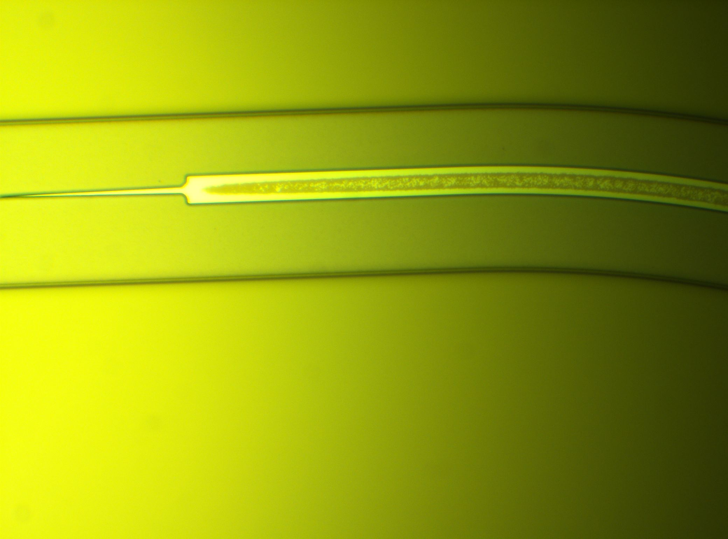
Wafer 4 – Very exposed + P-metal Litho
– 4’ash

Slide 68
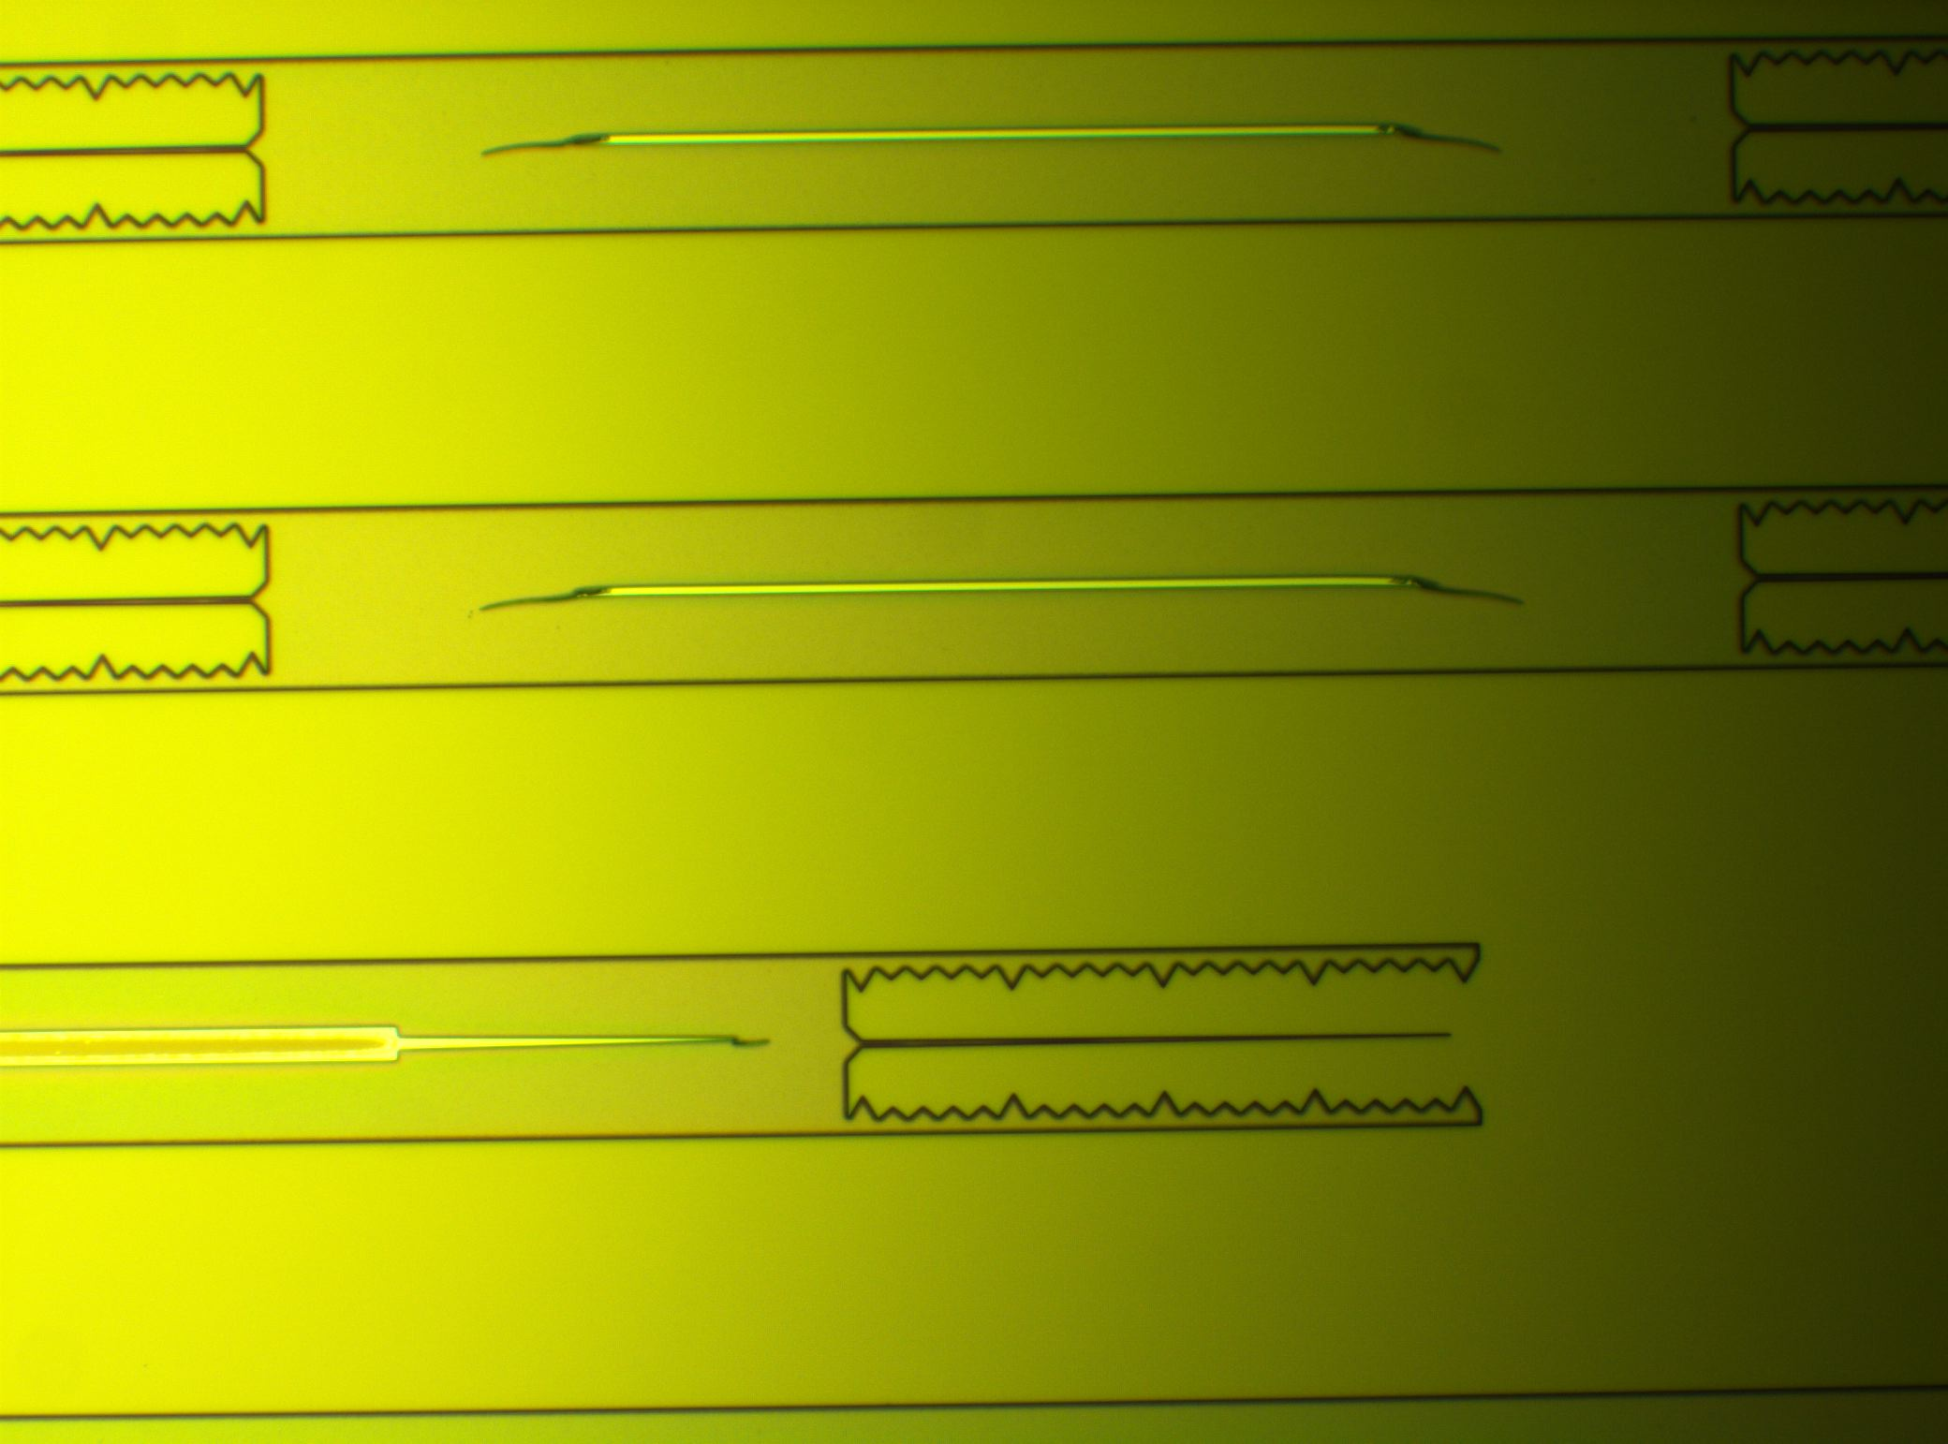
Wafer 4 – Very exposed + P-metal Litho

Slide 69
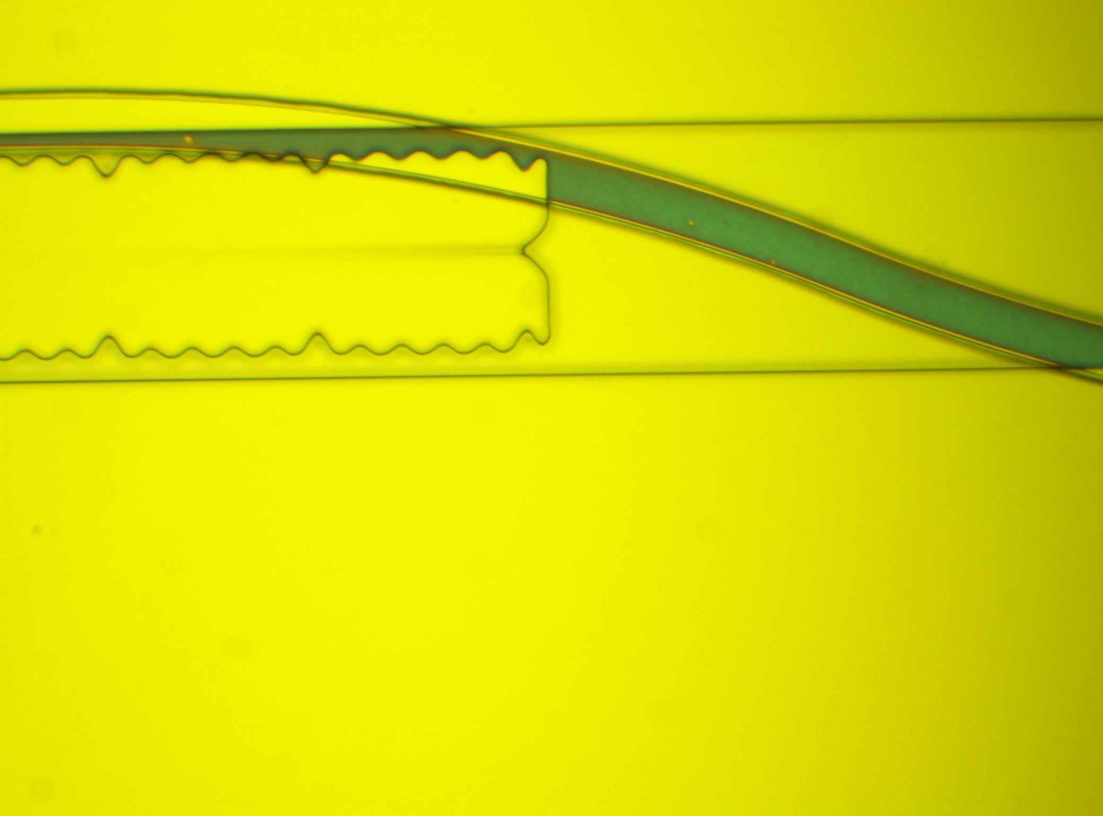
Wafer 4 – Very exposed with badly aligned P-metal Litho

Slide 70
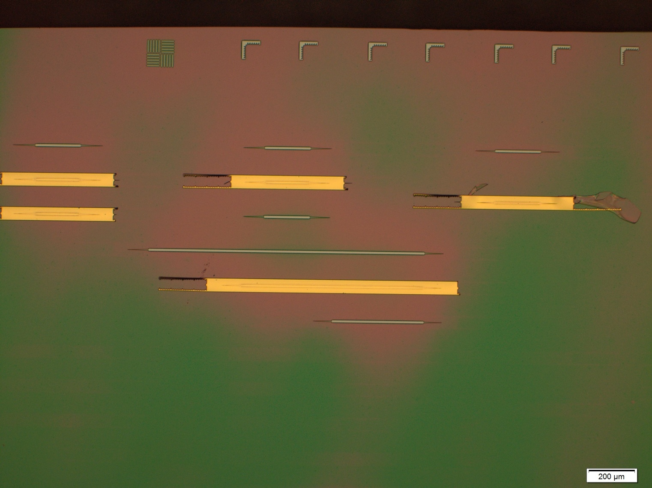
Wafer 4 – P-metal Deposition
About half of the mesas lost their metal in the liftoff. It looks like there was still some resist before deposition

Slide 71
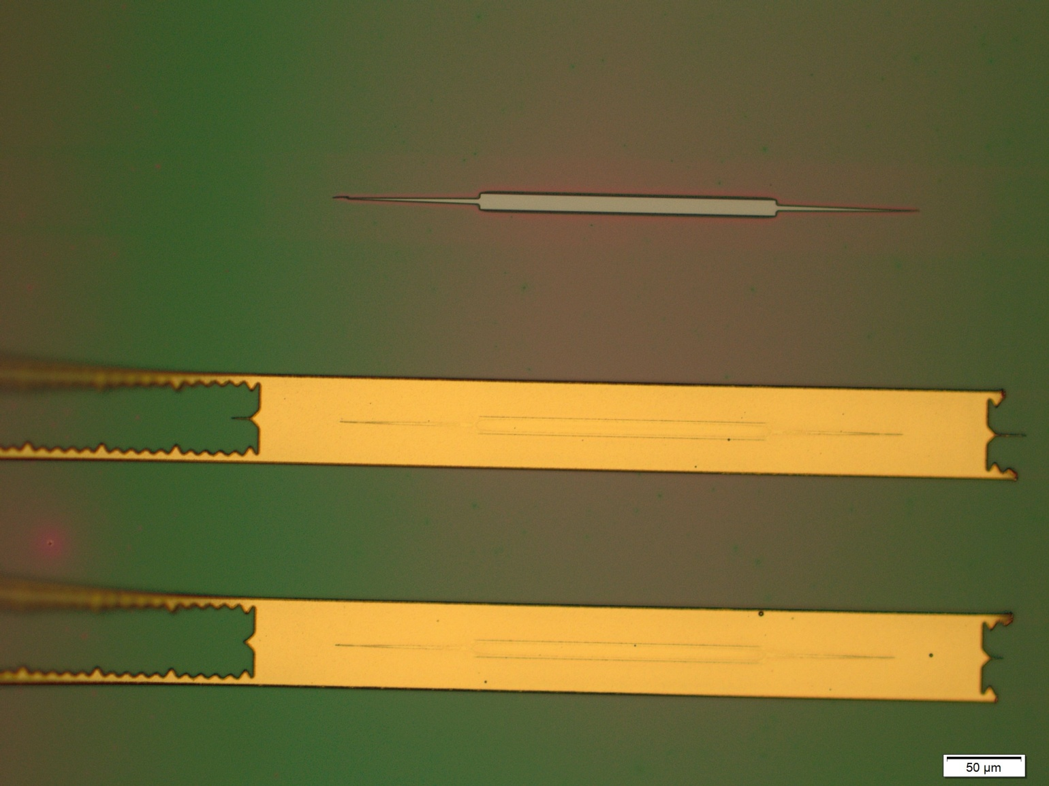
Wafer 4 – Post Anneal

Slide 72
Wafer 4 – Post Anneal

Slide 73
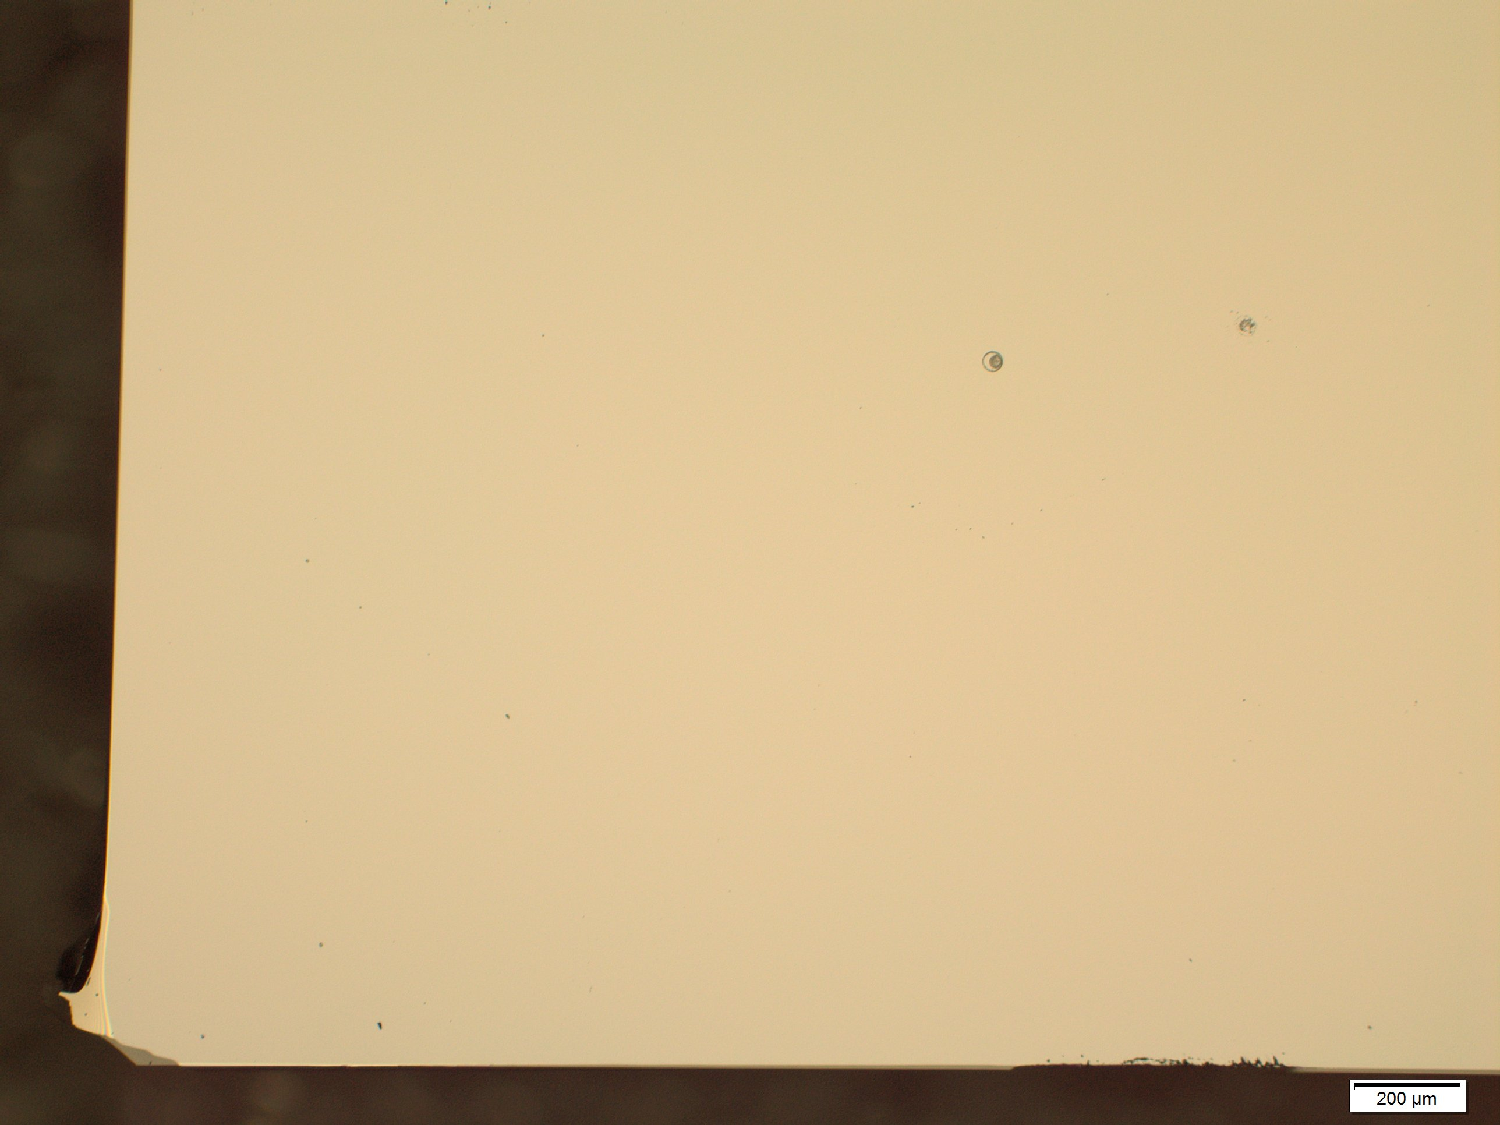
Wafer 4 – BCB Pre-anneal

Slide 74
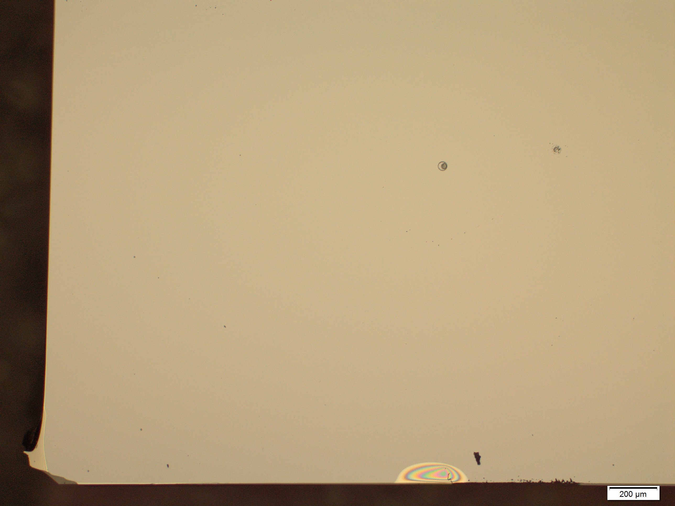
Wafer 4 – BCB Post-anneal

Slide 75
Wafer 4 – BCB Pre-anneal

Slide 76
Wafer 4 – BCB Post-anneal

Slide 77
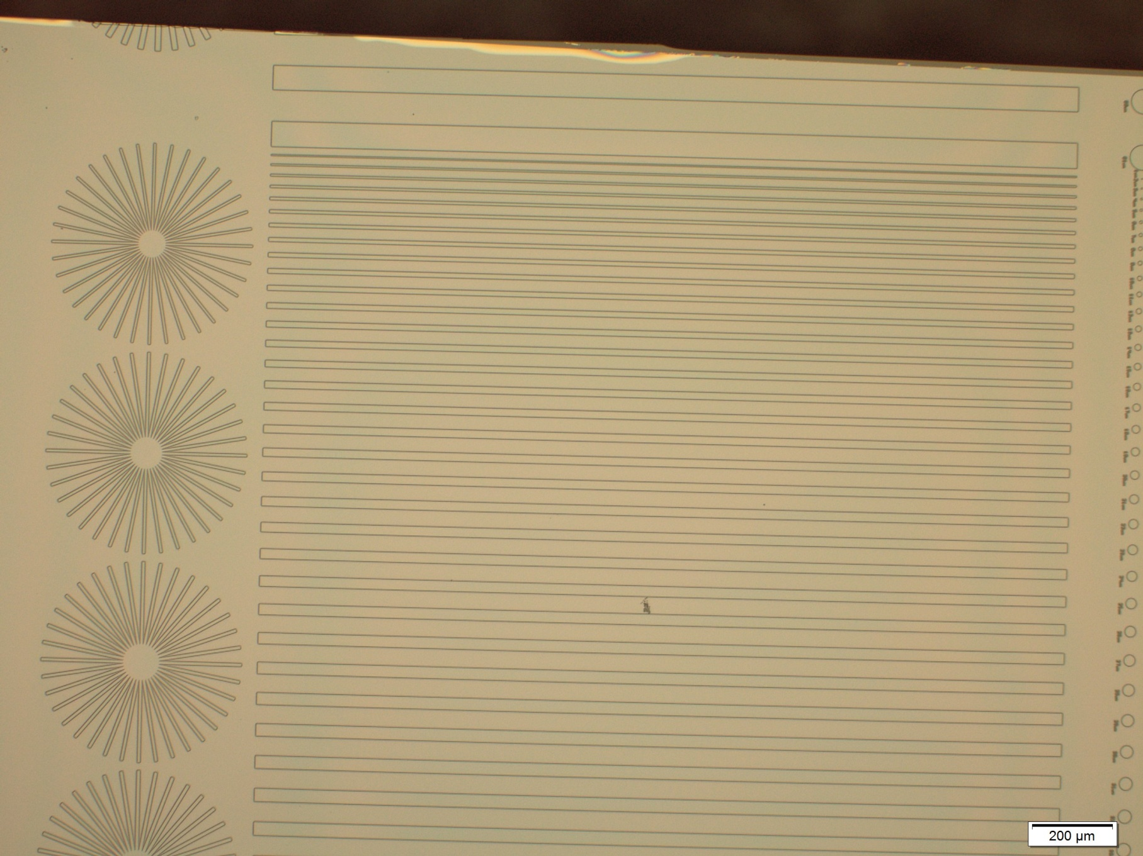
Wafer 4 – BCB Pre-anneal

Slide 78
Wafer 4 – BCB Post-anneal

Slide 79
Wafer 4 – BCB Pre-anneal

Slide 80
Wafer 4 – BCB Post-anneal

Slide 81
Wafer 4 – BCB Pre-anneal

Slide 82
Wafer 4 – BCB Post-anneal

Slide 83
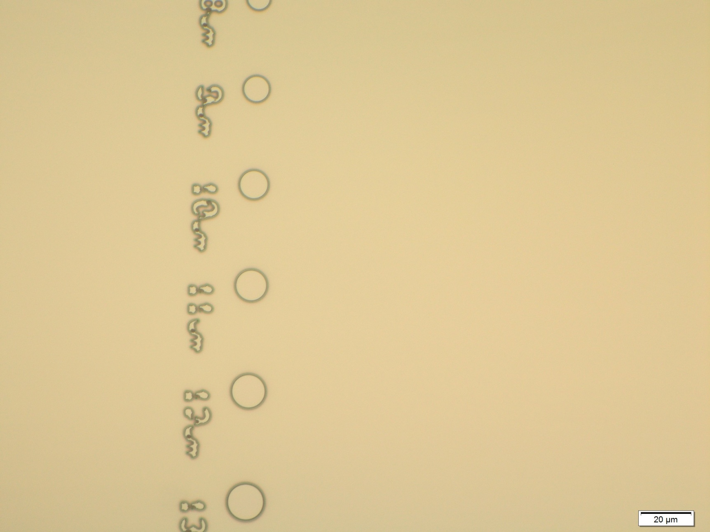
Wafer 4 – BCB Pre-anneal

Slide 84
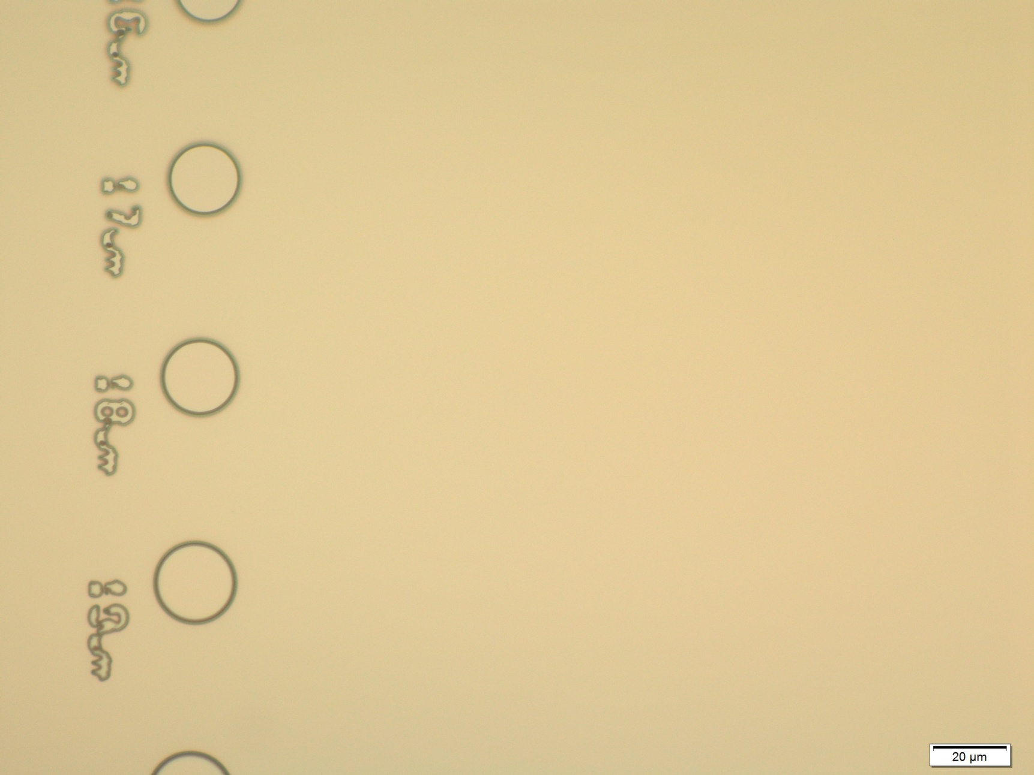
Wafer 4 – BCB Post-anneal

Slide 85
Conclusions
BCB hangs over edge when cleaving
You need a fresh cleave after each ash to SEM
Residue is left after exposure
Heat up time required before ashing begins in full (quantify this later)

