Slide 1
Integrated Recirculating Optical Buffers
Martijn J.R. Heck, Géza Kurczveil, Emily F. Burmeister, Hyundai Park, John P. Mack,
Daniel J. Blumenthal and John E. Bowers
Department of Electrical and Computer Engineering, University of California, Santa Barbara

Slide 2
Overview
Rationale: why integrated optical delay line buffers are the best option
Hybridly integrated InP / Silica optical buffers
Fully integrated hybrid silicon buffer
Towards 40 byte hybrid silicon buffers

Slide 3
Rationale: why integrated optical delay line buffers are the best option

Slide 4
LASOR architecture
1
2
Buffer requirements
≥ 40 byte packet length
≥ 40 Gbps
guard bands ~ns
cost, power consumption and footprint
Notes:
Fig. 1 Schematic of an optical data router comprised of synchronizers (Sync), buffers, packet forwarding chips (PFC), packet envelope detectors (PED), clock data recovery (CDR), deserializers (Deser), an arrayed waveguide grating router (AWGR), and control electronics. [E.F. Burmeister, D.J. Blumenthal and J.E. Bowers, “A comparison of optical buffering technologies,” Optical Switching and Networking vol. 5, 10-18 (2008).]

Slide 5
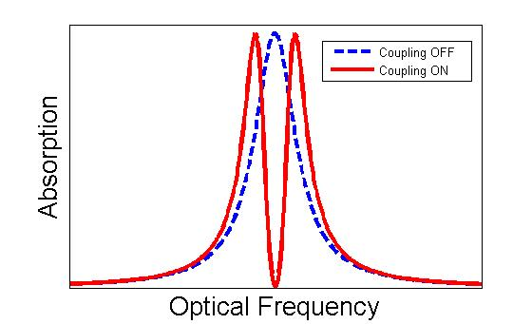
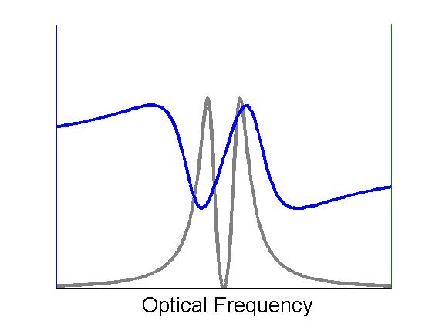
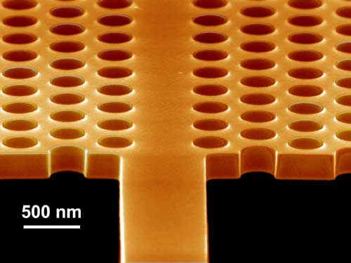
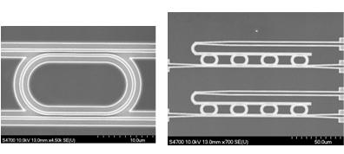
Buffer approaches (1)
transparent optical
  decrease group velocity: slow light
    material based resonance
    coupled resonance structure
  increase physical length: delay line
    feedforward
    feedback
electrical conversion: CMOS RAM
WIKIpedia: Electromagnetically induced transparency
Y.A. Vlasov, IBM Thomas J. Watson Research Center
Univ. of Glasgow

Slide 6
Buffer approaches (2)
transparent optical
  decrease group velocity: slow light
    material based resonance
    coupled resonance structure
  increase physical length: delay line
    feedforward
    feedback
electrical conversion: CMOS RAM

Slide 7
Buffer comparisons (1)
CMOS RAM
speed limits scalability
  however: 40 Gb/s (combination optical / electrical) possible [Takahashi et al., IEEE PTL 16 (2004) 1185]
long storage times, large capacity, random access at arbitrary times
loss and component complexity: limitation to < 10 byte packets
  serial to parallel conversion

Slide 8
Buffer comparisons (2)
Transparent optical buffers
compactness
loss

Slide 9
Buffer comparison (3)
Transparent optical buffers
realistic operation: bitrate and packet length
  transparency bandwidth
  (higher order) dispersion sets limit on device length

Slide 10
Buffer comparison: delay lines
Feedback configuration is beneficial
low component count
flexibility
small footprint
simultaneous reading and writing possible
→ Recirculating buffers meet all necessary requirements and are the most practical compromise as an overall solution

Slide 11
Hybridly integrated InP / Silica optical buffers

Slide 12
Rationale for hybrid integration
Hybridly integrated optical buffer
InP PIC
  active components for gain and absorption
  passive components for waveguiding, splitting and combining
  high loss > 3 dB/cm
Silica PLC
  low loss down to 1 dB/m
  no gain elements

Slide 13
InP switch
2 x 2 gate matrix switch
switch time < 2 ns (< packet guard band)
high extinction ratio > 40 dB for cascadability
booster SOAs for gain compensation

Slide 14
Silica delay line
5.5 x 5.5 μm² core, Δn = 0.76 %
2 m length, 6.4 cm² footprint
loss 4 dB/m @ 1550 nm
  (< 0.1 dB/m variation from 1525 – 1575 nm)
coupling 14 dB for two facets

Slide 15
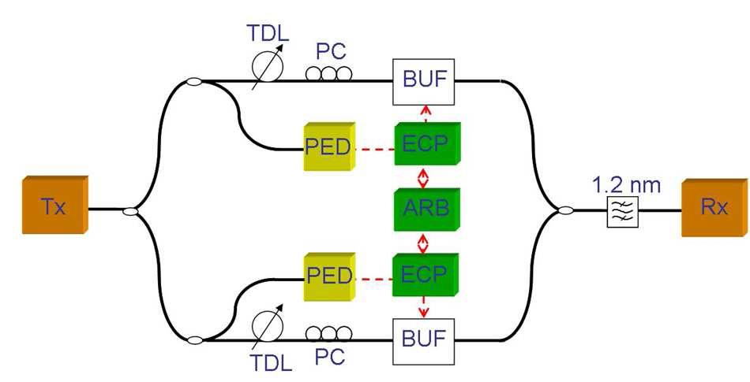
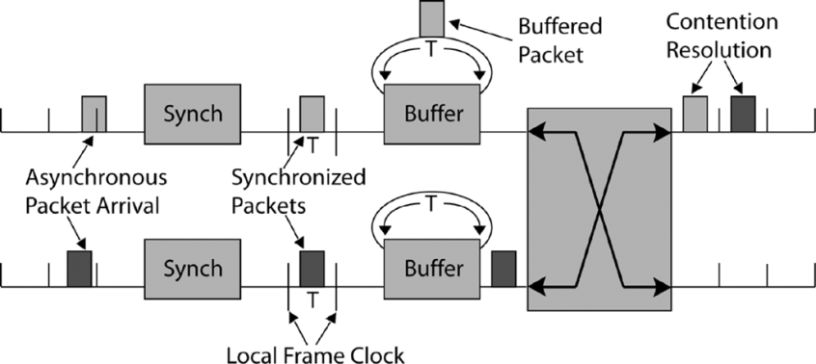
Results
98 % packet recovery shown for 5 circulations
(= 64 ns delay)
Contention resolution shown 40 byte packets @ 40 Gbps
Synchronous optical packet buffering shown
  Asynchronously arriving packets are optically synchronized
Burmeister et al., Opt. Exp.
Mack et al., IEEE PTL

Slide 16
Fully integrated hybrid silicon buffer

Slide 17
Rationale for full integration
Fully integrated silicon optical buffer
Hybrid integration 40-byte delay line loss: 22 dB (coupling + waveguide)
Silicon waveguides < 0.3 dB/cm (meas. at UCSB)
→ Fully integrated Si buffer competitive at 40 byte operation
Furthermore: fabrication and packaging cost and footprint favorable.
Issue: loss compensation and switching in silicon
→ Hybrid silicon platform

Slide 18
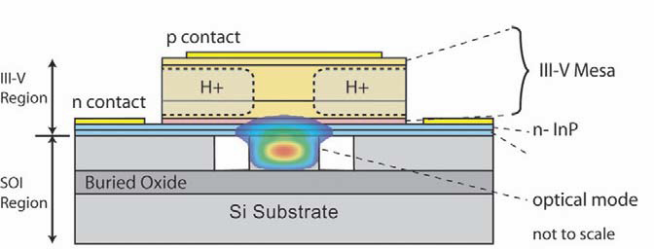
Hybrid Silicon Platform (1)
Silicon photonics makes use of low-cost and mature CMOS technology
Large area substrates (300 mm)
However silicon has indirect bandgap and does not provide optical gain
Hybrid Silicon Platform bonds III/V to silicon

Slide 19
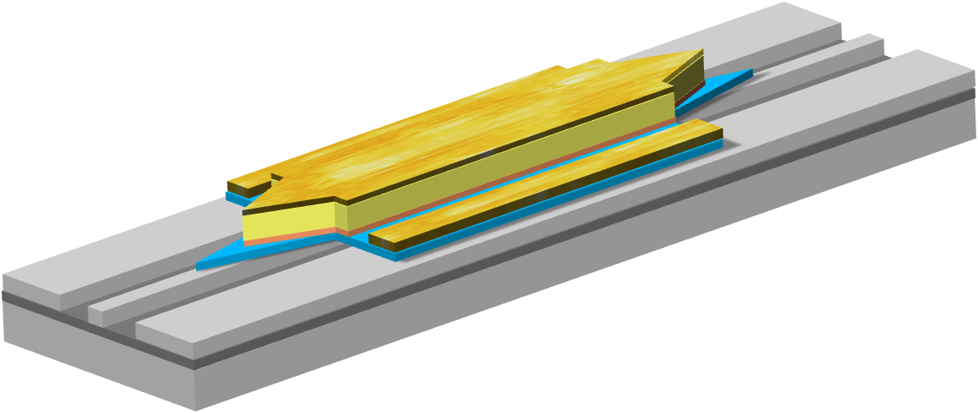
Hybrid Silicon Platform (2)
Optical gain or modulation from III-V Material;
Efficient coupling to silicon passive photonic devices
No bonding alignment necessary;
All back end processing low temperature (< 350 ⁰C);
150-mm wafer bonding and processing possible.

Slide 20
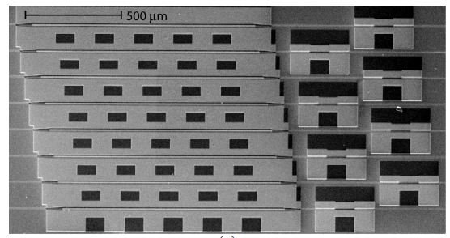
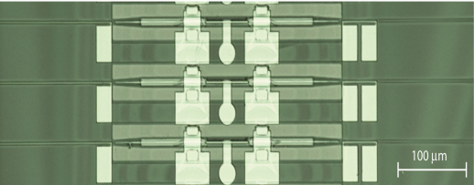
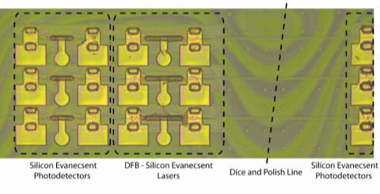
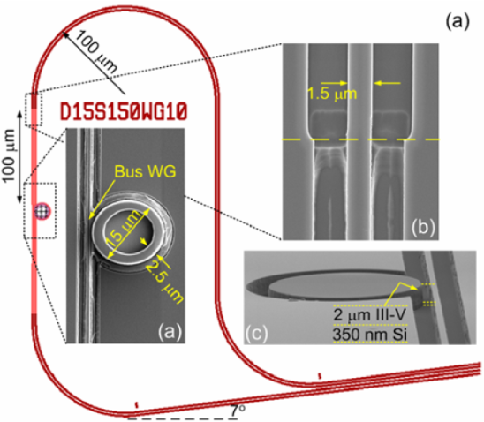
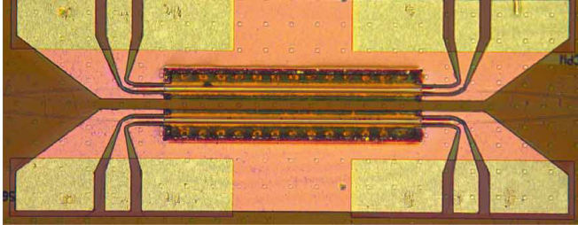
Demonstrated Hybrid Silicon Devices
FP, ML, DFB, and DBR lasers
(Fang et al., IEEE PTL, 20, 2008 )
Waveguide detector and amplifier
(Park et al.,IEEE PTL,19 , 2007)
MLL
AMP
detector
DBR
Ring laser
DFB
MOD
Microring resonator laser
(Liang et al. , GFP2009)
Modulators
(H. W. Chen et al. , GFP2009)

Slide 21
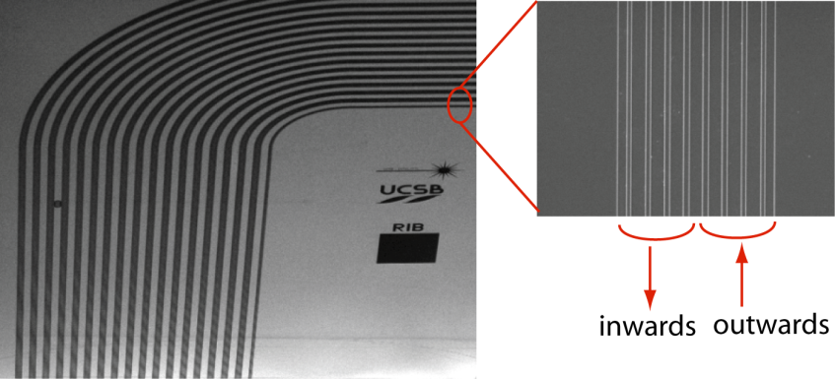
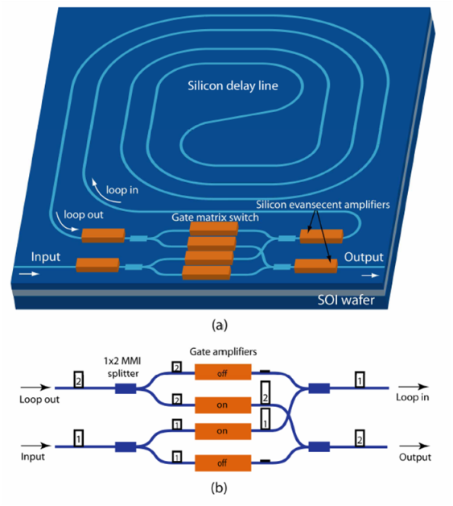
Device structure (1)
Silicon delay line
Delay line length: 9 cm
(1.1 ns delay)
Chip size: 6 x 9 mm²
(4 integrated devices)
Waveguide dimension: 2 μm (width), 0.7 μm (height)

Slide 22
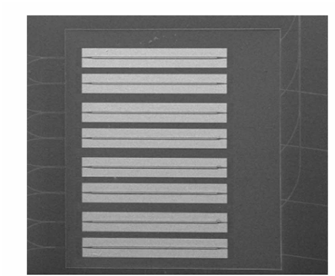
Device structure (2)
Gate matrix switch
Hybrid silicon SOAs

Slide 23
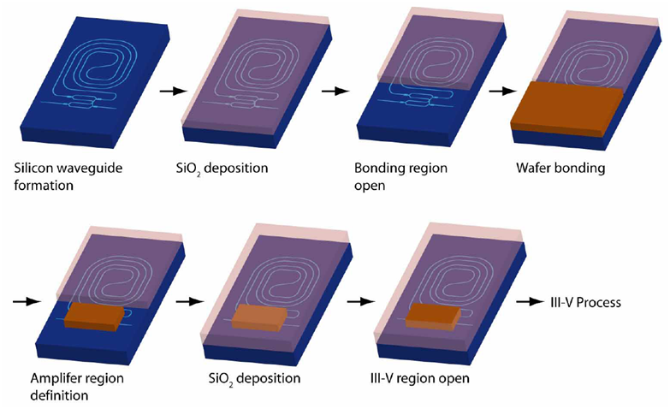
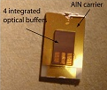
Fabrication

Slide 24
Device characterization
lensed fibers for incoupling
stage @ 15 °C
Si loss 15 dB (9 cm)
switch
  gain 8 dB (1200 μm), 6 dB (800 μm)
  crosstalk -34 dB
  extinction ratio 30 dB
  rise/fall times 1 ns

Slide 25
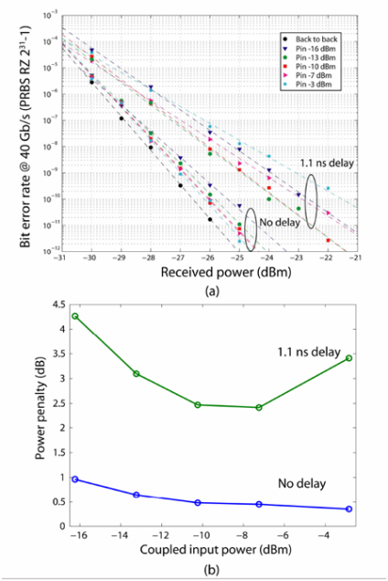
Experimental results
Performance limited by delay line loss
→ SOAs needed
→ ASE build-up
SOA saturation
ASE build-up
Notes:
Fig. 12 (a). Measured BER as a function of the received power with different input powers to the device. (b). Power penalty at a BER of 10⁻⁹.

Slide 26
Towards 40 byte hybrid silicon buffers

Slide 27
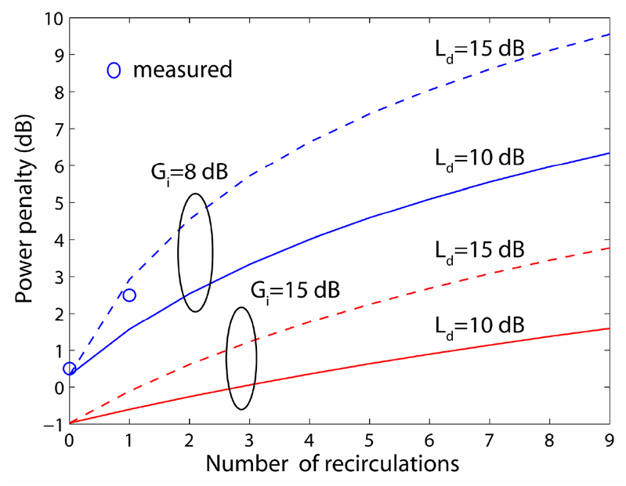
Possible improvements
delay line loss reduction
input gain improvement
(ASE) noise suppression

Slide 28
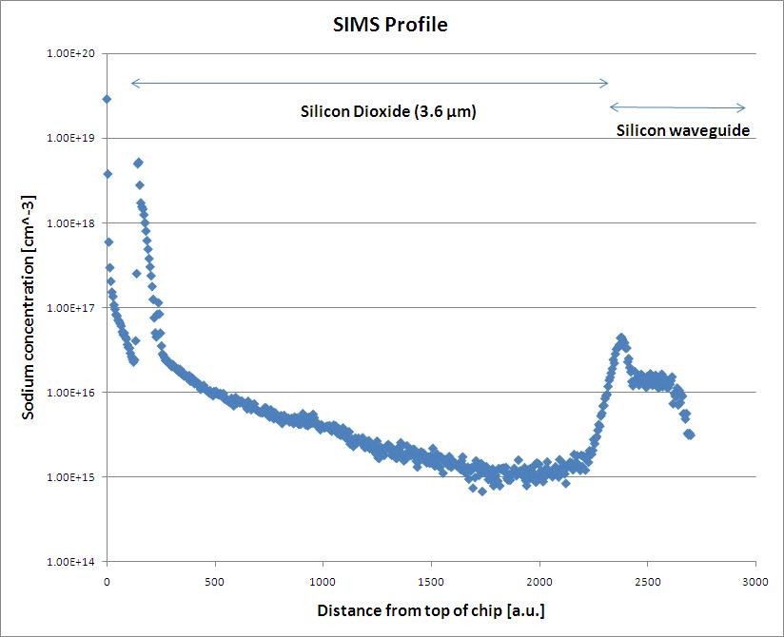
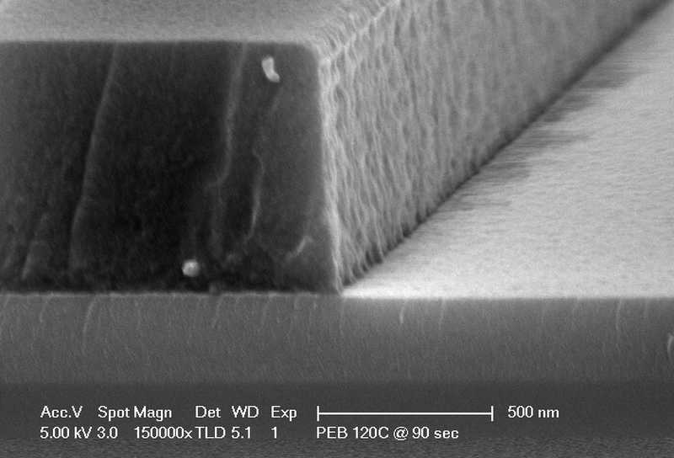
Si loss reduction
pre-bond loss
special undoped epitaxial growth
optimize litho
  0.8 dB/cm → 0.5 dB/cm
optimize etch conditions
post-bond loss
0.8 dB/cm → 1.8 dB/cm
SiO2 protection layer
  impurities → FCA
  structural damage due to stress/strain
SiO₂ (3.6μm)
Si waveguide
Sodium concentration (cm⁻³)
Distance from top of chip (a.u.)
Notes:
Sodium concentration profile as a function of the depth as measured by SIMS. The 0.7-μm silicon waveguide (right-hand side) is covered by a 3.6-μm thick oxide layer.

Slide 29
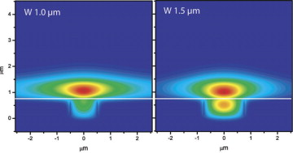
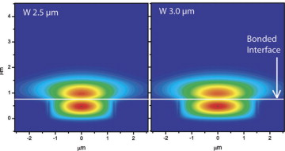
Gain improvement
Amplifier gain can be increased
→ Increase confinement with QWs
Si waveguide width
III/V (QW) design

Slide 30
Signal regeneration (1)
ASE noise can be suppressed
decrease broadband ASE
  bandpass filter
decrease ASE between bits
  SOA / SA pair → non-linear gain curve

Slide 31
Signal regeneration (2)
ASE noise can be suppressed
decrease broadband ASE
  bandpass filter
decrease ASE between bits
  SOA / SA pair → non-linear gain curve
P_{sat,SOA}
Gain (a.u.)
SOA
P_{sat,SA}
P_{in} →
SOA
SA
SOA
SA

Slide 32
Conclusion
Summary
40 byte packet length @ 40 Gbps needed
Delay line optical buffers only feasible option
Hybridly integrated InP / Silica buffer shows good performance
  98% packet recovery after 5 circulations
  contention resolution shown
  synchronous optical packet buffering shown
Fully integrated silicon buffer can have identical specs for 40 byte packet operation
  Feasibility shown
  Potential for low-loss and increased performance shown
Conclusion: The hybrid silicon platform is the most promising approach for integrated optical buffer applications
comparable or better performance possible over alternatives at 40 byte
low fabrication and packaging cost
small footprint
integration with CMOS-based driving electronics

Slide 33
Acknowledgements
This work was supported by DARPA/MTO and by ARL under LASOR award, contract #W911NF-04-9-0001
The authors would like to thank H.N. Poulsen, M.L. Mašanović,
B. Stamenić, H.W. Chen and A.W. Fang for their technical assistance.
The authors would also like to thank R. Jones from Intel and G. Epps from Cisco for helpful discussion and M. Haney and W. Chang for their support.

