Slide 1
Selective Ge wet etching

Slide 2
Goal/context
Passive WG
Si
Si
Mesa etch (wet)
Waveguide etch (dry)
Proposed process follower
Advantages:
PDs automatically aligned to waveguide
Don’t have to find a dry etch for Ge that leaves top Si surface smooth

Slide 3
Options
Many solutions etch Ge with good Si selectivity:
H202 alone (heated or at room temp)
H2O2:NH4OH:DI
NH4OH by itself will etch Si, so it is important to keep a large H2O2 concentration
H2O2:HCl:DI
H2O2:H2SO4:DI
Very fast

Slide 4
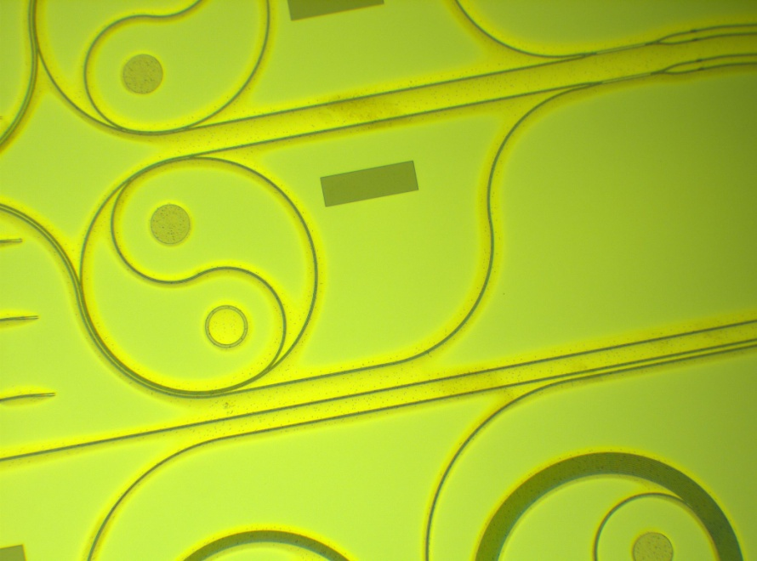
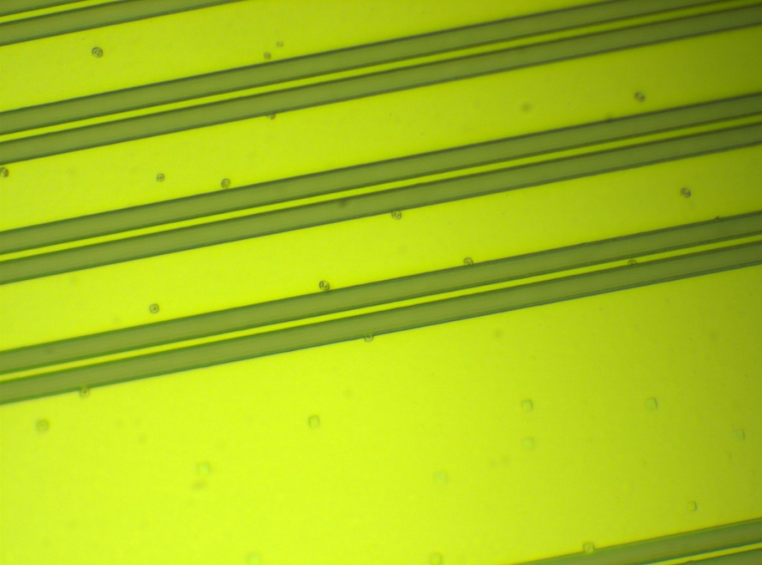
H2O2
Some Ge
Etch is not even, stops at Si/Ge interfacial layer, especially in large open areas
Surface left pretty smooth
Except when it isn’t:
Si
Ge

Slide 5
NH4OH:H2O2:DI
Ge
Si
Various concentrations tested, rates usually ~200nm/min
Etched surface rougher than as-grown surface
Laser pointer test
Ge etches anisotropically

Slide 6
HCl:H2O2:DI
Si
Si
Ge
Ge
Leaves more SiGe than NH4OH:H2O2:DI
Visible to naked eye, using color of surface
Etched surface clearly rougher than as-grown surface
Etches Ge isotropically
I think the pits are from the growth, not the wet etch

Slide 7
More on pits
Looks like a thin damaged layer at Si surface

Slide 8
Also tried
NH4OH:H2O2:DI+HF:HNO3:DI 1:1:50 1’
Could also try ICP1 ashing chamber CF4/O2 (50:200 sccm)

Slide 9
Dry etch after wet etch
5 second Cl ICP etch after selective wet etch (wet etch was all the way to the Si)

Slide 10
Dry etch only (point of reference)

Slide 11
Wet + dry etching
Process:
Wet etch 3-3.5 min. HCl:H2O2:DI 2:2:15
Dry etch 5-20s in standard WG etch (SF6/O2 ICP)
3-die piece: 3.5 min wet etch
4-die piece: 3 min wet etch
+8s dry etch
+8s +5s dry etch
+15s +2s dry etch

Slide 12
Summary
Si
Waveguide sidewall
Ge
Si
Ge
Si
Dry etch only
Wet + dry
Wet etch only
All images are the same scale, wet-only and wet+ dry are both flat, though dry-only is angled
Wet + dry works pretty well

