Slide 1
Over 40 GHz Traveling-Wave Electroabsorption Modulator Based on Hybrid Silicon Platform
Yongbo Tang^{1,2,3*}, Hui-Wen Chen¹, Jonathan D. Peters¹, Urban Westergren^{2,3} and John E. Bowers¹
¹Dept. of Electrical and Computer Engineering, UC Santa Barbara, USA
2, JORCEP, Zhejiang University, China
3, School of information and communication technology, KTH, Sweden
ytang@ece.ucsb.edu
Supported by DARPA MTO CIPHER PICO project (Scott Rodgers) and Intel
Notes:
Thank you for the chair’s nice introduction. I am Yongbo Tang. I will talk about our work on high speed traveling-wave electroabsorption modulator based on hybrid silicon platform.

Slide 2
Outline
Review of silicon and III-V modulators
Hybrid silicon platform and hybrid modulators
Performance of hybrid silicon TW-EAM
Loss, static extinction ratio
Bandwidth, chirp
Eye diagram
Summary and future work

Slide 3
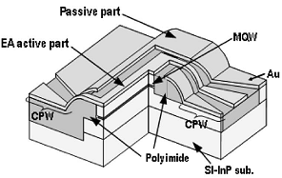
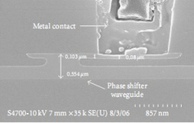
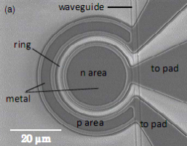
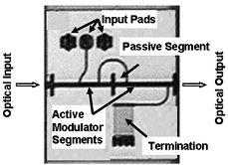
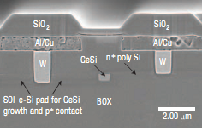
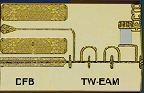
Silicon modulator/III-V modulator
NTT, 2006
Carrier depletion-based MZM
Intel 2008,
TW-EAM
NTT, 2008
Microring Si Modulator
Kotura 2009
This work
KTH, 2008
Kotura 2008
KTH, 2010
Segmented EAM
KTH, 2008
MIT 2008
Intel, 2008
GeSi EAM
MIT 2008
Segmented EML
KTH, 2010
Only the work reported after 2004 is included.
Notes:
Let us see the recent progress of integrated modulators first. Here, x axis is the bandwidth, related to the high speed performance. Y axis is the Extinction ratio over driving voltage swing, which covers the tradeoff between them. As we all known, silicon is not a good material for high speed and efficient modulation. In the last five years, remarkable achievement has been reached based on carrier dispersion effect or EA effect in GeSi material. However, if compared with the report of the III-V modulators, those progresses are still trivial, althougt great effort is devoted. So here comes a basic idea, is that possible to transfer the state of the art modulation technique to the silicon platform.

Slide 4
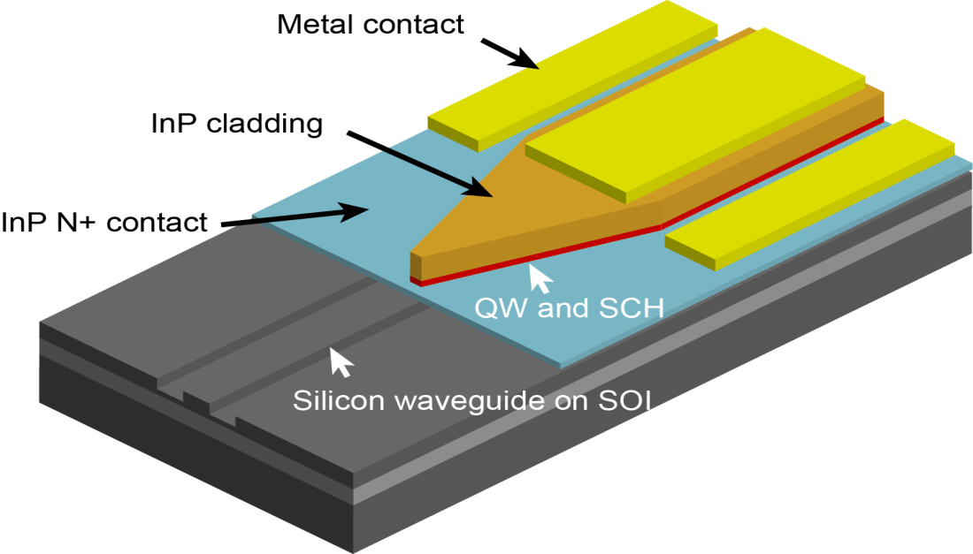
Hybrid Silicon Platform
Silicon photonics (Silicon substrate)
Good for Passive functionality (high index contrast)
Legacy (CMOS process, foundry etc) from microelectronics
III-V platform (InP substrate)
Mature technique for active functionalities (Laser, detector etc)
Hybrid silicon platform
Complete photonic functionalities
Reduced coupling interfaces
Notes:
A promising solution is the hybrid silicon platform. We know that silicon photonics is really attractive. One thing is that it is such a good material for passive funcitonality. For example, the high index contrast enables very compact design and high volume per wafer. Another thing is that it can have lots of resouces from microelectronics. For the III-V platform, mainly based on InP substrate, we can have mature technique for active functionalities. Most commersial product of laser, detector are based on this technique. Once we combine the two material systems together, the hybrid silicon platform can have complete photonics circuit

Slide 5
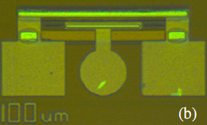
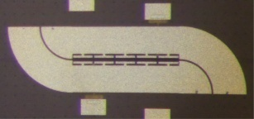
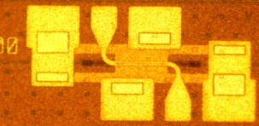
Hybrid silicon modulator
NTT, 2006
Lumped EAM
2008
CPW MZM
2008
This work
KTH, 2008
Kotura 2008
KTH, 2010
Slot MZM
2009, 2010(OWQ5)
MIT 2008
Intel, 2008
TW-EAM
2010. This work
Notes:
III-V:
strong QCSE/Franz-keldysh EA effect
Pockels, Kerr, Plasma dispersion effect
Si:
Plasma dispersion
GeSi:
QCSE/Franz-keldysh EA effect

Slide 6
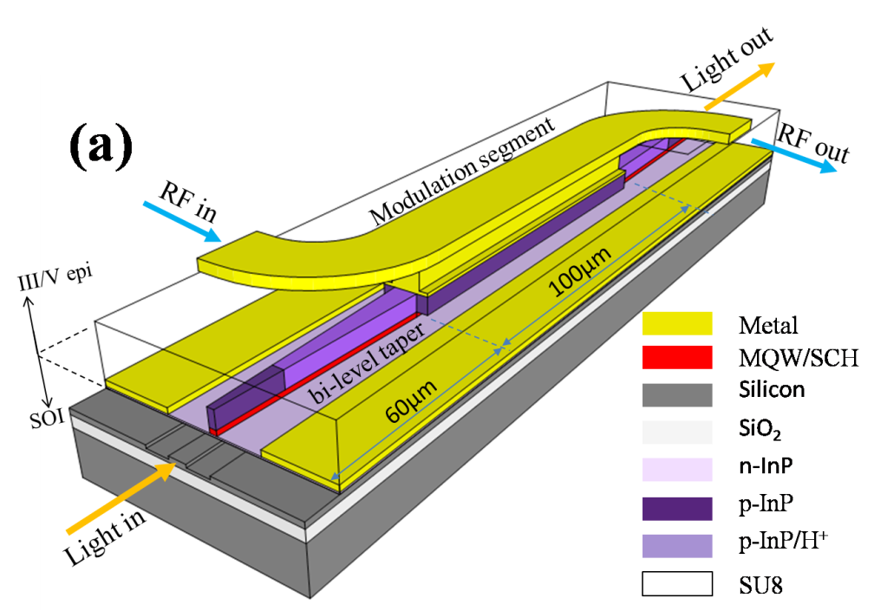
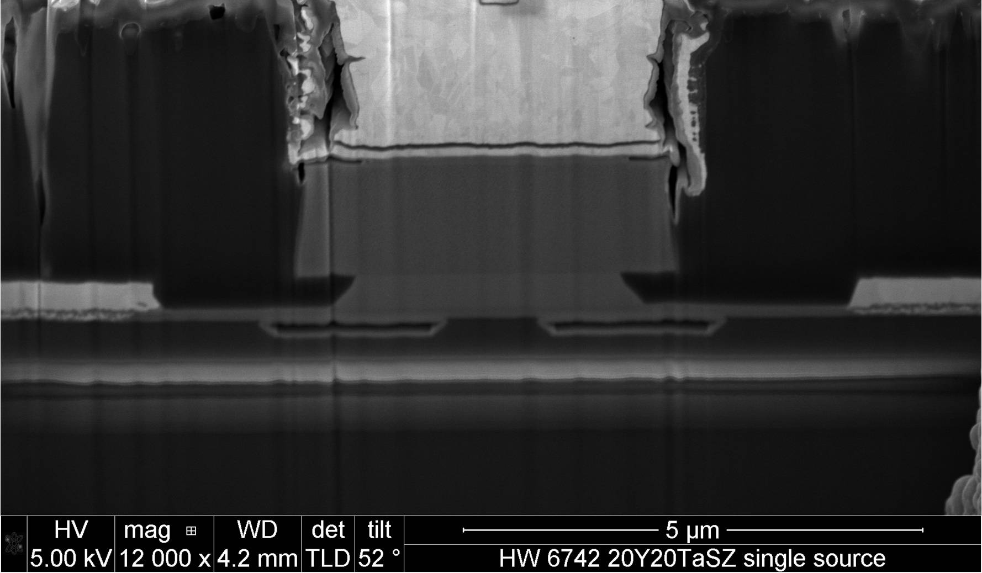
TW-EAM Device Structure
240μm
430μm
Top-view
Cross-section
Traveling-wave electrode with a 50Ω teminator.
Elimination of the tapers’ electrical influence by H⁺implatation
Under-etching is applied to reduce the intrinsic capacitance
Footprint: 240 x 430μm

Slide 7
From lumped to Traveling-Wave
RF
RF in
light
light
RF out
Lumped
Traveling-Wave
Notes:
The major revision is that we use traveling-wave electrode to replace the previous lumped design. Here I show the equivelent circuits for the two electrode configurations. For a short modulator, the bandwidth is mainly related to the RC. While, for the traveling-wave, the bigger item ralted to the source impedance is removed. That means at least a double of the bandwidth.

Slide 8
Device Loss
P₁
I₁
P₂
I₂
EAM1
EAM2
100 μm
60 μm
Loss
Unbiased Loss: 5dB @1550nm
ER: >11dB/2V @1550nm
P_{in} = ~3dBm
Notes:
Let’s see the device loss first. We use cascaded EAMs to get the device loss. The photocurrent from the EAM is proptional to the input optical power. Hence, we can roughtly evaluate the device loss by using this formula.

Slide 9
E/O Measurement
Bias = -3V
3dB bandwidth: ~43 GHz
Electrical Reflection: <-10 dB till 30 GHz

Slide 10
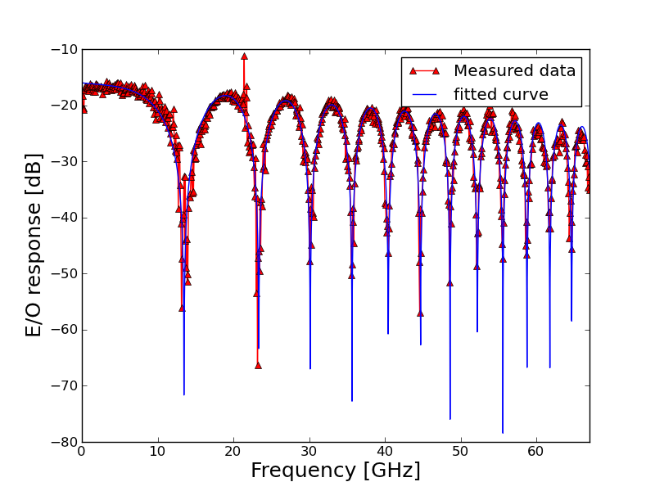
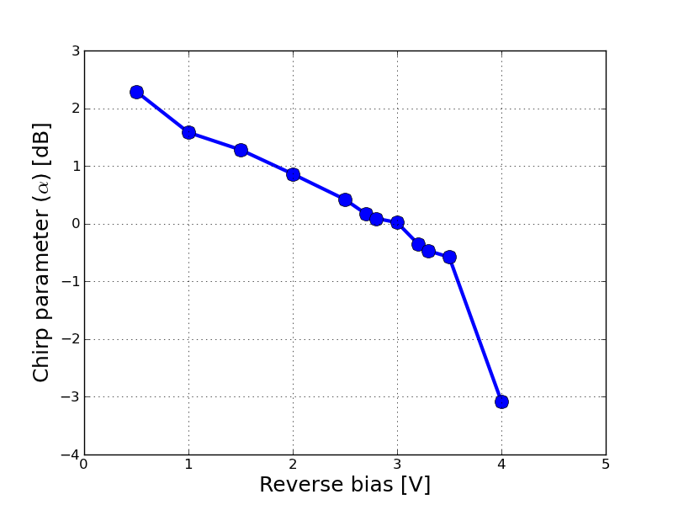
Chirp
Chirp-free operation
Bias = -3V
27.92 km SMF is used for the testing
F. Devaux, Y. Sorel, and J. F. Kerdiles, J. Lightw. Technol. 11(13), 1937-1940 (1993).

Slide 11
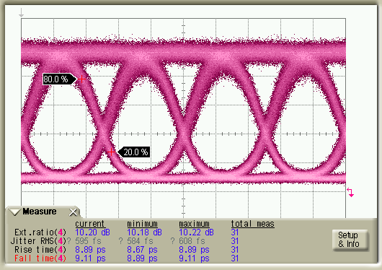
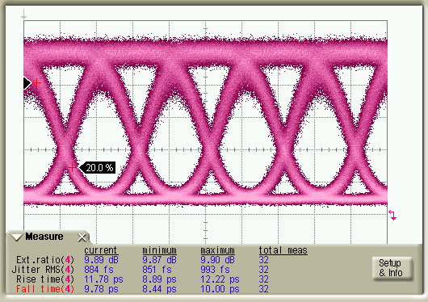
Large signal performance
Bitrate: 40 Gb/s
Dyn. ER: 10.2 dB
Vpp: 2 V
20ps
2³¹-1, PRBS, NRZ, bias=-3V
Bitrate:50 Gb/s
Dyn. ER: 9.8 dB
Vpp: 2 V
20ps
2³¹-1, PRBS, NRZ, bias=-3V

Slide 12
Summary
Structure | Ring |  | EAM |  | MZM
Group/Platform | Cornell / Si | Kotura/Si | MIT / SiGe | UCSB/Hybrid | Intel / Si | IBM / Si
Static ER (V_{pp}) | 17 dB (1.8 V) | 12 dB (2V) | 10 dB (7 V) | 11 dB (2V) | 22 dB (8V) | 6 to 10 dB (1.8V)
f_{3dB} | — | 11GHz | 1GHz | 43GHz | 33GHz | —
Dynamic ER Freq. Vpp | 9dB 12.5Gb/s 8V | 6.5dB 10Gb/s 2V | — | 9.8dB 50Gb/s 2V | 1.1dB 40Gb/s 6.2V | — 10Gb/s —
Length (μm) | 10 | 30 | 50 | 100 | 1000 | 100
Loss /device | — | 2dB | 14.8dB | ~5dB | 5.4dB | 12dB
We have demostrated hybrid silicon TW-EAM. So far as we known, it is the world’s fastest modulator on silicon substrate.
The paper including detailed demonstration has been submitted to optical express

Slide 13
Future Work
Toward high speed, energy-efficient Electroabsorption modulated laser (array)
12.5Gb/s
λ₁
100 Gb/s
λ₁
12.5Gb/s
λ₁
25 Gb/s
Silicon region
λ₁
λ₂
100 Gb/s
Hybrid region
.
.
.
.
.
.
λ₂
12.5Gb/s
λ₂
25 Gb/s
λ
100Gb/s
λ₃
λ₃
25 Gb/s
Laser
Modulator
λ₃
100 Gb/s
λ₄
1x100 Gb/s EML
λ₄
25 Gb/s
λ₄
100 Gb/s
4x25 Gb/s EML array
Tb/s Transmitter Module

Slide 14
Thank you

Slide 15
Backup

Slide 16
Loss measurement/derivation
P₁
I₁
P’₁
P₂
I₂
P’₂
EAM1
EAM2
Loss
Note: It is an approxmiate method to evaluate the loss of EAM since power dependent absorption will lead to certain deviation;

Slide 17
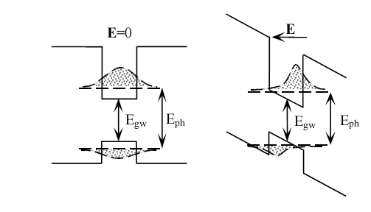
Absorption change by quantum Stark effect
Absorption in QW:
sharp absorption edge
strong electron interaction
Quantum Stark effect:
red shift of absorption peak
change of electron-hole overlapping

Slide 18
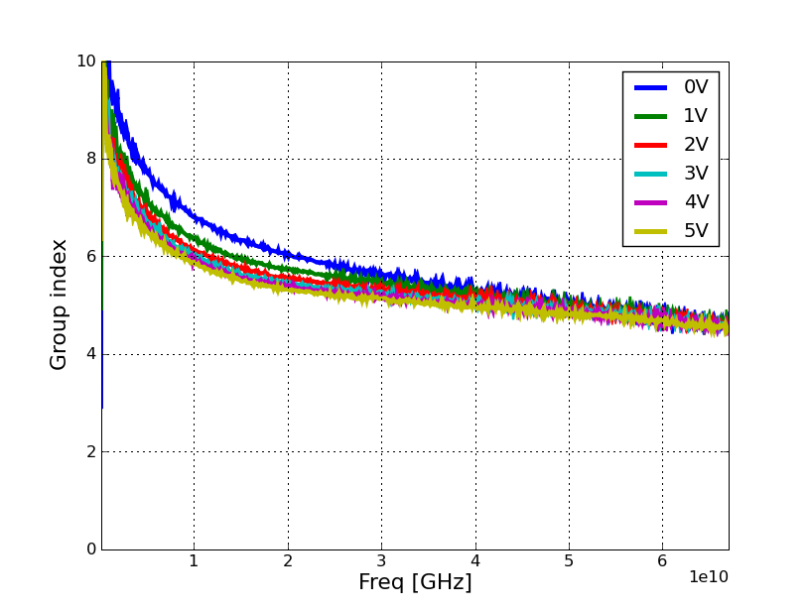
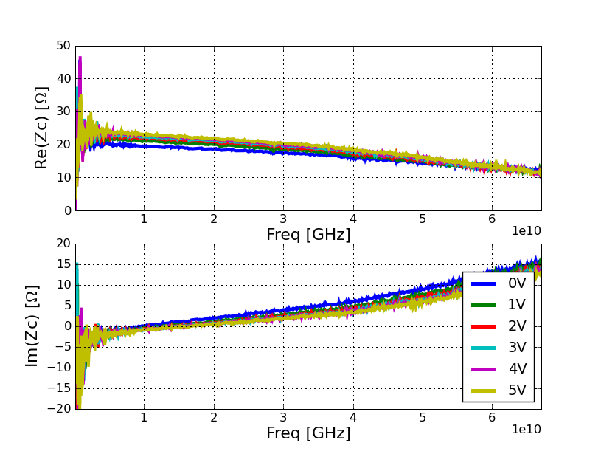
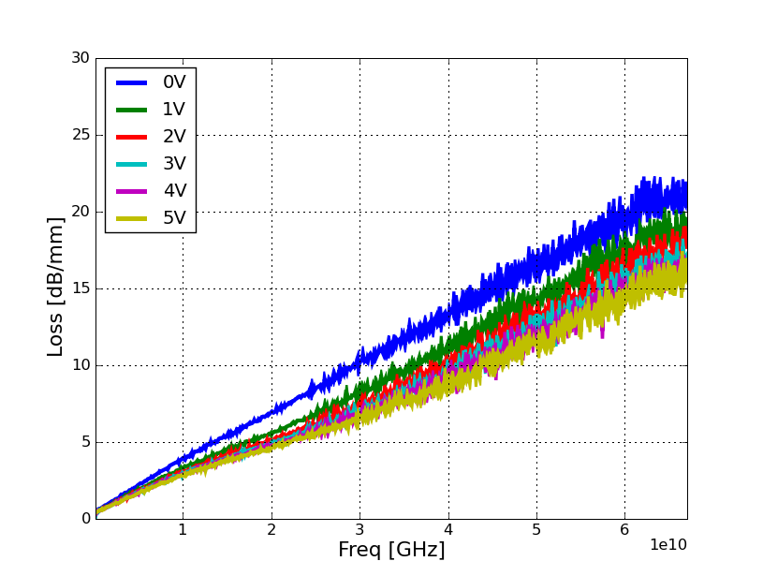
Electrical parameters of modulator segment
Zc ~20Ω
n: 5~6
Smaller C due to depletion

