Slide 1
InGaAsP Wet Etch
4/20/2009

Slide 3
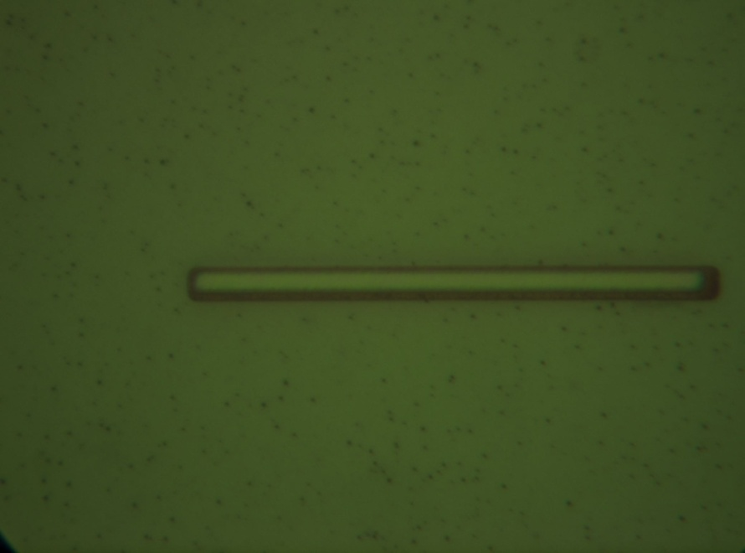
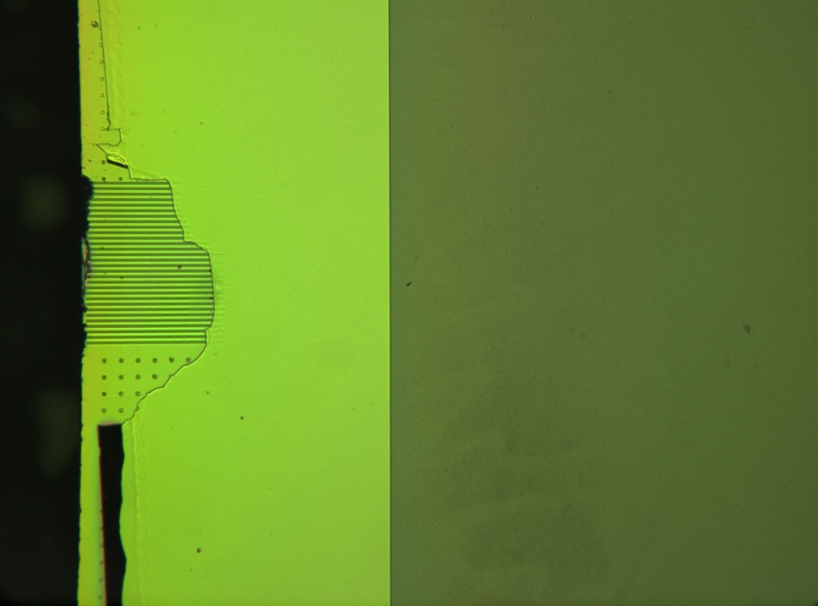
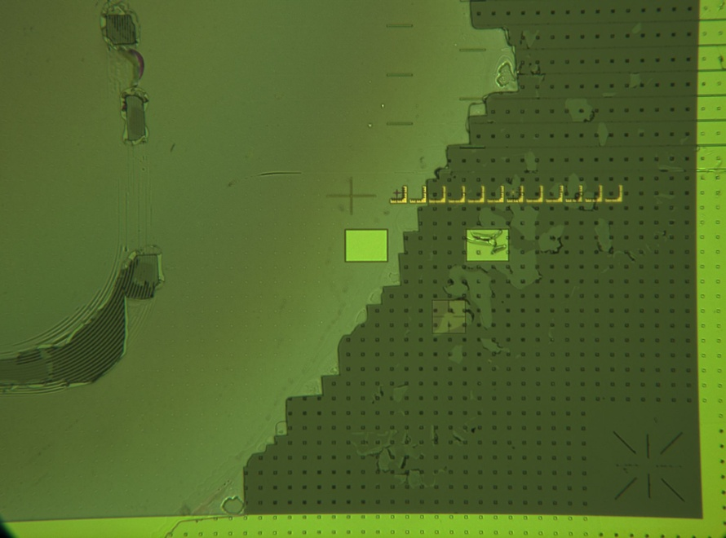
InGaAsP Pre Etch
Die 1
Measurement Site 1
Measurement Site 2
2027 nm Step
1997 nm Step
830 nm Step

Slide 4
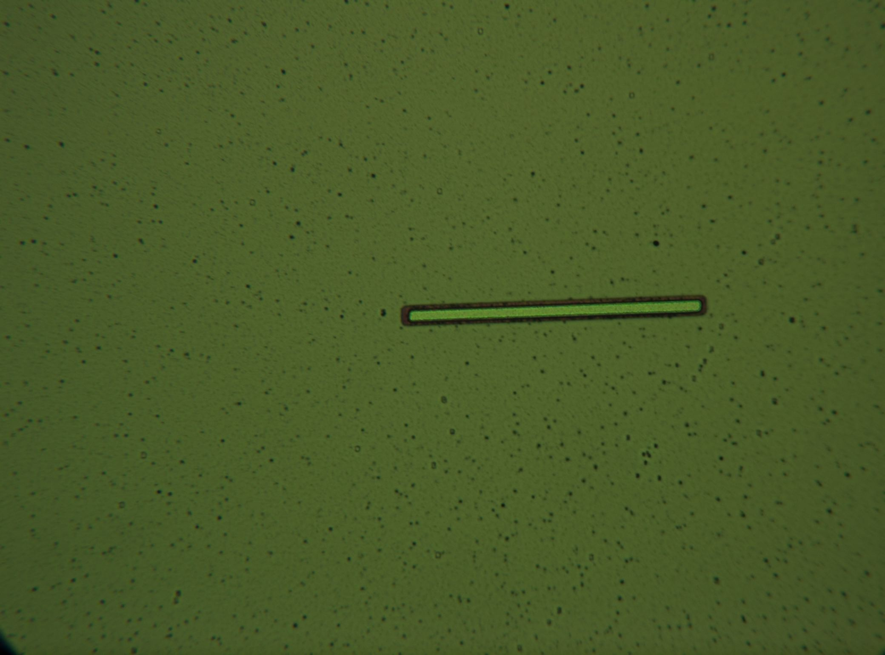
AWG Die 2 Pre Etch

Slide 5
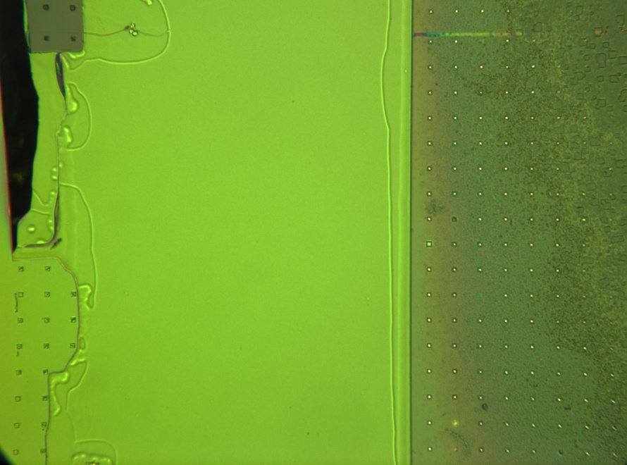
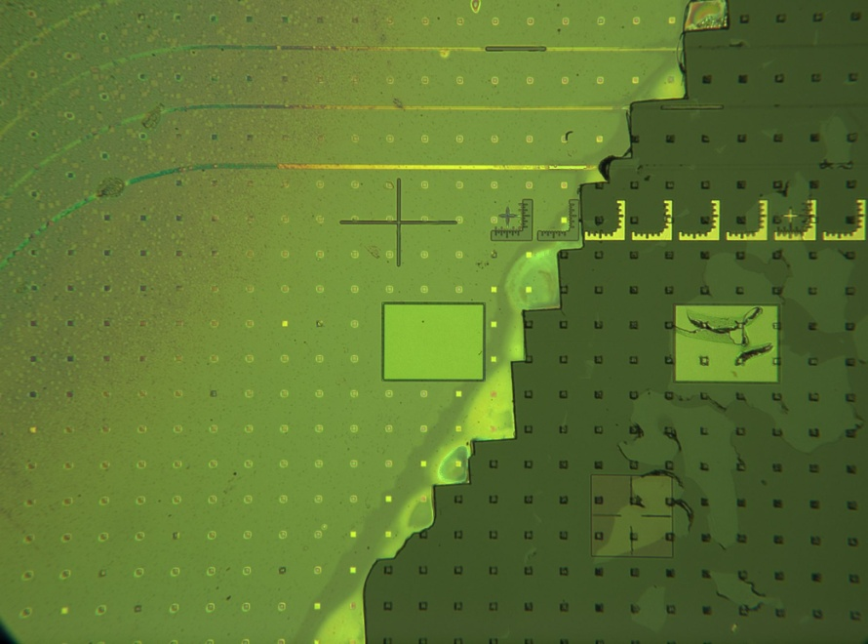
InGaAsP Pre Etch
Post 2270 nm – Pre 1960 nm = 310 nm loss
Post 2377 nm – Pre 2027nm = 350 nm loss
Measurement Site 1
Measurement Site 2
Post 8.5 minute Etch in 1:1:10 H2SO4:H2O2:DI
2027 nm Step
1997 nm Step
830 nm Step

Slide 6
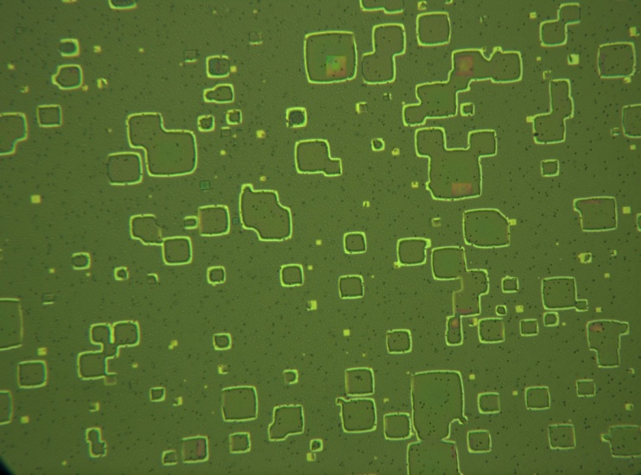
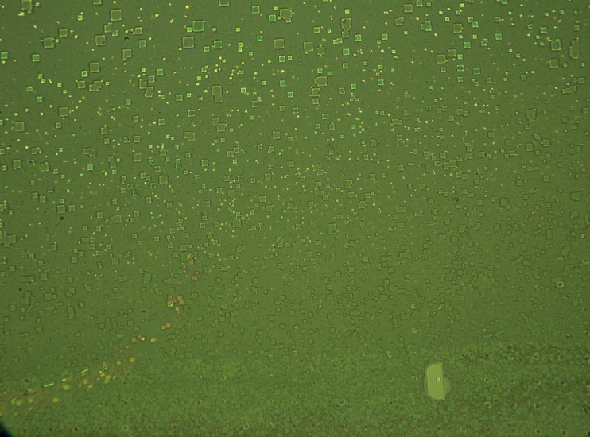
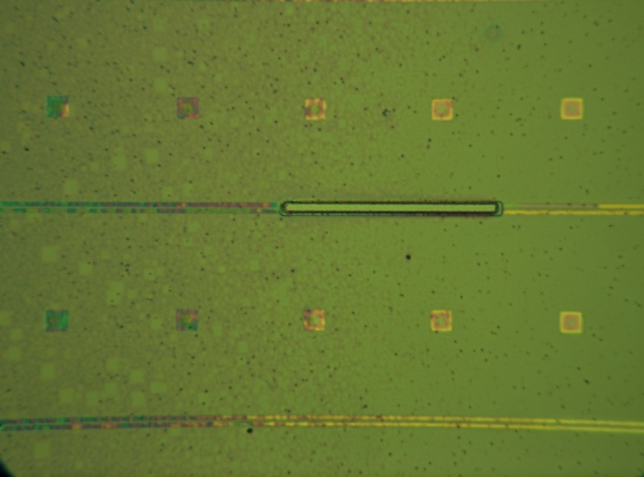
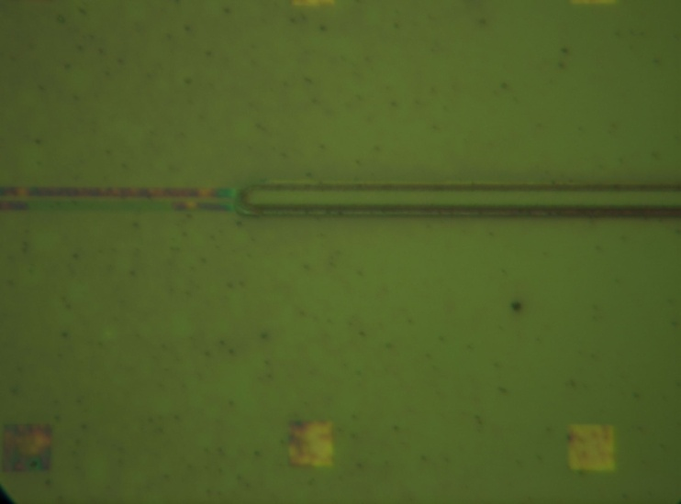
Underetch Post 8.5 minutes. Edges cleared but 90% of area still underetched.

Slide 7
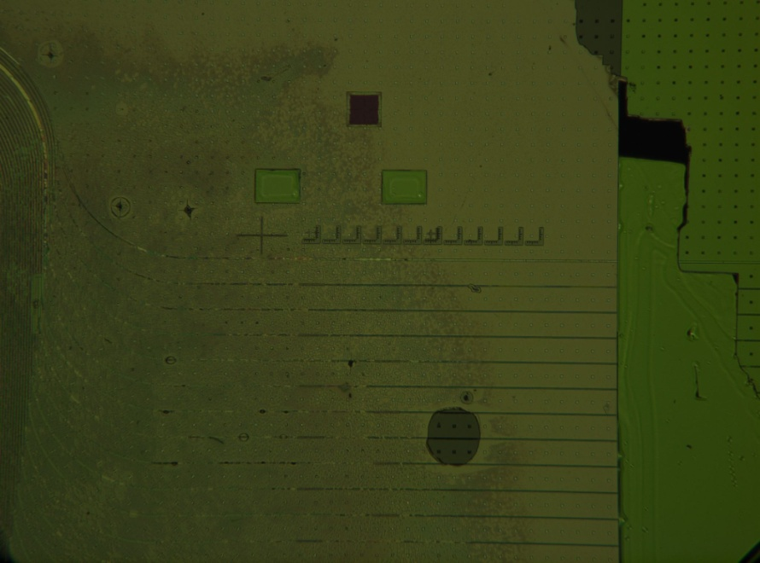
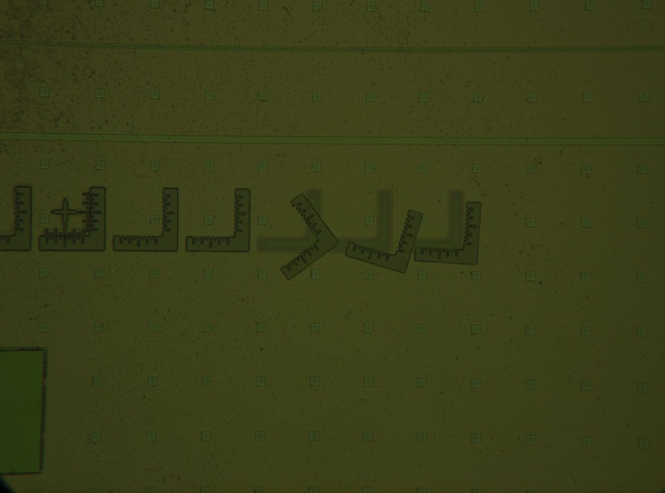

Slide 8
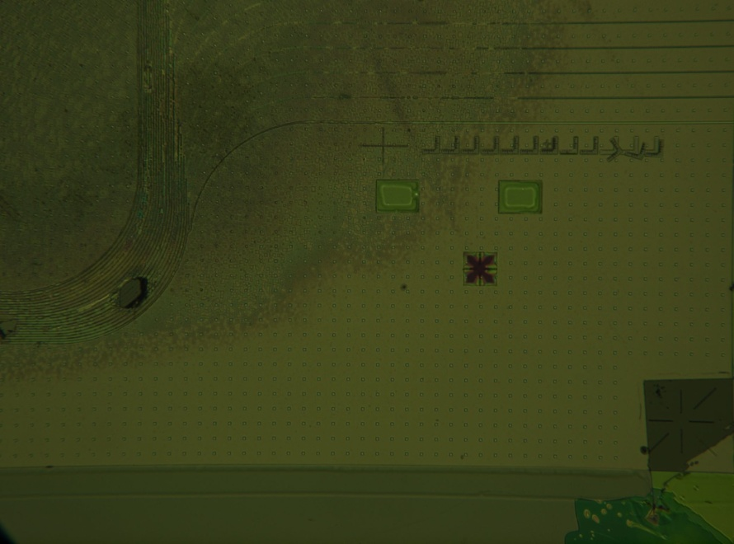
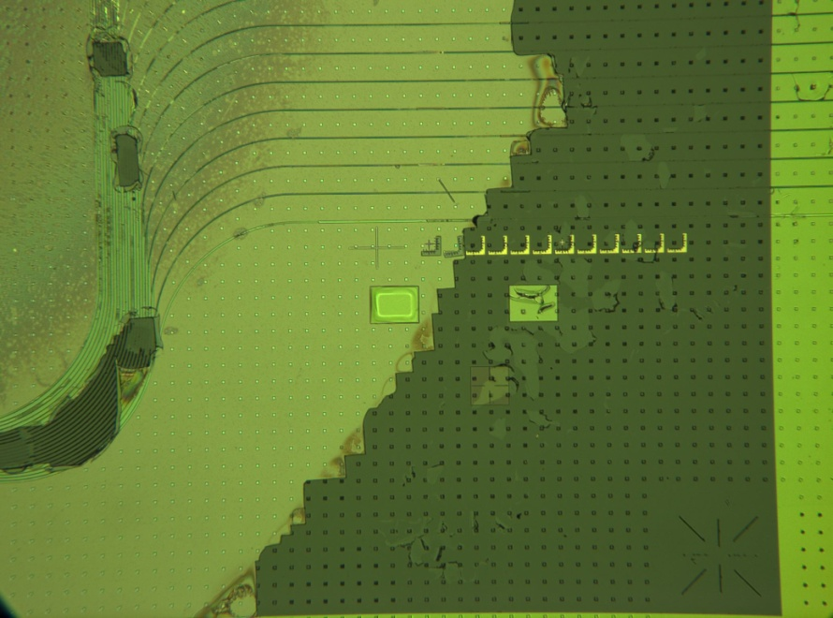
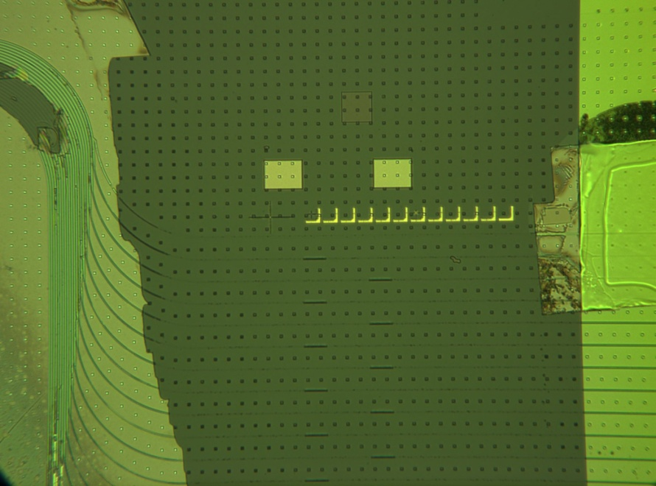

Slide 9
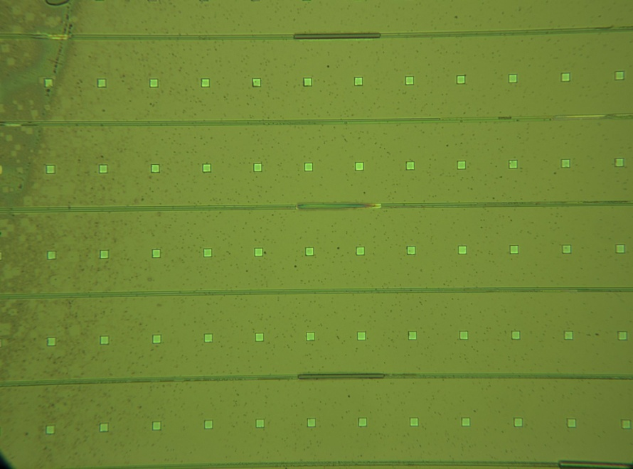
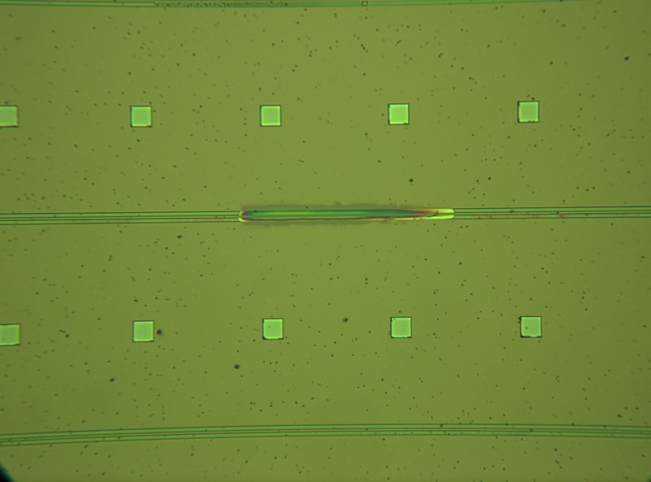
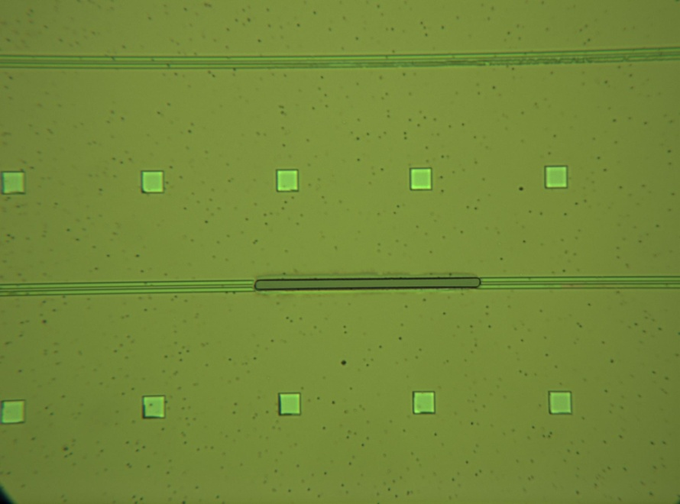

Slide 10
