Slide 1
High-power MLL update
Silicon Photonics meeting
4/20/10

Slide 2
Mask polarity summary
Mask | Polarity | Photoresist type
Waveguide | Negative | Positive
Vertical channel | Negative | Positive
Mesa | Positive | Positive
QW | Positive | Positive
N layer | Positive | Positive
PN metal | Positive | Negative
Isolation etch | Negative | Positive
Implantation | Negative | Positive
Vias (SU-8) | Positive | Negative
Probe | Positive | Negative

Slide 3
Waveguide etch: Hard mask deposition
2750A of SiO₂
0.7um waveguide layer
1um SiO₂
Si substrate

Slide 4
Waveguide etch: Spin and pattern PR
Waveguide mask (negative)
Positive PR
2750A of SiO₂
0.7um waveguide layer
1um SiO₂
Si substrate

Slide 5
Waveguide etch: Develop PR, etch hard mask
Dry etch hard mask in ICP#2
2750A of SiO₂
0.7um waveguide layer
1um SiO₂
Si substrate

Slide 6
Waveguide etch: Develop PR, etch hard mask
Dry etch Si in ICP#2
Repeat lithography and Si etch for vertical channels (not shown)
2750A of SiO₂
0.7um waveguide layer
1um SiO₂
Si substrate

Slide 7
Waveguide etch: Remove hard mask

Slide 8
Post bond
P layer
QWs
N-layer

Slide 9
Mesa Etch: Deposit thin p-metal, hard mask, and spin PR(+)
Positive photoresist
1500A of SiN
Thin p-metal (Pd/Ti/Pd/Au)
P layer
QWs
N-layer

Slide 10
Mesa Etch: Pattern PR
Thin p mask (positive)
Positive photoresist

Slide 11
Mesa Etch: Develop PR, etch hard mask, strip PR
Dry etch hard mask in RIE#3

Slide 12
Mesa Etch: Thin p-metal
Wet etch gold
Dry etch Ti and Pd in ICP#2

Slide 13
Mesa Etch: InP etch
Dry etch mesa in RIE#2

Slide 14
Isolation Etch: Spin PR(+), isolation etch litho
In between thick p metal strips on the mesa
Isolation 1 Mask (negative)
Positive photoresist

Slide 15
Isolation Etch: Spin PR(+), isolation etch litho

Slide 16
Isolation Etch: Metal etch
Dry etch SiN in ICP#2
Dry etch thin p metal in isolation regions in ICP#2
Dry etch ~200nm of p-layer in RIE#2

Slide 17
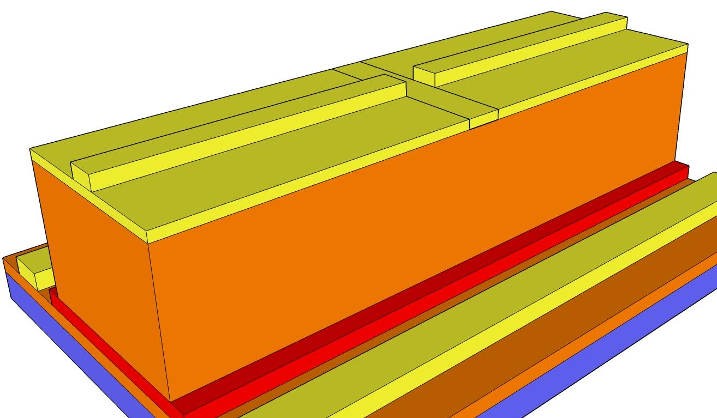
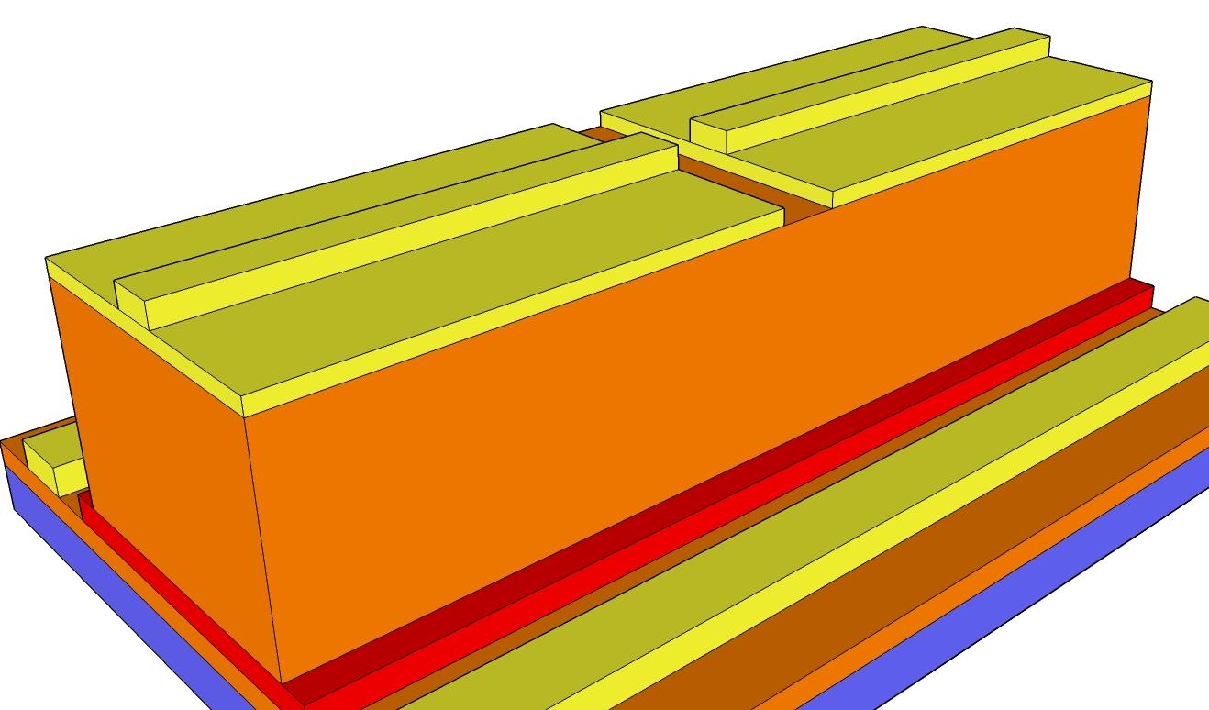

Slide 18
Dry etch mesa in RIE#2 by 200nm
Some QW region will be etched

Slide 19
QW Etch: Spin PR(+), expose
QW mask (positive)
Positive photoresist

Slide 20
QW Etch
Wet etch QWs
(SiN layer?)

Slide 21
N Layer Etch

Slide 22
N Layer Etch: Spin and pattern PR(+)
N layer mask (positive)
Positive photoresist

Slide 23
N Layer Etch

Slide 24
N Layer Etch
Dry etch hardmask in ICP #2 (recipe 181)
Dry etch N layer in RIE#2

Slide 25
Thick P and N Metal
Strip PR

Slide 26
Thick P and N Metal: Spin and pattern PR(-)
PN metal mask (positive)
Negative photoresist

Slide 27
Thick P and N Metal: Pattern hardmask
Etch SiN in PE2

Slide 28
Thick P and N Metal: Deposit metal
Deposit Ni/Ge/Au/Ni/Au in e-beam 3

Slide 29
Thick P and N Metal
Liftoff metal

Slide 30
Implant
Deposit 3000A of SiN

Slide 31
Implant: Spin and pattern PR(+)
Implant Mask (negative)
Positive photoresist

Slide 32
Implant
Send out for implant

Slide 33
Implant: In isolation etch area

Slide 34
Vias

Slide 35
Vias: SU-8 patterning
Via mask (positive)
SU-8 (negative)

Slide 36
Vias

Slide 37
Vias
Deposit 3000A of SiN

Slide 38
Vias: SiN etch
Perform via mask lithography again with negative resist, dry etch SiN in ICP#2

Slide 39
Probe Pads: Spin and pattern PR(-)
Probe mask (Negative)
Positive photoresist

Slide 40
Probe Pads: Develop PR

Slide 41
Probe pads
Deposit metal in E-Beam 1
Ti/Au

Slide 42
Probe Pads: Liftoff

