Slide 1
Results from Batch1 of SOIBuffer2R run

Slide 2
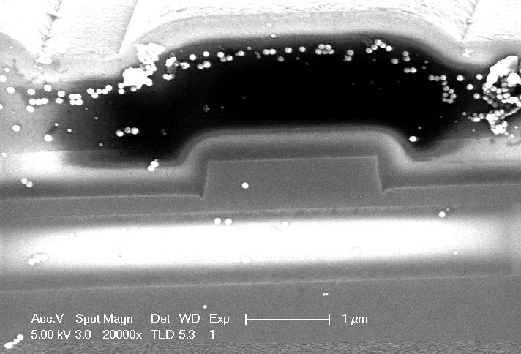
SEM

