Slide 1
Integrated Microring Optical Isolator by Magneto-optic Effect

Slide 2
Concept of Microring Isolator
x
Magnetic film
y
z
Si
B
BOX
Nonreciprocal phase shift
  Magnetic field perpendicular to the propagation direction
  TE-polarized light propagating in clockwise (CW) and counterclockwise (CCW) directions has different propagation constants
  Optical input with resonance wavelength will be blocked while the other direction input will not.

Slide 3
Design of Optical Isolator
Figures of merit
  Optical isolation
  Insertion loss
  Isolation bandwidth
Design parameters
  Q of the resonator
  Faraday coefficient of magnetic material
  Waveguide structure

Slide 4
Optical Isolator based on High-index Contrast Waveguides
Index offset with presence of magnetic field
Ce:YIG
350 nm
Si
500 nm
BOX
y
Magnetic film: Ce:YIG (n=2.22)
Faraday coefficient: 7.85 x 10³ rad/m
Resonance wavelength shift: 45 pm
x

Slide 5
Isolation at Through Port
Q of the ring: 30,000
Isolation Ratio > 40dB
Insertion loss : 3.5dB
Isolation bandwidth
  Narrow rejection band
  > 20dB isolation: 7pm
  > 10dB isolation: 22pm
Q doesn’t need to be very high!
Narrowband rejection
Insertion loss is usually lower

Slide 6
Influence of Q
High-Q resonators lead to better isolation and lower insertion loss

Slide 7
Isolation Bandwidth
Narrower bandwidth means higher wavelength accuracy required!

Slide 8
Influence of Faraday Coefficient
Fe:InGaAsP(218 rad/m)
Gd₂Bi₁Fe₅O₁₂(1745 rad/m)
Ce:YIG (7850 rad/m)
Q=10⁵
Q=5x10⁴
Q=10⁴
Q=10⁴
Q=5x10⁴
Q=10⁵

Slide 9
Isolation at Drop Port
Q of the ring: 10⁷
Power coupling = resonator loss
Isolation Ratio ~ 45dB
Insertion loss : 3.5dB
Isolation bandwidth
  Narrow passband
  > 20dB isolation: 9pm
  > 10dB isolation: 32pm
High Q resonator is required!
broadband rejection
Insertion loss is usually higher
high-order resonator can increase passband width and isolation ratio

Slide 10
Influence of Q on Isolation Ratio
κ1 =κ2=γ
Insertion loss doesn’t change much!
Pass bandwidth doesn’t change much!

Slide 11
Influence of Faraday Coefficient
Fe:InGaAsP(218 rad/m)
κ1 =κ2=γ
Gd₂Bi₁Fe₅O₁₂(1745 rad/m)
Ce:YIG (7850 rad/m)
Q=10⁷
Q=10⁶
Q=10⁵

Slide 12
Coupled-ring design
B
Single ring
Q of the ring: 10⁶
κ1 =κ2=3γ, κ_ring=4 γ
Isolation Ratio ~ 40dB
Insertion loss : 2.5dB
Isolation bandwidth
  > 20dB isolation: 32pm
  > 10dB isolation: 95pm
Double ring
Improved isolation ratio and bandwidth simultaneously
Higher insertion loss ( can be overcome by stronger coupling theoretically)

Slide 13
Double-ring design: Q factor
κ1 =κ2=3γ, κ_ring=4 γ

Slide 14
Double-ring design: Faraday coefficient
κ1 =κ2=3γ, κ_ring=4 γ
Q=10⁷
Q=10⁶
Q=10⁵

Slide 15
Conclusions
Magnetic field direction?
Isolation at drop port has broadband rejection
High-order ring resonators may have larger isolation and bandwidth at the expense of insertion loss
  Insertion loss can be reduced by larger power coupling ration between the rings and waveguides

Slide 16
Nonreciprocal Phase Shift for TM modes
light
B
B
light
B
B
light
light
B
B
light
light

Slide 17
Nonreciprocal Phase Shift for TE modes
B
B
light
light
B
B
light
light
B
B
light
light

Slide 18
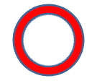
Magnetic field direction (I)
LH
RH
MO material
I
B
Light with RH and LH polarization has different propagation constants
  Different resonance wavelength
In the reverse direction, RH and LH are opposite, but the resonance wavelengths are the same
  Reciprocal
Polarization keeps changing during propagation in the ring
It’s ok for switches (JJAP), but not isolators.

Slide 19
Magnetic field direction (II)
B
Si
Si
MO
B
MO material
BOX
TE modes have different propagation constants for forward and reverse directions
Asymmetric waveguide structure in lateral direction
  Only outer ring is coated by MO material

Slide 20
Magnetic field direction (III)
I
Metal wire
B
MO
Si
Si
B
MO material
BOX
Magnetic induced by injected current
Maximum propagation constant difference for CW and CCW
No process needed for MO material after bonding or deposition
Work for TM polarization

Slide 21
Optical circulator based on ring resonators
Port 1
Port 3
Port 2
Only port 1→2 and port 2→3 are allowed
1→3, 2→1,3→1, 3→1 are all prohibited
Exactly Identical two rings are required to ensure the same resonance wavelength

Slide 22
Single mode condition for rib waveguides
W
H=0.7um
Multi-mode
Slab height
Single mode condition
Single mode
Soref, et.al., JQE, 1991

Slide 23
TE mode isolator
W=0.5um
H=0.7um
MO material
Slab height
MO material : Ce:YIG
  refractive index =2.22
  Loss: 2 cm-1

Slide 24
Waveguide design
W
H=0.7um
MO material
W=0.3um
Slab height
W=0.4um
W=0.5um
W=0.6um

Slide 25
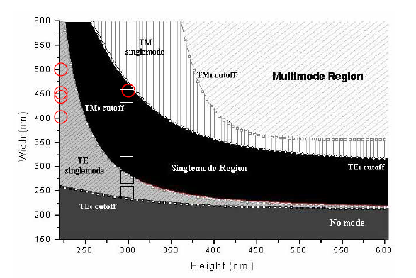
Single mode condition for rectangular waveguides
Silicon core, oxide cladding

Slide 26
TM mode isolator
W=1um
Waveguide: silicon nitride
Cladding: SiO₂
MO material : Ce:YIG
  refractive index =2.22
  Loss: 2 cm-1
H=0.4um
SiO₂

Slide 27
Integrated Optical Isolator
Input
Magneto-optic material
Si
Si
MO
BOX
B
y
B
x
Output
  Nonreciprocal phase shift
  Different propagation constants for forward and reverse directions
  Different resonance wavelengths
Magneto-optic material on the sidewall
  TE mode isolator
Magneto-optic material on the top
  TM mode isolator

Slide 28
Integrated Optical Circulator
Port 1
Port 3
B
Port 2
Cascade optical isolators
  Each resonator can consist of double-ring
Micro-heaters are required to adjust the resonance wavelength
Allowed: 1→2 and 2→3
Prohibited: 1→3, 2→1,3→1, 3→2

Slide 29
Conventional Optical Isolator
Light propagation direction
B
Magneto-optic material
(polarization rotates 45 degree)
With magnetic field parallel to the light propagation direction, right-hand and left-hand circular polarized light has different propagation constants, and thus the polarization rotates. This is so called Faraday rotator. The rotation direction is independent of propagation direction, which is always counterclockwise (or clockwise).
Placing the two polarizers in 45 degree with a 45-degree Faraday rotator in-between, only one direction of light can pass.

Slide 30
Nonreciprocal propagation constant
y
Magnetic field transverse to the light propagation constant
➔ forward and backward light has different propagation constants
➔ nonreciprocal propagation constants
x
z
Propagation direction
Magnetic field in y-direction
Magnetic field in x-direction

Slide 31
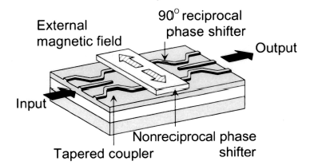
Literature example
Lateral magnetic field
TM-polarized light has nonreciprocal phase shift
Interferometer structure
  Forward: construction interference
  Backward: destructive interference
Different directions of magnetic fields on both arms shorten the required length to half
Yokoi, et. al., Applied Optics, 2003

Slide 32
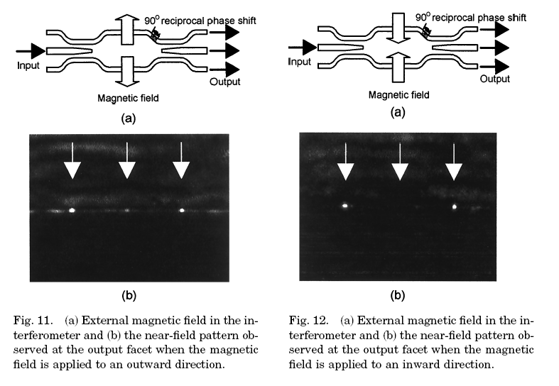
Yokoi, et. al., Applied Optics, 2000

Slide 33
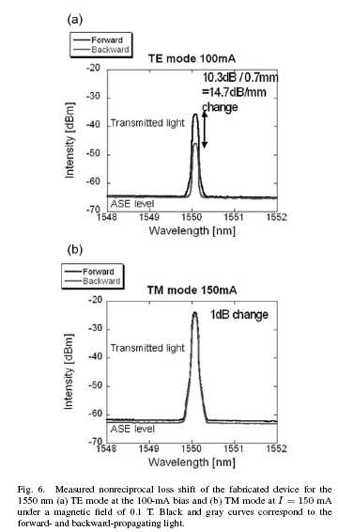
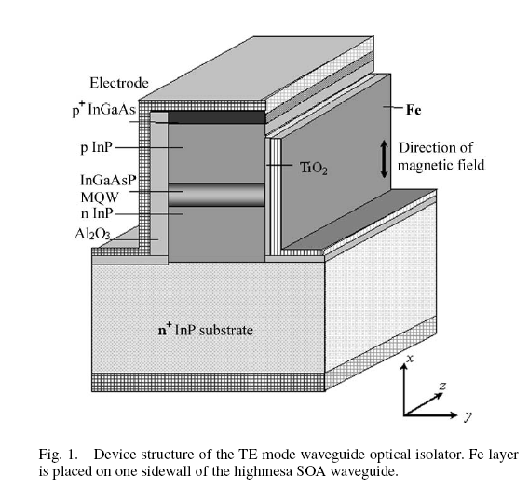
Literature of nonreciprocal loss
Shimizu, et. al., JLT, 2006

Slide 34
Summary of Nonreciprocal Propagation
y
x
z
Magnetic field
Magnetic field
Propagation direction
Propagation direction
Magnetic field
Propagation direction
θ_{F} Can be parallel or antiparallel to the magnetization
Magnetic field
The 3 right configurations all have opposite propagation constant shift compared to the original one
Propagation direction

Slide 35
Nonreciprocal propagation constant in ring resonators
Top view
Cross-section
YIG
I
Metal wire
y₁
B
YIG
B
y₀
Si
Si
y
BOX
x
y₀ and y₁ are the bottom and top boundary of the YIG layer
Magnetic field direction has to be toward the center of the ring (or outward)
Propagation constant change is proportional to field intensity difference at the boundary of the YIG layer

Slide 36
Nonreciprocal propagation constant in ring resonators
x₀
x₁
Input
Si
Si
MO
B
y
B
BOX
x
output
x₀ and x₁ are the left and right boundary of the YIG layer
Magnetic field direction has to be perpendicular to the wafer (the device)
Propagation constant change is proportional to field intensity difference at the boundary of the YIG layer

Slide 37
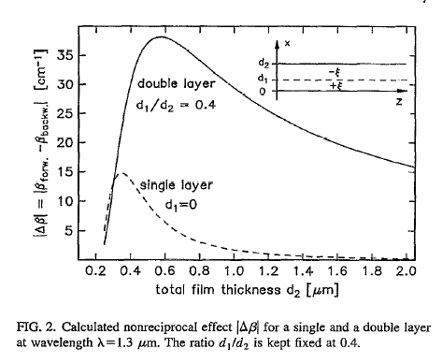
Maximize the propagation constant difference
Larger Faraday rotation (θ_{F})
Place the YIG layer in the region where field intensity is maximal
Double magneto-optic layers (+θ_{F} & -θ_{F})
Wallenhorst, et. al., JAP, 1995

Slide 38
YIG/nitride Waveguides
Since the refractive index of YIG is close to that of nitride, YIG/nitride waveguides with oxides as cladding can be designed to maximize the difference of propagation constants. Adjust the thickness of YIG and nitride to allow maximum field intensity to drop at the interface of YIG/nitride. Note YIG has larger material loss than nitride. Larger confinement factor of YIG leads to larger optical loss
W=1um
Waveguide: silicon nitride/YIG
Cladding: SiO₂
YIG optical property
  refractive index =2.22
  Loss: 20 cm-1
YIG
H=0.4um
nitride
SiO₂

Slide 39
YIG/nitride waveguide design
W=1um
YIG
H=0.4um
nitride
SiO₂

Slide 40
Rib waveguide design
W
H=0.7um
YIG
W=0.3um
Slab height
W=0.4um
MO material : Ce:YIG
  refractive index =2.22
  Loss: 20 cm-1
  thickness: 200nm
W=0.5um
W=0.6um

Slide 41
SOI rib waveguide with YIG on the sidewall
W=0.5um
H=0.7um
YIG
Slab height
MO material : Ce:YIG
  refractive index =2.22
  Loss: 20 cm-1
  thickness: 200nm

Slide 42
Plans for optical ring isolators
Magnetic material search
  Sputtering: BIG, YIG targets
  Crystal: YIG on GGG substrates (for bonding)
  Permanent magnets (linear & radial directions), metal coil to generate magnetic field
Process flow
  E-beam writing, sputtering, metalization, etc…
Waveguide design
  Silicon- or nitride-based waveguides
  geometry design (optical mode profile, confinement factor of the MO layer)
Test plans
  What if the device doesn’t work?
    small Faraday rotation
    low optical confinement in MO
    small external magnetic field
    Small Q of ring resonator
  Tunable laser +synchronized oscilloscope spectrum measurement

Slide 43
Magneto-optic material – Ce:YIG

Slide 44
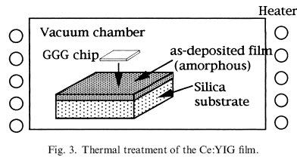
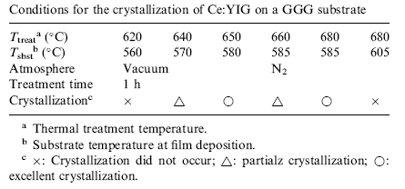
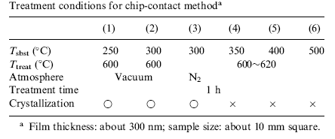
Ce:YIG on SiO₂
2001 JECS, Uno, Kaganawa Institute of Technology
low-temperature sputtering
Thermal annealing with GGG chip contact for crystallization
θ_{F}~1000 degree/cm
Epitaxial growth on GGG(100)

Slide 45
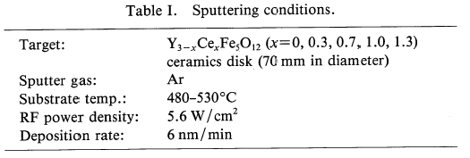
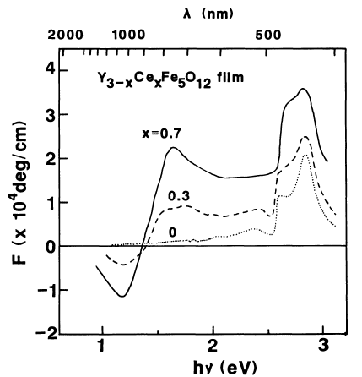
Epitaxially sputter Ce:YIG on GGG
1988 JJAP Gomi, Tokyo Institute of Technology
Epitaxially sputtering on GGG (111) when temp is above 500C
Larger Ce portion, larger Faraday rotation
No post-annealing

Slide 46
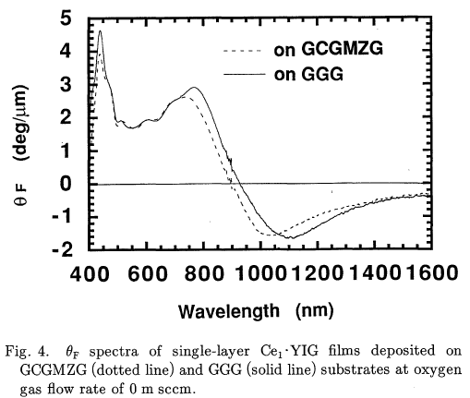
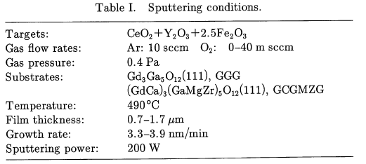
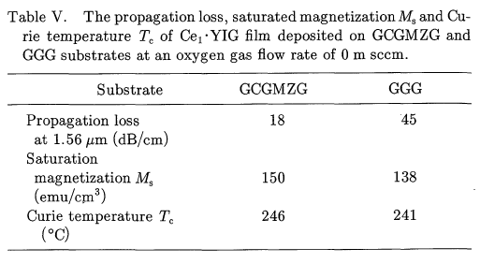
Epitaxially sputter Ce:YIG on GGG
1993 JJAP Mino, NTT
Epitaxially sputtering Ce:YIG on GGG(111)
Temp: 490C
θ_{F}~4000 deg/cm

Slide 47
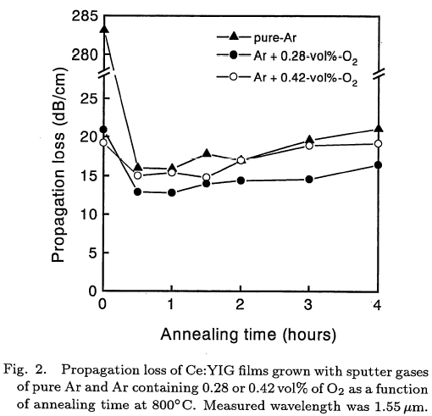
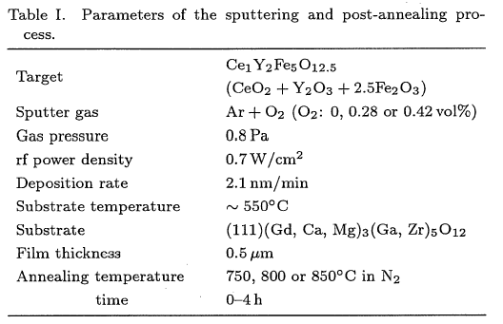
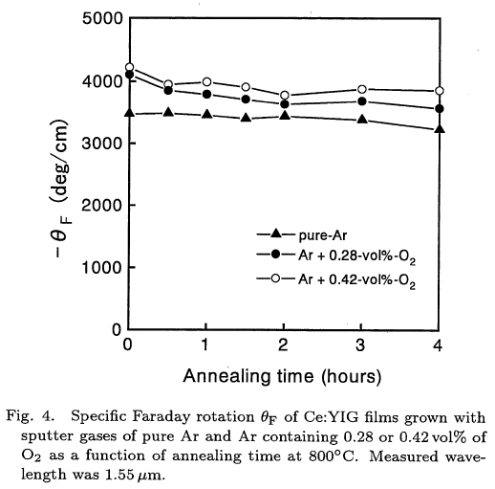
Epitaxially sputter Ce:YIG on GCGMZG
1996 JJAP Shintaku, NTT
Epitaxial growth on GGG(111) at 550C
Annealing: N2 800C, 0.5~1hr
θ_{F}~4000 deg/cm
Propagation loss ~ 15dB/cm

Slide 48
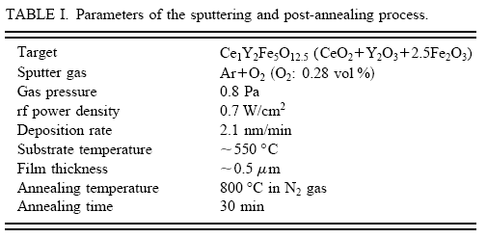
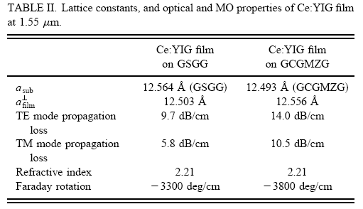
Epitaxially sputter Ce:YIG on GSGG(111)
1997 APL Shintaku, NTT
Epitaxial growth on GSGG(111) at 550C
Annealing: N2 800C, 0.5 hr
θ_{F}~3300 deg/cm
Propagation loss : TE~9.7dB/cm, TM~5.8dB/cm

Slide 49
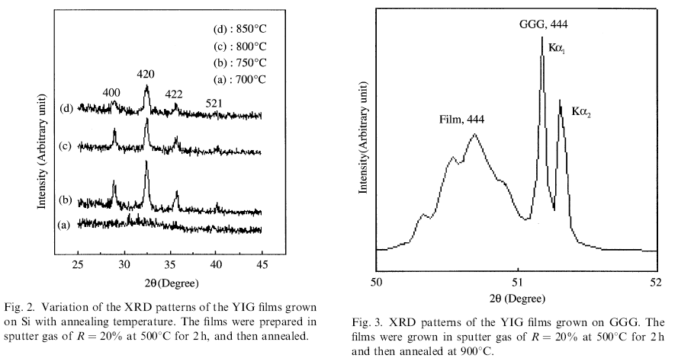
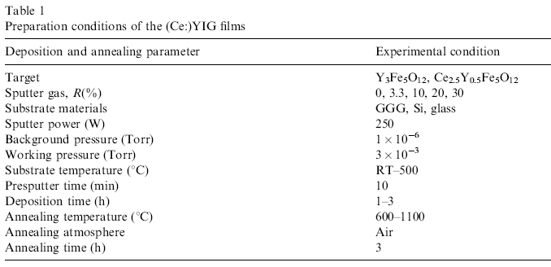
Epitaxially sputter Ce:YIG on Si & GGG(111)
2001 JMMM Cho, Inha University
Growth temperature: 500C
Annealing: 900C 2hr, air
Substrate: Si, GGG(111)

Slide 50
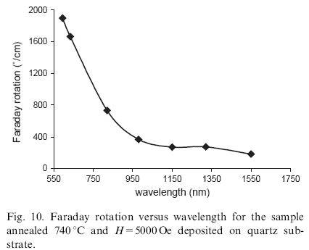
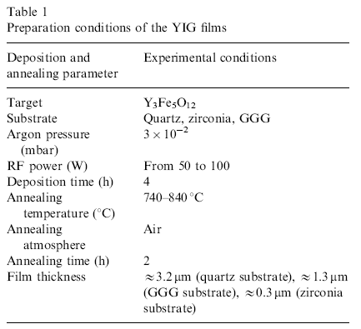
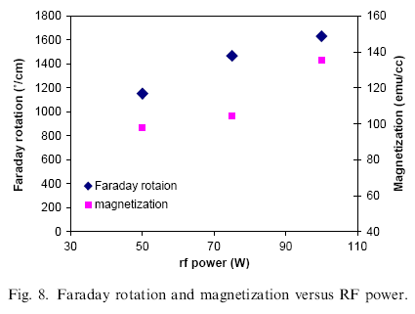
Epitaxially sputter YIG on GGG(111)
2004 JMMM Boudiar, DIOM Lab, France
Epitaxial growth of YIG
Annealing: 740C 2hr
Substrate: GGG(111)

Slide 51
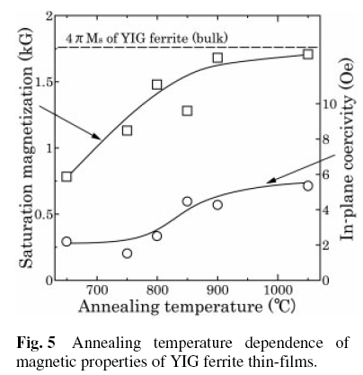
Epitaxially sputter YIG on GGG(111)
2004 phys. Stat. sol. , Yamamoto, Yamaguchi Univ.
Sputtering parameters:
Ar/O2: 2.5Pa/0.125Pa
RF power: 5.1W/cm2
Thickness: 2.5~2.8um
Substrate: GGG(111)
Temp: 400C
Annealing: Air 650~1050C

Slide 52
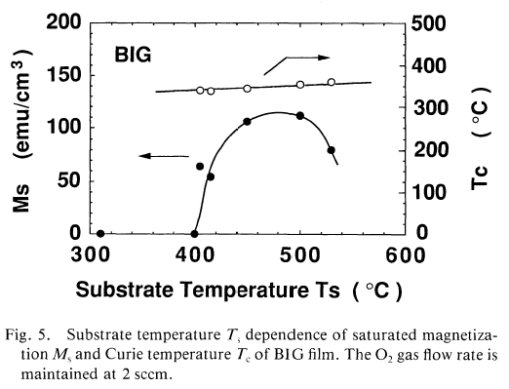
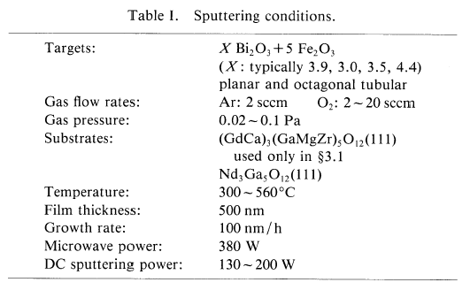
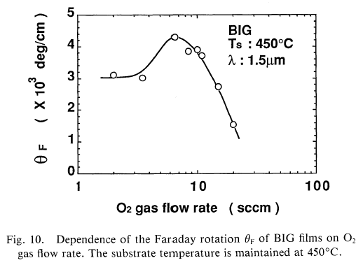
BIG sputtering on NGG
1992 JJAP , Mino, NTT
Epitaxial growth of BIG
Propagation loss : 86dB/cm (TE)
No annealing
θ_{F}:3000~4000 deg/cm

Slide 53
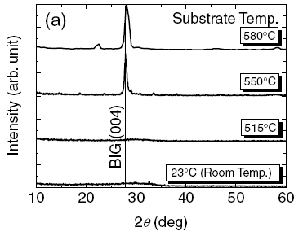
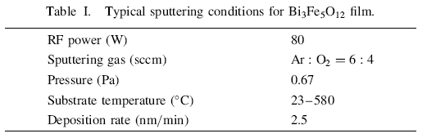
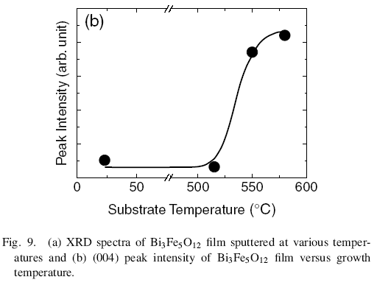
Amorphous BIG on SiO2
2008 JJAP , Taura, Hiroshima Univ.
Amorphous BIG
Propagation loss : 100dB/cm
No annealing
θ_{F}~1000 deg/cm

Slide 54
Integrated optical isolator
Hybrid laser
SOI wafer

Slide 55
Ring resonator with ferromagnetic coating
Micro-heater
SOI wafer

Slide 56
Nonreciprocal ring resonators
Ce:YIG
Output
Input
SOI

Slide 57
Process flow –post LioniX
`
`
Si3N4/SiO2 waveguides
Pattern Cr as hardmask
`
`
`
`
`
Sputter Ce:YIG or BIG magnetic material
Deep etch SiO2 and strip Cr hardmask

Slide 58
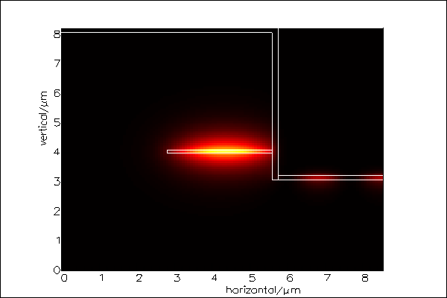
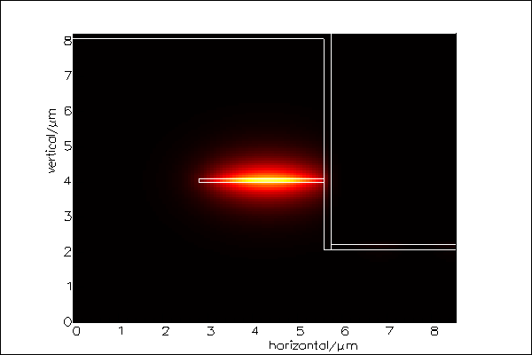
Optical modes in Si₃N₄ waveguides
Magnetic film
Magnetic film thickness : 150 nm
Si₃N₄ core
5 um etch
6 um etch
Thicker magnetic film will suck optical field from Si₃N₄ (n=2) core to Ce:YIG (n=2.22) layer.
Shallower etch causes leak mode to the horizontal magnetic film, which doesn’t contribute to Faraday effect but extra optical loss!

Slide 59
Design plot for magnetic film thickness
MO material : Ce:YIG
  refractive index =2.22
  Loss: 20 cm-1

Slide 60
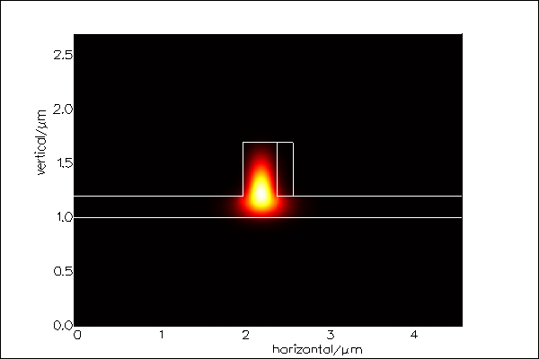
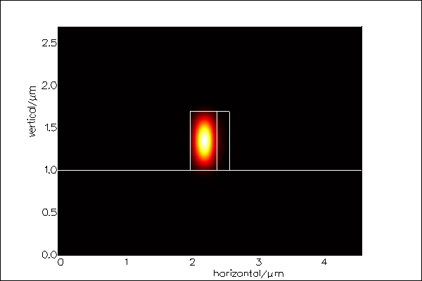
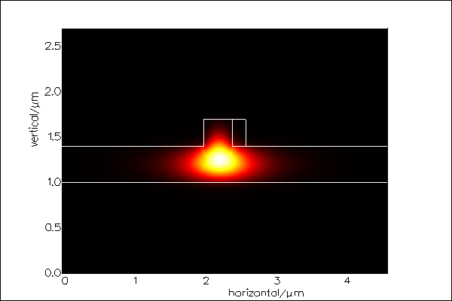
Design of Si waveguide
W
H=0.7um
Ce:YIG
Slab height
MO material : Ce:YIG
  refractive index =2.22
  Loss: 20 cm-1
  thickness: 200nm

Slide 61
Comparison between confinement factor and wavelength splitting
Analytic calculation
(rectangular waveguide like)
FIMMWAVE calculation
W=0.3um
W=0.4um
W=0.5um
W=0.6um

Slide 62
Optimization of Coupling
Loss=1000 *Г_{MO}
Faraday: 0.24nm*Г_{MO}
Г_{MO} =20%
Insertion loss is independent of resonator loss
Isolation is dependent on confinement factor; the higher, the better.

Slide 63
Table of coupling gap
Confinement of MO: 20%
Loss of MO: 1000/m
Radius | Resonator loss | WG-ring coupling gap | Ring-ring coupling gap
50 um | 0.0609
75 um | 0.0899
100 um | 0.1181
150 um | 0.1718
200 um | 0.2222
Need FIMMWAVE simulation

Slide 64
0.4um WG width
0.7um WG height
0.2um rib height
Confinement of MO: 20%
Simulation coupling length: 15um
WG-ring
 | 0.2um gap | 0.4um gap | 0.5um gap | 0.6um gap
50um | 0.5/0.128 | 0.1128/0.002 | 0.0509/2.46*10^-4 | 0.0229/3*10^-5
75um | 0.651/0.1772 | 0.162/2.83*10^-3 | 0.07/3.47*10^-4 | 0.0297/4.2*10^-5
100um | 0.766/0.253
ring-ring
 | 0.2um gap | 0.3um gap | 0.4um gap | 0.5um gap
50um | 0.35/0.0556 | 0.157/0.007 | 0.0475/9.9*10^-4 | 7*10^-3/1.57*10^-4
75um | 0.399/0.074 | 0.267/0.0125 | 0.0618/0.00128 | 0.0342/1.81*10^-4
100um

Slide 65
Influence of Confinement Factors
Parameters for calculation
Kapa_{WG}=gama_{ring}
Kapa_{ring}= gama_{ring}
Loss=1000 *Г_{MO}
Faraday: 0.24nm*Г_{MO}
Large confinement factor of magnetic film results in higher isolation ratio

Slide 66
Single ring optimization
Faraday: 0.24nm*Г_{MO}
Г_{MO} =20%
20dB/cm
30dB/cm
40dB/cm
50dB/cm
Through port
Drop port

Slide 67
Single ring optimization
Faraday: 0.24nm*Г_{MO}
Г_{MO} =20%
10dB/cm
20dB/cm
Drop port
30dB/cm
40dB/cm
50dB/cm

Slide 68
Influence of confinement factor
Faraday: 0.24nm*Г_{MO}
Loss=2000* Г_{MO}
40%
30%
20%
10%
Through port
Drop port

Slide 69
Single-ring
Q=10⁶
300 nm
Ce:YIG
Si
700 nm
Isolation ratio (dB)
Q=10⁵
BOX
y
x
Q=10⁴
Δλ=78pm
κ_{WG}/γ_{ring}
κ_{WG}=0.5γ_{ring}
κ_{WG}= γ_{ring}
κ_{WG}=2γ_{ring}
Insertion loss (dB)
Isolation ratio (dB)
Isolation ratio (dB)
κ_{WG}=0.5γ_{ring}
κ_{WG}= γ_{ring}
κ_{WG}=2γ_{ring}
κ_{WG}/γ_{ring}
Q factor
Q factor

Slide 70
Double-ring
Q=10^5
Δλ=78pm
κ_{WG}=γ_{ring}
κ_{WG}=γ_{ring}
κ_{WG}=2 γ_{ring}
κ_{WG}=2 γ_{ring}
κ_{WG}=3 γ_{ring}
κ_{WG}=3 γ_{ring}
Isolation ratio (dB)
Insertion loss (dB)
κ_{ring}/γ_{ring}
κ_{ring}/γ_{ring}

Slide 71
Double-ring
300 nm
Ce:YIG
Si
700 nm
Δλ=78pm
κ_{WG}= κ_{ring}= κ
BOX
y
x
Δλ=78pm
κ / γ_{ring} | IL (dB)
1 | 7.96
2 | 4.22
3 | 2.85
4 | 2.15
5 | 1.73
κ=γ_{ring}
κ=2 γ_{ring}
κ=3 γ_{ring}
κ=4 γ_{ring}
Isolation ratio (dB)
κ=5 γ_{ring}
κ=γ_{ring}
Isolation ratio (dB)
κ=2 γ_{ring}
κ=3 γ_{ring}
κ=4 γ_{ring}
κ=5 γ_{ring}
Q factor
Q factor

Slide 72
Influence of Q factor
Δλ=78pm
Q=10^5
Double-ring:κ_{WG}= κ_{ring}=γ_{ring}
Single-ring:κ_{WG}= γ_{ring}
Double-ring
Double-ring
Single-ring
Single-ring
Isolation ratio (dB)
Isolation ratio (dB)
Q factor
Q factor

Slide 73
Influence of Faraday coefficient
Δλ=78pm
Q=10^5
Double-ring:κ_{WG}= κ_{ring}=γ_{ring}
Single-ring:κ_{WG}= γ_{ring}
Double-ring
Single-ring
Isolation ratio (dB)
Isolation ratio (dB)
Isolation ratio (dB)
Faraday coefficient (deg/cm)
Faraday coefficient (deg/cm)
Faraday coefficient (deg/cm)

Slide 74
Ce:YIG Characterization
From Si substrate
Sample 1)
400C
Ar/O2=20/0sccm
Power: 300W
Pressure: 6mT
Time: 2hr
(400)
Sample 2)
500C
Ar/O2=50/0.25sccm
Power: 300W
Pressure: 6mT
Time: 2hr
(620)

Slide 75
Ce:YIG Characterization
RTA annealing:
800C 5 min
Ramp: 2 min
(400)
(620)
Ps: extra RTA annealing at 800C for 30 min does help.

Slide 76
450C
Ar/O2=20/0sccm
Power: 300W
Pressure: 6mT
Time: 2hr
chamber pressure: 1.5e-6 -> 7e-7
RTA annealing:
800C 5min +
900C 10min

Slide 78
CeYIG at room temperature
Res: 0.02deg, int. time: 0.3sec
Res: 0.05deg, int. time: 2sec
Room temperature
Ar/O2=16/0sccm
Power: 200W
Pressure: 3mT
Time: 2hr
chamber pressure: 3.5e-7 Torr
RTA annealing:
800C, 850C, and 900C 10 min
Ramp: 5 min

Slide 79
Sputtering recipe for Si disks
Sputtering recipe for Si disks
Res: 0.05deg, int. time: 2sec
Sample clean: BHF/Piranha
Room temperature sputtering
Ar/O2=16/0sccm
Power: 200W
Pressure: 3mT
Time: 3min/2hr
chamber pressure: 4.6e-7 Torr
900C RTA annealing for 10 min
(420)
(400)
Run seasoning recipe for 10/20 min

Slide 80
CeYIG: 500C
500C
Ar/O2=50/0.25sccm
Power: 300W
Pressure: 6mT
Time: 2hr
chamber pressure:1.6e-6->7.8e-7
RTA annealing:
800C, 850C, and 900C 10 min
Ramp: 5 min

Slide 81
CeYIG: 520C
520C
Ar/O2=50/0.25sccm
Power: 300W
Pressure: 6mT
Time: 2hr
chamber pressure: 1.3e-6 -> 8.5e-7
RTA annealing:
800C 5min +
900C 5min

Slide 82
CeYIG:520C
520C
Ar/O2=50/0.25sccm
Power: 300W
Pressure: 6mT
Time: 2hr
chamber pressure: 1.4e-6 -> 6.3e-7
RTA annealing:
800C, 850C, and 900C 10 min
Ramp: 5 min

Slide 83
CeYIG: 550C
550C
Ar/O2=50/0.25sccm
Power: 300W
Pressure: 6mT
Time: 2hr
Note: chamber pressure was high during heating (10⁻⁵ Torr)!
RTA annealing:
750C, 850C, and 1000C 5 min
Ramp: 2 min

Slide 84
CeYIG: 550C
550C
Ar/O2=50/0.25sccm
Power: 300W
Pressure: 6mT
Time: 2hr
chamber pressure:4.5e-6 -> 7.5e-7
RTA annealing:
800C, 850C, and 900C 10 min
Ramp: 5 min

Slide 85
CeYIG: 600C
600C
Ar/O2=50/0.25sccm
Power: 300W
Pressure: 6mT
Time: 2hr
chamber pressure: 5e-6 -> 2e-6
RTA annealing:
800C, 850C, and 900C 10 min
Ramp: 5 min

Slide 86
Annealing Time
10 min of annealing time is sufficient for crystallization

Slide 87
NRPS in Microdisk Resonator
MO
Si
BOX
B
Disks with smaller radius push the optical mode outward and thus increase confinement factor of MO.
Trade-off between the bend loss and confinement factor of MO
One step litho and no need to etch MO
Oxide hardmask is used to prevent mode overlap with the top MO, which increases optical loss

Slide 88
Fabrication process- disk isolator
Si
Si
BOX
BOX
Ebeam lithography
Waveguide and disk etch
Ce:YIG MO sputtering
thermal annealing for crystallization

Slide 89
Fabrication process- ring isolator
Waveguide
Ring
BOX
BOX
Ring and waveguide Patterning by e-beam and dry etch
Ce:YIG MO sputtering
Two-step e-beam lithography and etching
Ce:YIG etching -
BOX
remove Ce:YIG on the outer ring

Slide 90
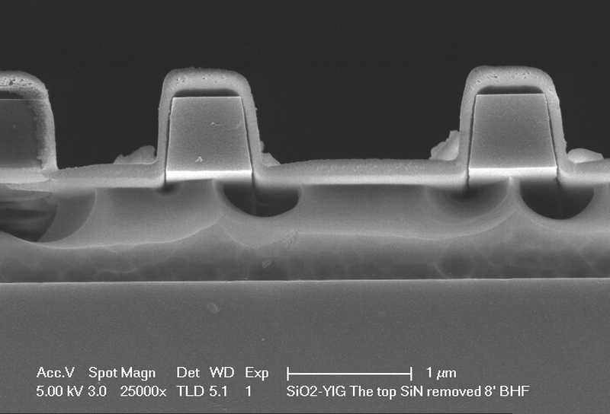

Slide 91
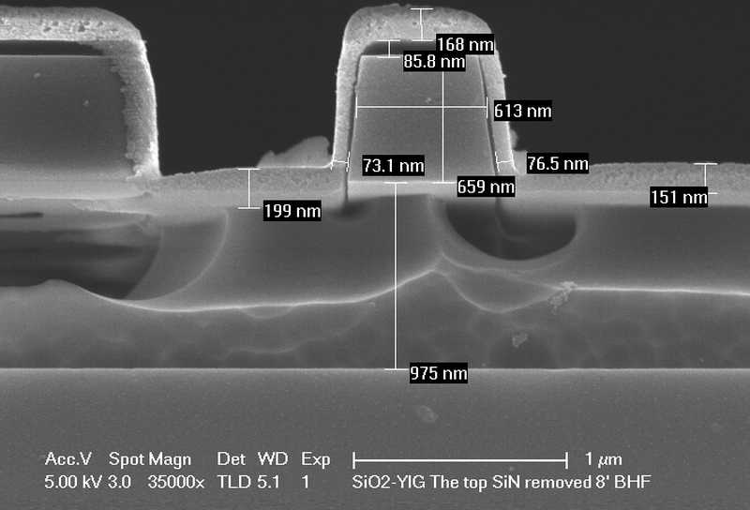

Slide 92
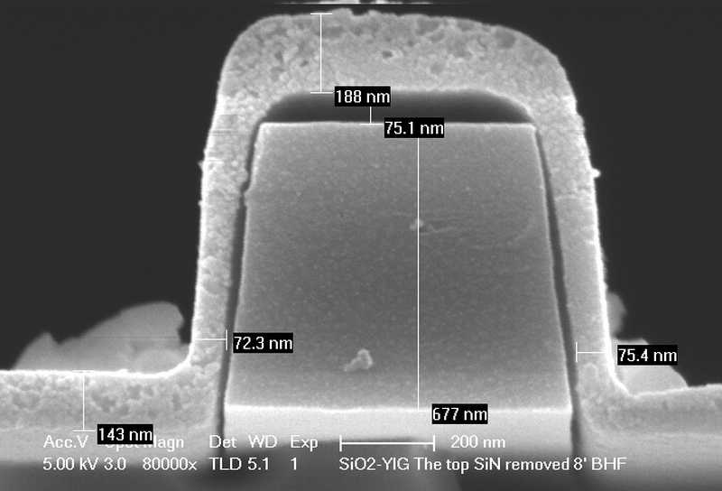

Slide 93
Polarization controlling setup:
Free space
Polarization rotator
Objective or lens
Laser
PD
PD
PC
DUT
polarizer
½ λ plate
analyzer
Order list:
Two Thin film polarizers mounted on rotators
Half-lambda plate mounted on a rotator
Large-area PD
Two objectives and lens for waveguide coupling
Two collimators for fiber-free space coupling

Slide 94
Polarization controlling setup:
In-fiber
PM lensed fiber
SM fiber
Laser
OSA
PC
In-line polarizer
rotator
DUT
Precisely-aligned
PM-PM adapter
Order list:
in-fiber polarizer: Thorlabs, Oz Optics
PM lensed fiber: OZ-optics
Rotator stage: Thorlabs
Precisely-aligned adapter
Thin-film polarizer mounted on a rotator
Large-area PD
PD
large-area PD
analyzer
Polarization analyzer

Slide 95
Uni-directional ring laser
Cross-sectional view
III-V gain medium
III-V gain medium
III-V gain medium
Non-reciprocal ring resonator
MO
SOI wafer
y
BOX
x
Nonreciprocal ring resonator with different gain/loss in different directions
Bonded III-V material provides the required gain.
Lasing only happens in either clockwise or counterclockwise direction

Slide 96
Uni-directional ring laser
P contact
N contact
y
MO
BOX
x
Based on Di’s ring laser structure
More optical confinement for small ring laser
Cavity is defined by III-V region

Slide 97
Nonreciprocal Loss
B
III-V gain medium
y
BOX
x
Non-diagonal dielectric tensor
  Ce:YIG: i8.6E-3
  InGaAs: i2.7E-4
  Fe: 3.15+1.8i
Г_{MO} increases ➔ Δα increases ➔ propagation loss increases
but Г_{QW} increases ➔ modal gain decreases
Trade-off between Г_{MO} and Г_{QW} .
Calculate the relation between Δα and threshold by adjusting the waveguide width

Slide 98
Sputtering recipe for Si disks
Sputtering recipe for Si disks
Res: 0.05deg, int. time: 2sec
Sample clean: BHF/Piranha
Room temperature sputtering
Ar/O2=16/0sccm
Power: 200W
Pressure: 3mT
Time: 3min/2hr
chamber pressure: 4.6e-7 Torr
900C RTA annealing for 10 min
(420)
Film thickness: 180nm
(400)
Run seasoning recipe for 10/20 min

Slide 99
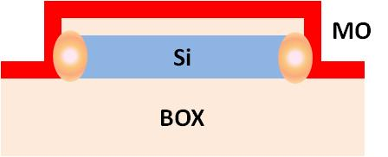
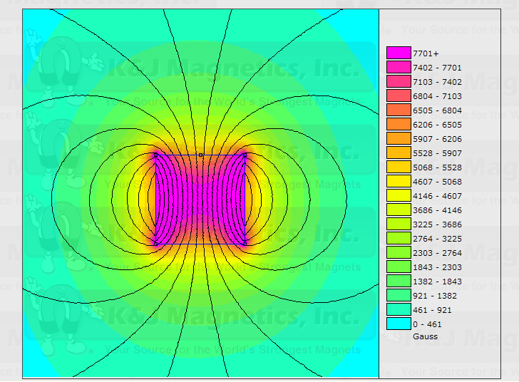
Measurement setup
Tunable laser
N
Polarization controller
magnet
Field distribution of the permanent magnet
synchronized
S
Power meter
Surface intensity: 5754 Gauss
0.5”
0.5”

Slide 100
Transmission spectrum of disk
Lots of high order resonance spectra because of multi modes of the disk
350nm
3um
Waveguide-disk gap: 125nm
Magnetic field ~ 3000 (Gauss)
Optical input is TE-polarized
Q : 2000~3000
Reverse the direction of the magnetic field and observe the spectra again
72.6 nm

Slide 101
Two resonance spectra
Magnetic field ~ 3000 (Gauss)
Optical input is TE-polarized
Q : 2000~3000
Reverse the direction of the magnetic field and observe the spectra again
No obvious resonance shift ( within 30pm)
Cross-section of the disk
B

Slide 102
Permanent magnet specification
Dimensions: 1/2" x 1/2" x 1/2" thick
Tolerances: ±0.004" x ±0.004" x ±0.004"
Material: NdFeB, Grade N42
Plating/Coating: Ni-Cu-Ni (Nickel)
Magnetization Direction: Thru Thickness
Weight: 0.542 oz. (15.37 g)
Pull Force, Case 1: 18.71 lbs
Pull Force, Case 2: 21.64 lbs
Surface Field: 5754 Gauss
Max Operating Temp: 176ºF (80ºC)
Brmax: 13,200 Gauss
BHmax: 42 MGOe
0.5”
0.5”

Slide 103
Spectra with magnetic field
Resonance wavelength shift is within measurement error
Temperature effect: ~80pm/C
1510.59nm (field upward)
1510.63 nm (field downward)
1510.605nm (field upward)

Slide 104
Conclusions
Failure analysis
  Material issue: crystallinity, saturation magnetization
The optical field is highly confined in the disk. Even for 3um-diameter disk, the resonance shift is within 30pm, which is difficult to see for the resonator of Q on the order of 1000.
It is better to have resonance shift ~ 100 pm. 200-nm-width ring can reach it theoretically.
CeYIG is poly-crystalline with preferred orientation direction in (420)
Temperature effect on resonance : 80pm/C
  Need to control the temperature variation within 0.1C
Non-ferromagnetic fiber holder to make the setup more stable

Slide 105
SiN isolator
`
`
Thin down the top SiO2 cladding
- BHF: 35 min (remove 4um SiO2)
Pattern Cr as hardmask
- pattern nLOF2020
- deposit Cr in EB1
- lift-off
`
`
`
`
`
Sputter Ce:YIG magnetic material
Deep etch SiO2 and strip Cr hardmask
- etch SiO2 in ICP2
- remove Cr in ICP2

Slide 106
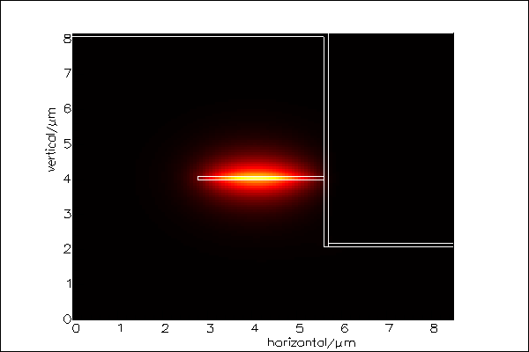
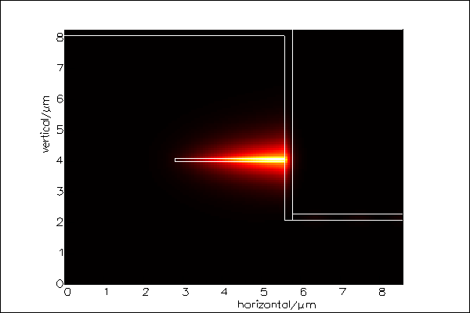
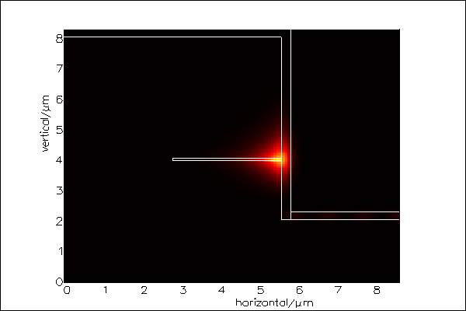
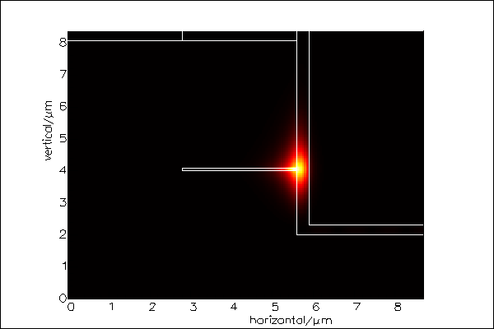
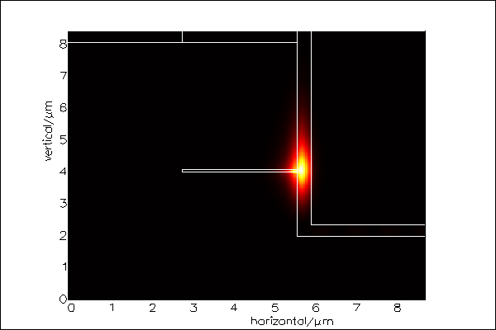
Confinement in YIG layer
*Film thickness/ confinement factor
100nm/0.65%
150nm/1%
200nm/4.4%
250nm/15.6%
300nm/35.9%
350nm/ 53%
The optimal YIG thickness is between 250 nm and 300 nm. In that case, the optical peak intensity is located on the boundary of the films. The drawback is that the scattering loss is also maximized.

Slide 107
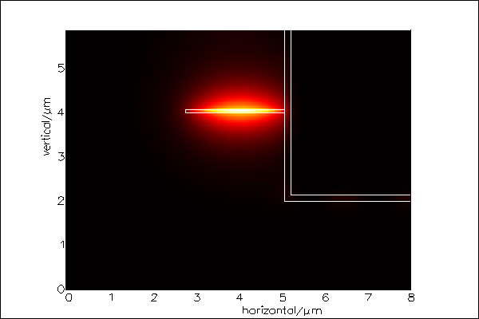
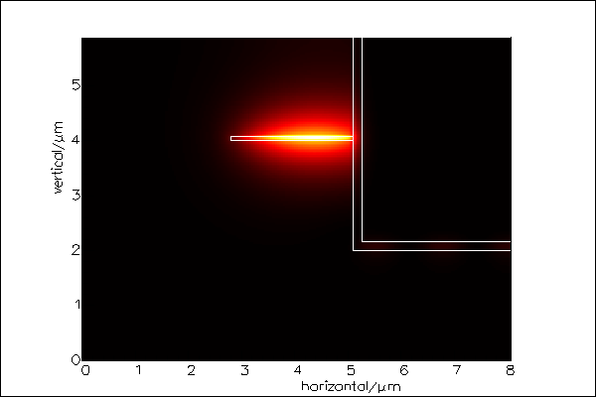
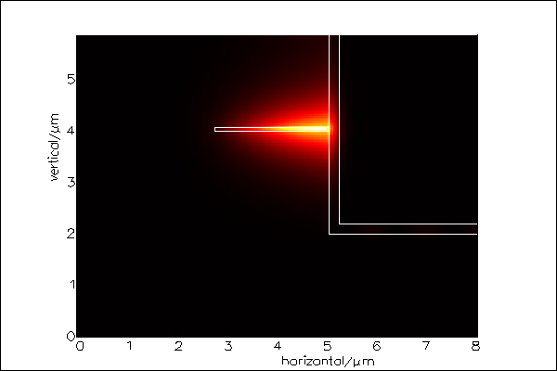
Confinement in YIG layer
WG width : 2.3 um
WG thickness: 90 nm
CeYIG thickness/ confinement factor
150nm/1.3%
175nm/2.1%
200nm/4.7%

Slide 108
Transmission spectrum comparison before and after thinning the top cladding
Lc=25um
Lc=50um
Limited by PD dark current
Lc=75um
Lc=100um
Transmission spectra are similar before and after top cladding thinning down
Different measurement setups are used for the 2 measurements

Slide 109
Nonreciprocal propagation constant in ring resonators
Top view
Cross-section
YIG
I
Metal wire
y₁
B
YIG
B
y₀
Si
Si
y
BOX
x
y₀ and y₁ are the bottom and top boundary of the YIG layer
Magnetic field direction has to be toward the center of the ring (or outward)
Propagation constant change is proportional to field intensity difference at the boundary of the YIG layer

Slide 110

How to apply radial magnetic field?
Permanent magnet
CeYIG
1.6 mm
0.8 mm
CeYIG
Si
Si
Ring resonator
BOX
The diameter of the ring matches that of the cylinder magnet
- magnet: 1.6 mm
- ring: 1.8mm
Material of ring can be Si or SiN
Better quality of CeYIG can be bonded to ring resonator

Slide 111
Ring resonators with horizontal YIG film
Approach 1)
Wafer bond YIG-film on to Si ring resonators
Approach 2)
Fabricate a-Si ring resonators on the GGG substrate with YIG
GGG
Si
Si
a-Si
a-Si
BOX
GGG
YIG-Si bonding needs to be developed.
Low-loss a-Si waveguide is required.

Slide 112


Optical Mode Calculation
CeYIG
A
A
A’
Si
BOX
GGG
GGG
CeYIG
Si
BOX
A’
0.5um CeYIG on GGG substrate
Bond CeYIG to the Si waveguide on SOI
Si waveguide: 0.8um * 0.2um
Peak intensity of the optical mode is close to the interface of CeYIG and Si waveguide

Slide 113



a-Si waveguide on Ce:YIG
a-Si
CeYIG
GGG sub.
0.5um CeYIG on GGG substrate
0.8um * 0.2um a-Si waveguide

Slide 114

Ce:YIG bonded to SOI
GGG
CeYIG
Si
BOX
0.5um CeYIG on GGG substrate
Bond CeYIG to SOI Si waveguide
Si waveguide: 0.8um * 0.2um

Slide 115



Ce:YIG bonded to SOI
A’
GGG
CeYIG
Si
BOX
A
A
A’
0.5um CeYIG on GGG substrate
Bond CeYIG to SOI Si waveguide
Si waveguide: 0.6um * 0.2um
Resonance wavelength split: 0.37nm

Slide 116



Ce:YIG bonded to SOI
A’
GGG
CeYIG
Si
BOX
A
A
A’
0.5um CeYIG on GGG substrate
Bond CeYIG to SOI Si waveguide
Si waveguide: 0.6um * 0.25um

Slide 117



A’
GGG
CeYIG
Si
BOX
A
A
A’
0.5um CeYIG on GGG substrate
Bond CeYIG to SOI Si waveguide
Si waveguide: 0.6um * 0.3um

Slide 118
Faraday Effect
Resonance wavelength shift 0.37nm as Ce:YIG is 0.5 um thick
10X larger than that in Si disk

Slide 119

Coupling calculation by FIMMPROP
0.5um CeYIG on GGG substrate
Bond CeYIG to SOI Si waveguide
Si waveguide: 0.6um * 0.2um
Radius : 1 mm

Slide 120

Device layout
CeYIG on GGG
Magnet
1.8mm
5mm
4mm
1.6mm
4mm

Slide 121
Advantages:
  > 10X wavelength split than that on Si disks
  Better CeYIG quality because of lattice match, similar thermal expansion coefficient, and same crystal structure
Challenge:
  Bonding between CeYIG and silicon waveguides
Potential issue:
  A large ring is not a resonator anymore if the waveguide loss is too high

Slide 126
Im-balanced MZI Test Structure
L1
ΔL=290um
Δn=7e-4 ➔ Δλ~0.5nm
L2
External magnetic field
As a test pattern to measure Faraday coefficient
Easy to apply external magnetic field
Waveguide loss doesn’t matter

Slide 127





3dB MMI
14.25 um
4 um
2.2um
FIMMWAVE calculation
FIMMPROP calculation
0.8um
TM
input
output
TM transmission: 82.1%
TE transmission: 83.3%

Slide 128





3dB directional coupler
R=1000um
WG: 800nm x 190nm
g=395nm
48%
0.43%
47.6%
98%

Slide 129




240 nm thick Si layer
WG: 600 nm x 240 nm
Intensity distribution
TE
TM
Air
BOX
ng=3.98
ng=4.35
TE
TM
GGG
YIG
BOX
ng=3.8
ng=3.54

Slide 130


240 nm thick Si layer
WG: 600 nm x 240 nm
TM mode Hx field
YIG
GGG

Slide 131



236nm
ng=3.66
TE
ng=3.6
Hx
TM

Slide 132


236nm

Slide 133




295 nm thick Si layer
WG: 600 nm x 295 nm
Intensity distribution
TE
TM
Air
BOX
ng=3.97
ng=4.68
TE
TM
GGG
YIG
BOX
ng=3.85
ng=3.86 (0.15um YIG)
ng=3.88
ng=3.97 (0.15um YIG)

Slide 134


295 nm thick Si layer

Slide 135


295 nm thick Si layer
WG: 600 nm x 295 nm
TM mode Hx field
YIG
GGG

Slide 136



295nm
ng=3.8
TE
Hx
ng=4.17
TM

Slide 137


295nm

Slide 138

SOI bonded with CeYIG
Si WG: 600 nm x 240 nm
YIG: 0.5um
R=0.9mm
TM
TE

Slide 139

SOI bonded with CeYIG
Si WG: 600 nm x 295 nm
YIG: 0.5um
R=0.9mm
TM
TE

Slide 140
SOI bonded with CeYIG
Si WG: 600 nm x 240 nm
YIG: 0.5um
R=20um

Slide 141

SOI bonded with CeYIG
Si WG: 600 nm x 295 nm
YIG: 0.5um
R=20um

Slide 142

MMI design
Si WG: 600 nm x 295 nm
YIG: 0.5um
8.25 um
3um
1um
Transmittance: TM: 92.4%, TE: 86.1%

Slide 143

MMI design
Si WG: 600 nm x 240 nm
YIG: 0.5um
8um
3um
1um
Transmittance: TM: 91%, TE: 85%

Slide 144




Process of isolator on 90-nm-thick SiN ring
200 nm Cr lift-off by AZ5214E on 9.6um oxide
After 1 um oxide etch using Cr as hardmask
After 3.5 um oxide etch using Cr as hardmask

Slide 145


Process of isolator on 90-nm-thick SiN ring (cont.)
After oxide deep etch and Cr hardmask stripping
Alignment accuracy is within +-0.2um
Some residual may come from litho or lift-off process

Slide 146
Deep etch single side of rings
1.6um
1.83um
LioniX: W35-90nm
Coupling length: 150um
Loss: 1.45 dB/cm
WG-ring coupling: 1.5%

Slide 147
Deep etch single side of rings
Before etch
After etch
Waveguide loss increases from 0.04 dB/cm to 1.45 dB/cm

Slide 148
Deep etch single side of rings
Lc=75um
Loss: 14.3 dB/cm
WG-ring coupling: 0.86%
Lc=125um
Loss: 1.46 dB/cm
WG-ring coupling: 0.6%
Lc=175um
Loss: 10.6 dB/cm
WG-ring coupling: 1.1%

Slide 149
Failure Mode Analysis
LioniX 90nm SiN waveguide
  Transmitted power degrades dramatically
    Power is not guided in the WG?
    Upper CeYIG sucks all the power and absorbs?
    Partially remove CeYIG in H3PO4 (40C)
  No ring resonance
    Power is not in the WG and no coupling to the ring
    Too much overlap with CeYIG
    Different modes of ring and straight WGs
Si ring isolator
  Poor fiber-WG coupling
    Try Di’s setup with top IR imaging
    1um spot-size lensed fibers (coming this Thursday)
    Thicker device layer (done this week)

Slide 150

90nm
ng=3.8
150nm
86nm
FP_FSR: 88 pm
Q=40,000
Loss=21dB/cm

Slide 151
120nm

Slide 152
150nm

Slide 153
900um ring
Loss=23 dB/cm (k=65%, r=95%), Fimmprop: 30%
Loss=10.6 dB/cm (k-10%, r=75%), Fimmprop: 8.3%

Slide 154

Chip 2 – Asymmetric MZI
Si rectangular waveguide
- WG height: 295 nm
Length difference between 2 arms: 313um
ASE and OSA was used for measurement
No ring resonance spectra was observed because of over-large coupling gap due to over etch
50% TE (n_{g}=4) and 50% TM (n_{g}=4.68)
Calculation
ASE+OSA spectra
Measurement

Slide 155
Chip 2 – Asymmetric MZI
Tunable laser wavelength scanning
TE
TM

Slide 156
After sputtering Ce:YIG
150nm CeYIG
2 hr RT sputtering + 900C 10min RTA

Slide 157
Asymmetric MZI-295nm

Slide 158
Asymmetric MZI-236nm

Slide 159
Asymmetric MZI-236nm
By OSA
RB: 60pm
Sensitivity: -90dBm
RB: 60pm
Sensitivity: -92dBm

Slide 160
20um rings -236nm

Slide 161
Asymmetric MZI- 295nm

Slide 162
Asymmetric MZI- 295nm
By OSA

Slide 163
20um rings – 295nm

Slide 164
Waveguide Loss
Before Ce:YIG sputtering, 236nm TE
 | 90nm | 120nm | 150nm
Kappa | 0.055 | 0.041 | 0.032
loss | 21dB/cm | 25dB/cm | 31.8dB/cm
After Ce:YIG sputtering
236nm TE, Г_{YIG}=14%
 | 60nm | 90nm | 120nm | 150nm
Kappa | 0.42 | 0.1 | 0.06 | 0.05
loss | 60dB/cm | 261dB/cm | 64dB/cm | 68dB/cm
295nm TM, Г_{YIG}=26.5%
 | 60nm | 80nm
Kappa | 0.09 | 0.024
loss | 113dB/cm | 56dB/cm

Slide 165
GGG vs SGGG
SGGG peak is closer to that of Ce:YIG ➔ closer lattice constant

Slide 166
Ce:YIG on GGG
RT sputtering for 2 hr (150nm) + 900C RTA 10min
GGG substrate
(444)
(400)

Slide 167
Ce:YIG on GGG
RT sputtering for 2 hr (150nm) + 900C RTA 10min
GGG substrate is thinned down
GGG sub.?

Slide 168
Ce:YIG on SGGG

Slide 169
Magnetization of Ce:YIG
RT sputtered Ce:YIG (0.2um) on GGG (5mm by 5mm) and 900C 10min RTA
In-plan magnetization at room temperature
Magnetization of Ce:YIG and GGG substrate
Magnetization of Ce:YIG only (subtract GGG contribution)
Paramagnetic GGG
Ce:YIG thin film saturates at external magnetic field of 10 gauss

Slide 170


IR Camera
1519 nm
With magnetic field
Without magnetic field
Output PBS allows TM to transmit
Minimize TM output

Slide 171




IR image at MZI output
Magnetic field direction
objective
TL
CCD
Lensed fiber
MZI
polarizer
Wavelength : 1519nm
Magnetic field in north
No magnetic field
Magnetic field in south

Slide 172
Transmission spectra of MZI
Input polarization: TM
Magnetic field direction
Power meter
TL
Lensed fiber
MZI
When input wavelength is fixed, the transmitted power difference between north and south direction magnetic field is about 3~5 dBm
Wavelength split (0.1nm) is much smaller than calculated value (0.4nm).

Slide 173


Temporal response of MZI
1520.05 nm
25C
Surface magnetic field of electromagnet: 200~300 Gauss
TM
TE

Slide 175
X-ray Diffraction of Ce:YIG
0.5um Ce:YIG on SGGG(111) from Mizumoto’s group
XRD resolution: 0.01 deg
Kα1
Kα2
SGGG (444)
Ce:YIG (444)

Slide 176
Magnetization of Ce:YIG
Measured by SQUID at room temperature (in-plane direction)
0.5um Ce:YIG from Mizumoto’s group
0.2um Ce:YIG grown at UCSB
Saturation H-field ~50 Oe
Saturation H-field ~10 Oe

Slide 177
60 107 113 116
84 139 -- --
108 162 -- --
156 217 -- --
204 261 271 269
396 465
600 574
702 674
804 781
900 887

Slide 178
MZI-type Isolator
B field
ΔL=343um
ΔL=343um
B field
Comparison is based on the same Faraday coefficient (Δn=1e-4)

Slide 179
B field
ΔL=10um

Slide 180
MZI: ΔL=282um
FSR~1.7 nm
ng ~5
FSR~2nm
ng ~4.3

Slide 181
Design plot for coupling gap
900um ring to straight waveguide coupling design
295 nm thick SOI

Slide 182
FSR (TM) ~ 84pm (ng~5)

Slide 183
900um ring 144 nm gap
Ring radius: 900um
Coupling gap: 144nm
Extinction ratio ~ 4dB
TM mode
Radiation direction magnetic field
Before Ce:YIG bonding
After Ce:YIG bonding

Slide 184
900um ring 192 nm gap
Ring radius: 900um
Coupling gap: 192nm
Extinction ratio ~ 6dB
TM mode
Radiation direction magnetic field
Before Ce:YIG bonding
After Ce:YIG bonding
Isolation ratio ~ 6dB

Slide 185


Magnetic optical switch
Ring radius: 900um
Isolation ratio ~ 9dB
TM mode
Magnetic field intensity ~ 200 Gauss
IR near-field image

Slide 186
Tunable magnetic optical filter
Ring radius: 900um
Coupling gap: 144nm
Extinction ratio: 4~5dB
TM mode

Slide 187
Tunable magnetic optical filter
Ring radius: 900um
Coupling gap: 192nm
Extinction ratio: 9 dB
TM mode

Slide 188


Ring isolator
Ring radius: 900um
Waveguide dimension: 600 nm x 300 nm
Ce:YIG: 0.5um
Isolation ratio ~ 9dB
TM mode
Magnetic field intensity ~ 200 Gauss
Near field IR image

Slide 189
NRPS calculation
Si waveguide thickness: 300 nm
Ce:YIG thickness: 500 nm

Slide 190


NRPS calculation
Si thickness: 200nm
Narrower waveguides confine less power at the Si-garnet interface

Slide 191


NRPS calculation
Si thickness: 300nm
Narrower waveguides have larger filed intensity in Si-garnet interface

Slide 192
Output
B
Ce:YIG
Si
Si
BOX
Input

