Slide 1
N-implant verification

Slide 2
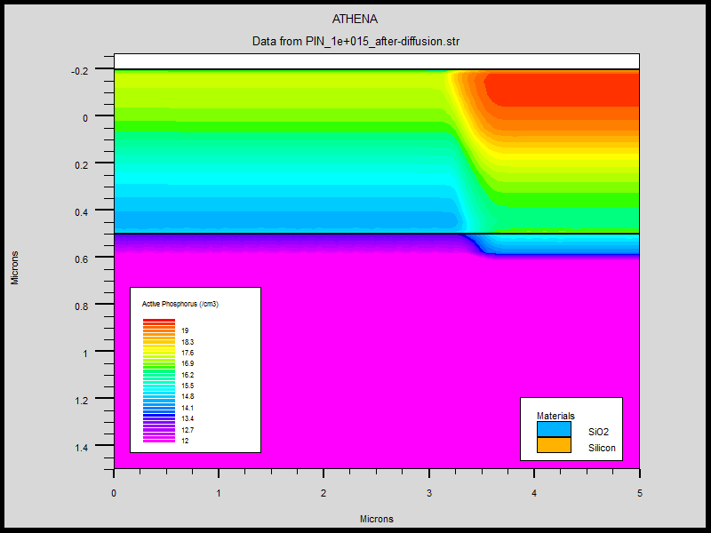
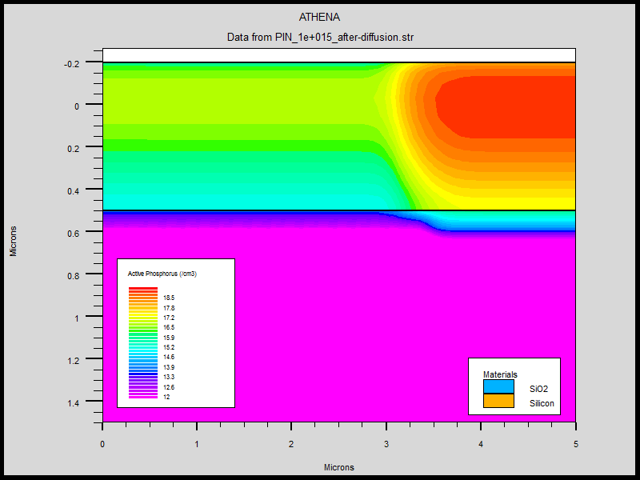
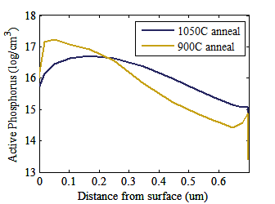
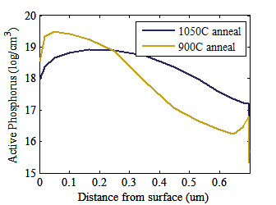
Implant and anneal - design
900C 40 min. anneal
1050C 40 min. anneal
N++
N++
N region
N region
SiO₂
SiO₂
Athena simulations: doses/energies on next slide
It looks like n-contact will be close to mask dimension regardless of anneal temperature
I actually only annealed for 5 minutes
n-contact
Under PD

Slide 3
Implant/anneal: experiment
700nm SOI
Implanted 2 sets of doses/energies (phosphorus only):
1) N (target: 1e18 cm-3, 100nm thick): 5e12 dose, 30, 80 keV
2) N++ (target: mid 1e19 cm-3, 300nm thick): 5e14 dose, 30, 80, 110, 150 keV
Measured sheet resistance in 4-point probe: very high for both
Annealed in RTA 5 minutes at 900C
Clear color change in both samples
Measured sheet resistance in 4-point probe again: ~4kΩ/ for n, ~40 Ω/ for n++
Fabricated TLM structures, including etched mesa all the way to the BOX, and measured sheet resistance again (next slide)
Ni contacts (Ben has done a lot of experiments with Ni contacts and they are consistently ohmic as-deposited whereas Ti contacts are sort of iffy)
Need to etch back between contacts to get active doping as a function of depth, but I have not done that – these results were good enough for me and I didn’t have much time

Slide 4
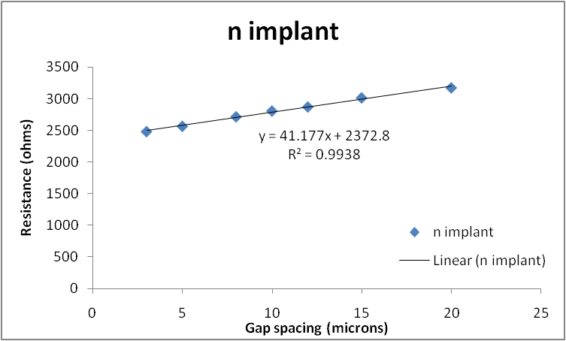
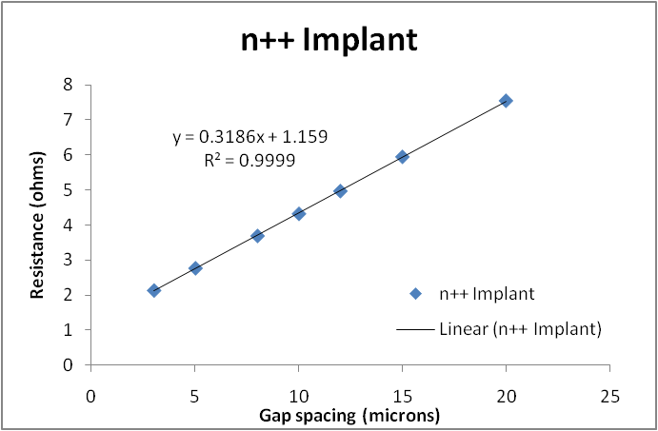
N-implant verification
TLM pattern:
120um
Rsh=4941 Ω/
120um
For the n-implant, Lt ~60um, so the measurement probably isn’t very accurate
Agrees with 4-point probe in cleanroom and simulation anyway
N++ implant also agrees with expected value
Rsh=38Ω/

