Slide 1
Office Professional Plus 2010

Slide 2
If you don’t have the software
Borrow a DVD floating around the lab
Email Jock@ece.ucsb.edu for product key
OR
Email: manager@software-depot.ucsb.edu, and reserve a copy to be picked up as COSL/Software Depot 1517 Phelps Hall
Reference order 305863 in the email
Email Jock@ece.ucsb.edu for product key
OR
If you have Office 2010 installed, but you get an activation error popup, follow the instructions in the next slides.

Slide 3
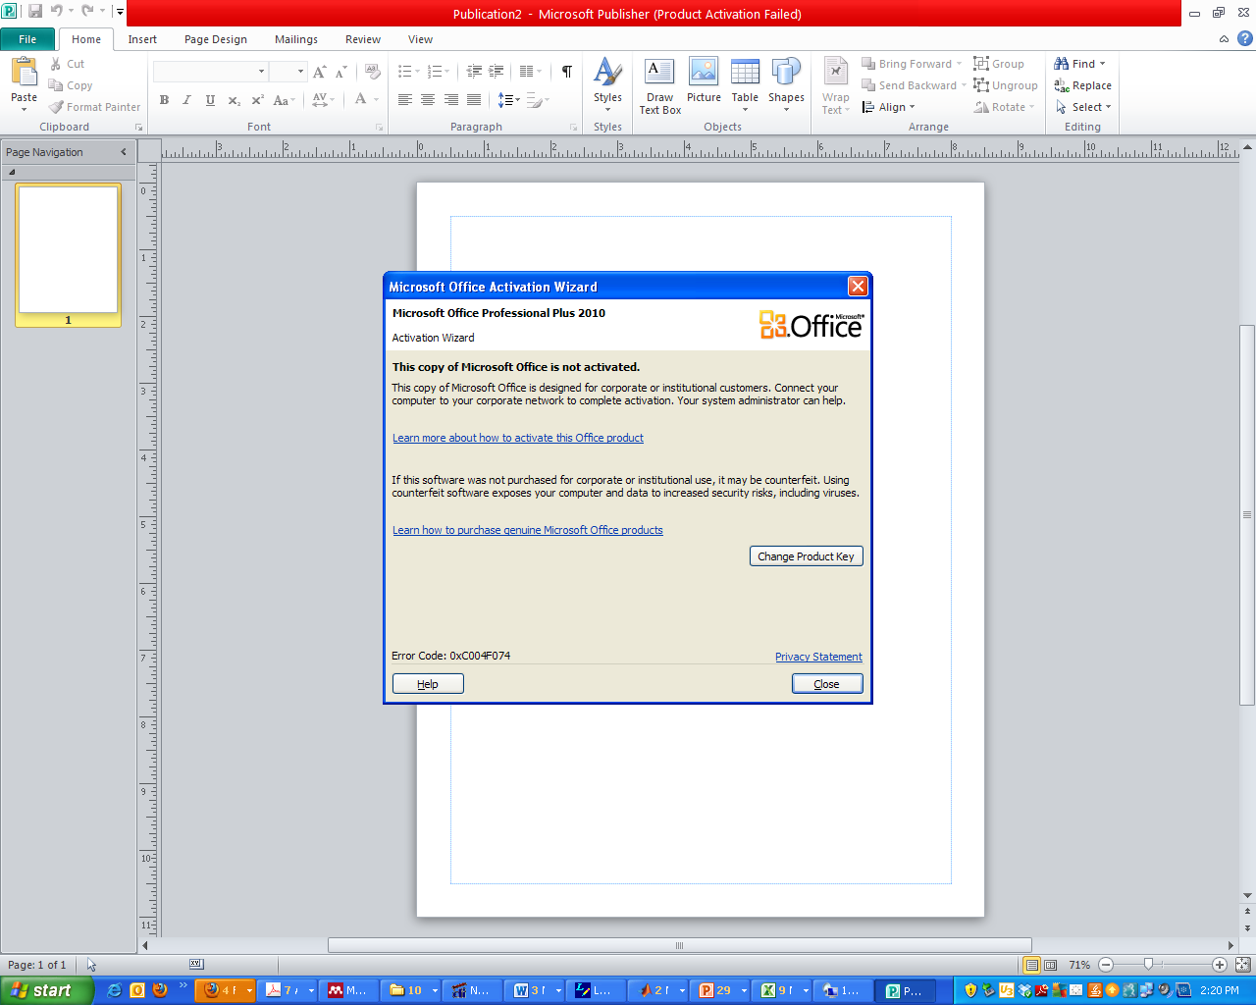
Activation Error Popup
If, you do, then update your key.
Click “Change Product Key”

Slide 4
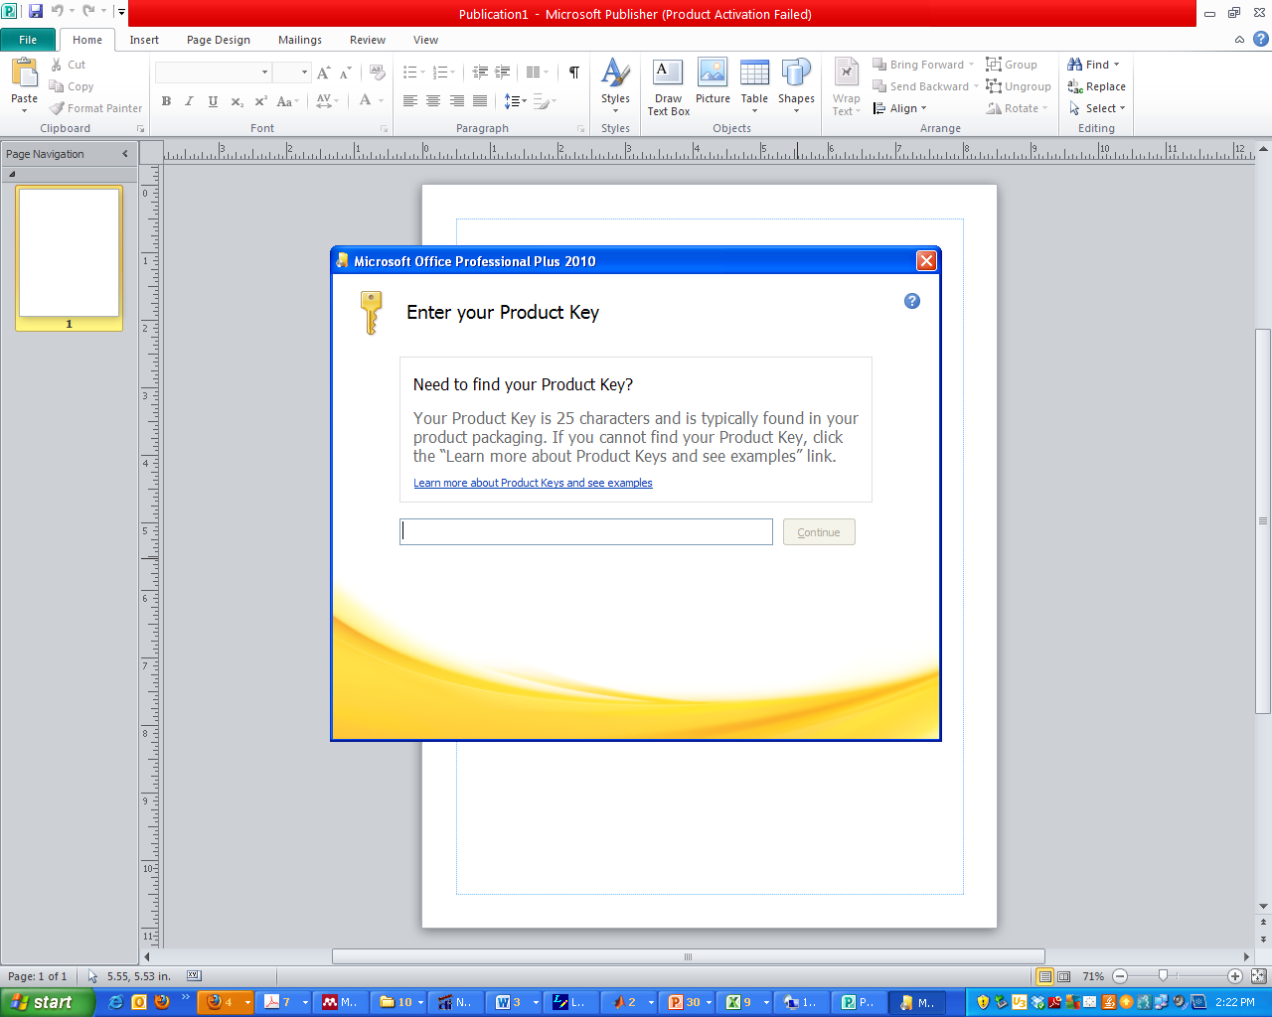
Enter Key (email Jock@ece.ucsb.edu for key)
I need to track the number of licenses.

Slide 5
Click “Install Now”
Close the Program
Then, reopen the program

Slide 6
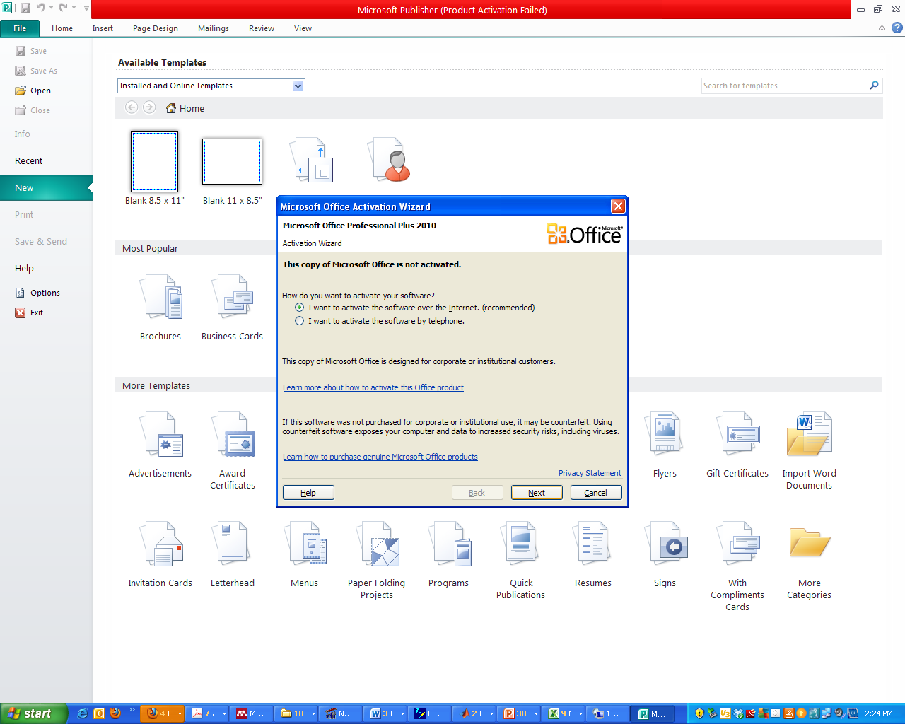
Click Next

Slide 7
You should be good…
Let me know if you have any issues.

