Slide 1
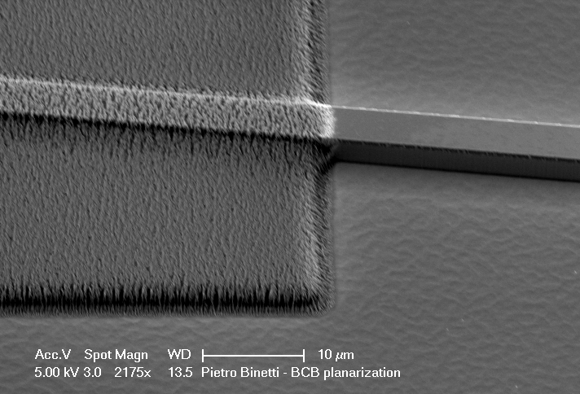
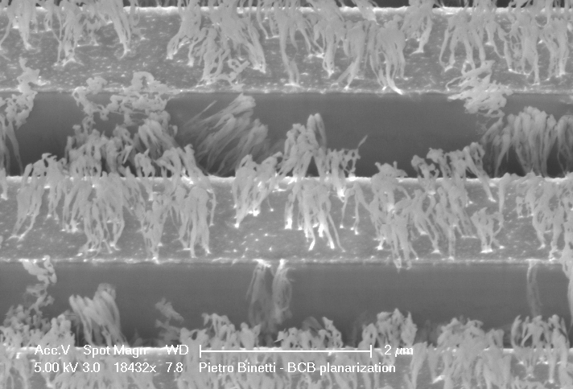
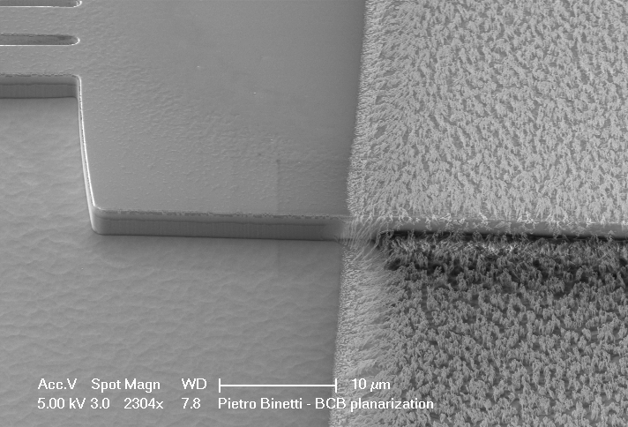
BCB planarization
After 15min etch back in RIE#3
Cleave Bar
Our recipe:
BCB 4024 series, photosensitive, 3.7µm thick after spin at 5krpm
Ridges ~1.5µm thick after cure (planarization)
Etch back: RIE#3; CF4/O2=4/16sccm, 20mT, 350V
Etch rate: 100-150nm/min
BCB etched back
After 2.5min extra in ICP#1 to try to clean the sample and redo the process
BCB etched back
Cleave Bar
Notes:
1
1
1
1
1
1
1

Slide 2
BCB planarization
(My) final recipe:
Our photosensitive BCB-4024 + our development
Curing at 250C for 2hrs (pretty standard)
Etch back with Rodwell’s recipe-1: ICP#1; 50°C, CF4/O2=50/200sccm, 40 Pa, 1000 W
ICP-1 much faster than RIE-3 (pump down) and gives much more uniform BCB etch back.
Etch rate is different than for Rodwell’s guys! 500-600nm/min (open areas) and 350-400nm/min (small openings, like Sweeper waveguide array)
Work on PIC-1 dummy:
Will try ICP-1 to open the SiN as well for following p-contact via step → probably this week.
BCB etched back
BCB etched back
BCB etched back
Notes:
2
2
2
2
2
2
2

