Slide 1
Si Photonics Meeting - Isolator
Jason
1/19/2010

Slide 2
Outline
Optical isolator literature review
Faraday rotation
Nonreciprocal phase shift and optical loss
Optical isolator design based on ring resonators

Slide 3
Conventional optical isolator
Light propagation direction
B
Magneto-optic material
(polarization rotates 45 degree)
With magnetic field parallel to the light propagation direction, right-hand and left-hand circular polarized light has different propagation constants, and thus the polarization rotates. This is so called Faraday rotator. The rotation direction is independent of propagation direction, which is always counterclockwise (or clockwise).
Placing the two polarizers in 45 degree with a 45-degree Faraday rotator in-between, only one direction of light can pass.

Slide 4
Nonreciprocal phase shift and optical loss
M≠0 for backward and forward light
α_{eff}
Magnetic field
M=0
Propagation direction
n_{eff}
Magnetic field transverse to the light propagation direction
Nonreciprocal phase shift
Different propagation constant sfor forward and backward light
Nonreciprocal optical loss
Different absorption coefficients for forward and backward light

Slide 5
Nonreciprocal propagation constant
y
x
z
Propagation direction
Magnetic field in y-direction
Magnetic field in x-direction

Slide 6
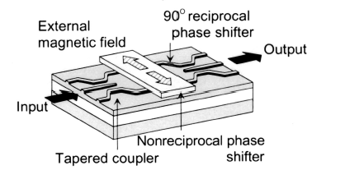
Literature example
Lateral magnetic field
TM-polarized light has nonreciprocal phase shift
Interferometer structure
Forward: construction interference
Backward: destructive interference
Different directions of magnetic fields on both arms shorten the required length to half
Yokoi, et. al., Applied Optics, 2003

Slide 7
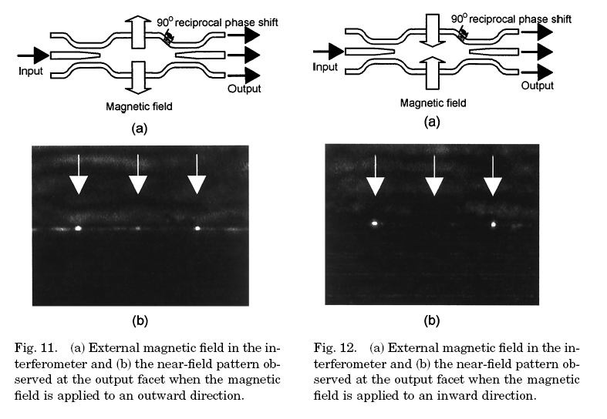
Yokoi, et. al., Applied Optics, 2000

Slide 8
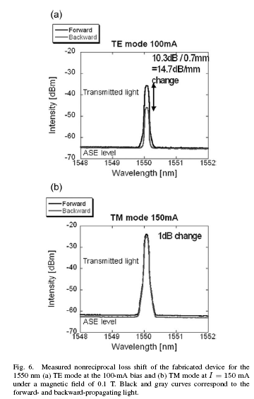
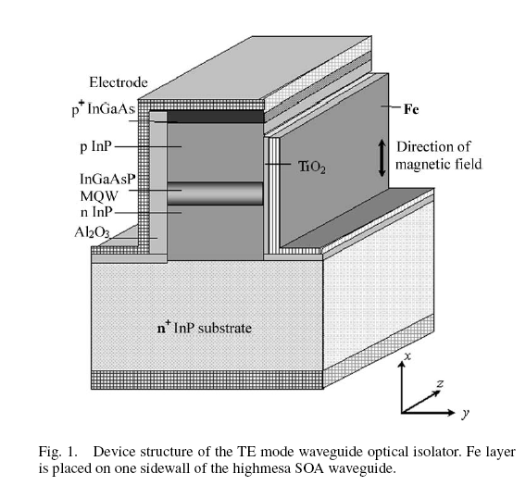
Literature of nonreciprocal loss
Shimizu, et. al., JLT, 2006

Slide 9
Summary of nonreciprocal propagation
y
x
z
Magnetic field
Magnetic field
Propagation direction
Propagation direction
Magnetic field
Propagation direction
θ_{F} Can be parallel or antiparallel to the magnetization
Magnetic field
The 3 right configurations all have opposite propagation constant shift compared to the original one
Propagation direction

Slide 10
Concept of isolators based on ring resonators
x
y
z
B
Nonreciprocal phase shift
Magnetic field transverse to the propagation direction
Light propagating in clockwise (CW) and counterclockwise (CCW) directions has different propagation constants
Optical input with resonance wavelength will be blocked while the other direction input will not.
Single ring
Double ring
Q of the ring: 10⁶
κ1 =κ2=3γ, κ_ring=4 γ

Slide 11
Nonreciprocal propagation constant in ring resonators
Top view
Cross-section
YIG
I
Metal wire
y₁
B
YIG
B
y₀
Si
Si
y
BOX
x
y₀ and y₁ are the bottom and top boundary of the YIG layer
Radial magnetic field direction toward the center of the ring (or outward)
Propagation constant change is proportional to field intensity difference at the boundary of the YIG layer

Slide 12
Nonreciprocal propagation constant in ring resonators
x₀
x₁
Input
Si
Si
MO
B
y
B
BOX
x
output
x₀ and x₁ are the left and right boundary of the YIG layer
Magnetic field direction has to be perpendicular to the wafer (the device)
Propagation constant change is proportional to field intensity difference at the boundary of the YIG layer

Slide 13
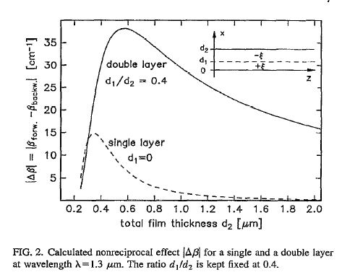
Maximize the propagation constant difference
Larger Faraday rotation (θ_{F})
Place the YIG layer in the region where field intensity is maximal
Double magneto-optic layers (+θ_{F} & -θ_{F})
Wallenhorst, et. al., JAP, 1995

Slide 14
YIG/nitride waveguide design
W=1um
YIG
H=0.4um
nitride
SiO₂

Slide 15
SOI rib waveguide with YIG on the sidewall
W=0.5um
H=0.7um
YIG
Slab height
MO material : Ce:YIG
refractive index =2.22
Loss: 20 cm-1
thickness: 200nm

Slide 16
SOI rib waveguide design
W
H=0.7um
YIG
W=0.3um
Slab height
W=0.4um
MO material : Ce:YIG
refractive index =2.22
Loss: 20 cm-1
thickness: 200nm
W=0.5um
W=0.6um

Slide 17
Single mode condition for rib waveguides
W
H=0.7um
Multi-mode
Slab height
Single mode condition
Single mode
Soref, et.al., JQE, 1991

Slide 18
Coming next
Design resonator & waveguide
Material preparation
Ce:YIG (CeY₂Fe₅O₁₂)
BIG (Bi₃Fe₅O₁₂)
Process flow based on silicon or silica waveguides

