Slide 1
Grating Analysis
2010-12-01
Jock Bovington
Wenzao Li
Jared Bauters

Slide 2
Outline
Experiment design with Process flow
Brief summary of AFM analysis
Characteristic SEM images
Dose/Duty Cycle analysis

Slide 3
Experiment design with Process flow
Two initial calibration samples were run
  InP Epi (epump2) with IBD SiO₂ (88nm)
    11nm Au Thermal Evaporated
    Developed
    ICP #2 (Oxide Etch)
    AFM
    RIE #2 (InP/SL Etch) - Thanks Mike and Jared
    AFM
  SOI (700nm Si, 1um BOx)
    11nm Au Thermal Evaporated
    Developed
    AFM (~393+/-7nm)
    Deep Si RIE “Bosch” (Si Etch) - Thanks Jason
    AFM
Calibration includes dose and duty cycle splits

Slide 4
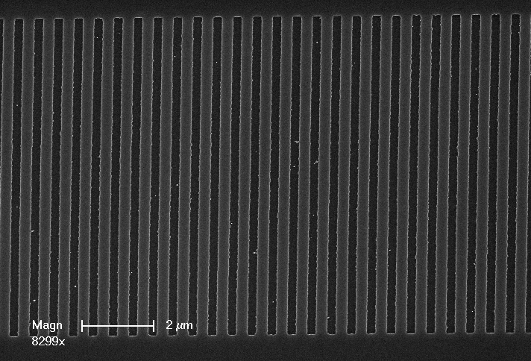
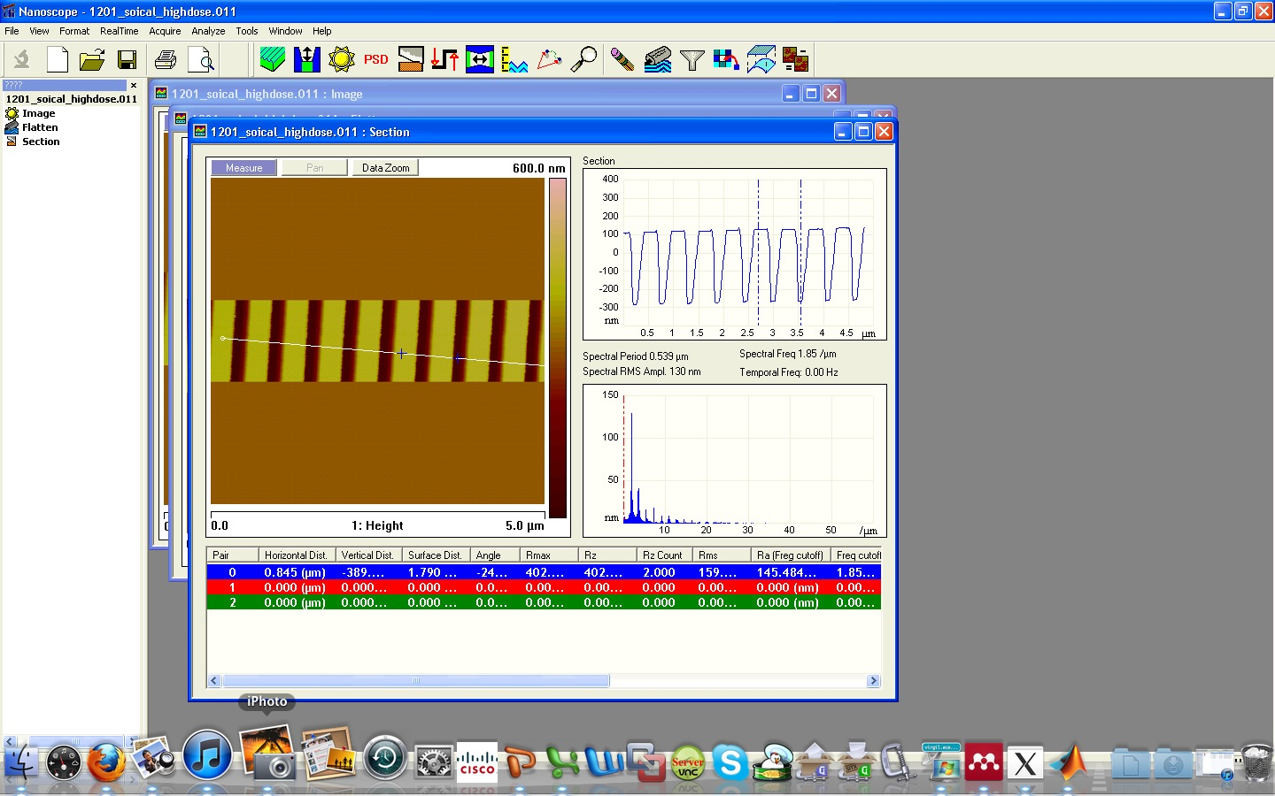
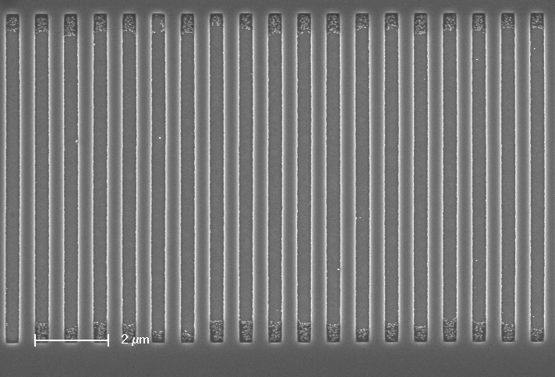
Grating Analysis
with assistance from Bill Michell, Jared and Wenzao

Slide 5
AFM Analysis
AFM gives valuable information about the quality of a grating, but can only take a small snap shot.

Slide 6
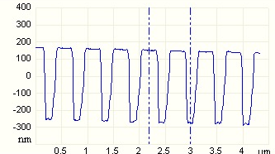
SOI AFM Analysis
Before Etch
After Etch
390nm
425nm
fd

Slide 7
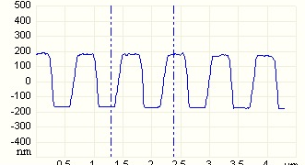
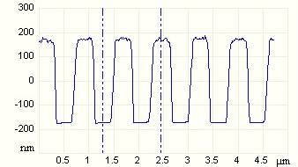
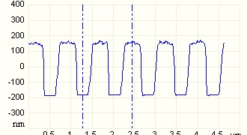
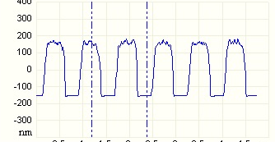
InP AFM Analysis
Before Etch
After 20s Oxide Etch
~350nm
~347nm
After 40s Oxide Etch
After 105s Oxide Etch
~344nm
~317nm

Slide 8
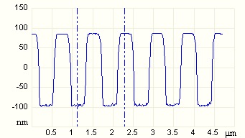
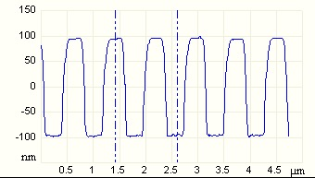
InP AFM Analysis
Before Etch
After Strip & 52s InP Etch
~317nm
~181nm
After Strip, 52s InP Etch, H2SO4
~189nm

Slide 9
SEM Analysis
Top down SEM is an excellent way to gain understanding about gratings.
  Dose
  Proximity Effects
  Duty cycle
  Qualitative information about pattern distortion

Slide 10
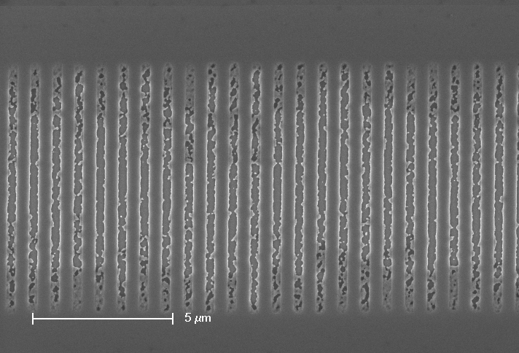
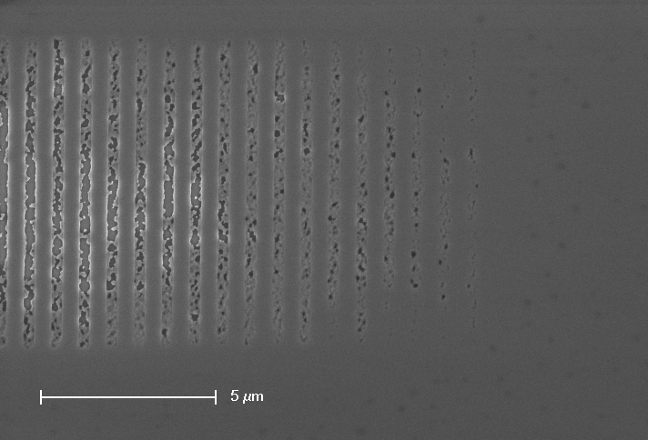
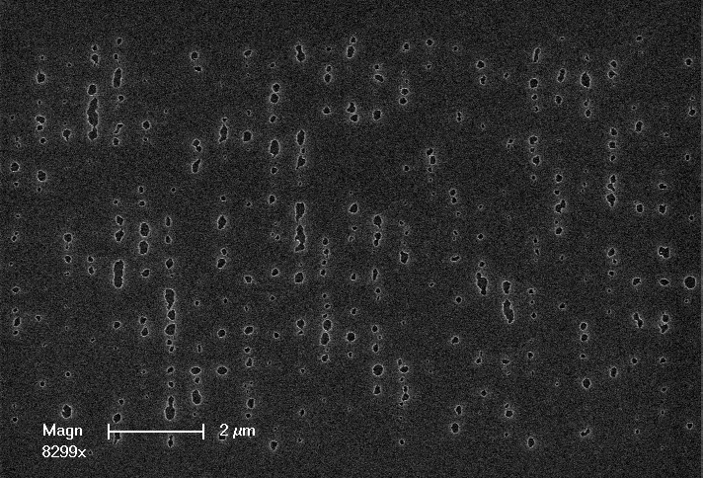
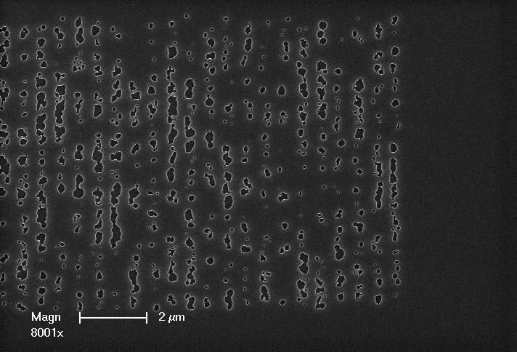
Low Dose, Proximity Effects

Slide 11
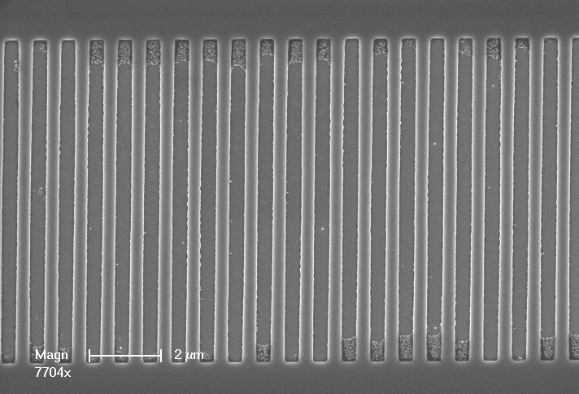
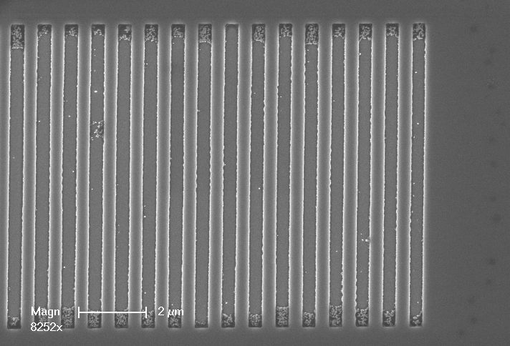
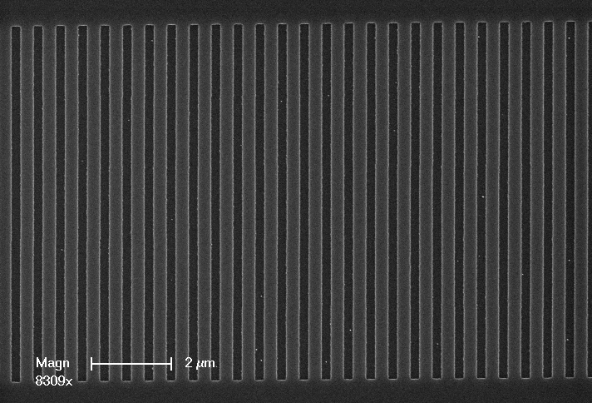
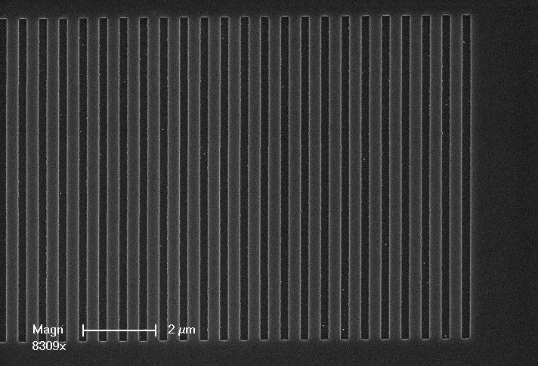
Higher Dose, Uniform Gratings

Slide 12
SOI Image Analysis Results

Slide 13
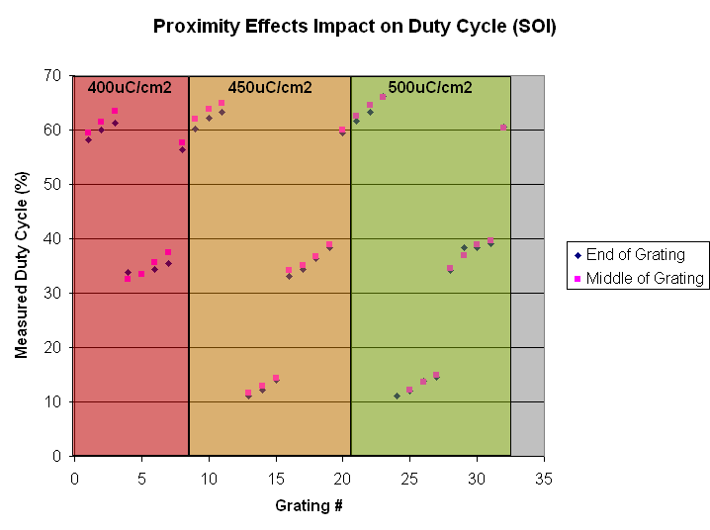
SOI Image Analysis Results

Slide 14
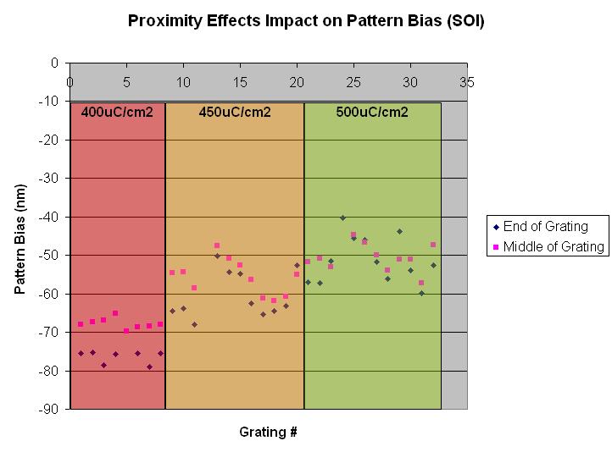
SOI Image Analysis Results

Slide 15
SOI Image Analysis Results

Slide 16
SOI Image Analysis Results

Slide 17
InP Image Analysis Results

Slide 18
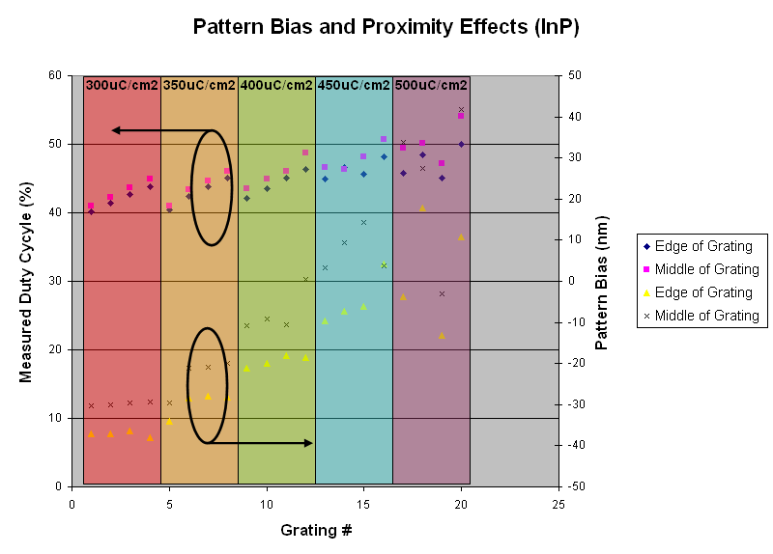
InP Image Analysis Results

Slide 19
InP Image Analysis Results

Slide 22
InP Image Analysis Results

Slide 23
Conclusion
Nearly half of the gratings were under exposed.
No gratings were overexposed
In general cleanest of the gratings had smaller patterns than those in the mask, which is counter to the underlying assumption of the pattern bias design of the DC split. Possible explanations include:
  A programming error
  Thick resist
  Dose is too low to see backscattering effect.

Slide 24
Next EB Litho Run
Sweeper – ~5 characteristic patterns from first mask with thinner resist over 5-8 doses. 50% DC pattern repeated with different pattern bias
  Total: ~100 gratings
InP & GaAs Grating Coupler – We were happy with the results of the initial calibration. Next will be a dry run of the first mask with different lengths and flip-chip bonding alignment marks.

