Slide 1
Sputter 4 W deposition optimization
Geza

Slide 2
Problem
Sputtering W on bonded samples resulted in a lot of III-V delamination → Stress?
Deposition pressure was 5.3 mT even though recipe name suggested 3 mT
At what dep pressure is film stress zero?

Slide 3
Experiment
Deposit W on 4” Si wafers at different dep. pressures
All wafers have 100 nm SiO2 for easy, residue-free film removal
W: H2O2
SiO2: BHF
Measure wafer bow before (bow_i) and after (bow_f) deposition → induced bow = bow_f - bow_i
Induced bow is zero when film stress is zero
Wafer bow measured using Tencor film stress tool
Each wafer measured twice
Wafer removed from tool between measurements
Wafer bow reproducible to within 0.5 μm

Slide 4
Deposition conditions
Power: 300W
Gun angle: 5 mm
Gas flow: Ar, 45 sccm
Temperature: 50 °C
5 min source conditioning before each deposition (done at 5.3 mT)
Deposition time: 600 s (~100 nm) at varous dep. pressures

Slide 5
Data
 | Deposition Pressure [mT] | Bow_i [μm] | Bow_f [μm] | Induced Bow [μm]
Wafer 1 | 5.3 | 15.17 | 4.1 | -11
Wafer 2 | 4 | 5.66 | -9.8 | -15
Wafer 3 | 3 | -2.7 | -6.5 | -3.8
Wafer 1 (1st W layer was etched) | 2.8 | 16.08 | 17 | 1.2
5.3 mT: This was the dep pressure which resulted in III-V flaking off bonded samples
4 mT: This is what Johann suggested I try for zero stress
3 mT: This is the pressure that the deposition recipe name suggested the dep should be done at
2.8 mT: This is one of the nulls when a parabola is fit to the above three data points.

Slide 6
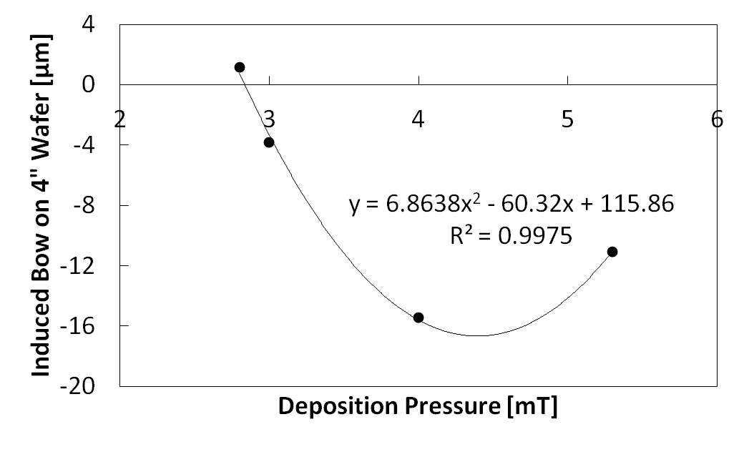
Depositions at 5.3, 4, and 3 mT were performed on 9/11/13, 2.8 mT on 9/16/13
Quadratic trend also seen in Y. G. Shen et al., “Residual stress, microstructure, and structure of tungsten thin films deposited by magnetron sputtering,” J. Appl. Physics, vol. 87, number 1, 2000
→ Parabolic trend believable

Slide 7
Conclusion
For Si substrates, W in sputter 4 is stress-free ~2.85 and ~5.95 mT
Film resistivity at 2.85 mT: 1.6 Ω/□
No data on film properties at 5.95 mT

