Slide 1
DUV Stepper Waveguides
Si Dummy Run
Jock Bovington
&
Jared Hulme

Slide 2
Overview
Design of Experiment
Device Layout
SEM Results
Conclusions

Slide 3
Design of Experiment
Jock Bovington

Slide 4
Design of Experiment
Using (3) Si wafer (NOT SOI)
  Split DBARC bake temperature (160,170,180C)
  Split dose energy (16,17,18…31mJ/cm²)
  Hold focus (-0.15um)
  Etch 250s
Run (1) SOI wafer given the results

Slide 5
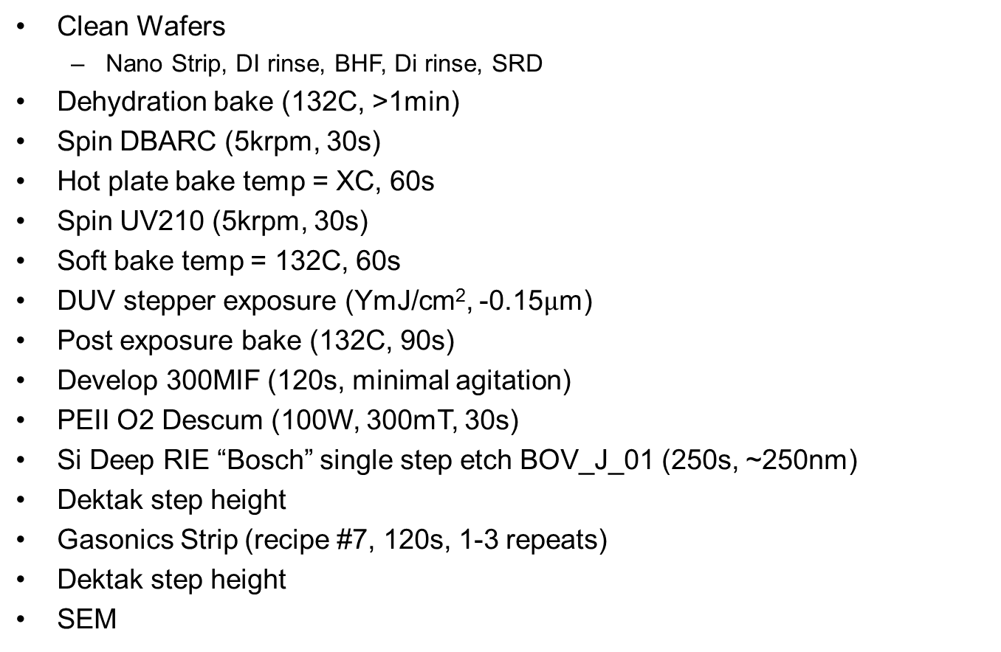
Process Follower
Clean Wafers
  Nano Strip, DI rinse, BHF, Di rinse, SRD
Dehydration bake (132C, >1min)
Spin DBARC (5krpm, 30s)
Hot plate bake temp = XC, 60s
Spin UV210 (5krpm, 30s)
Soft bake temp = 132C, 60s
DUV stepper exposure (YmJ/cm², -0.15$µ$m)
Post exposure bake (132C, 90s)
Develop 300MIF (120s, minimal agitation)
PEII O2 Descum (100W, 300mT, 30s)
Si Deep RIE “Bosch” single step etch BOV_J_01 (250s, ~250nm)
Dektak step height
Gasonics Strip (recipe #7, 120s, 1-3 repeats)
Dektak step height
SEM

Slide 6
Device Layout
Jared Hulme

Slide 7
Device Layout – Dose Energy
26 | 27 | 28 | 29 | 30
25 | 24 | 23 | 22 | 21
16 | 17 | 18 | 19 | 20

Slide 8
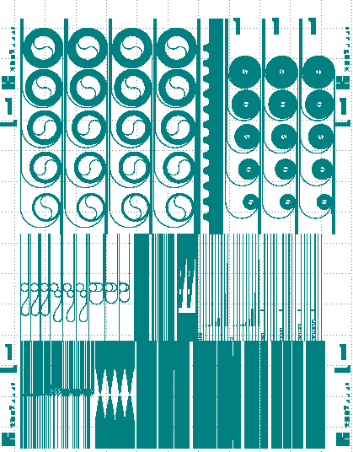
Pattern Layout
PTPNSL-EPhi1.2_DUV2.gds
EPhi 1.2 points of interest
  Coupler gaps
  300nm period gratings
  Star Coupler points
  Taper Tips

Slide 9
SEM Results
Jared Hulme

Slide 10
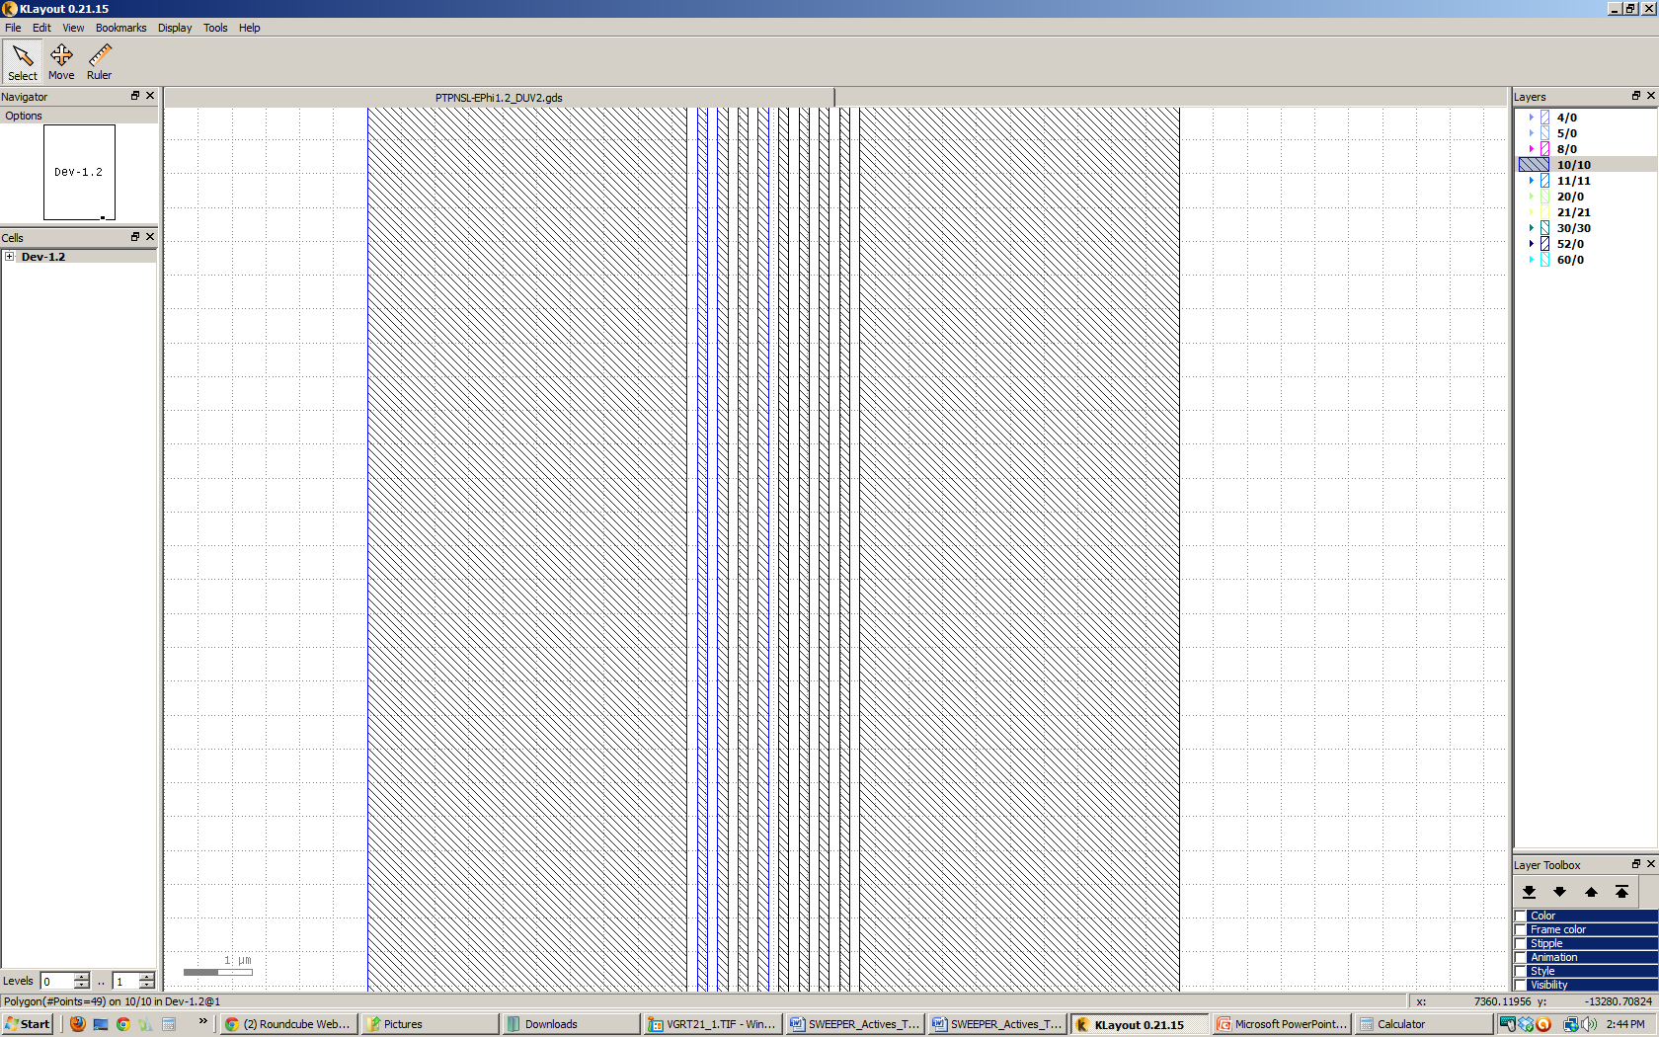
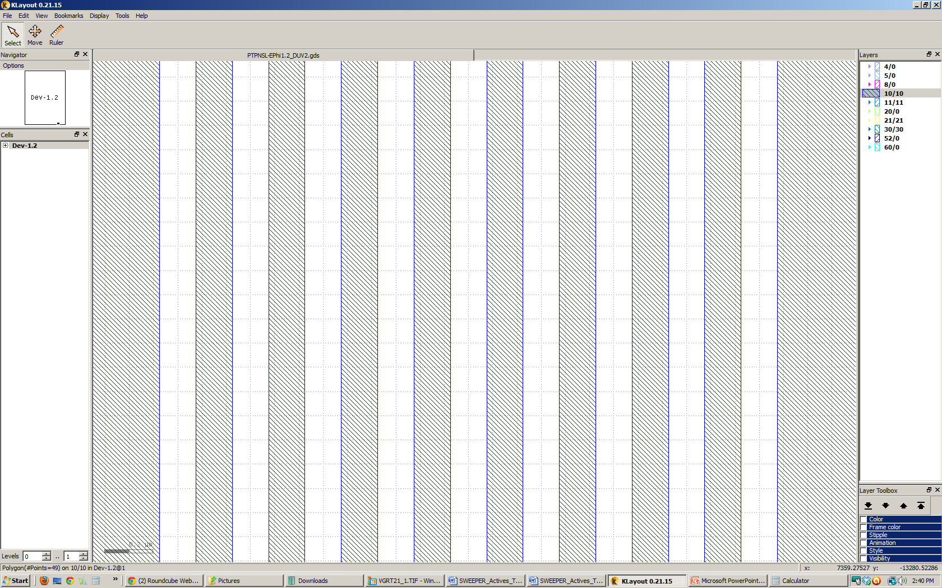
Pattern Layout
PTPNSL-EPhi1.2_DUV2.gds
EPhi 1.2 points of interest
  Coupler gaps
  300nm period gratings
  Star Coupler points
  Taper Tips
12um
2.55um
.3um
.15um
.15um

Slide 11
SEMs – 160C Bake time
Die 26
Die 27
Die 28
Die 29

Slide 12
SEMs – 170C Bake time
Die 24
Die 25
Die 28

Slide 13
SEMs – 180C Bake time
Die 25
Die 26
Die 27
Die 28

Slide 14
SEMs – 180C Bake time
Die 29

Slide 15
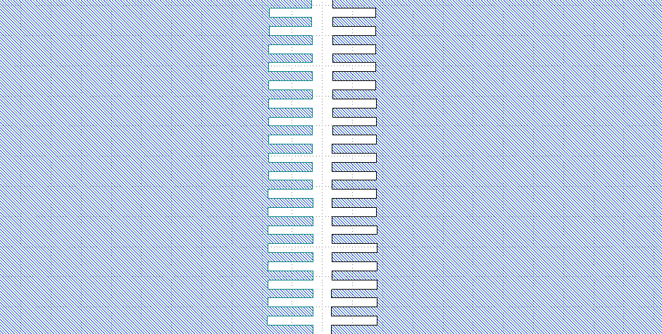
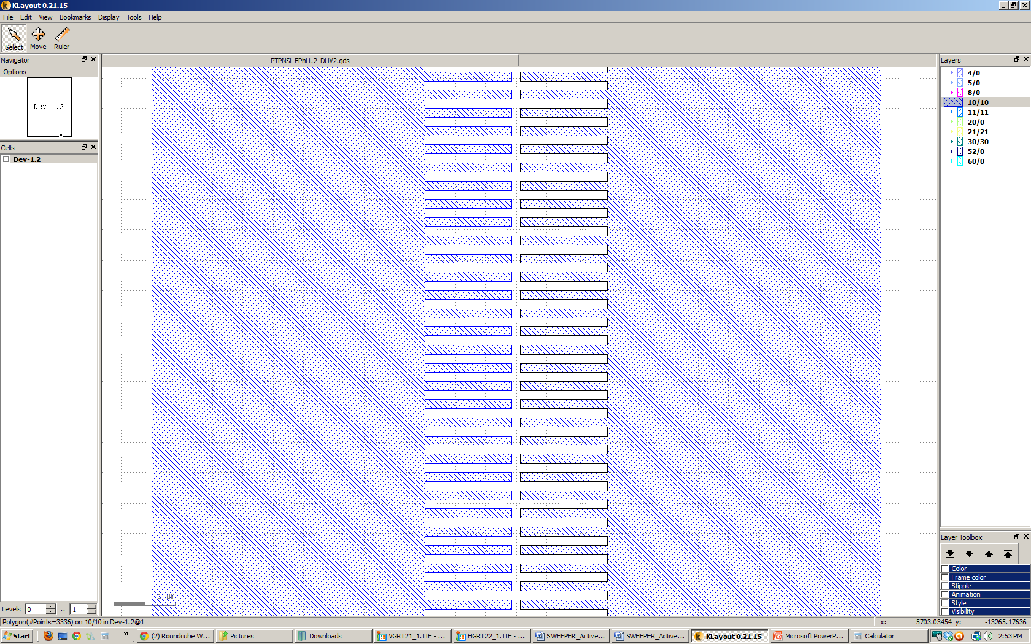
Pattern Layout
PTPNSL-EPhi1.2_DUV2.gds
EPhi 1.2 points of interest
  Coupler gaps
  300nm period gratings
  Star Coupler points
  Taper Tips
12um
3um
1.425um
.15um
.15um
.15um

Slide 16
SEMs – 160C Bake time
Die 26
Die 27
Die 28
Die 29

Slide 17
SEMs – 170C Bake time
Die 24
Die 25
Die 26

Slide 18
SEMs – 180C Bake time
Die 25
Die 26
Die 27
Die 28

Slide 19
SEMs – 180C Bake time
Die 29

Slide 20
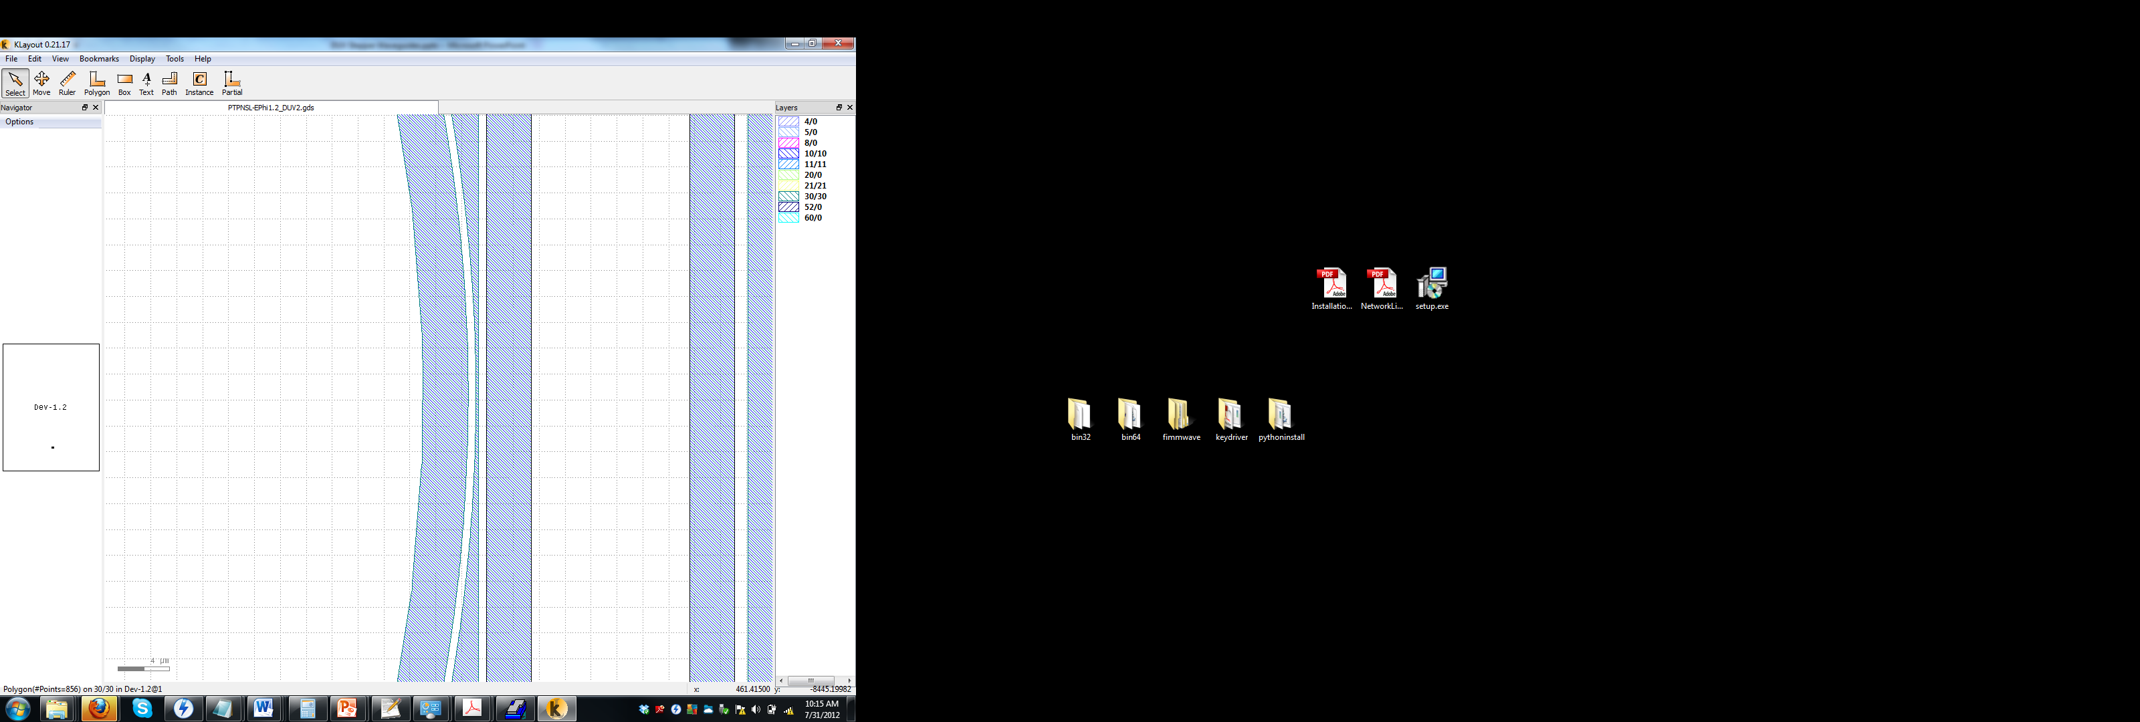
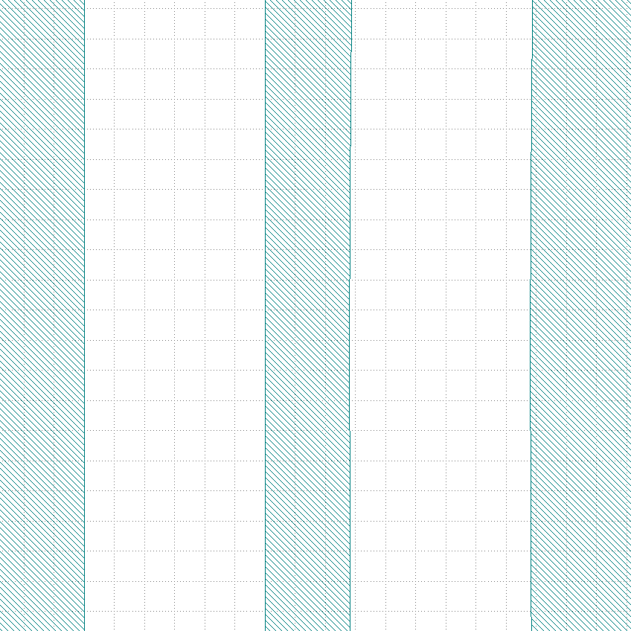
Pattern Layout
PTPNSL-EPhi1.2_DUV2.gds
EPhi 1.2 points of interest
  Coupler gaps
  300nm period gratings
  Star Coupler points
  Taper Tips
.28um
.6um
.6um

Slide 21
SEMs – 160C Bake time
Die 26
Die 27
Die 28
Die 29

Slide 22
SEMs – 170C Bake time
Die 24
Die 25
Die 26
Die 27

Slide 23
SEMs – 180C Bake time
Die 25
Die 26
Die 27
Die 28

Slide 24
SEMs – 180C Bake time
Die 29a
Die 29b

Slide 25
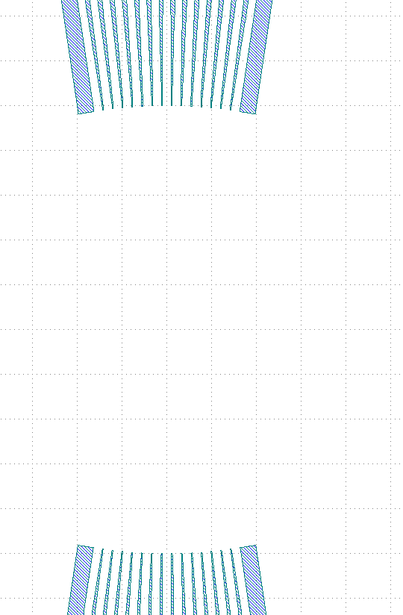
Pattern Layout
PTPNSL-EPhi1.2_DUV2.gds
EPhi 1.2 points of interest
  Coupler gaps
  300nm period gratings
  Star Coupler points
  Taper Tips

Slide 26
SEMs – 160C Bake time
Die 26
Die 27
Die 28
Die 29

Slide 27
SEMs – 170C Bake time
Die 24
Die 25
Die 26

Slide 28
SEMs – 170C Bake time
Die 27a
Die 27b

Slide 29
SEMs – 180C Bake time
Die 25
Die 26
Die 27
Die 28

Slide 30
SEMs – 180C Bake time
Die 29

Slide 31
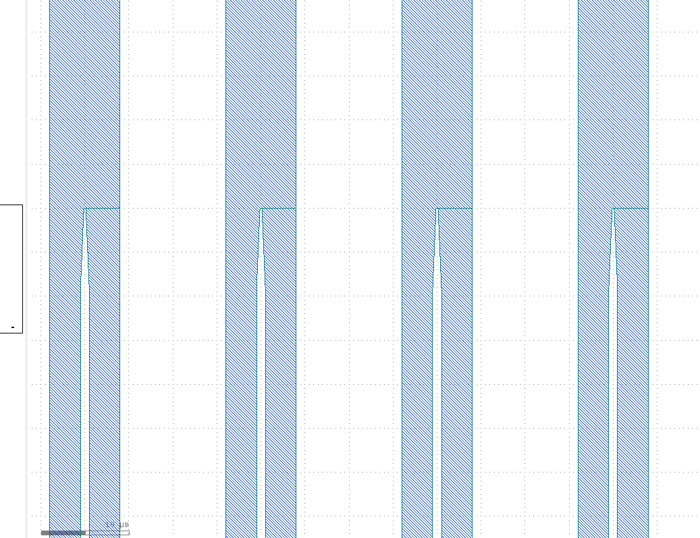
Pattern Layout
PTPNSL-EPhi1.2_DUV2.gds
EPhi 1.2 points of interest
  Coupler gaps
  300nm period gratings
  Star Coupler points
  Taper Tips

Slide 32
SEMs – 160C Bake time
Die 26
Die 27
Die 28
Die 29

Slide 33
SEMs – 170C Bake time
Die 24a
Die 24b
Die 25

Slide 34
SEMs – 180C Bake time
Die 25
Die 26
Die 27
Die 28

Slide 35
SEMs – 180C Bake time
Die 29

Slide 36
Conclusions
Jared Hulme & Jock Bovington

Slide 37
Si Litho Conclusions – Bad News
It appears that at low DBARC bake temp (160C) there is often severe undercut during development which destroys fine features.
For gratings and narrow gaps high DBARC bake temp (180C) leaves webbing which partially masks these area.
All wafers have residue that was not removed after 3x Recipe#7 in Gasonics.
  Follow-up Experiment
    (1) 30min Piranha 100C
    (1) 30min Nanostrip Dip
    (1) HOLD most dissimilar wafer
    SEM both cleaned wafers

Slide 38
Si Litho Conclusions – Good News
DUV Stepper SOI should be set around
  25mJ/cm^2
  170C DBARC Bake Temp
Run (1) SOI wafer with Focus/Energy array to measure offsets for all patterns
  Energy: 23, 24, 25, 26, 27
  Focus: -0.35, -.25, -0.15, -0.05, 0.05

Slide 39
DUV Stepper Waveguides
SOI Test Run
Jock Bovington
&
Jared Hulme

Slide 40
Overview
Design of Experiment
Device Layout
SEM Results
Conclusions

Slide 41
Design of Experiment
Jock Bovington

Slide 42
Design of Experiment
Using (3) Si wafer (NOT SOI)
  Split DBARC bake temperature (160,170,180C)
  Split dose energy (16,17,18…31mJ/cm²)
  Hold focus (-0.15um)
  Etch 250s
Run (1) SOI wafer given the results

Slide 43
Process Follower
Clean Wafers
  Nano Strip, DI rinse, BHF, Di rinse, SRD
Dehydration bake (132C, >1min)
Spin DBARC (5krpm, 30s)
Hot plate bake temp = XC, 60s
Spin UV210 (5krpm, 30s)
Soft bake temp = 132C, 60s
DUV stepper exposure (YmJ/cm², -0.15$µ$m)
Post exposure bake (132C, 90s)
Develop 300MIF (120s, minimal agitation)
PEII O2 Descum (100W, 300mT, 30s)
Si Deep RIE “Bosch” single step etch BOV_J_01 (250s, ~250nm)
Dektak step height
Gasonics Strip (recipe #7, 120s, 1-3 repeats)
Dektak step height
SEM

Slide 44
Device Layout
Jared Hulme

Slide 45
Device Layout – Dose Energy
 | 23 | 24 | 25 | 26 | 27
-.35
-.25
-.15
-.05
0.5

Slide 46
Pattern Layout
PTPNSL-EPhi1.2_DUV2.gds
EPhi 1.2 points of interest
  Coupler gaps
  300nm period gratings
  Star Coupler points
  Taper Tips

Slide 47
SEM Results
Jared Hulme

Slide 48
Pattern Layout
PTPNSL-EPhi1.2_DUV2.gds
EPhi 1.2 points of interest
  Coupler gaps
  300nm period gratings
  Star Coupler points
  Taper Tips
12um
2.55um
.3um
.15um
.15um

Slide 49
Pattern Layout
PTPNSL-EPhi1.2_DUV2.gds
EPhi 1.2 points of interest
  Coupler gaps
  300nm period gratings
  Star Coupler points
  Taper Tips
12um
3um
1.425um
.15um
.15um
.15um

Slide 50
Pattern Layout
PTPNSL-EPhi1.2_DUV2.gds
EPhi 1.2 points of interest
  Coupler gaps
  300nm period gratings
  Star Coupler points
  Taper Tips
.28um
.6um
.6um

Slide 51
Pattern Layout
PTPNSL-EPhi1.2_DUV2.gds
EPhi 1.2 points of interest
  Coupler gaps
  300nm period gratings
  Star Coupler points
  Taper Tips

Slide 52
Pattern Layout
PTPNSL-EPhi1.2_DUV2.gds
EPhi 1.2 points of interest
  Coupler gaps
  300nm period gratings
  Star Coupler points
  Taper Tips

Slide 53
Conclusions
Jared Hulme & Jock Bovington

Slide 54
SOI Test Conclusions – Bad News

Slide 55
SOI Conclusions – Good News

