Slide 1
DUV Stepper Tutorial
Jock Bovington

Slide 2
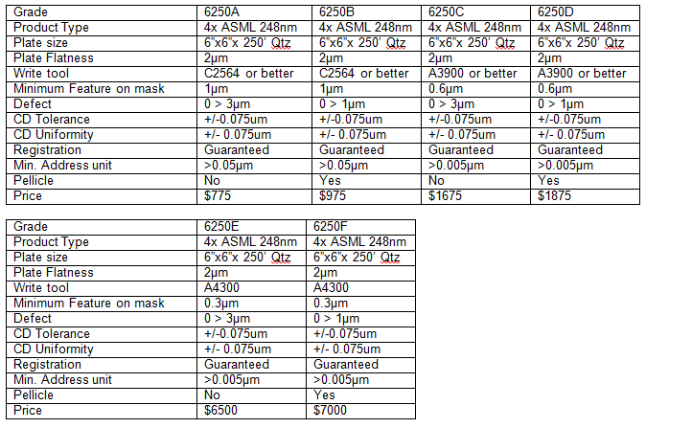
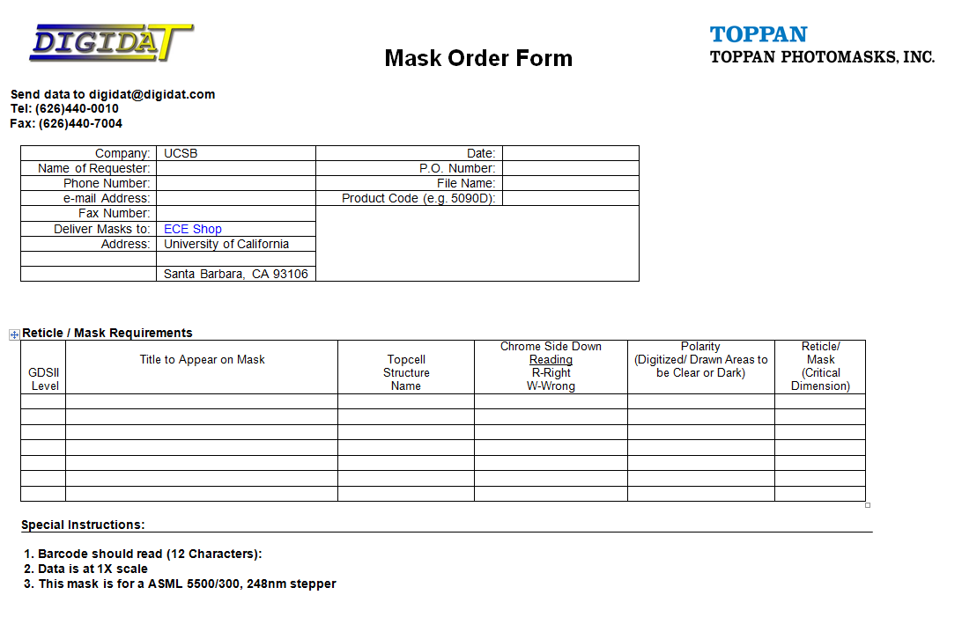
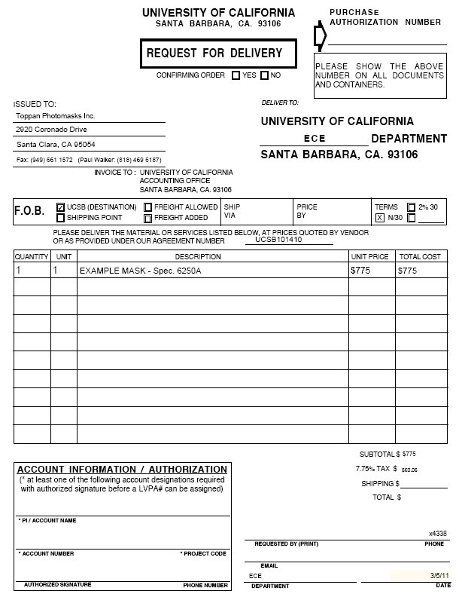
Ordering
You can only order from TOPPAN
Masks are all shipped to the Nanofab
Quotes, Order form, and PO Template are on the wiki.

Slide 3
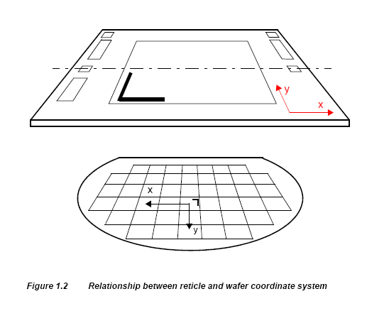
Wafer Level
4” Wafers Only (SEMI Standard)
(Smaller die on 4” carrier later)
Wafer can be rotated in increments of 90°
Mask can not be rotated.
Alignment is done wafer level with 2 global alignment marks placed in 2 different areas of the wafer. Allowable areas are in red below.
Marks placed on wafers by tools other than the DUV stepper must both fit in these red areas and have a <0.5°rotational alignment to the major flat.
38°
31mm

Slide 4
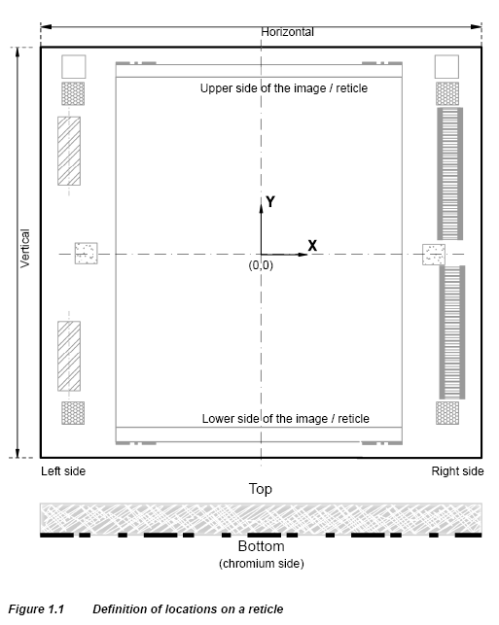
Mask Level
All masks must have unique bar-codes.
Low NA field is 22x27.4mm (die scale).
High NA field is 21x21mm (die scale).
Mask can not be rotated.
Wafer can be rotated, but only in 90 degree steps.

Slide 5
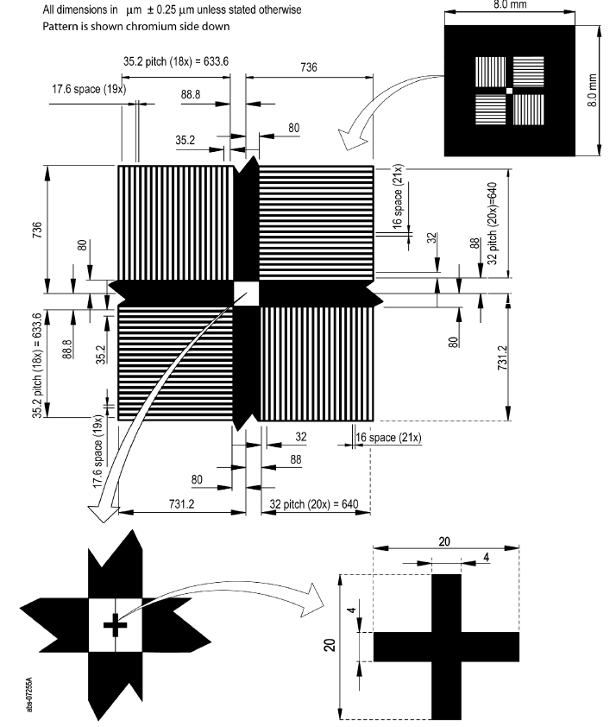
Global Alignment Mark
Global mark on right
(mask scale)
8 and 8.8um pitch
(die scale)

Slide 6
Specifications
Resolution
Minimum mask resolution 100nm
Low NA resolution <250nm
High NA <200nm (~150nm, bur pattern dependent)
This does not mean that you will always get 100nm. We will need to test the limits. That is the purpose of the first mask.
Low NA field is 22x27.4mm (die scale).
High NA field is 21x21mm (die scale).
Alignment < 45nm
Throughput >88 wafers per hour

