Slide 1
Sweeper Processing Issues
March, 2012

Slide 2
Post Anneal Observations

Slide 3
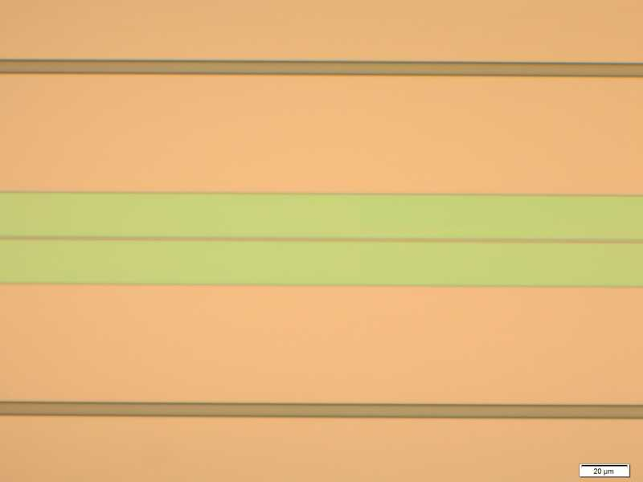
Sweeper Chip E Post 1050C Anneal
Nomarski Image of Dope area
Same area normal view
Hard to see Dope windows after 1050C anneal but faint outline can be seen under Nomarski.

Slide 4
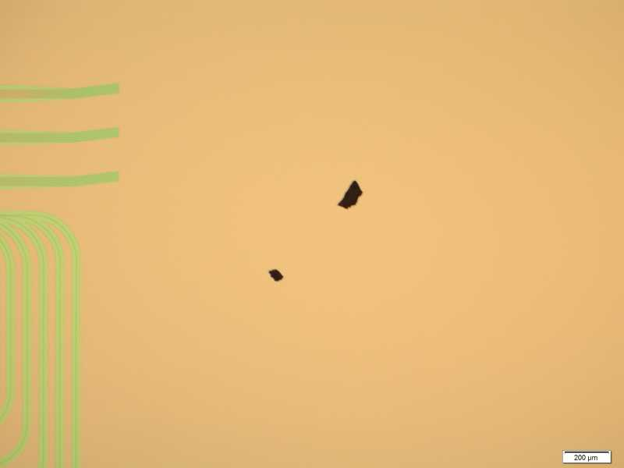
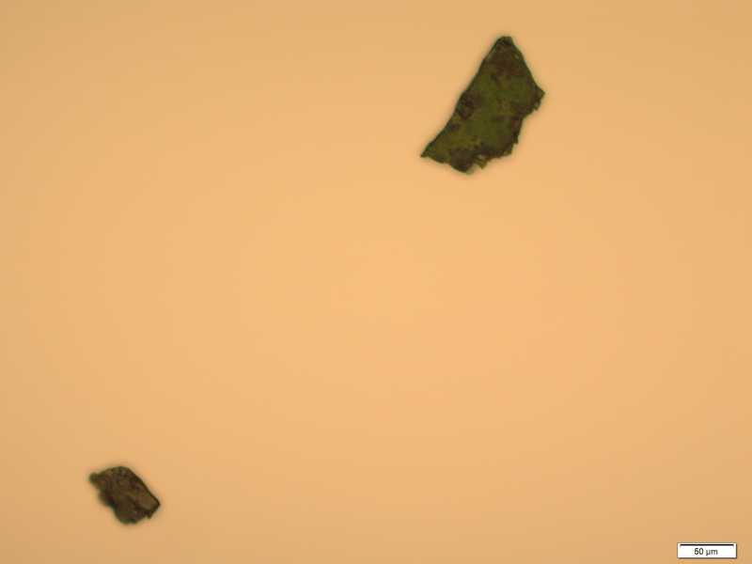
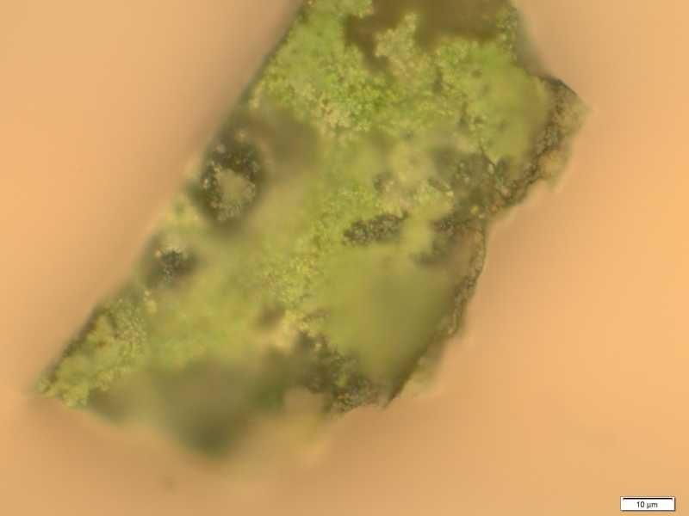
Sweeper Chip E Post 1050C Anneal
Eight large particles seen post anneal. An ISO soak with U/S at 5/5/High for 3 min and DI for 2 min was used to remove them.

Slide 5
Sweeper Chip E Post 1050C Anneal
Nomarski view. Streaks extend to edge of wafer in all cases. Seen in differenct densities but similar to this in five spots around circumference of the chip. Not sure if present preanneal
Same image under normal view, streaks not noticed.

Slide 6
Stripping Issues at Post SiN Hardmask Etch
13.2. SiN deposition
13.2.1. Dehydration bake 5 min @ 150 C
13.2.2. Deposit 3000A of SiN
13.3. Mesa litho (Mesa Def mask)
13.3.1. Sample prep
13.3.1.1. Acetone 3 min / Isopropyl alcohol (IPA) 3 min / DI rinse 3 min
13.3.1.2. Dry with N2, dehydration bake 3 min 120 C
13.3.1.3. PE2 O2 descum 300 mT, 100 W, 1 min
13.3.1.4. Dehydration bake 5 min, 150 C
13.3.2. Spin resist
13.3.2.1. Blow sample with N2
13.3.2.2. Dispense HMDS, 30 sec @ 3K
13.3.2.3. Blow sample with N2
13.3.2.4. Dispense nLOF 5510, 30 sec @ 3K
13.3.2.5. Soft bake 1 min, 90 C
13.3.3. Expose in stepper 0.25 sec, offset: -1
13.3.4. Post bake 1 min, 110 C
13.3.5. Develop AZ300MIF, 1 min
13.3.6. Inspect: If bent tapers -> try a longer descum in next step to etch some of PR.
13.3.7. PE2 O2 descum 300 mT, 100 W, 1 min

Slide 7
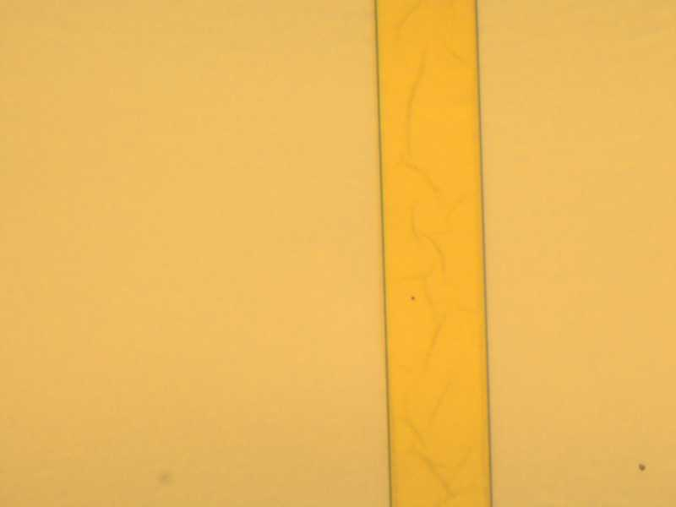
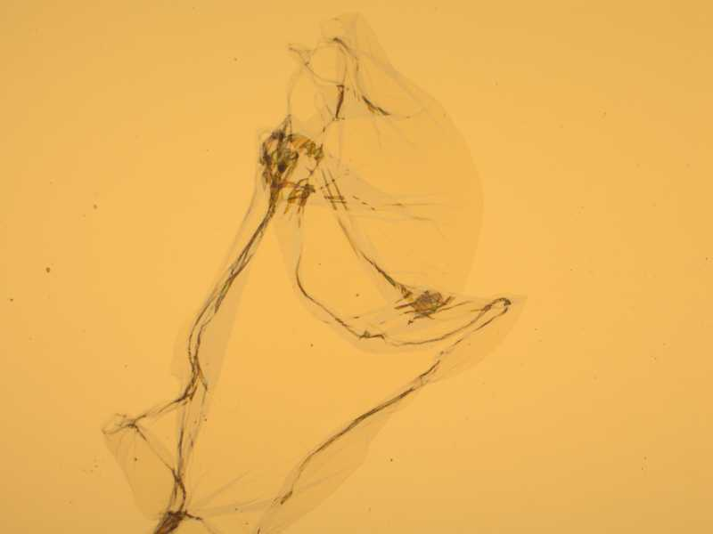
Test Piece
Residue on SiN
Wispy blobs

Slide 8
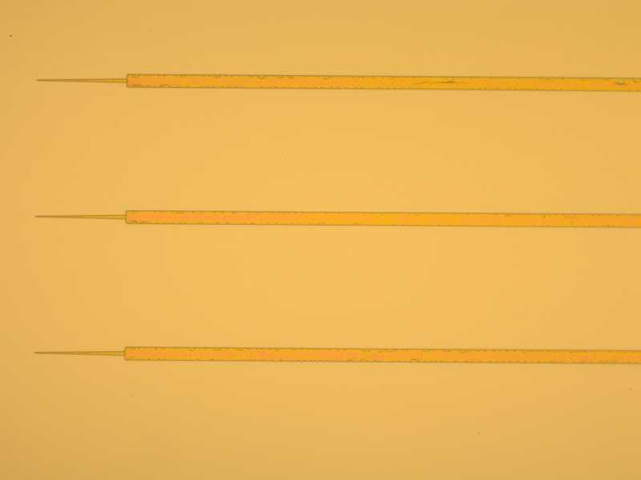
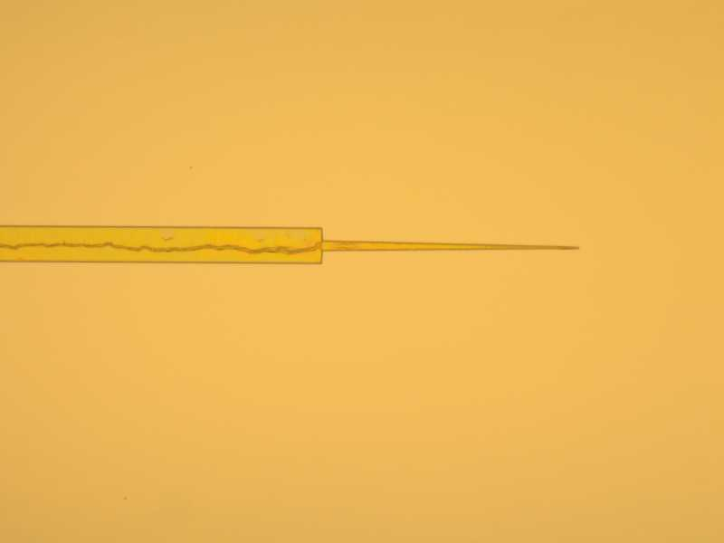
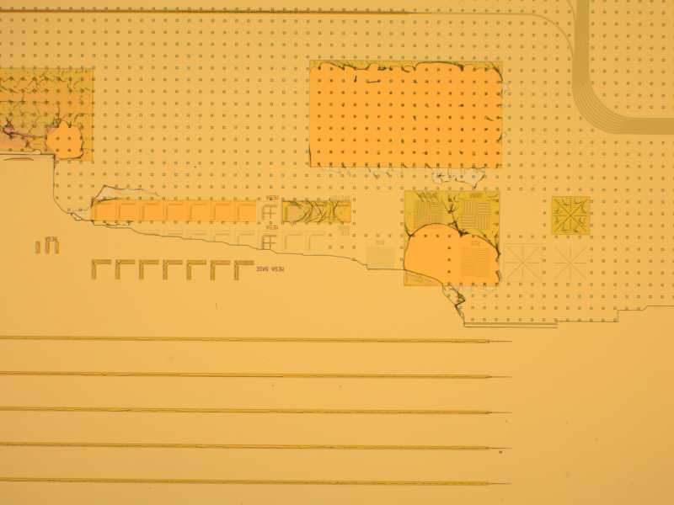
Chip C1
Resist
Large Resist blobs

Slide 9
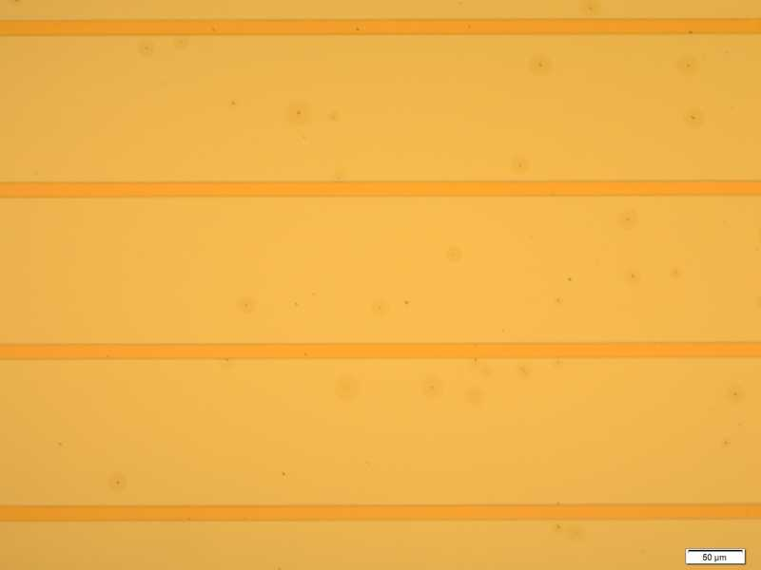
Chip A2 Left Die
Pits all over, mostly on left die

Slide 10
Other Projects Mesa Process
2010_04_28 Slotline
Positive resist 955 0.9, RIE 3 etch, Developer strip but not very effective
2008_10_03 Self Align Process
Positive resist 955 0.9, RIE 3 etch, 1165 Strip but still residue

