Slide 1
BCB Planarization Process
Jared Hulme
2/10/12

Slide 2
Hard Mask Dep & Lithography
Hard Mask Deposition
Clean - ACE/ISO/DI
Deposit Oxide
PlasmaTherm PECVD 400nm
Lithography
Clean
ACE/ISO/DI/PEII
O2 Decsum 30s, 300mT, 100W)
Dehydration bake: Hotplate 150C, 2-5min
Spin HMDS (5000rpm, 30s) (let sit for 30s on chip before spinning)
Spin AZ4210 (4000rpm, 30s)
Pre-Exposure Bake (95C, 1min)
Lithography - Pattern a window in the deep etch region
Litho Tool: GCA Stepper / Autostepper / I-Line filtered contact aligner
Exposure: 3sec / 1sec / 13sec
Focus Offset: 0 / 0 / NA
NO POST-EXPOSURE BAKE
Develop (AZ400K 1:4 diluted, 70sec) (actual is more like 2 min 20 sec)
DI Rinse
Inspect in microscope
Dektak height: = ______nm

Slide 3
Etch and Inspect
Hardmask Etch - SiO2 Etch target 400nm
Etch Tool: ICP#2
Clean: O2 Clean, 5min
Season (Recipe, Time): Bowers Sioxvert etch # 101, 5min (CHF3 etch so check gases)
Etch(Recipe, Rate): (Bowers Sioxvert etch # 101, 250nm/min = 4.16nm/s) over etch by 20% => Etch for 2’
Inspect in microscope
Dektak height: = ______nm
Strip PR
ACE/ISO/DI Rinse
1165 Soak at 80C in covered bath - 10min
ISO/DI Rinse
PEII - O2 Descum (100W, 300mTorr, 60-120sec)
Dektak height: = ______nm
Si Etch target 2um
Etch Tool: ICP#2 or Deep Si RIE
Clean: O2 Clean, 5min
Season (Recipe, Time): Bowers si etch # 127, 5min
Etch (Recipe, Rate): (Bowers si etch # 127, 4nm/s) : 2 um / (4 nm/s) = 500s = 8’ 20” => Etch for 8’ 30”
Selectivity - 1:10 (SiO2:Si)
Inspect in microscope
Dektak height: = ______nm
Remove Oxide
BHF dip (100 nm/min) : 400 nm / (100nm/min) = 4 min => Dip for 5’
DI Rinse
Inspect in microscope
Deposit Nitride or Oxide PlasmaTherm PECVD 40nm

Slide 4
BCB Application and Cure
BCB application
The ‘Blue Oven’ must be at room temperature 25_C or less before beginning
– Otherwise, BCB will bubble during the cure and the sample will be ruined
NOTE: there must not be any stops in the steps from sample surface preparation to loading the spun sample w/ BCB into the Blue oven
– Any delays will allow increased surface oxide to regenerate on the semiconductor, increasing leakage currents
– Oxygen contaminates BCB and prolonged exposure will compromise the cure and ruin the sample
Prepare the ‘Blue Oven’ – run N2 through chamber at 100%
Solvent clean sample (if necessary), PEII 30s
Coat wafer with BCB 3022-46 – let sit on surface for 30 sec
Spin BCB 500 rpm, ramp 100, 5 sec
Spin BCB 1500 rpm, 150rpm/s ramping, 30 sec – BCB thickness _ 3-4 μm
BCB Cure
Place sample into Al cup holder
– The holder should be deformed such that the sample is completely level, yet has minimal contact with the bottom holder surface
– Otherwise, cured BCB that has crept onto the bottom surface may prevent the sample from being removed from the holder
Place sample (in holder) into the ‘Blue Oven’
Reduce N2 flow to 60% after 3 min
Load and run Program 5 (confirm in case it has been altered)
Program sequence for SOFT CURE (used only for first layer for double layer BCB):
(a) 5 min ramp to 50_C, 5 min soak
(b) 15 min ramp to 100_C, 15 min soak
(c) 15 min ramp to 150_C, 15 min soak
(d) 20 min ramp to 210_C, 40 min soak
(e) Natural cool down (NOTE TIME OF COOL DOWN)
(f) Oven off
Program sequence for HARD CURE:
(a) 5 min ramp to 50_C, 5 min soak
(b) 15 min ramp to 100_C, 15 min soak
(c) 15 min ramp to 150_C, 15 min soak
(d) 60 min ramp to 250_C, 60 min soak
(e) Natural cool down (NOTE TIME OF COOL DOWN: 3 Hours)
(f) Oven off
Remove sample and inspect under the microscope
Turn off the ‘Blue Oven’

Slide 5
BCB Etch
Wafer planarization etch back
Clean carrier wafer in Panasonic ICP (Recipe 308: CF4/O2 50:200 sccm, 40 Pa, 1000W) 5 min
(a) Load sample on carrier wafer, BCB ICP etch (Recipe 308: CF4/O2 50:200 sccm, 40 Pa, 1000W) 5 min
(b) Inspect sample in FEI SEM to see if both large and small mesas and are exposed
Repeat the above etch (1 min increments) and inspection until all mesas are exposed
Be sure to run the wafer clean program in between each etch cycle
Repeat the BCB passivation and Wafer planarization etch back step for further sample planarization
P/Probe metal deposition (to be determined)

Slide 6
BCB Planarization Wafer Split and Results – RUN 1
Wafer Size |  | (Qty 6) 2" Silicon Wafers
Features |  | 2 um deep mesas etched |  |  |  |  |  |  |  |  | Blank Silicon
SiO2/Nx |  | Oxide - 40nm |  |  |  |  | Nitride - 40nm |  |  |  | No oxide
Layers BCB |  | 2 Layer |  |  | 1 Layer |  | 2 Layer |  | 1 Layer |  | 2 Layer |  | 1 Layer
Wafer # |  | 1-1 | 1-2 | 1-3 | 2-1 | 2-2 | 3a | 3b | 4a | 4b | 5a | 5b | 6-1 | 6b
Etch Time (s) |  | 2+2+2+2+17+10 | 2 | 10+10 | 10 | 3+2+2+2 |  |  |  |  |  |  | 10+10
Etch Rate Measured nm/min |  |  |  | L – 347 S - 315 |  | L- S-
Notes |  | Unless specified all ashing is done on recipe 308 – CF4/O2 50:200 sccm, 40 Pa, 1000W. After first etch it is not measurable in the Filmetrics
1-1 |  | Used 250W bias for all but the last etch. This should give a slower etch. It became opaque after a couple of etches, but I also was not cleaning the correct chamber, so it makes sense. After all etches it finally appears to have stripped all the BCB, but there either the surface is very rough now, or there is still a bumpy film of BCB left on it.
1-2 |  | Recipe 328 for a 2 min etch. 850W
1-3 | Etch 1 | The area with features looks very uniform (50nm hills), although not yet uncovered. The non-featured areas show “topological lines.” There is a 1.3um drop after the featured areas.
 |  | Area 1) 9092-5599nm= 3493 nm etched -> 349 nm/min
 |  | Area 2) 9090-6198nm= 2892 nm etched -> 290 nm/min
 | Etch 2 | All features exposed (1.21um). Little flecks of material in the trenches, but it looks pretty good. Based on my calculations this is a 412nm/min etch within the feature area, and 452nm/min in the non-featured area. Reality is probably in between them.
2-1 |  | All features exposed after 10 min etch. BCB is somewhat non-uniform within trenches. You can see “topological lines” and the edges of the feature area appears to be fully etched away.
2-2 |  | All features exposed after total 9 min etch. It may have been exposed at 7 min – I’m not sure that I was looking at it properly at that point.
6-1 |  | After 20 min etch everything is gone except some of the edge bead. There is some residue, but that might be from improper handling.

Slide 7
BCB Planarization Wafer Split and Results – RUN 2
Wafer Size |  | (Qty 4) 2" Silicon Wafers
Features |  | 2 um deep mesas etched
SiO2/Nx |  | Oxide - 40nm |  |  |  |  | Nitride - 40nm
Layers BCB |  | 2 Layer |  |  | 1 Layer |  | 2 Layer |  | 1 Layer
Wafer # |  | 1-1 | 1-2 | 1-3 | 2-1 | 2-2 | 3a | 3b | 4a | 4b
Etch Time (s)
Notes |  | Unless specified all ashing is done on recipe 308 – CF4/O2 50:200 sccm, 40 Pa, 1000W. After first etch it is not measurable in the Filmetrics

Slide 8
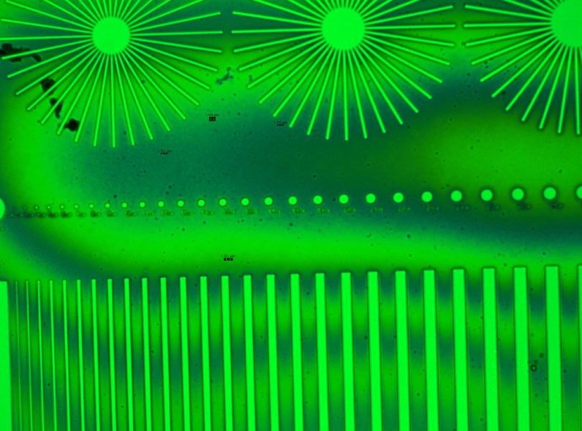
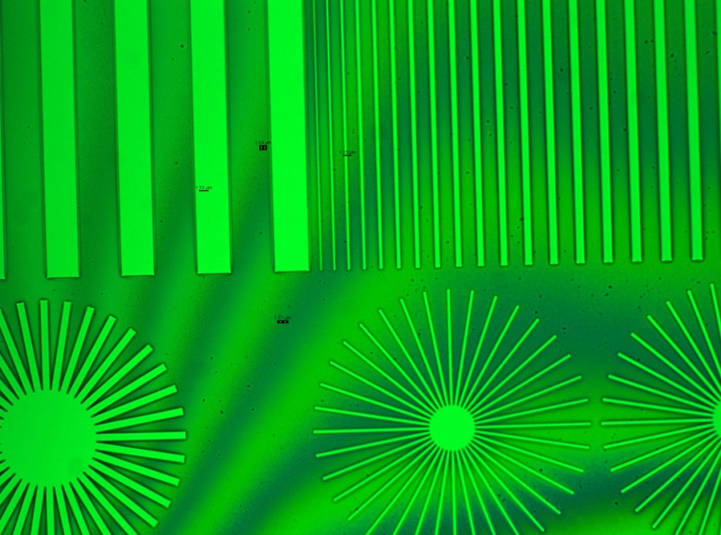
Sample 1-3, 20 min total etch All features exposed

Slide 9
Next Steps
Characterize etch rate more precisely on unfeatured wafers – 2/3/12
Etch single-layer features and measure uniformity – 2/3/12
Check uniformity in SEM 2/6/12
Unetched samples
Etch-back samples
Try intermediate etching
BCB-etch-measure + BCB-etch-measure instead of using the soft cure method

Slide 10
Notes
If grassing becomes a problem I could potentially use recipe 332 as a cool down/cleanout step in between 5 min etches

