Slide 1
DUV positive/negative PR metal liftoff

Slide 2
Recipe – Negative PR
DBARC
5k, 30 s
170C, 60 s
UVN 2300-0.5 (this recipe comes from UVN 30-0.5 spec sheet)
3k, 30 s (550 nm thick)
110 C, 60 s
Expose (~25 mJ/cm2, -0.15 focus, NA=0.63, annular σ=0.4/0.8)
105 C, 60 s
AZ300MIF, 60 s
Descum
30 s, 100 W
Metal dep (E-Beam 1)
100 nm, 1 Å/s with occasional spike at 2 Å/s
Liftoff
1165, 30 min, sonication

Slide 3
SEMs

Slide 4
Recipe – Positive PR
DBARC
5k, 30 s
170C, 60 s
UV 210-0.3
1k, 30 s (~500 nm according to spec sheet)
135 C, 60 s
Expose (~25 mJ/cm2, -0.15 focus, NA=0.63, annular σ=0.4/0.8)
135 C, 90 s
AZ300MIF, 45 s
Descum
15 s, 100 W
Metal dep (E-Beam 3)
20/80 nm (Ti/Au)
Liftoff
1165, 30 min, sonication

Slide 5
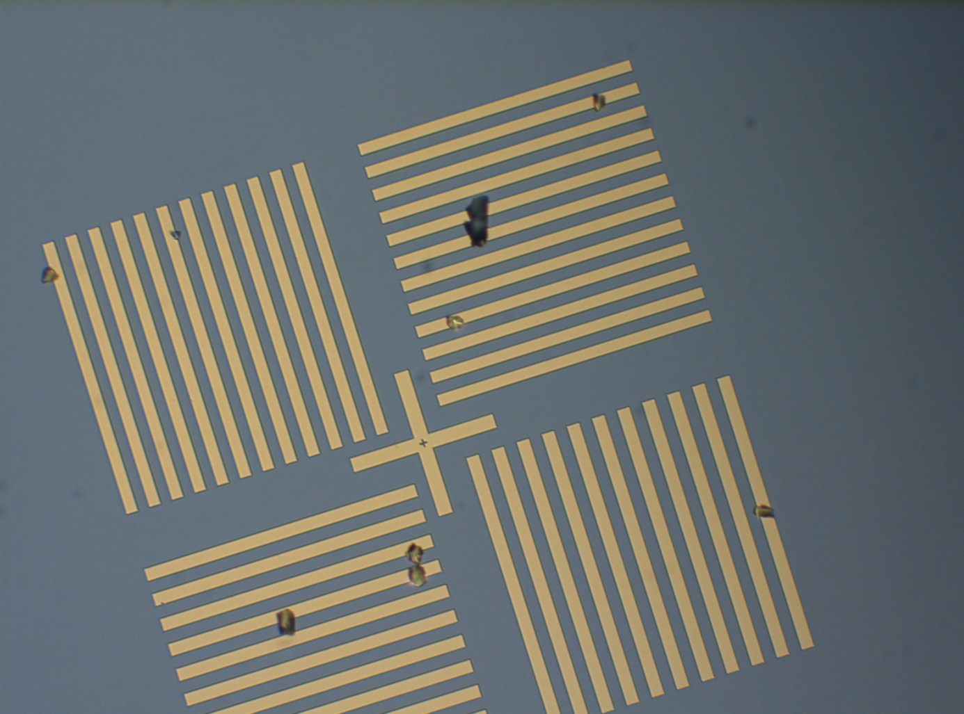
Optical microscope

