Slide 1
DUV process Development

Slide 2
Process
Sample: SOI, 1um BOX, 273 nm top Si, 200 nm PECVD SiO2 HM
Sample cleaning
Piranha
Spin DBARC
DS-K101: 30s @ 5k rpm
Inspect backside
Bake DBARC 60s @ 170C
Spin PR
UV210: 30s @ 5k rpm
Pre bake: 60s @ 135C
Expose (clear field, mostly isolated 500 nm wide WGs, some denser areas, couplers, star couplers, …)
Post bake: 90s @ 135C
Develop: 120s, 300MIF

Slide 3
1st exposure array
NA=0.63
Annular: σ_{inner}=0.4, σ_{outer}=0.8
 | -0.35 | -0.15 | +0.05
29 mJ/cm² | Y | Y | Y
28 | N | Y | Y
27 | N | N | Y
26 | N | N | Y
25 | N | N | N
24 | N | N | N
23 | N | N | N
22 | N | N | N
21 | N | N | N

Slide 4
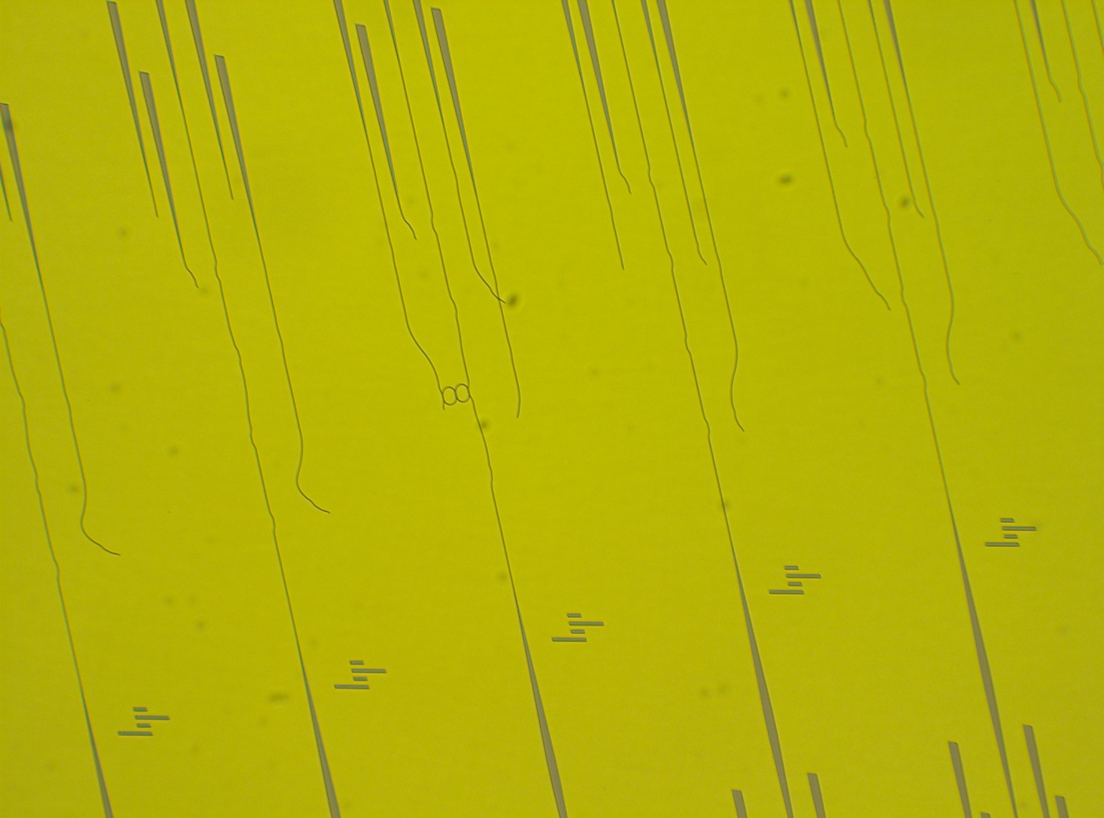
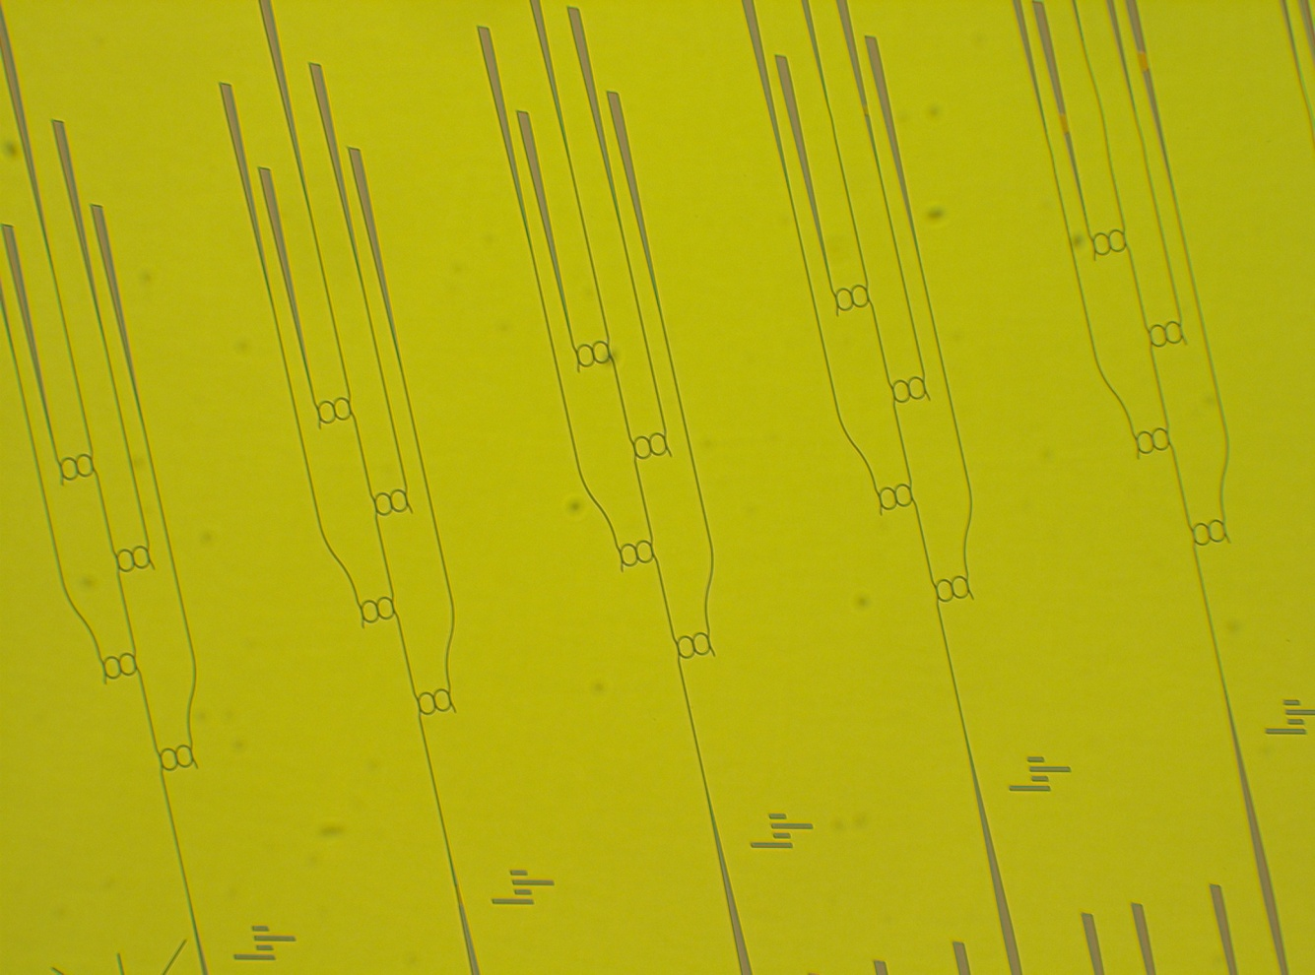
N (features overdeveloped)
Y (features ok)

Slide 5
2nd exposure array
NA=0.63
Conventional: σ=0.75
 | -0.15 | +0.05 | +0.25
33 | N | N | N
32 | N | N | N
31 | N | N | N
30 | N | N | N
29 | N | N | N
28 | N | N | N
27 | N | N | N
26 | N | N | N
26 | N | N | N

Slide 6
3rd exposure array
Bay 6 hot plate for DBARC cure
NA=0.63
Annular: σ_{inner}=0.4, σ_{outer}=0.8
Develop time: 45s
Grating test structures ugly, main features good
 | -0.15 | +0.05 | +0.25
37 | Y | Y | Y
35 | Y | Y | Y
33 | Y | Y | Y
31 | Y | Y | Y
29 | Y | Y | Y
27 | Y | Y | Y
25 | Y | Y | Y
23 | Y | Y | Y
21 | Y | Y | Y

Slide 7
4th exposure array
Bay 7 hot plate for DBARC cure
NA=0.63
Annular: σ_{inner}=0.4, σ_{outer}=0.8
Develop time: 45s
Grating test structures and main features look good
 | -0.15 | +0.05 | +0.25
41 | Y | Y | Y
38 | Y | Y | Y
35 | Y | Y | Y
32 | Y | Y | Y
29 | Y | Y | Y
26 | Y | Y | Y
23 | Y | Y | Y
20 | Y | Y | Y
17 | Y | Y | Y

Slide 8
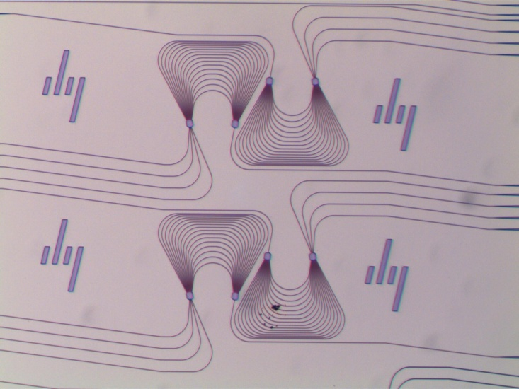
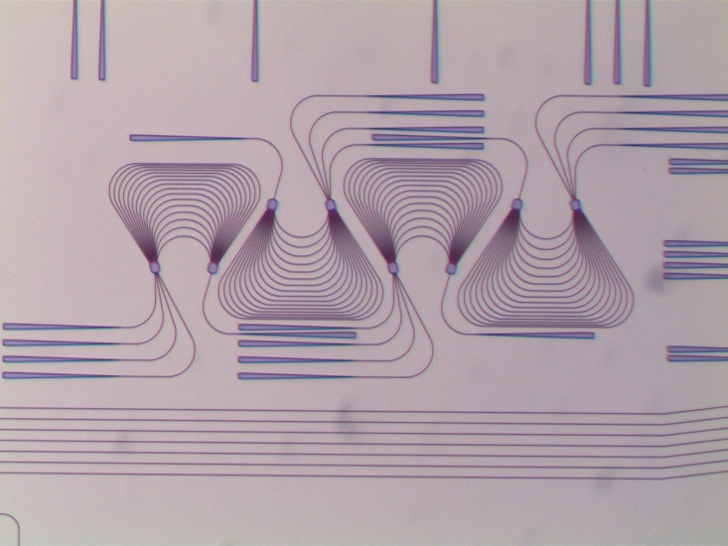
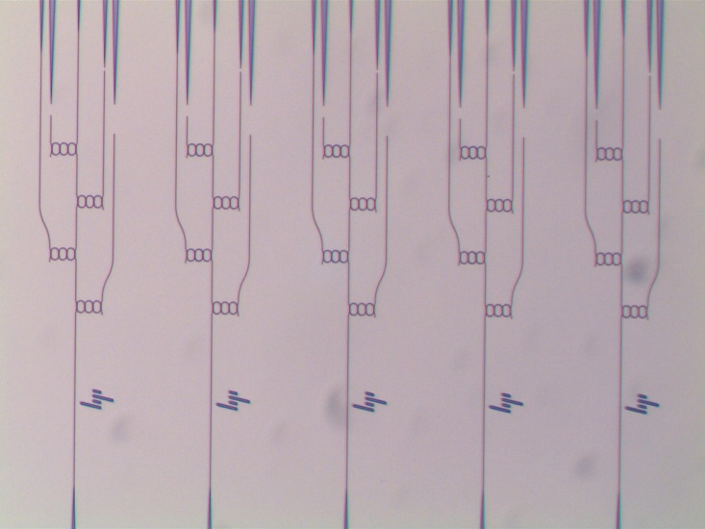
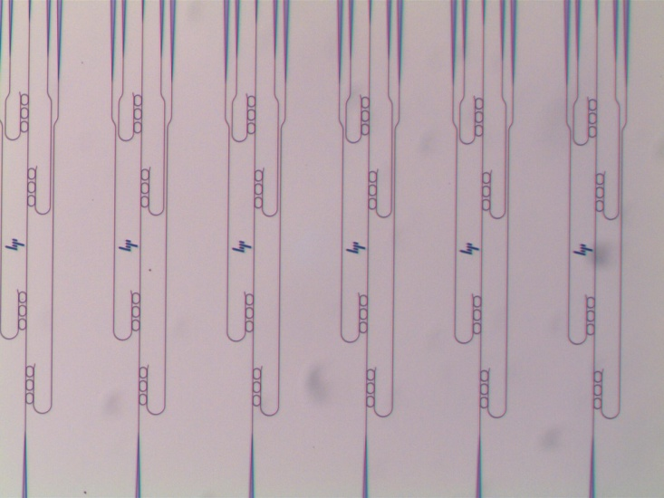
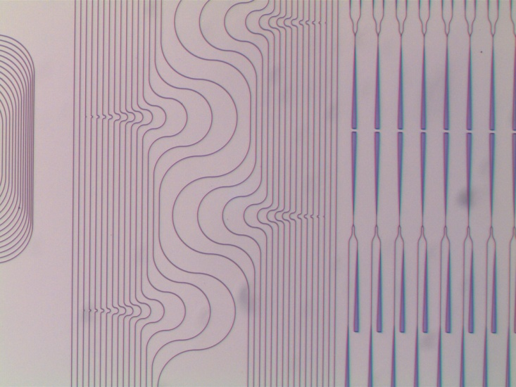

Slide 9
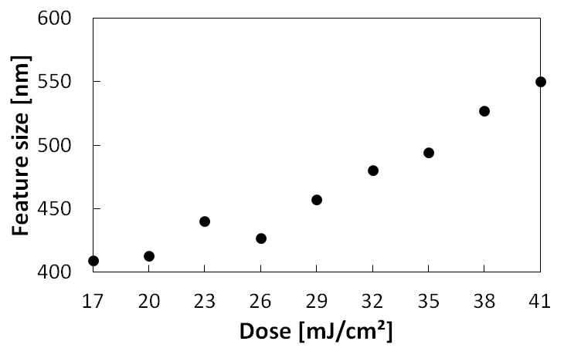
Feature size vs. Dose
Mask design

