Slide 1
DUV Stepper Waveguides
Jock Bovington
&
Jared Hulme

Slide 2
Overview
Design of Experiment
Device Layout
SEM Results
Conclusions

Slide 3
Design of Experiment
Jock Bovington

Slide 4
Design of Experiment
Using 3 Si wafer (NOT SOI)
Split DBARC bake temperature (160,170,180C)
Split dose energy (16,17,18…31mJ/cm²)
Hold focus (-0.15um)
Etch 250s

Slide 5
Process Follower
Clean Wafers
Nano Strip, DI rinse, BHF, Di rinse, SRD
Dehydration bake (132C, >1min)
Spin DBARC (5krpm, 30s)
Hot plate bake temp = XC, 60s
Spin UV210 (5krpm, 30s)
Soft bake temp = 132C, 60s
DUV stepper exposure (YmJ/cm², -0.15$µ$m)
Post exposure bake (132C, 90s)
Develop 300MIF (120s, minimal agitation)
PEII O2 Descum (100W, 300mT, 30s)
Si Deep RIE “Bosch” single step etch BOV_J_01 (250s, ~250nm)
Dektak step height
Gasonics Strip (recipe #7, 120s, 1-3 repeats)
Dektak step height
SEM

Slide 6
Device Layout
Jared Hulme

Slide 7
Device Layout – Dose Energy
26 | 27 | 28 | 29 | 30
25 | 24 | 23 | 22 | 21
16 | 17 | 18 | 19 | 20

Slide 8
Pattern Layout
PTPNSL-EPhi1.2_DUV2.gds
EPhi 1.2 points of interest
Coupler gaps
300nm period gratings
Star Coupler points
Taper Tips

Slide 9
SEM Results
Jared Hulme

Slide 10
Pattern Layout
PTPNSL-EPhi1.2_DUV2.gds
EPhi 1.2 points of interest
Coupler gaps
300nm period gratings
Star Coupler points
Taper Tips

Slide 11
SEMs

Slide 12
Pattern Layout
PTPNSL-EPhi1.2_DUV2.gds
EPhi 1.2 points of interest
Coupler gaps
300nm period gratings
Star Coupler points
Taper Tips

Slide 13
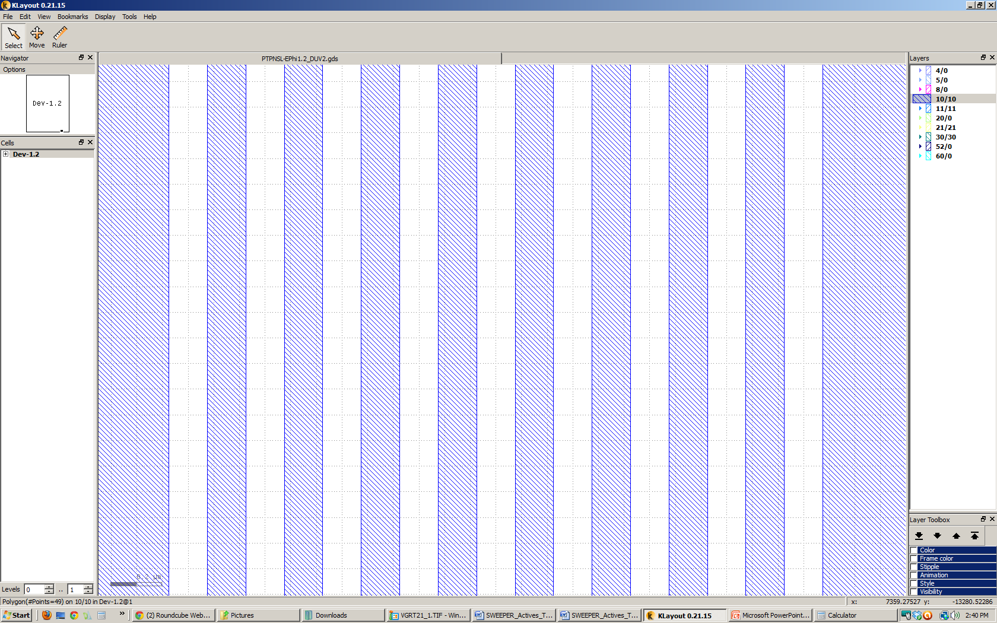
Vertical Gratings
12um
2.55um
.3um
.15um

Slide 14
SEMs – 160C Bake time
Die 21
Die 22
Die 23
Die 24

Slide 15
SEMs – 160C Bake time
PR for Vertical gratings can peel away easily.

Slide 16
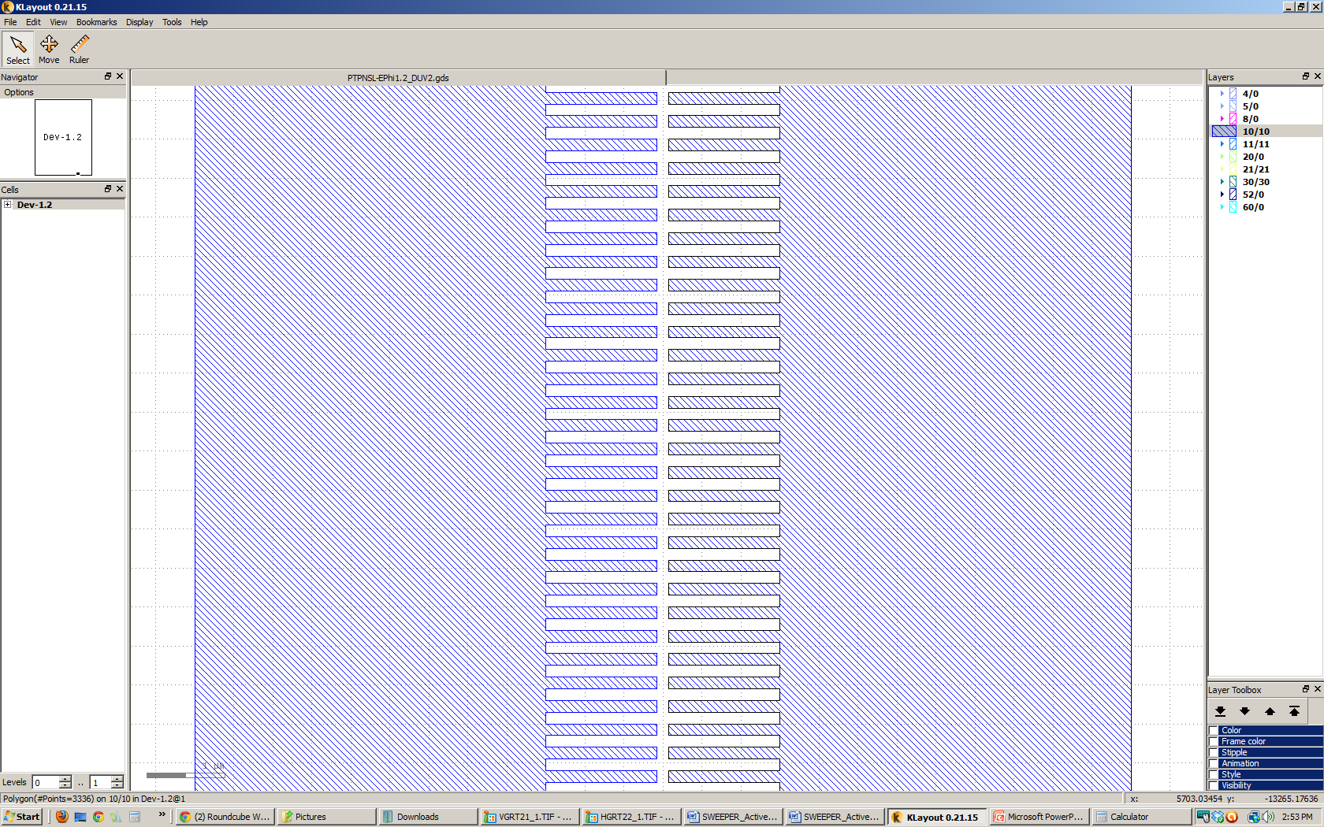
Horizontal Gratings
12um
3um
1.425um
.15um

Slide 17
SEMs – 160C Bake time
Die 21
Die 22
Die 24
Die 23

Slide 18
SEMs – 160C Bake time
Die 21
Die 22
Die 23
Die 24

Slide 19
Pattern Layout
PTPNSL-EPhi1.2_DUV2.gds
EPhi 1.2 points of interest
Coupler gaps
300nm period gratings
Star Coupler points
Taper Tips

Slide 20
SEMs

Slide 21
Pattern Layout
PTPNSL-EPhi1.2_DUV2.gds
EPhi 1.2 points of interest
Coupler gaps
300nm period gratings
Star Coupler points
Taper Tips

Slide 22
SEMs

Slide 23
Conclusions
Jared Hulme & Jock Bovington

Slide 24
Conclusions

