Slide 1
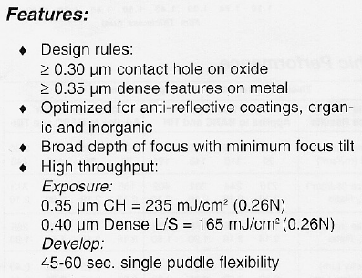
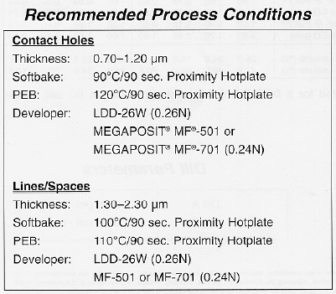
SPR955
Trying to get feature sizes smaller than a fraction 0.5 to 1 of the resist thickness is challenging. 0.9um resist → 0.5um is the limit.

Slide 2
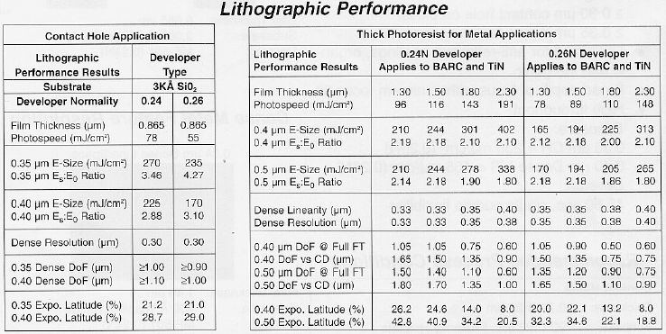

Slide 3
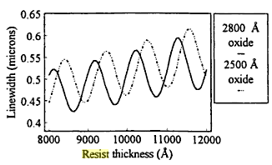
Accuracy – Sputter(~5nm)>PECVD(10-15nm)>Thermal- dry(10-20nm).

Slide 4
CEM - Sputter

Slide 5
CEM - Thermal

Slide 6
SPR - Sputter

Slide 7
SPR - Thermal

Slide 8
CEM
SPR
w
w
Resist profile
w + 200nm
w’
w’
Oxide profile
w’ + 150nm
w’ + 180nm
w’’ + 110 +/- 10 nm
248 +/- 5 nm
w’’ + 110 +/- 10 nm
Silicon profile
w’’
w’’
35 +/- 10 nm
Marginally better sidewalls for CEM – comparing slides 4&7

