Slide 1
Grating Analysis Update
2011-03-01
Jock Bovington
with assistance from
Wenzao Li

Slide 2
Outline
Grating Fabrication
  PULSAR Gratings
  SWEEPER Gratings
Grating SEM Gallery
Image Processing Tool*
  Attainment of nm resolution measurement accuracy for understanding dose and proximity effects
  Applications in fully controlled apodization of kappa with duty cycle…and later other parameters
*Thanks to Wenzao for building this tool with me

Slide 3
Experiment design with Process flow
Two initial device samples were run
  PULSAR (GaAs) Epi with IBD SiO₂ (55nm)
    11nm Au Thermal Evaporated
    Developed
    ICP #2 (Oxide Etch)
    AFM
    ICP #1 (GaAs Etch)
    AFM
    SEM
  Sweeper SOI (500nm Si, 1um BOx)
    2 patterned die, 2 unpatterned
    11nm Au Thermal Evaporated
    Developed
    AFM (~393+/-7nm)
    Deep Si RIE “Bosch” (Si Etch) - Thanks Jason
    AFM
    SEM

Slide 4
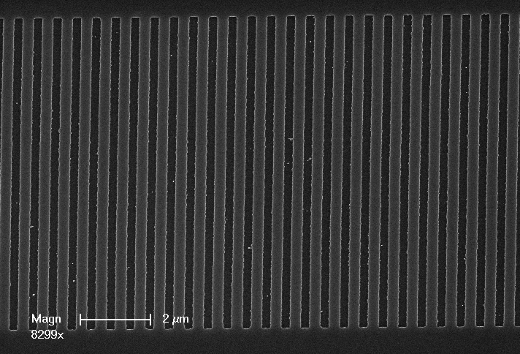
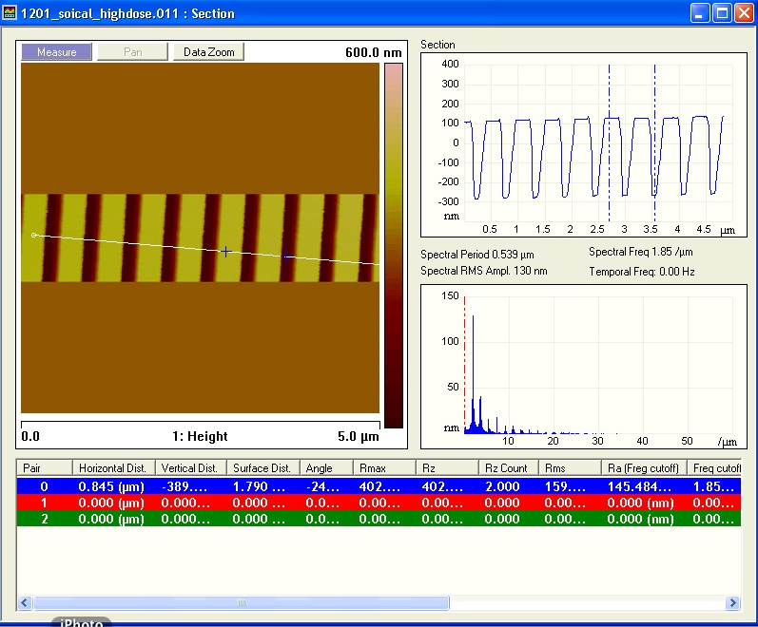
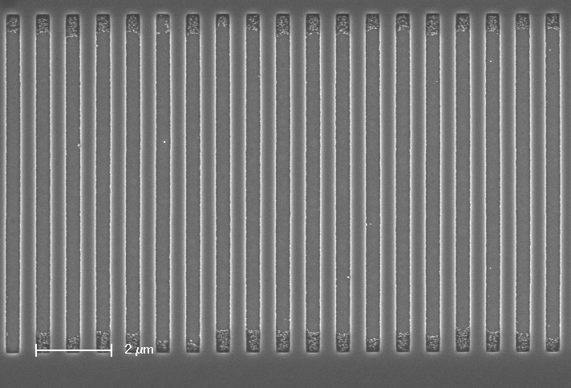
Grating Analysis

Slide 5
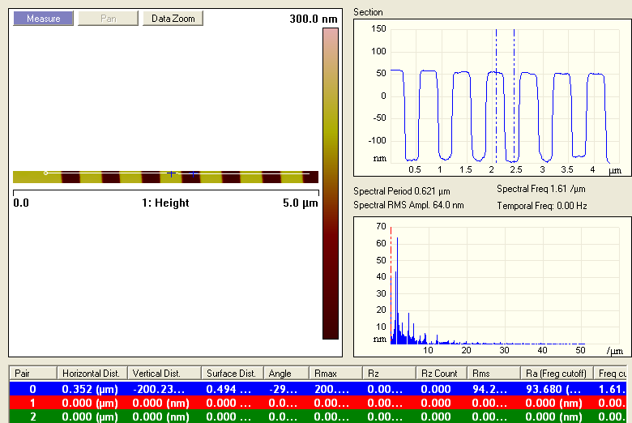
PULSAR AFM Analysis
with ~55nm SiO2 Hardmask

Slide 6
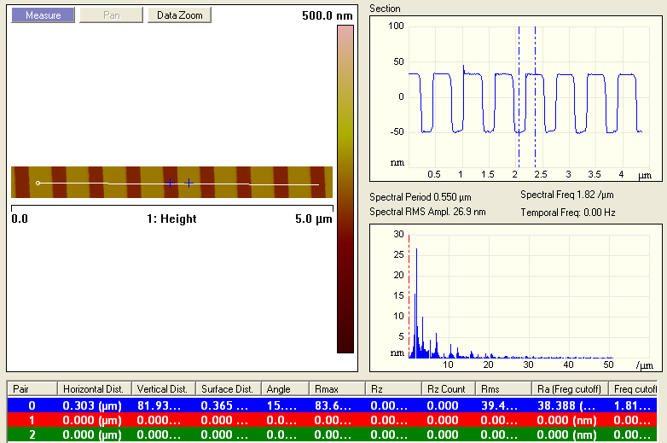
Sweeper AFM Analysis
Final etch height (no hard mask)

Slide 7
SEM Analysis
Top down SEM is an excellent way to gain understanding about gratings.
  Dose
  Proximity Effects
  Duty cycle
  Qualitative information about pattern distortion

Slide 8
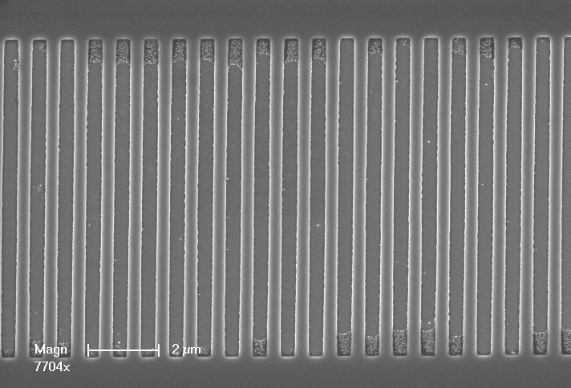
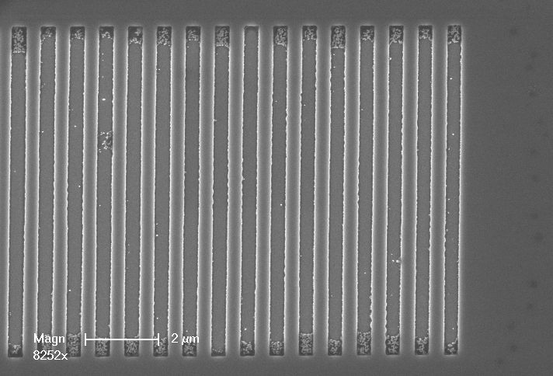
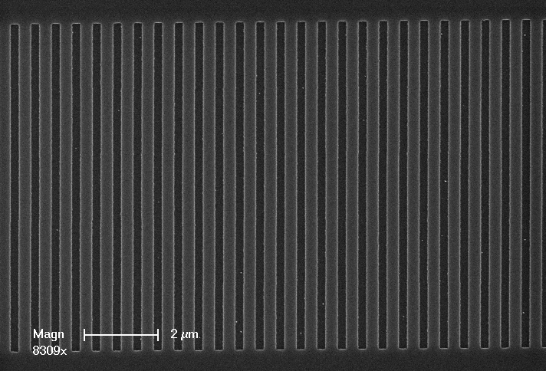
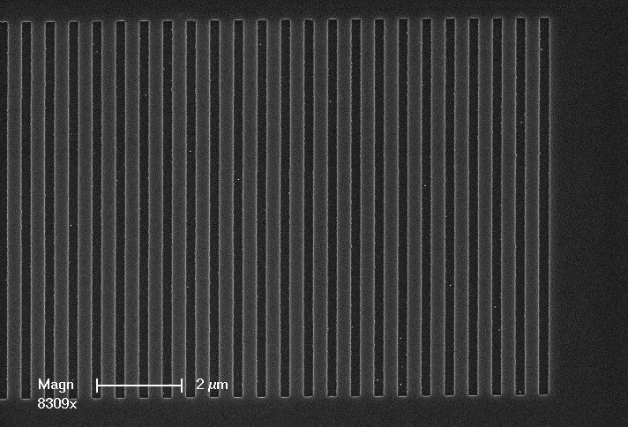
Understanding the grating

Slide 9
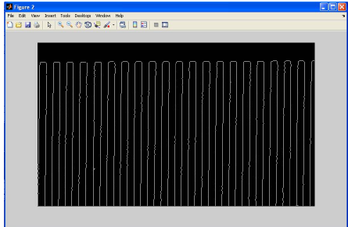
Edge Detection Program

Slide 10
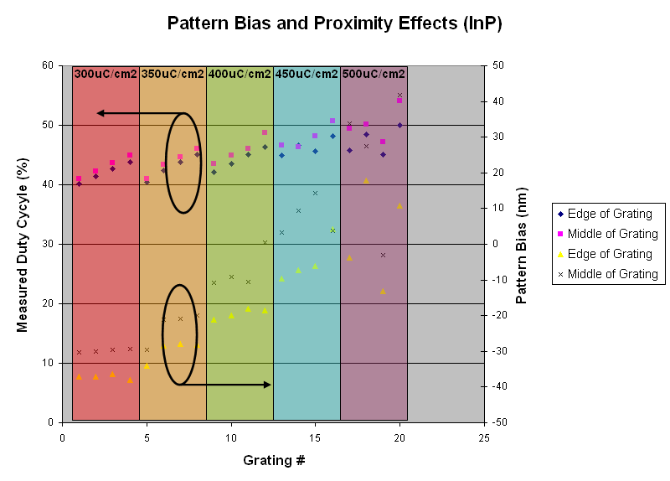
InP Image Analysis Results

Slide 11
PULSAR Grating SEMs

Slide 12
Sweeper Grating SEMs

Slide 13
Sweeper Grating SEMs

Slide 14
Conclusions
Honed in on the best Ebeam writing conditions for large pitch gratings ~500-700nm
Characterized etches for these gratings for:
  GaAs
  Si/SOI
  InP (Working on a polymerization issue with the MHA etch, next will try GaSonics. Pietro, Sweeper has a solution with the RIE#2)
Grating Development To-Do-List:
  Cross section POR gratings to fully qualify etches
  Characterize etch rate v. pattern size

