Slide 1
Isolator update
Jason Tien
3/1/2011

Slide 2
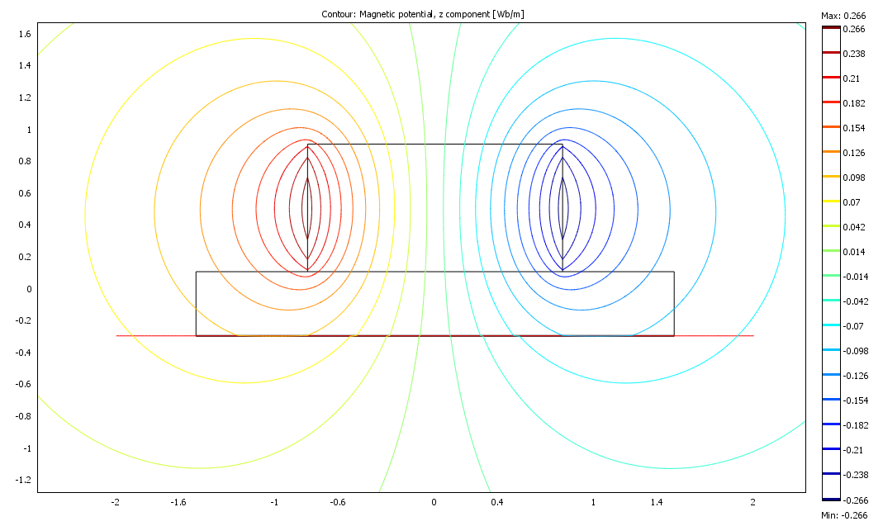
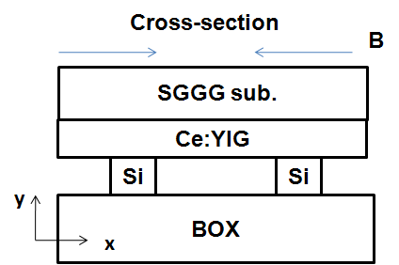
Device Structure
Input
Top view
Magnetic field flux from a cylinder magnet
B
1.6mm
Ce:YIG
Ce:YIG (0.5μm)
(a)
Magnet
0.4 mm
SGGG sub.
Silicon waveguides
(b)

Slide 3
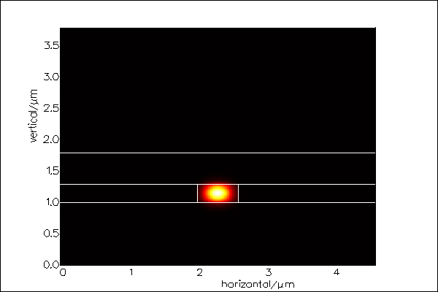
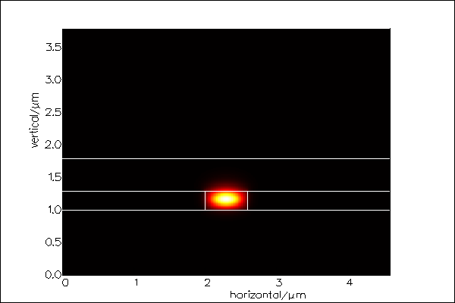
295 nm thick Si layer
WG: 600 nm x 295 nm
Intensity distribution
TE
TM
Air
BOX
ng=3.97
ng=4.68
TE
TM
GGG
YIG
BOX
ng=3.85
ng=3.88

Slide 4
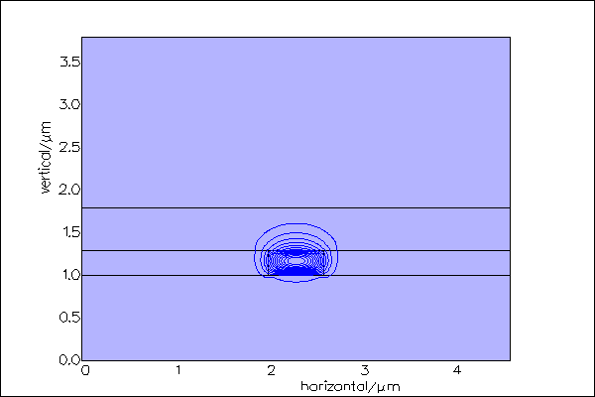
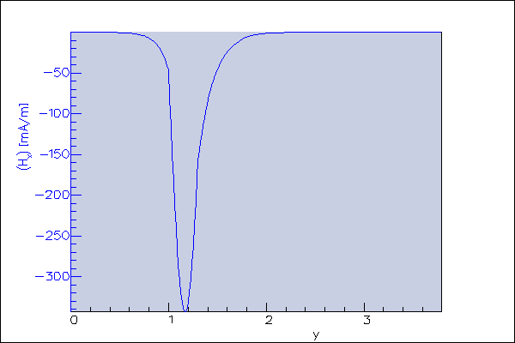
295 nm thick Si layer
WG: 600 nm x 295 nm
TM mode Hx field
YIG
GGG

Slide 5
NRPS calculation
Si waveguide thickness: 300 nm
Ce:YIG thickness: 500 nm
Hx field profile for 600 nm x 300 nm waveguide
SGGG
Ce:YIG
Air
Si
Air
BOX

Slide 6
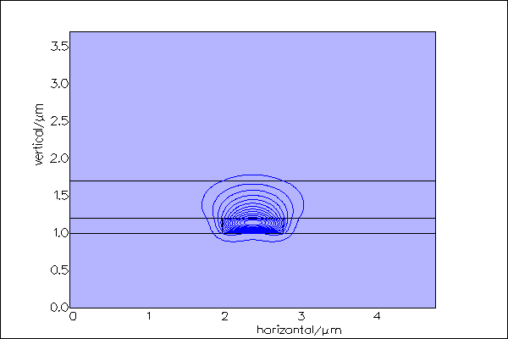
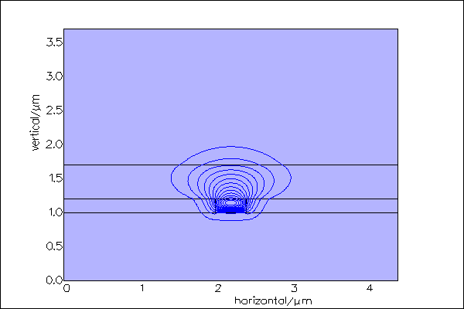
NRPS calculation
Si thickness: 200nm
Narrower waveguides confine less power at the Si-garnet interface

Slide 7
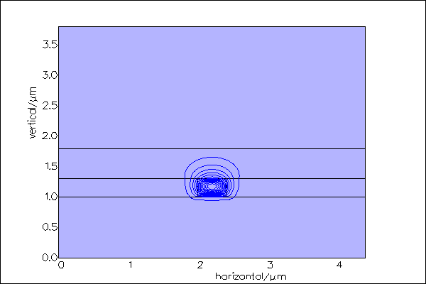
NRPS calculation
Si thickness: 300nm
Narrower waveguides have larger filed intensity in Si-garnet interface

Slide 8
Design plot for coupling gap
900um ring to straight waveguide coupling design
295 nm thick SOI

Slide 9
FSR (TM) ~ 84pm (ng~5)

Slide 10
Tunable magnetic optical filter
Ring radius: 900um
Coupling gap: 192nm
Extinction ratio: 9 dB
TM mode

Slide 11
Ring isolator
Ring radius: 900um
Waveguide dimension: 600 nm x 300 nm
Ce:YIG: 0.5um
Isolation ratio ~ 9dB
TM mode
Magnetic field intensity ~ 200 Gauss
Near field IR image

Slide 12
Summary
Resonance wavelength is tunable by applying different magnitudes of magnetic fields
Inward and outward radial magnetic fields show different resonance wavelengths with half of FSR of shift.
9dB of isolation with TM input
Better isolation can be achieved in critical coupling region.
Smaller ring isolator can be realized with a smaller permanent magnet or micro-electromagnet.
Drop port isolation, circulators…

