Slide 1
SOA EPI Design
Yongbo
12/16/2011

Slide 2
III/V epi design
 |  | revised design (0711281-9) |  | Note
(No.) | Material | Height | Doping (cm⁻³)
0 | n-InP substrate | 350 um | Up to grower
1 | u-InP buffer | 0.5 um | - | Landmark suggestion
2 | p-InGaAs | 30 nm | Up to grower | etching stop layer
3 | p-InP | 20 nm | Up to grower | InGaAs protection layer (Too thick affects implantation uniformity due to the undercut)
4 | p-InGaAs | 0.2 um | >1E19 | for etch-back tolerance (p-contact)
5 | p-InP | 1.5 um | 1E18 | 1.0 um - 0.3 um - 0.2 um with decreasing doping levels? To be decided (waiting for Landmark’s standard epi)
6
7
8 | p-InAlGaAs | 125 nm | 1E17 | Current SOA EPI (waiting for Landmark’s standard epi)
9 | u- 8x InAlGaAs (+0.85%) u- 9x InAlGaAs (-0.55%) | 7 nm / 10 nm (1545 nm) | nid
10 | n-InAlGaAs | 125 nm | 1E17
11 | n-InP | 0.11 um | 1E18 | Standard Design
12 | 2x n-InGaAsP / 2x n-InP | 7.5 nm / 7.5 nm | 1E18
13 | n-InP | 10 nm | 1E18
14 | n-InGaAs | 0.2 um | 1E18

Slide 3
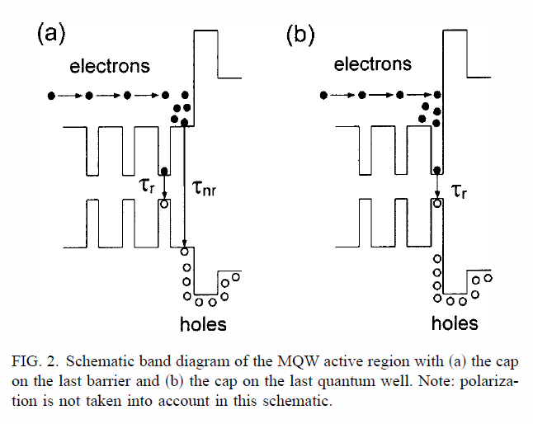
Electron Blocking layer
EBL after the well rather than the barrier
Confine the electron in the well rather than the barrier region
EBL improves confinement of the electron
better high temperature performance
Lower threshold
Improved quantum efficiency (sharp slope)

Slide 4
Etch Stop layer/Current channel
Add an etch stop layer above upper SCH
Under-cut to define the current channel
No proton implantation for lasers/no harm to the active region
Smaller differential resistance/tolerance for via opening
Thin layer will not affect the optical mode (TE) too much
It always reduces the capacitance of the modulator using undercut.
Current non-uniformity (need simulation)
How thin it could be for under-cut
One more step but compatible if we add etch stop layer
Repeatability using wet etching
Slightly direction-dependent but it could be OK
What kind of material?
InP/InGaAsP/InP?
What kind of Etchant?
H₂SO₄ : H₂O₂ : H₂O?

Slide 5
Backup: current EPI design

Slide 6
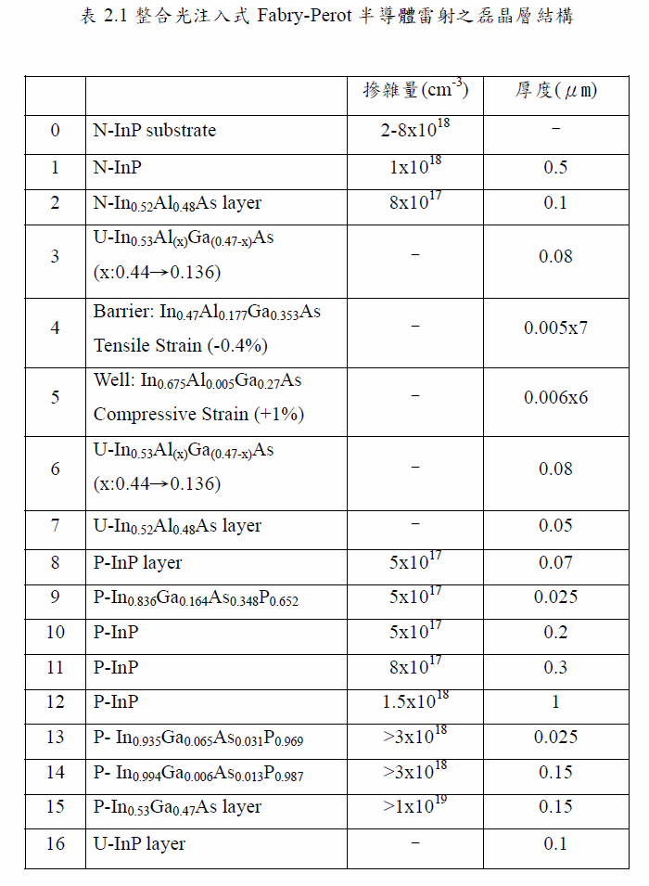
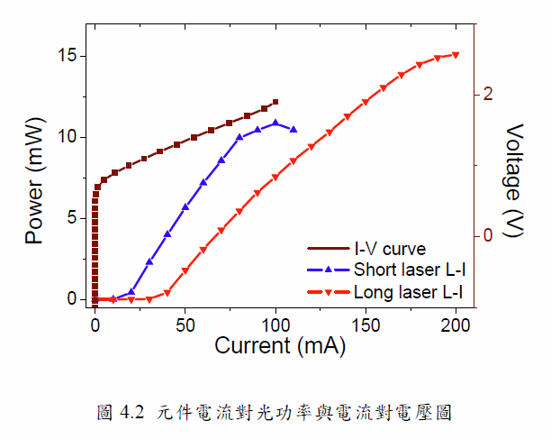
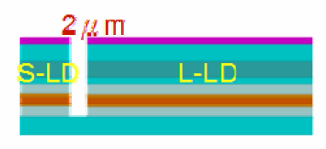
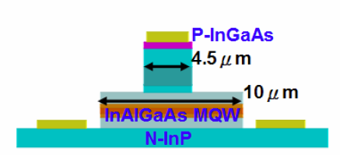
One version of Landmark’s EPI (1550)
ASE’s peak @~1540.6nm, red-shift with pump current increased
200μm
700μm
FP Lasers’ performance
From Zheng’s thesis

Slide 7
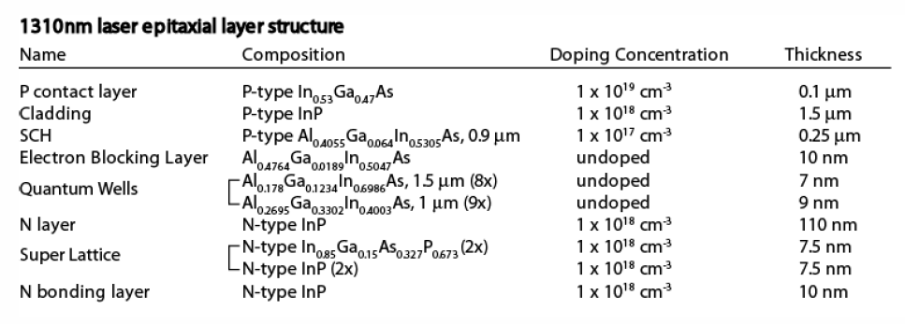
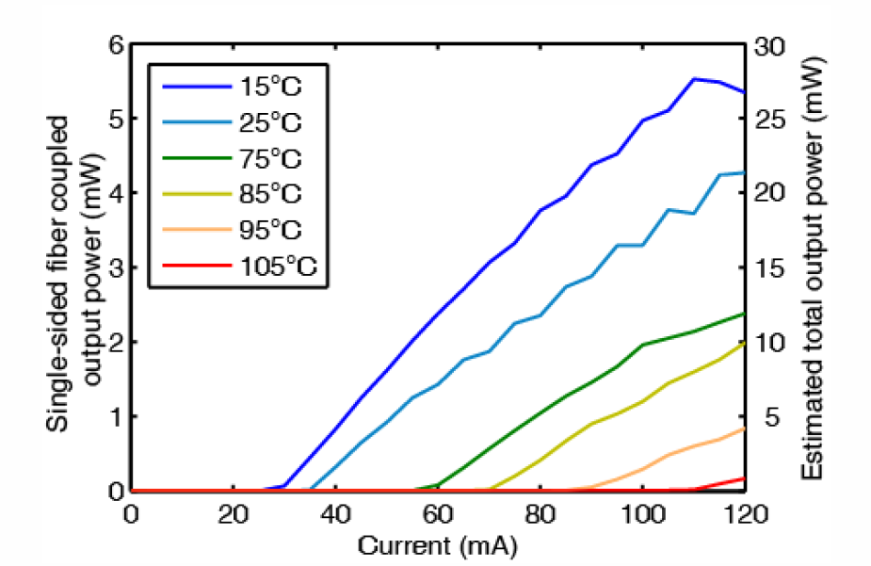
Andy’s EPI (1310)

Slide 8
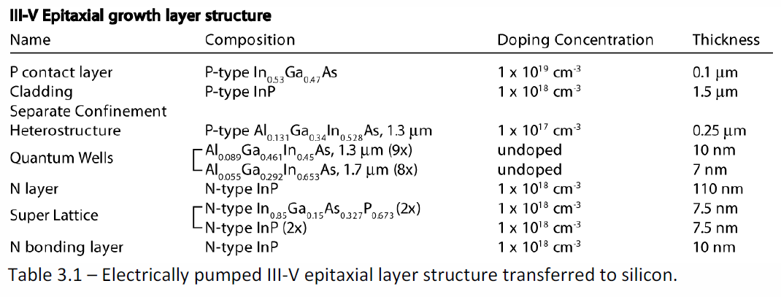
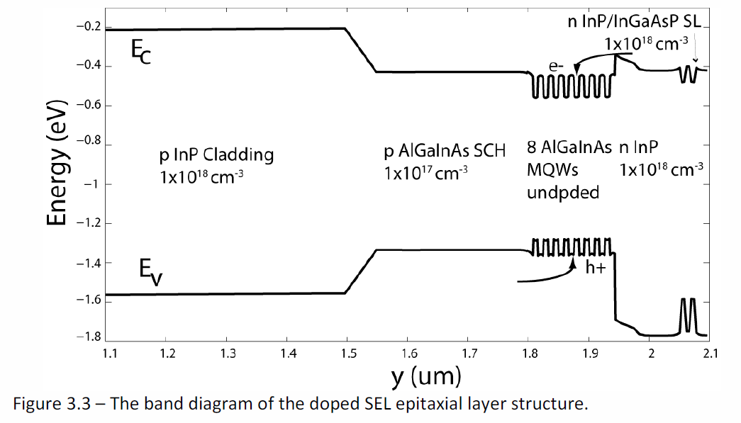
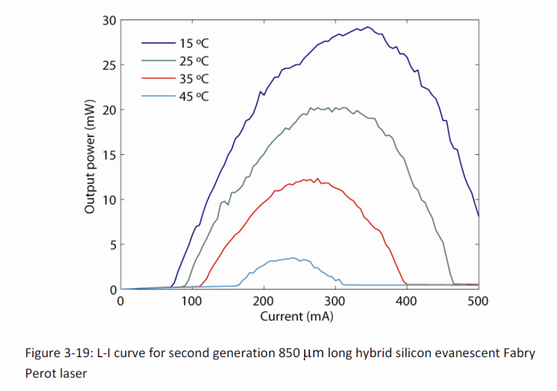
AW Fang(1550)

Slide 9
Phaser EPI (1550)
SCH: 1.3um 125nm/p-1e17
Well: InAlGaAs 8x 7nm +0.85%
Barrier: InAlGaAs 9x 10nm -0.55%
SCH: 1.3um 125nm/n-1e17

