Slide 1
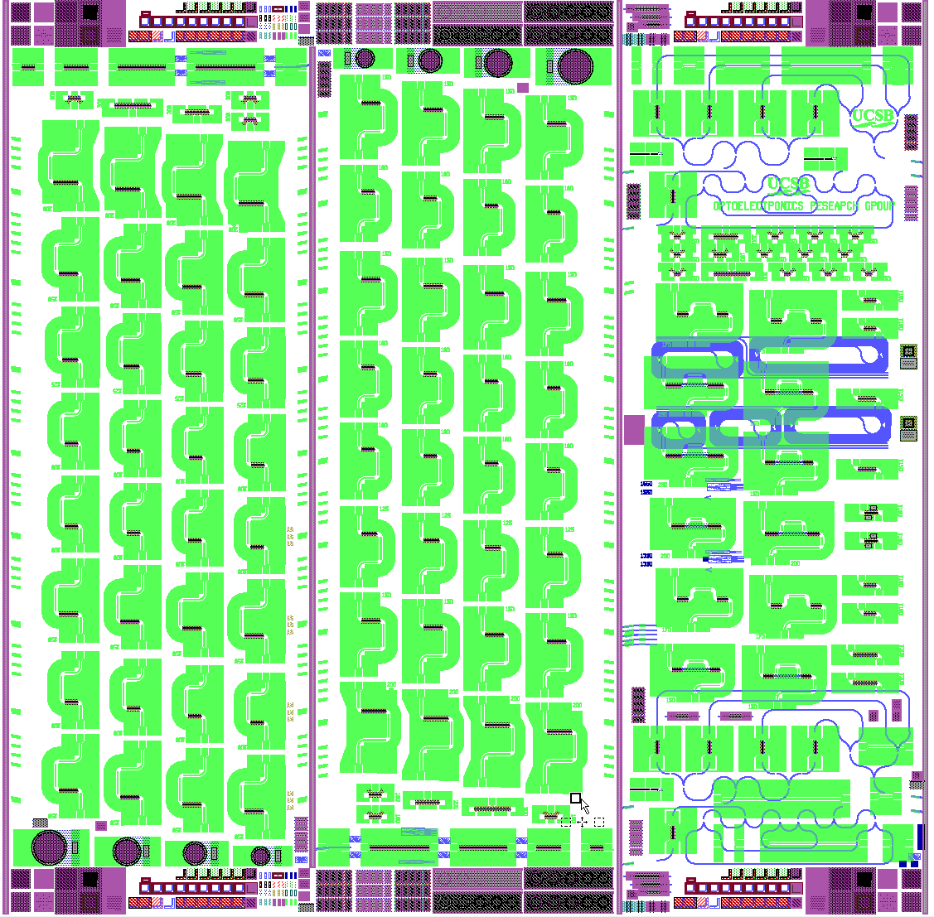
A
B
C
A1
A2
A3
A4
W1
W2
W3
W4
P1
P2
P3
P4
P5
0
1
2
3
4
1
1
1
2
3
4
5
1
2
3
4
8
4
3
2
1
2
1
2
2
3
4
3
1
2
3
4
5
7
4
4
3
2
1
3
1
5
2
3
4
6
1
2
3
6
4
4
3
2
1
4
7
1
2
1
2
3
4
3
5
4
3
2
1
5
8
1
2
1
2
3
3
4
4
3
4
3
2
1
6
9
1
2
1
2
3
4
4
10
1
2
3
3
4
3
2
1
7
4
1
2
3
4
1
3
11
2
4
2
4
3
2
1
8
1
2
3
4
12
1
2
3
4
2P3
1
4
3
2
1
5
3
2
0
4
1
2P6
2P2
W4
W3
W2
W1
A4
A3
A2
A1
13
2P1
2P4
2P5
NarrowQW: 100, 125, 150, 200
A1 | A2 | A3 | A4
100 | 200 | 400 | 500
Date:
Sample:
Purpose:
Note:
Wide QW: 100, 125, 150, 200
Len [um]
P2 | P3 | P4 | P6
100 | 300 | 600 | 1000
CrossSection
Len [um]
W1 | W2 | W3 | W4
120 | 160 | 200 | 260
D [um]
S1 | S2 | S3 | S4 | S5 | S0
16.91 | 20.51 | 24.83 | 27.58 | 34.31 | 2.2
L [mm]
V2, 20120315

Slide 2
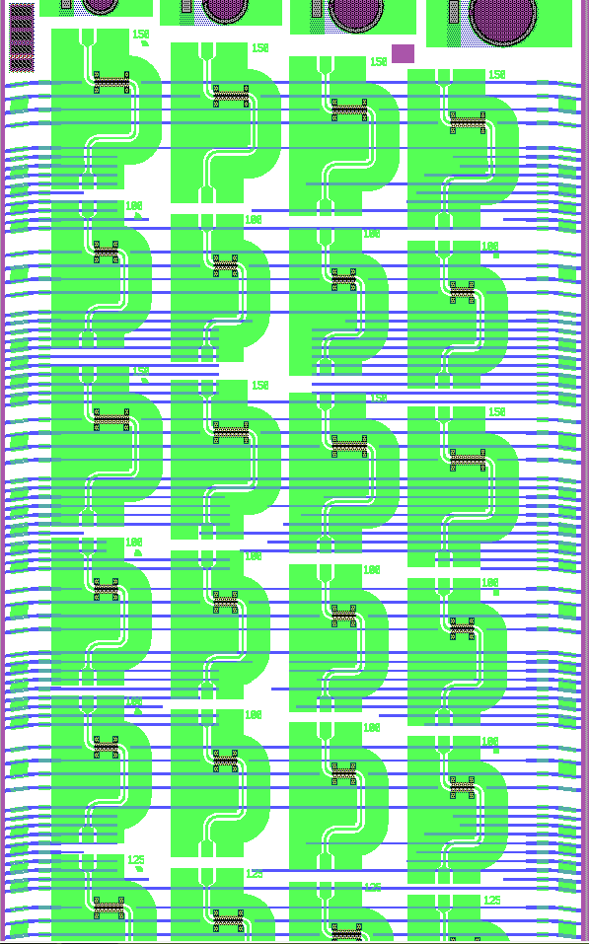
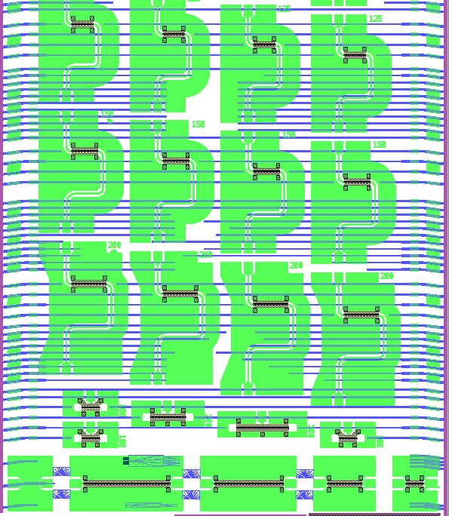
B
T11
Taper1(QW=7)
6/288 6/720 6/360 4/480 8/480 6/480 2/480 10/480
T110
I11
Impl.1 (QW=7)
250/300/30/80/140/0/50/100/200/0
I111
H11
HSW1(QW=7)
0/0/320/50/200/120/400/600/480/800/1000
H111
H21
HSW2(QW=7.5)
50/200/320/120/400/480/600/800
H29
T21
Taper2(QW=7)
6/288 6/720 6/360 4/480 8/480 6/480 2/480 10/480
T209
I21
Impl.2(QW=7)
250/300/30/80/140/0/50/100/200
I210
H31
HSW3(QW=7)
0/0/320/50/200/120/400/600/480/800/1000
H311
H41
HSW4(QW=6.5)
0/50/200/400/120/320/480/600/800
H49

