Slide 1
EPHI/SWEEPER Dev2 proton implant recipe
J. K. Doylend
10.24.2012

Slide 2
Layer stack
Air (no nitride or oxide on top of the stack)
0.2 um InGaAs
0.025 um 1.5 Q InGaAsP
0.025 um 1.3 Q InGaAsP
1.45 um InP
0.015 um 1.05 Q InGaAsP
0.015 InP
0.125 um InAlGaAs
Quantum wells – implant must not reach this layer.
Should be the same for both epi’s, the modified LASOR2 and the SWEEPER2, which were used for these chips.

Slide 3
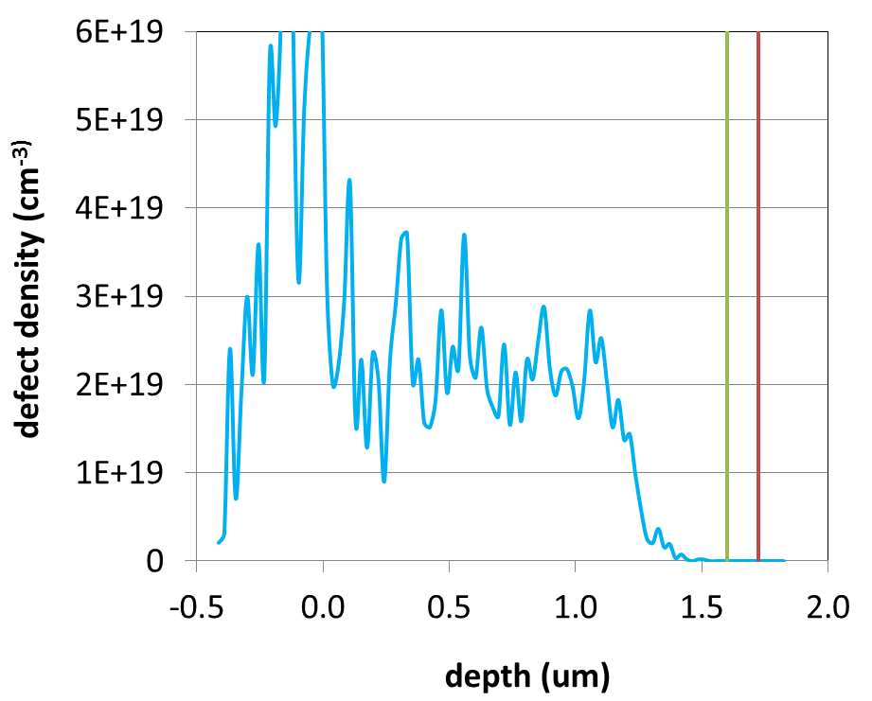
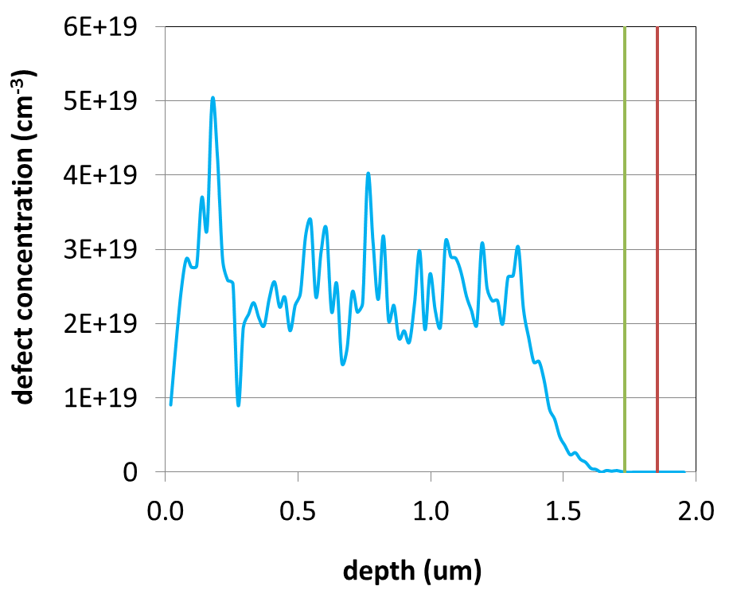
Implant recipes
LASOR2 recipe:
50 keV 5e13 cm⁻²
80 keV 8e13 cm⁻²
120 keV 9e13 cm⁻²
160 keV 1e14 cm⁻²
200 keV 8e13 cm⁻²
220 keV 8e13 cm⁻²
230 keV 5e13 cm⁻²
Notes: The implanted region is covered with thin p-metal (137 nm) and nitride (300 nm).
Dev2 recipe:
10 keV 5e13 cm⁻²
35 keV 8e13 cm⁻²
70 keV 9e13 cm⁻²
110 keV 1e14 cm⁻²
150 keV 8e13 cm⁻²
170 keV 8e13 cm⁻²
180 keV 5e13 cm⁻²
Notes: The implanted region is exposed.
SCH
SCH
QW
QW

