Slide 1
Mesa Sidewall Profile
June 14, 2011

Slide 2
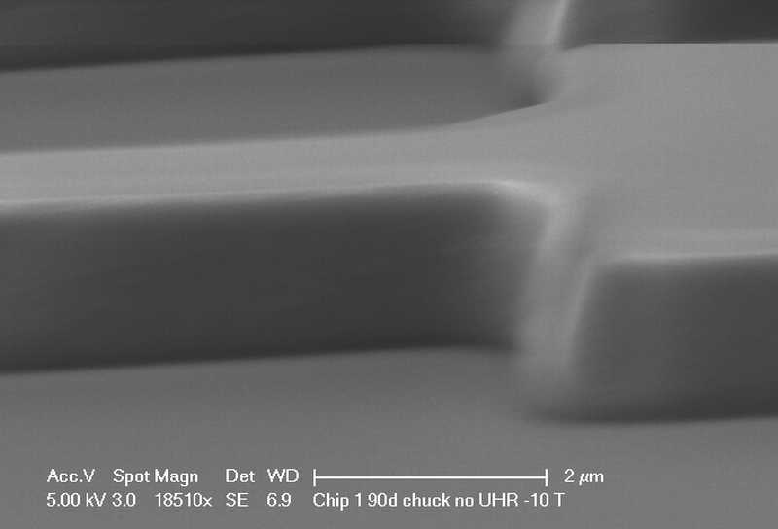
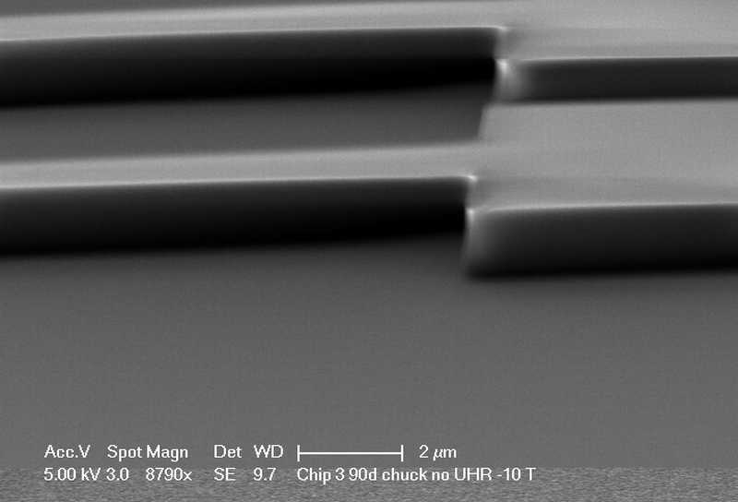
Mesa Lithography
Chip 3 Photoresist on SiN
Chip 1 Photoresist on SiN/Au
No image of Chip 2 Photoresist on SiN

Slide 3
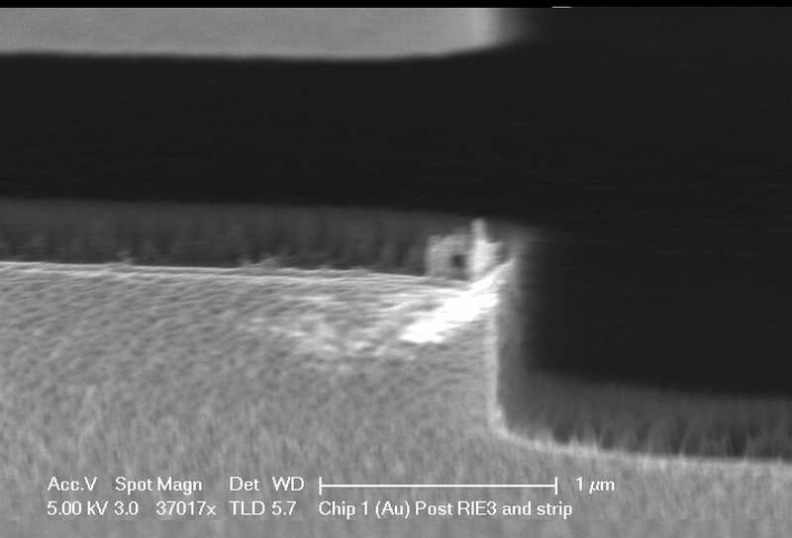
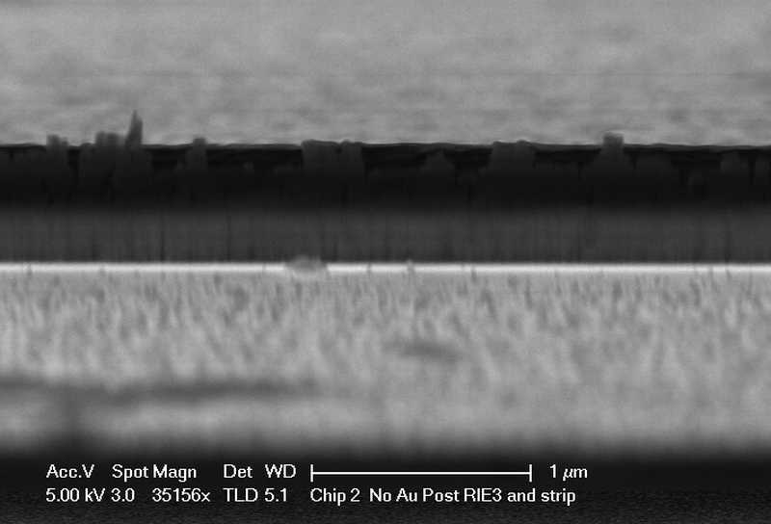
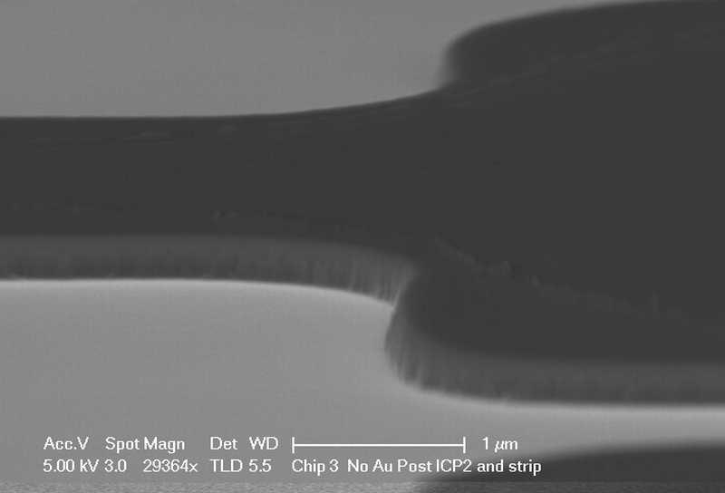
Mesa Post SiN Etch Post First 1165 Strip
Chip 1 RIE SiN on Au
Chip 2 RIE SiN on InP
Chip 3 ICP SiN on Au

Slide 4
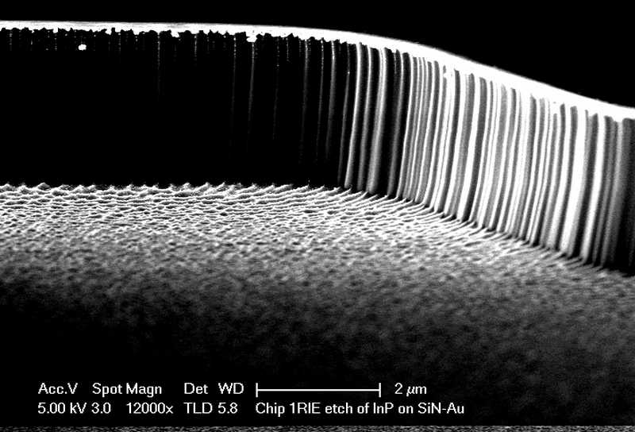
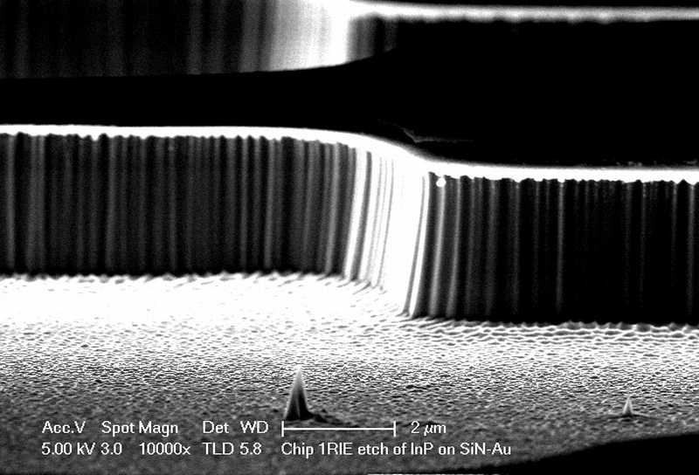
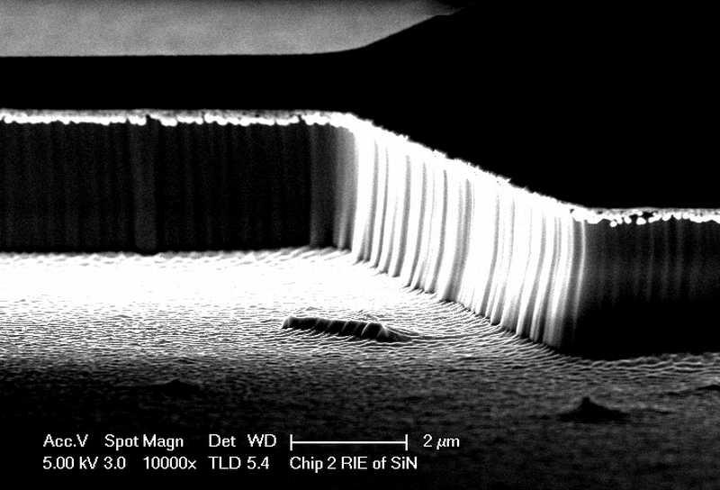
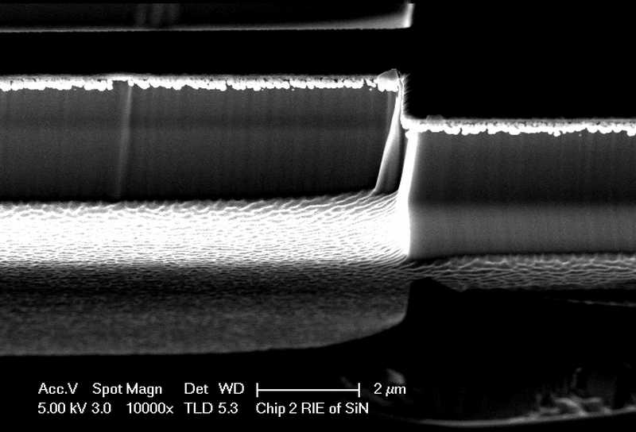
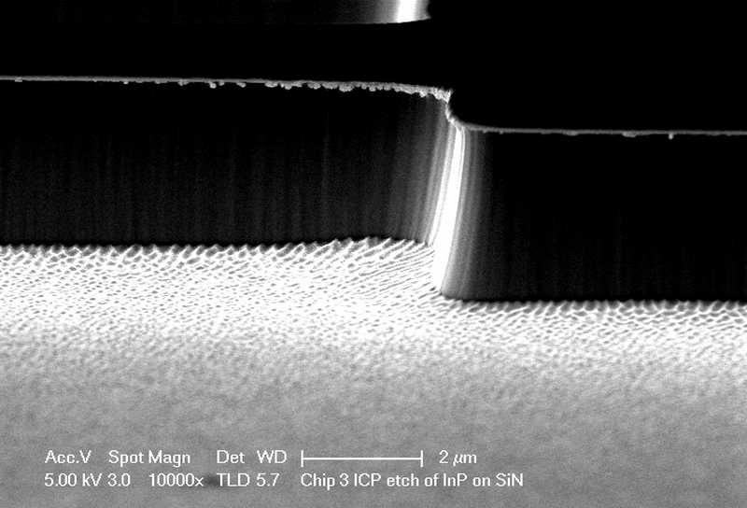
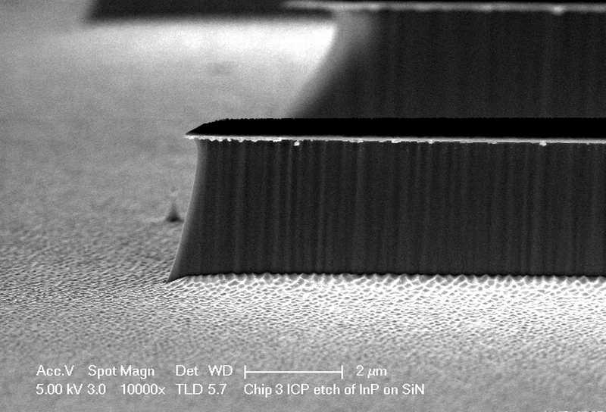
Mesa Post InP Etch
Chip 1 RIE SiN on Au
Chip 2 RIE SiN on InP
Angled area rougher than straight areas. Chip 2 also has incomplete RIE 3 resist strip causing masking
Chip 3 ICP SiN on InP

Slide 5
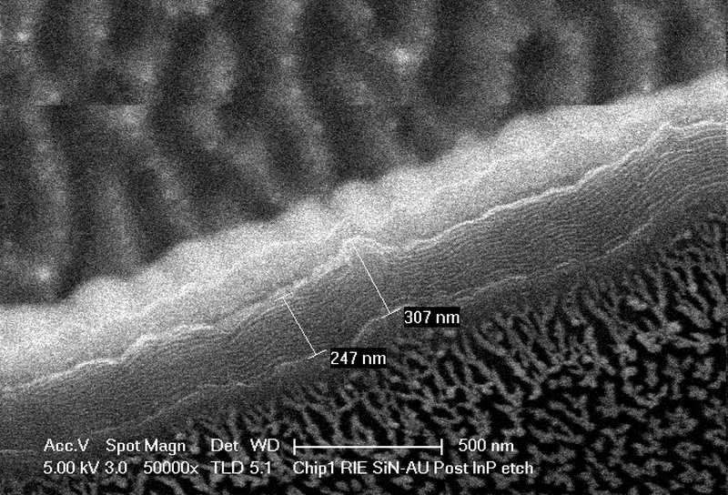
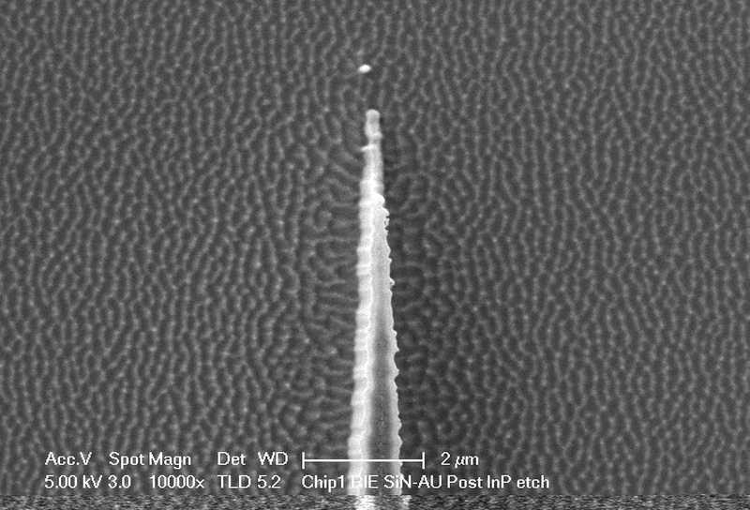
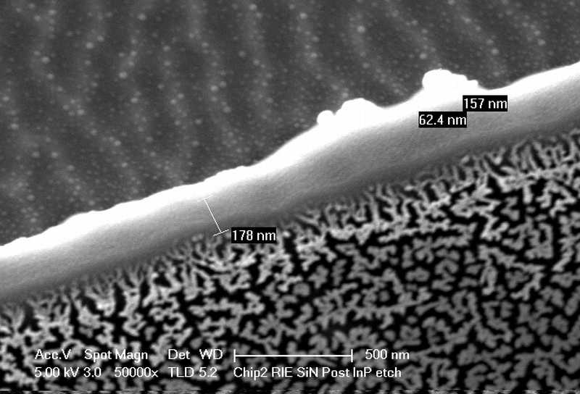
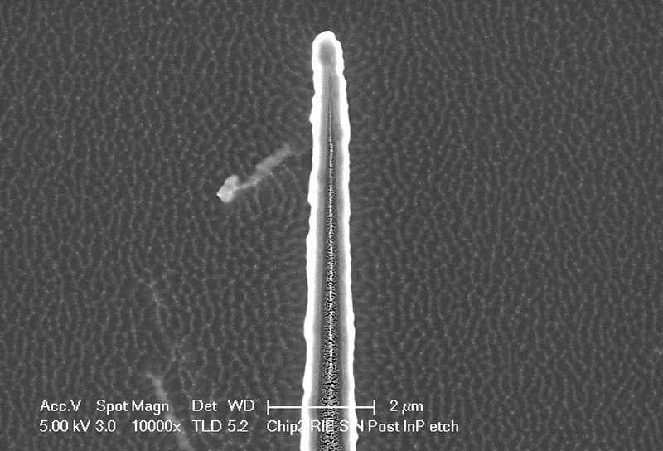
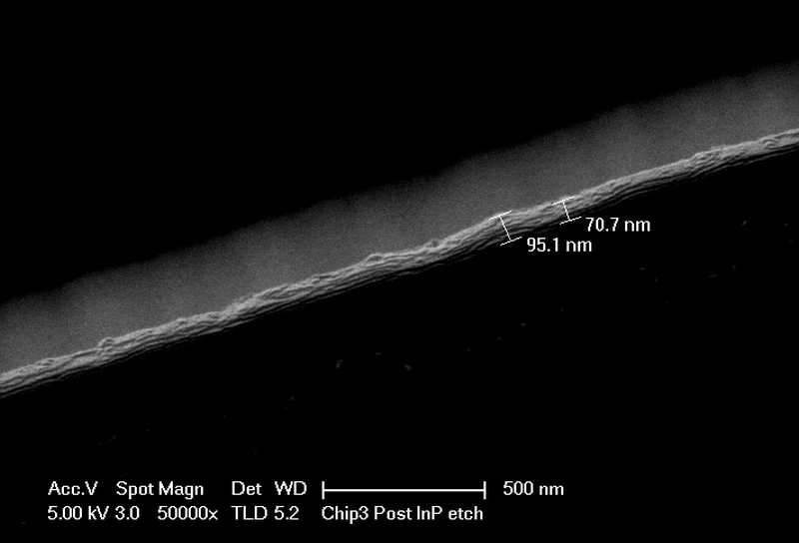
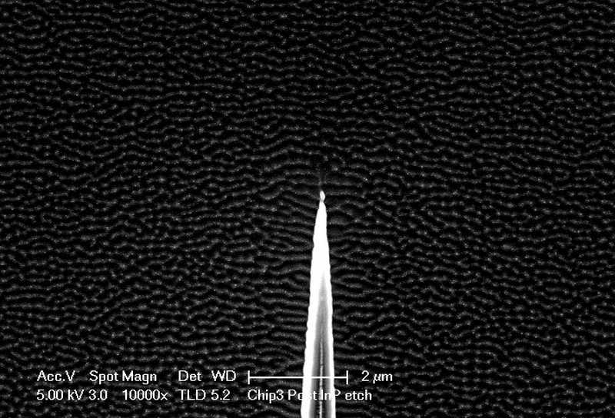
Mesa Post InP Etch
Chip 1 RIE SiN on Au
Chip 2 RIE SiN on InP
Chip 3 ICP SiN on InP

Slide 6
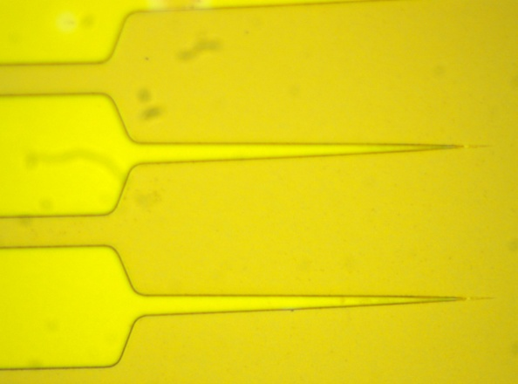
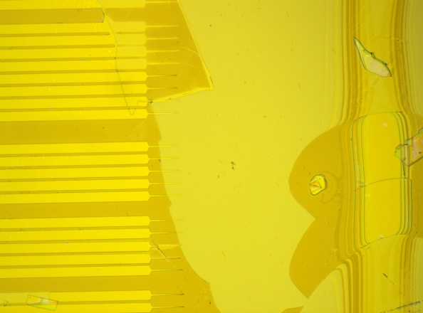
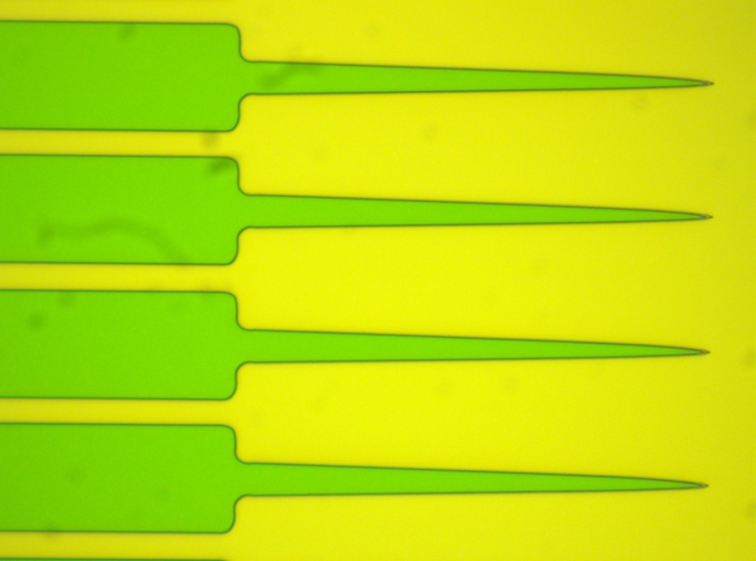
Mesa Post SiN Etch Post First 1165 Strip
Chip 1 RIE SiN on Au
Chip 2 RIE SiN on InP
Chip 3 ICP SiN on Au

Slide 7
Observation and Notes
RIE 3 Etch Time (CF4/02) is 17 minutes for InP pieces. Etch rate for 10 minutes is 210-240nm on Test Silicon piece
ICP 2 Etch time (CHF3) is 1 min 11 seconds for the InP piece. Etch for 45 seconds is 240-250nm for Test Silicon piece
Post SiN etch was done for 15 min soaked in 1165 stripper. Pieces were horizontal and stripper container was in 80C water bath.
Resist residue on top of SIN and on sides typical after one soak in 1165. Usually a light swab with additional soak is needed to remove standard RIE dry etch of SiN and may need to be repeated with plasma. Residue is still often present after additional 1165 soaks, Plasma, and swabbing. A 5-10 sec DI:HCL 1:10 dip will often remove the residue. Both RIE etches have much more residue than the ICP which looked relatively clean.
SEM images were difficult to image due to charging and angle
RIE 2 etch time was set to 35 min which caused the etch depth to be 2X more than target. Target is 1.5 um. Dektak depths measured are 3.2 to 3.6 um.

Slide 8
Additional Images Taken
See following slides

Slide 9
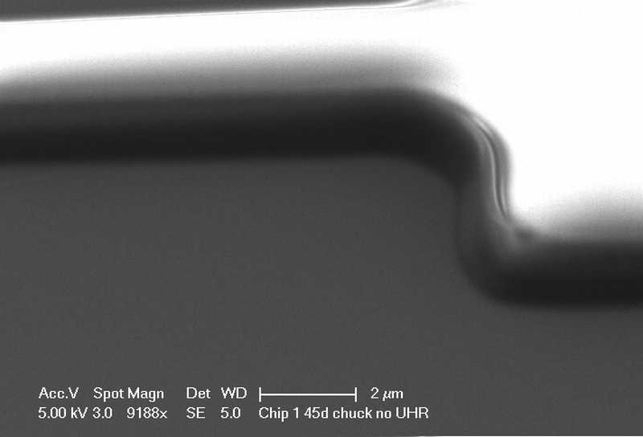
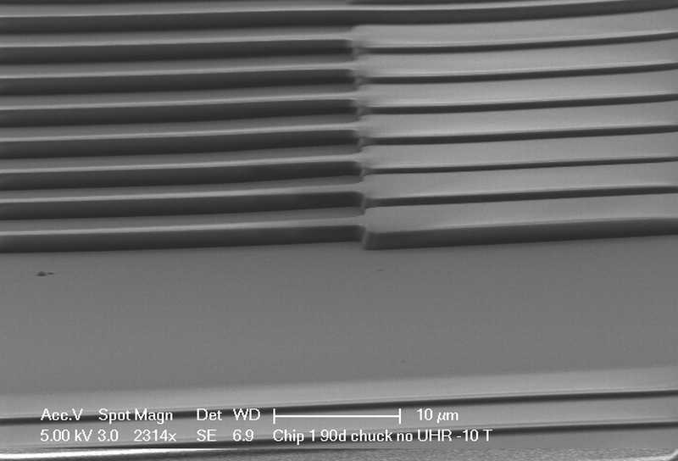
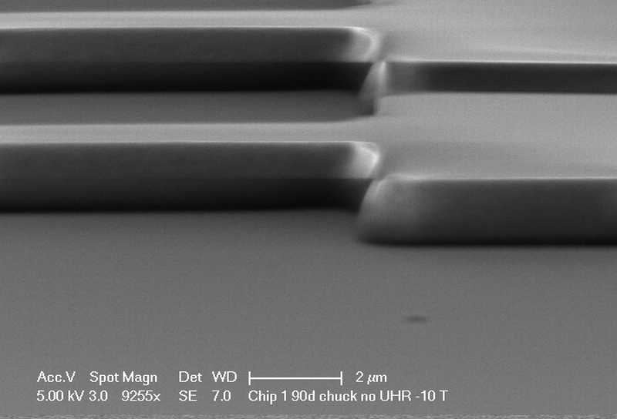
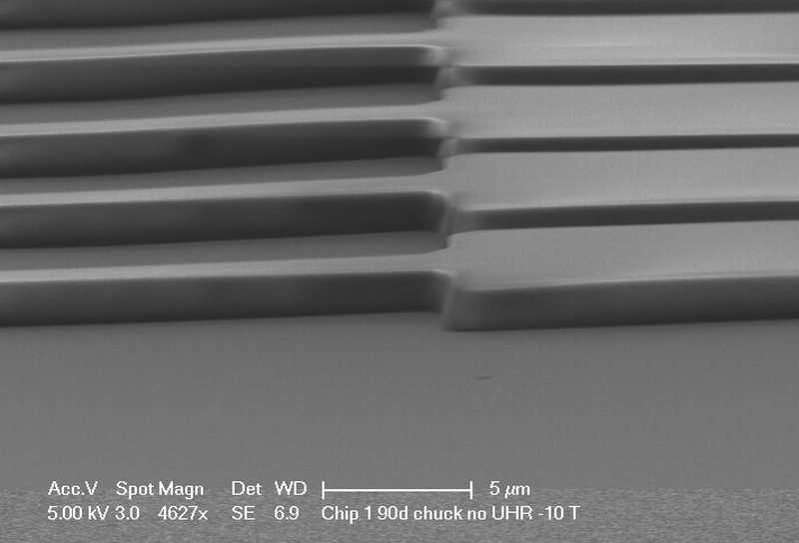
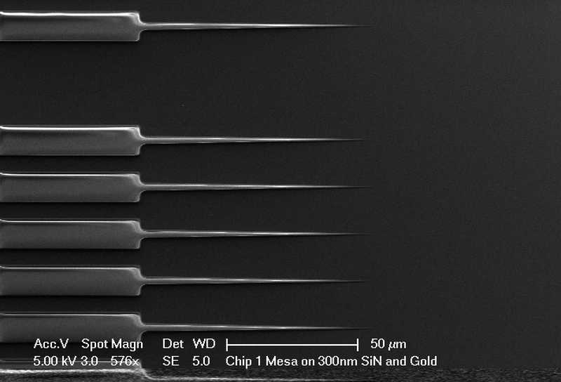
Chip 1 Photoresist on SiN/Au

Slide 10
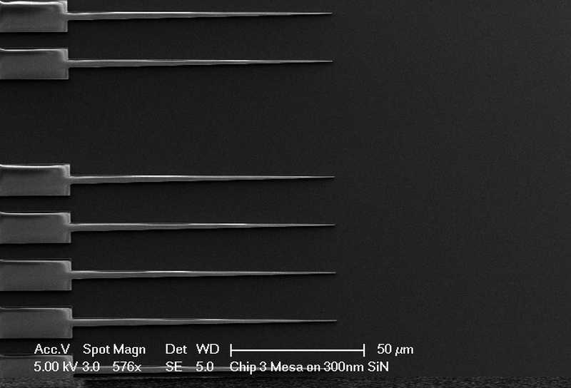
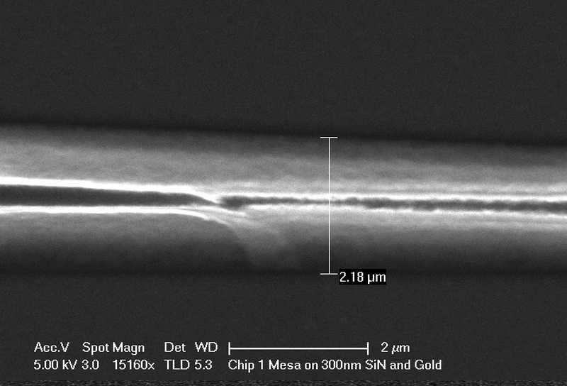
Chip 3 Photoresist on SiN

Slide 11
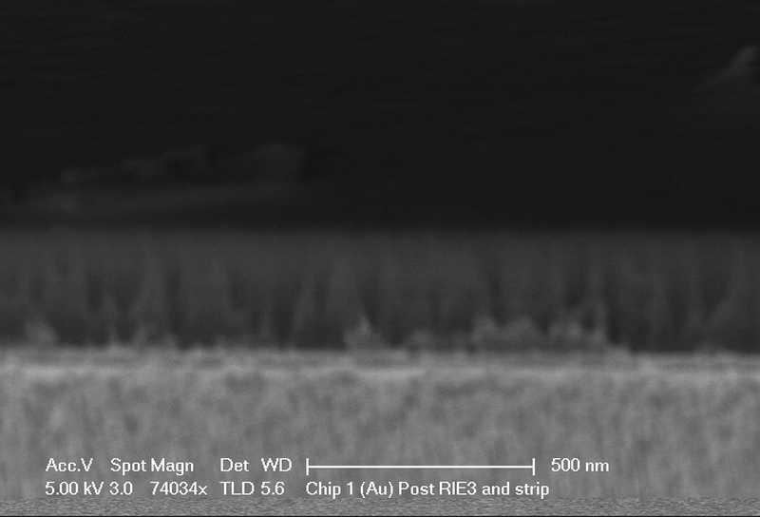
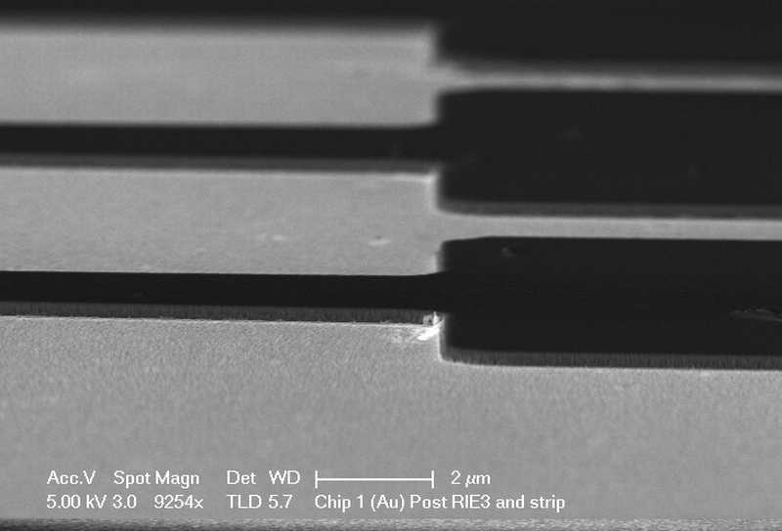
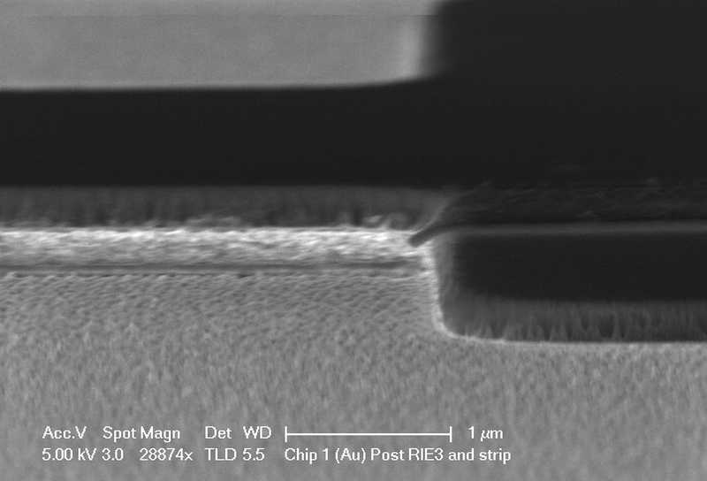
Chip 1 RIE SiN Etch Post Strip on SiN/Au

Slide 12
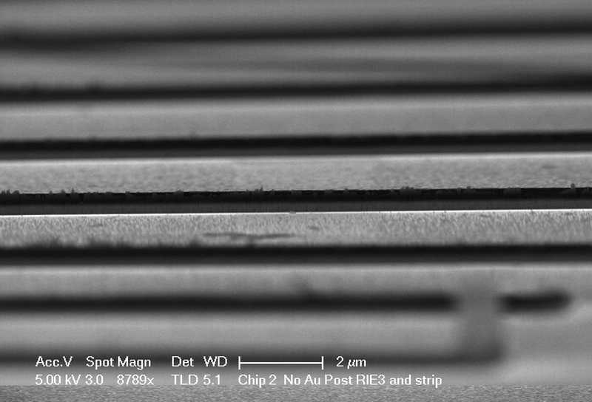
Chip 2 RIE SiN Etch Post Strip

Slide 13
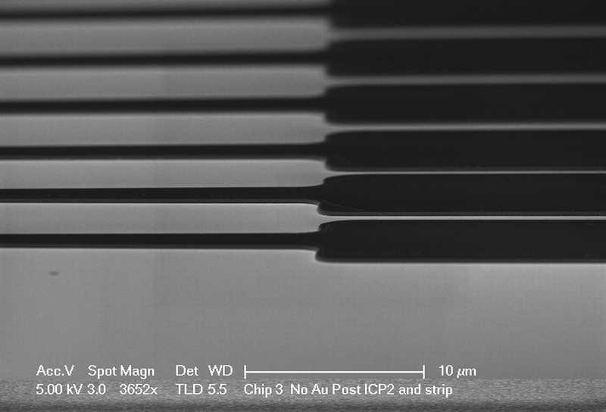
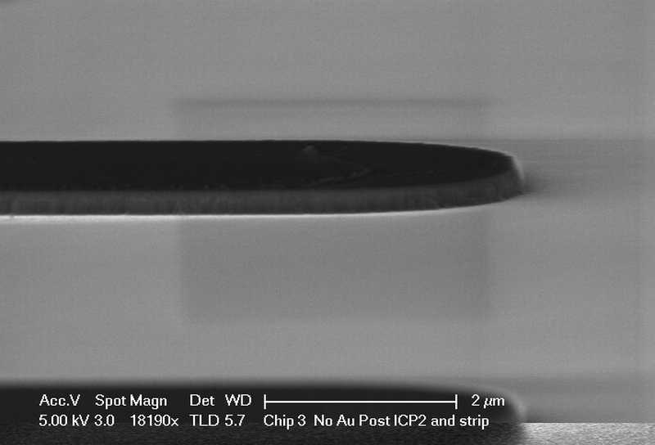
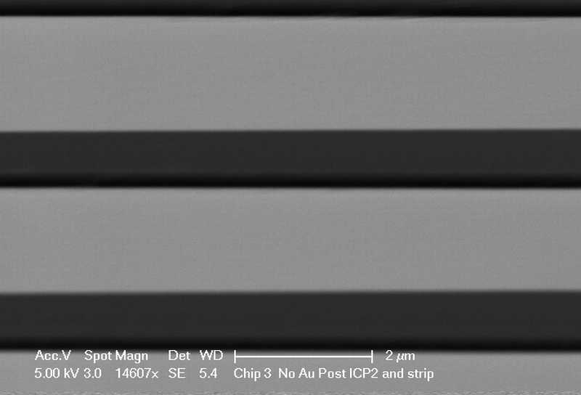
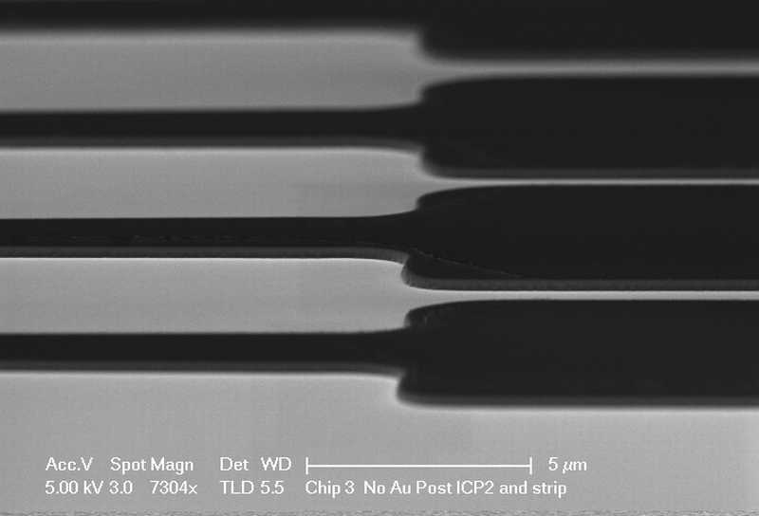
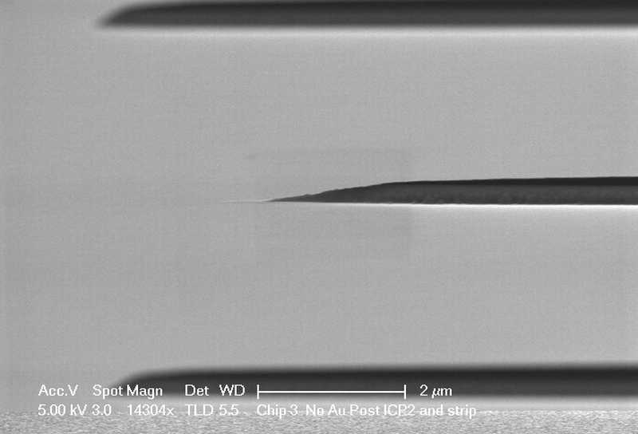
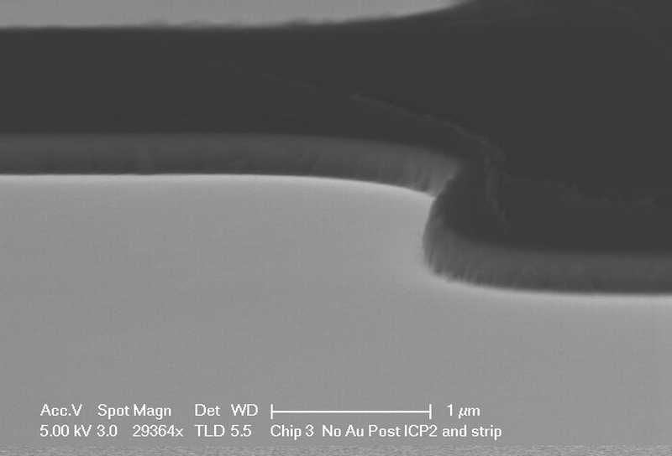
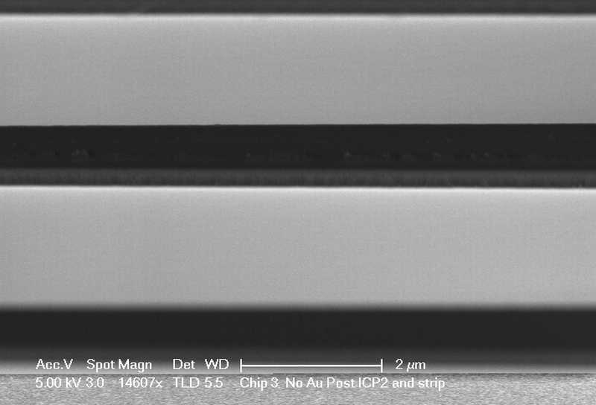
Chip 3 ICP SiN Etch Post Strip

Slide 14
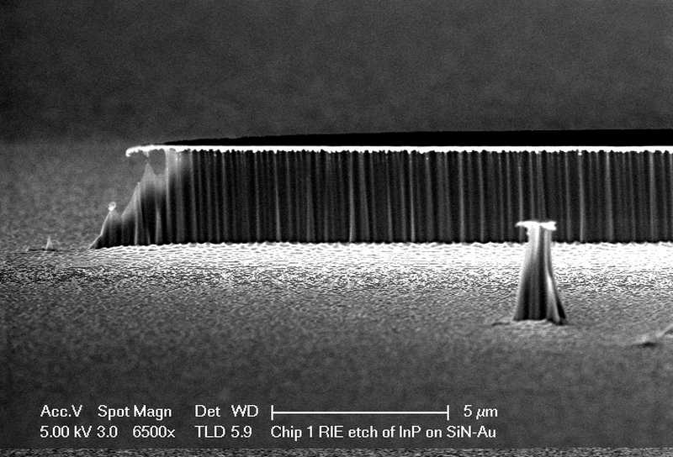
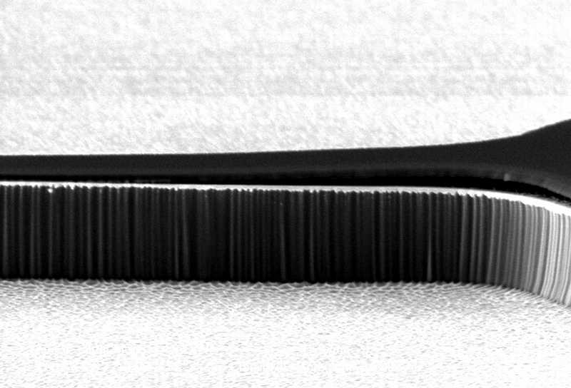
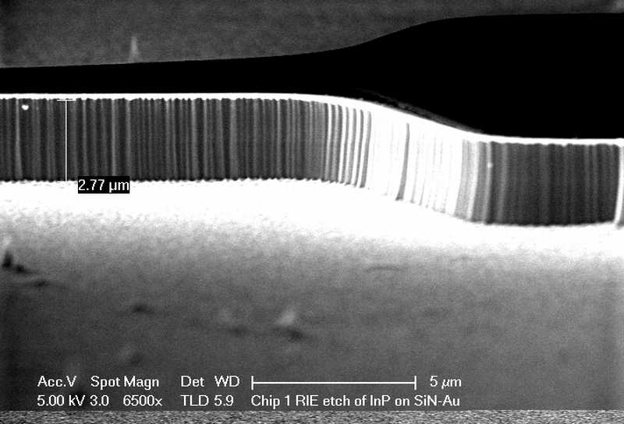
Chip 1 RIE SiN-Au Mesa Post InP Etch

Slide 15
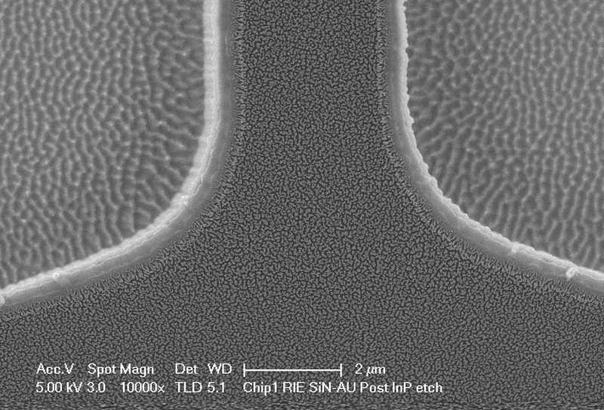
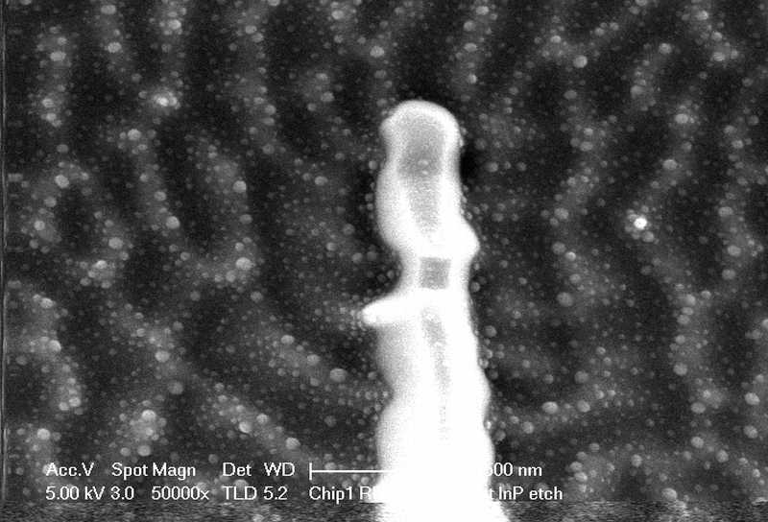
Chip 1 RIE SiN-Au Mesa Post InP Etch

Slide 16
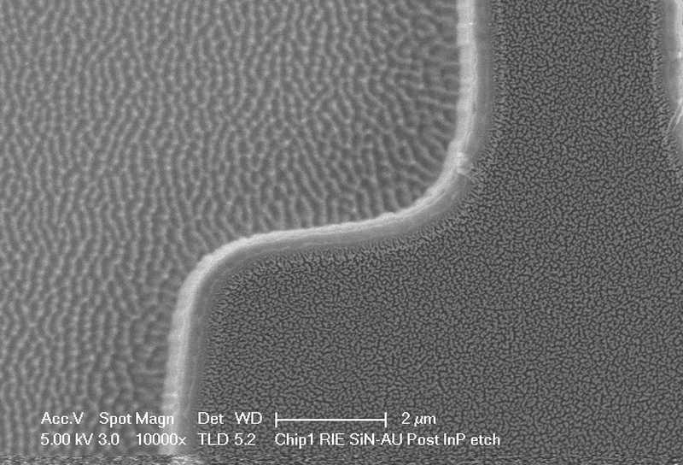
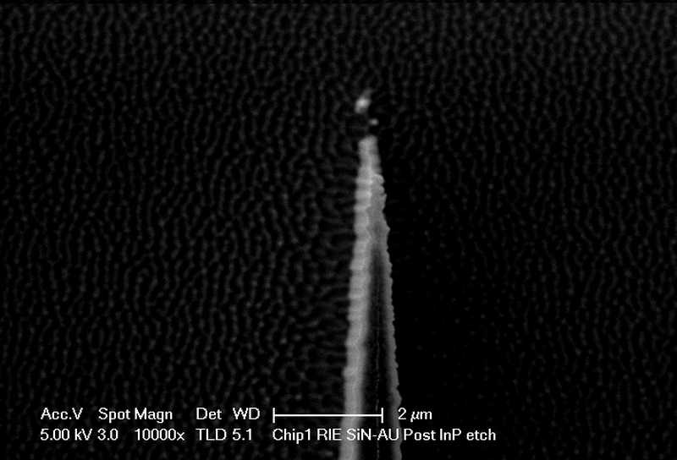
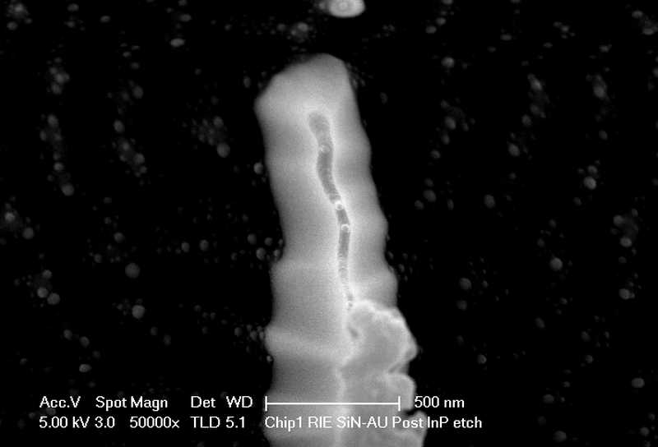
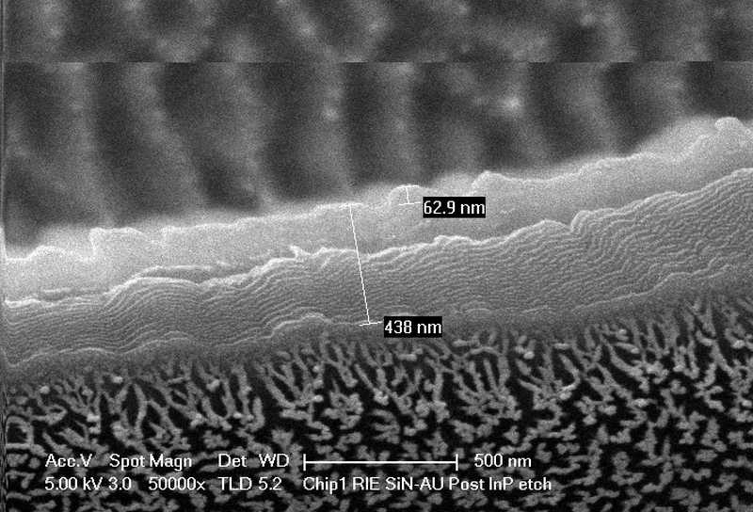
Chip 1 RIE SiN-Au Mesa Post InP Etch

Slide 17
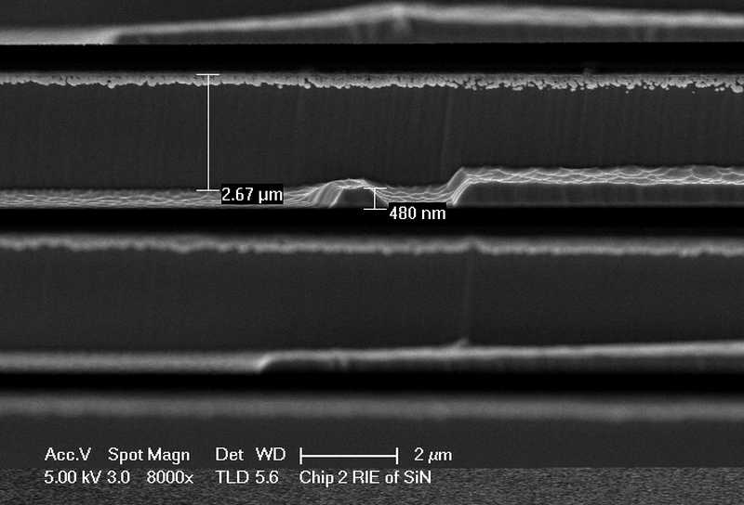
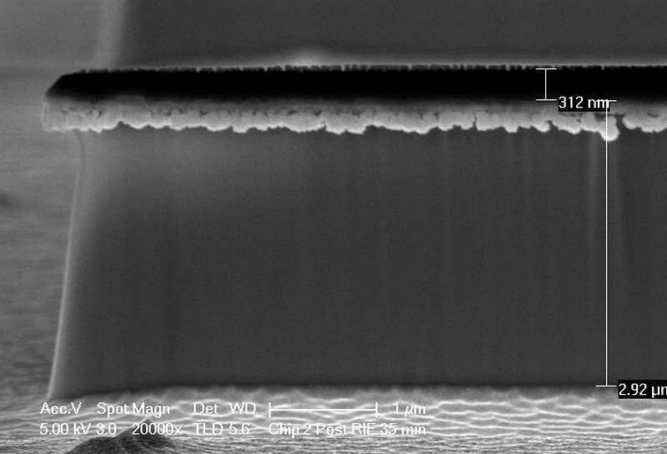
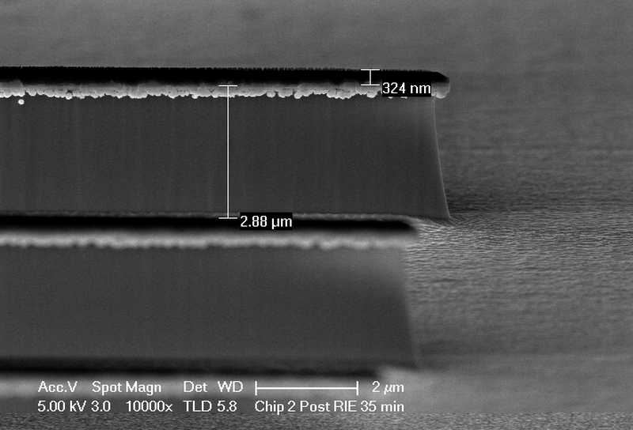
Chip 2 RIE SiN Mesa Post InP Etch

Slide 18
Chip 2 RIE SiN Mesa Post InP Etch

Slide 19
Chip 2 RIE SiN Mesa Post InP Etch

Slide 20
Chip 2 RIE SiN Mesa Post InP Etch

Slide 21
Chip 3 ICP SiN Mesa Post InP Etch

Slide 22
Chip 3 ICP SiN Mesa Post InP Etch

Slide 23
Chip 3 ICP SiN Mesa Post InP Etch

Slide 24
Chip 3 ICP SiN Mesa Post InP Etch

Slide 25
Chip 1 RIE SiN Etch Post Strip on SiN/Au

Slide 26
Chip 2 RIE SiN Etch Post Strip

Slide 27
Chip 3 ICP SiN Etch Post Strip
InP appears golden in color but actually grayish like Chip 2.

