Slide 2
a)
f1
SOA1
f2
SOA2
AWG
fc
f3
SOA3
f4
SOA4
b)
f1
f2
f3
fc
f4
c)

Slide 3
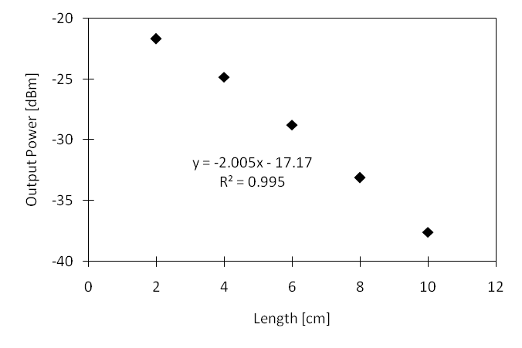
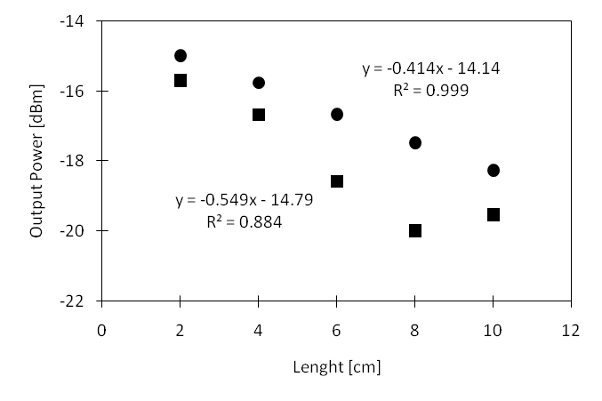

Slide 5
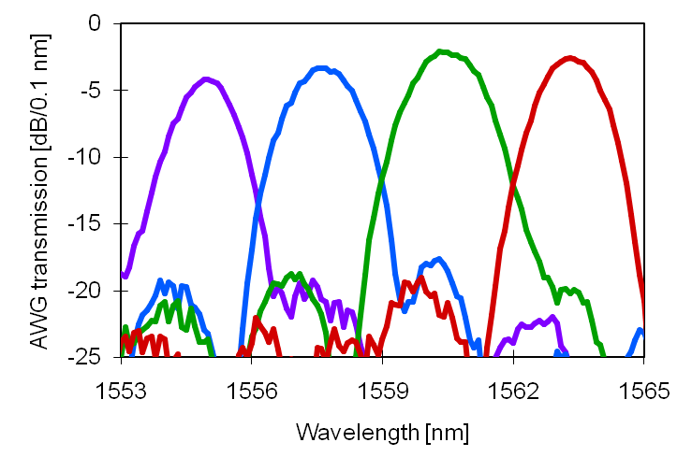
3.5 dB
9 dB

Slide 6
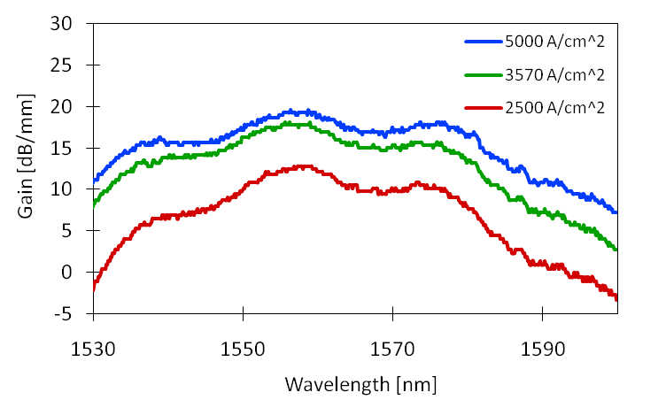
2125 A/cm^2
(FP data)

Slide 7
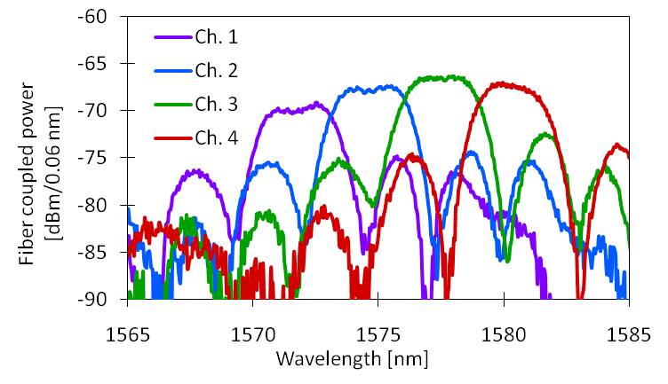
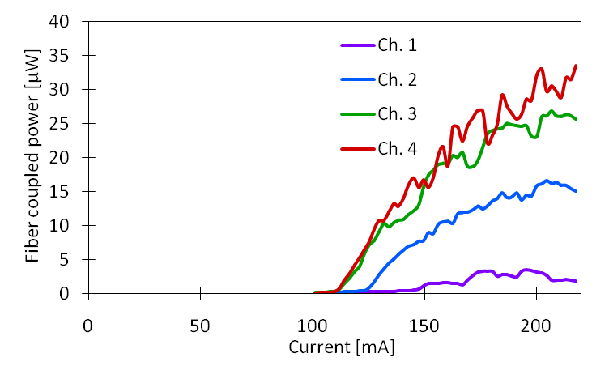
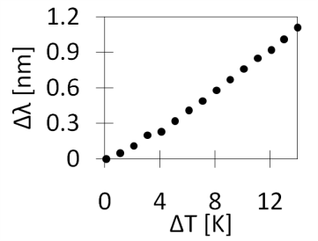

Slide 8
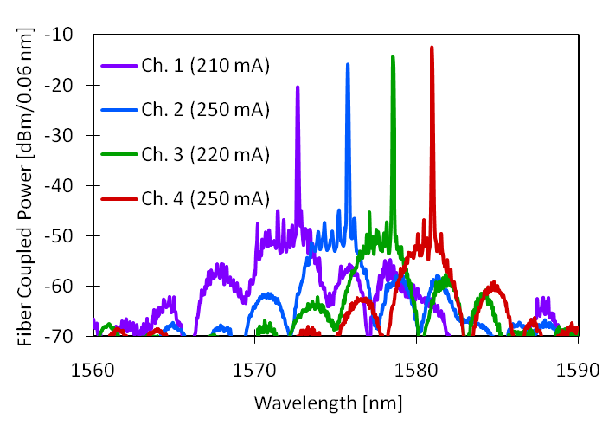
35 dB

Slide 9
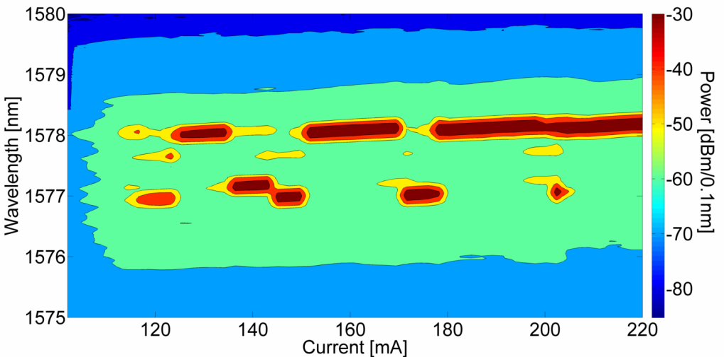
a)
b)

Slide 10
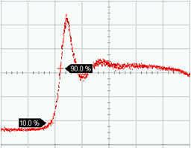
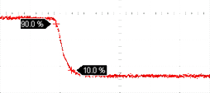
a.u.
500 ps

Slide 11
a)
SU-8
Si
SiO₂
Si
b)
P-contact
P-InP
SCH
QW
SCH
N-contact
N-InP
Si
SiO₂
Si

Slide 12
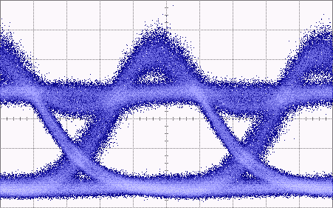
a.u.
200 ps
7.7 dB

Slide 13
SOA
MMI
HR
Mod
SOA
AR
MMI
Mod
…
AWG

Slide 14
Layer | Material | Doping | Thickness
Substrate | InP | S-Doped | 350 μm
Buffer | InP | Undoped | 200 nm
Contact | In_{0.53}Ga_{0.47}As | P – 1E19 | 100 nm
Cladding | InP | P – 1E 18 | 1.5 μm
SCH | AlGaInAs | P – 1E17 | 125 nm
QW | AlGaInAs (well) (8x) AlGaInAs (barrier) (9x) | Undoped | 7 nm 8 nm
SCH | AlGaInAs | N – 1E17 | 125 nm
Contact | InP | N – 1E18 | 110 nm
Superlattice | In_{0.85}Ga_{0.15}As_{0.327}P_{0.773} (2x) InP (2x) | N – 1E18 N – 1E18 | 7.5 nm 7.5 nm
Bonding | InP | N – 1E18 | 10 nm
Cap | In_{0.53}Ga_{0.47}As | N – 1E18 | 200 nm

Slide 15
Layer | Material | Thickness
Contact | In_{0.53}Ga_{0.47}As | 100 nm
Cladding | InP | 1.5 μm
SCH | Al_{0.131}Ga_{0.34}In_{0.528}As | 125 nm
Quantum wells/barriers | Al_{0.089}Ga_{0.461}In_{0.45}As (well) (8x) Al_{0.055}Ga_{0.292}In_{0.653}As (barrier) (9x) | 7 nm 8 nm
SCH | Al_{0.131}Ga_{0.34}In_{0.528}As | 125 nm
Contact | InP | 110 nm
Superlattice | In_{0.85}Ga_{0.15}As_{0.327}P_{0.773} (2x) InP (2x) | 7.5 nm 7.5 nm
Bonding | InP | 10 nm
Waveguide | Si | 700 nm
Buried Oxide | SiO₂ | 1 μm
Substrate | Si | 600 μm

