Slide 1
Sweeper Processing Issues
March, 2012

Slide 2
Post Anneal Observations

Slide 3
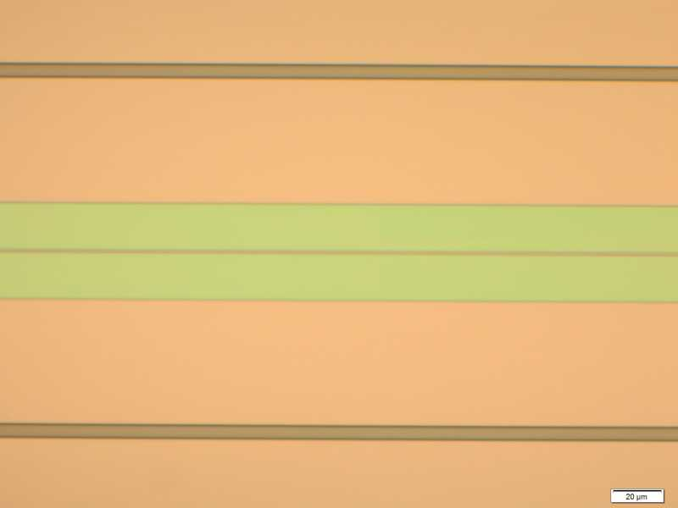
Sweeper Chip E Post 1050C Anneal
Nomarski Image of Dope area
Same area normal view
Hard to see Dope windows after 1050C anneal but faint outline can be seen under Nomarski.

Slide 4
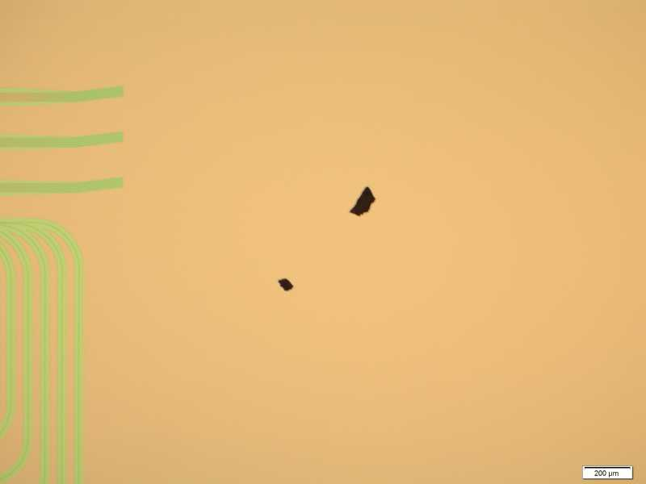
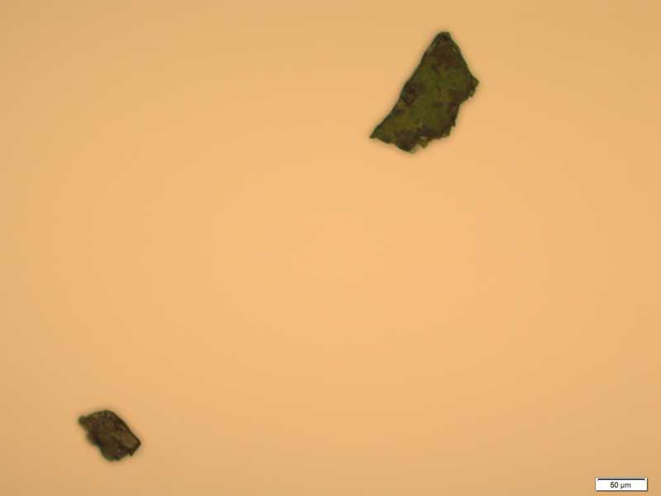
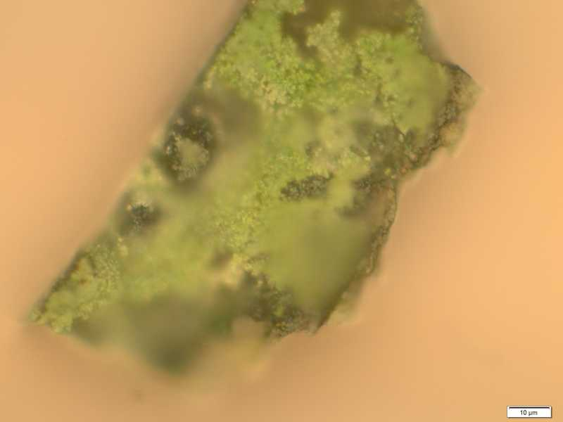
Sweeper Chip E Post 1050C Anneal
Eight large particles seen post anneal. An ISO soak with U/S at 5/5/High for 3 min and DI for 2 min was used to remove them.

Slide 5
Sweeper Chip E Post 1050C Anneal
Nomarski view. Streaks extend to edge of wafer in all cases. Seen in differenct densities but similar to this in five spots around circumference of the chip. Not sure if present preanneal
Same image under normal view, streaks not noticed.

Slide 6
Stripping Issues at Post SiN Hardmask Etch
13.2. SiN deposition
13.2.1. Dehydration bake 5 min @ 150 C
13.2.2. Deposit 3000A of SiN
13.3. Mesa litho (Mesa Def mask)
13.3.1. Sample prep
13.3.1.1. Acetone 3 min / Isopropyl alcohol (IPA) 3 min / DI rinse 3 min
13.3.1.2. Dry with N2, dehydration bake 3 min 120 C
13.3.1.3. PE2 O2 descum 300 mT, 100 W, 1 min
13.3.1.4. Dehydration bake 5 min, 150 C
13.3.2. Spin resist
13.3.2.1. Blow sample with N2
13.3.2.2. Dispense HMDS, 30 sec @ 3K
13.3.2.3. Blow sample with N2
13.3.2.4. Dispense nLOF 5510, 30 sec @ 3K
13.3.2.5. Soft bake 1 min, 90 C
13.3.3. Expose in stepper 0.25 sec, offset: -1
13.3.4. Post bake 1 min, 110 C
13.3.5. Develop AZ300MIF, 1 min
13.3.6. Inspect: If bent tapers -> try a longer descum in next step to etch some of PR.
13.3.7. PE2 O2 descum 300 mT, 100 W, 1 min

Slide 7
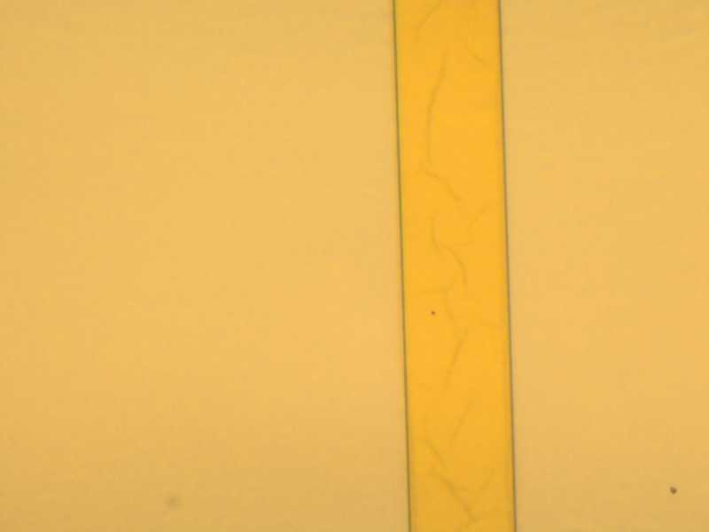
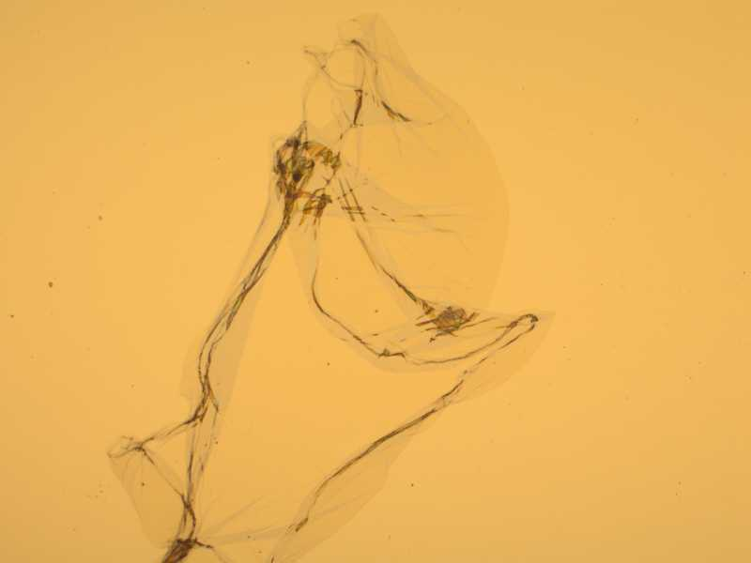
Test Piece
Residue on SiN
Wispy blobs

Slide 8
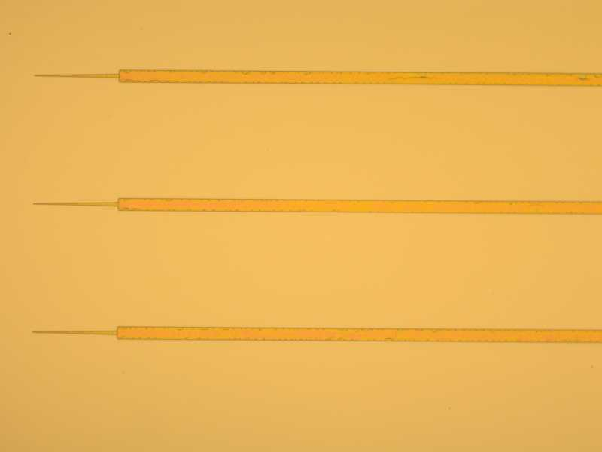
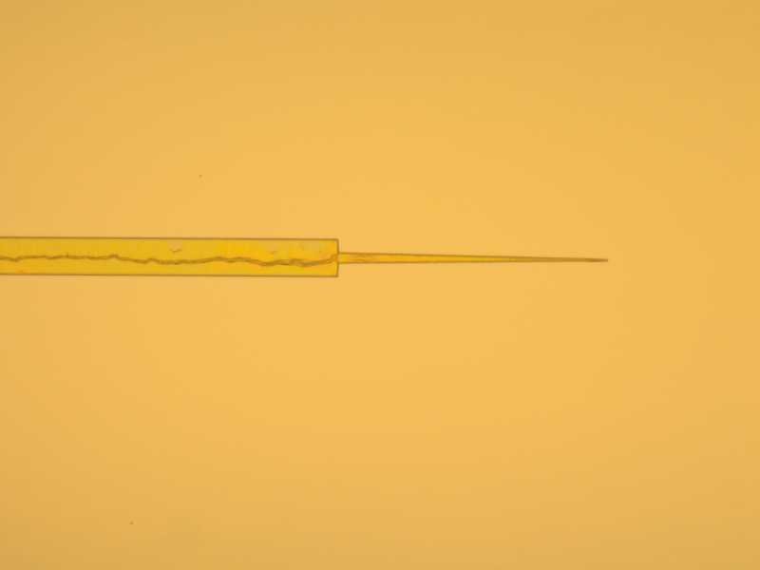
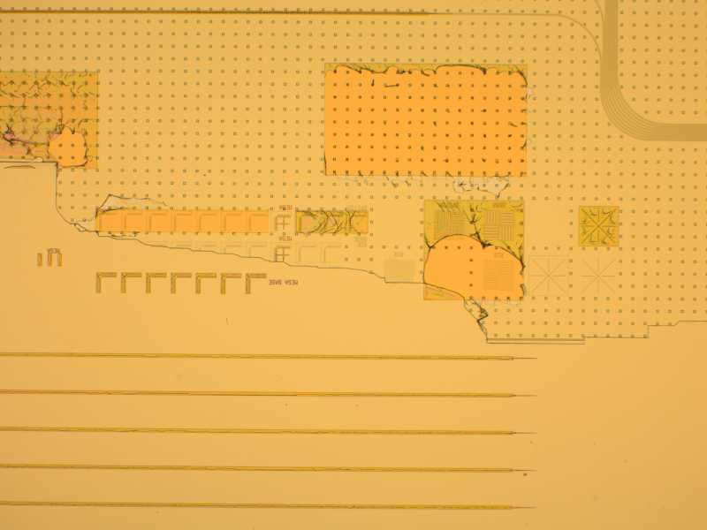
Chip C1
Resist
Large Resist blobs

Slide 9
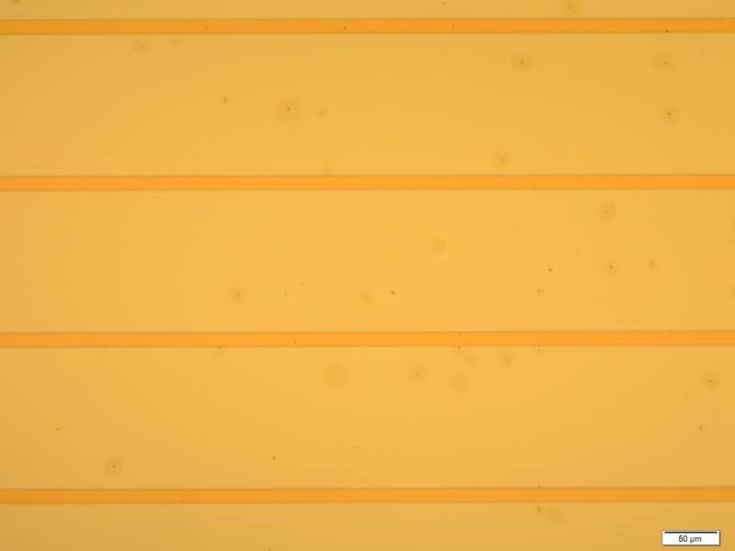
Chip A2 Left Die
Pits all over, mostly on left die

Slide 10
Other Projects Mesa Process
2010_04_28 Slotline
Positive resist 955 0.9, RIE 3 etch, Developer strip but not very effective
2008_10_03 Self Align Process
Positive resist 955 0.9, RIE 3 etch, 1165 Strip but still residue

Slide 11
Mesa Etch Strip Issues
September 22, 2011

Slide 12
Process
Two Bonded Chips
Chips 1 and 2
Mesa Metal Pd/Ti/Pd/Au EBeam 3
300nm SiN PE-CVD
Mesa Lithography (Positive Resist 1.8um)
Plasma (PE-II) 30 sec 100W
Chip 1 Only
RIE2 SiN Etch CF4/O2, 20 sccm/1.8 sccm, 10 mT, 250 V, 17 minutes
RIE 2 O2 clean 20 sccm, 10mT, 250V, 5 minutes
Chip 2 Only
ICP2 SiN Etch CHF3 , 40 sccm, 0.5 Pa, SRC Forward 900W, Bias 200W, 1 minute 12 seconds
Plasma (PE-II) 2 minutes 100W
Chips 1 and 2 Strip
Solvent soak 1165 at 80C
Plasma 2 min at 200W PE-II. Improvement seen on ICP Chip but still residue left.
Acetone, ISO, and DI. No improvement seen.

Slide 13
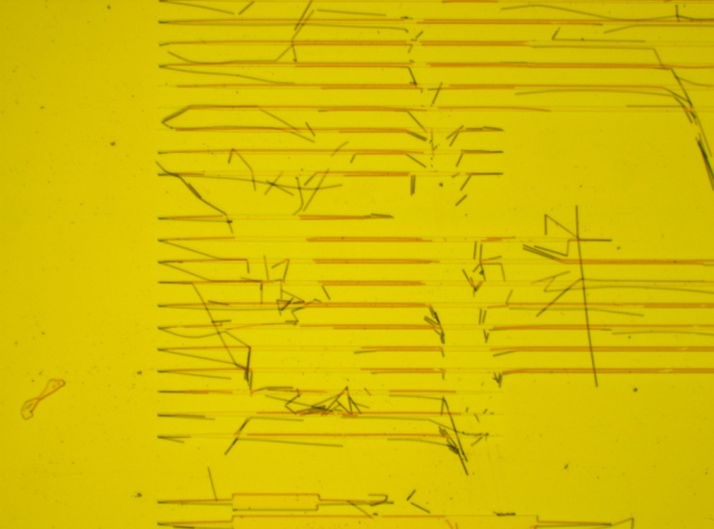
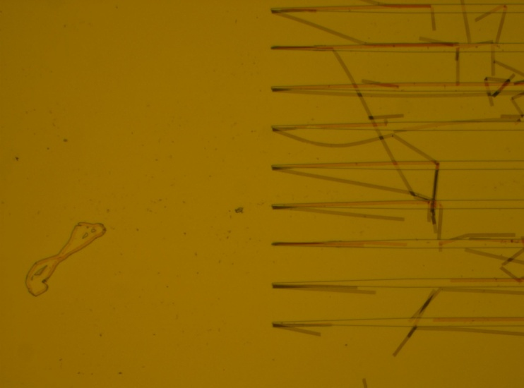
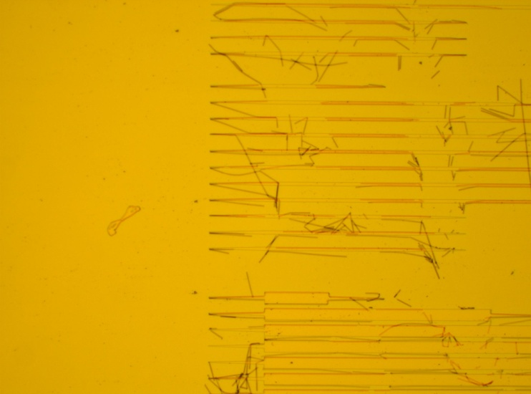
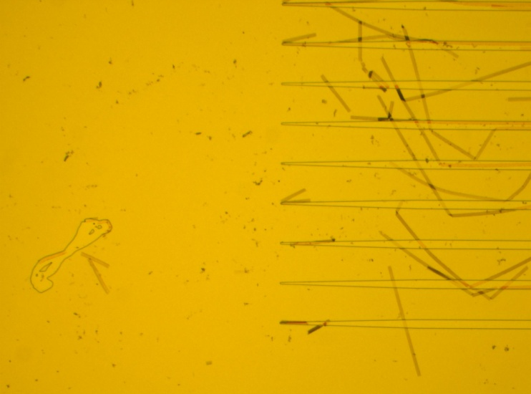
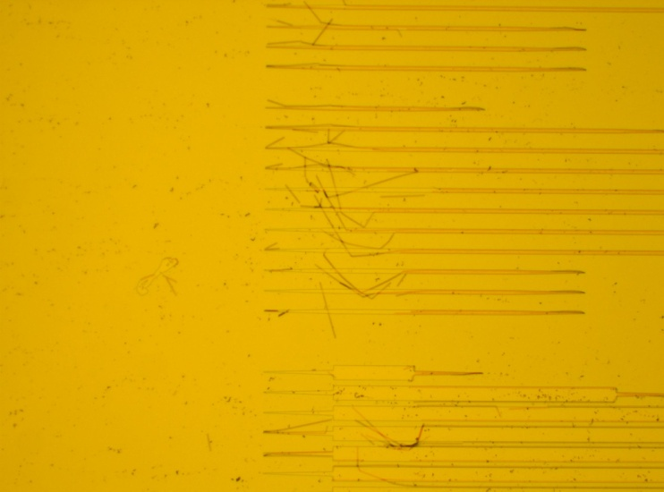
RIE2 17 min CF4/O2 SiN Etch
Post 2 hour 80C 1165 Strip
Post 2 hour 80C 1165 Strip and 2 min 200W O2 Plasma
Particle on Mask
Post 2 hours 80C 1165 Strip, 2 min 200W O2 Plasma, and Acetone-Iso

Slide 14
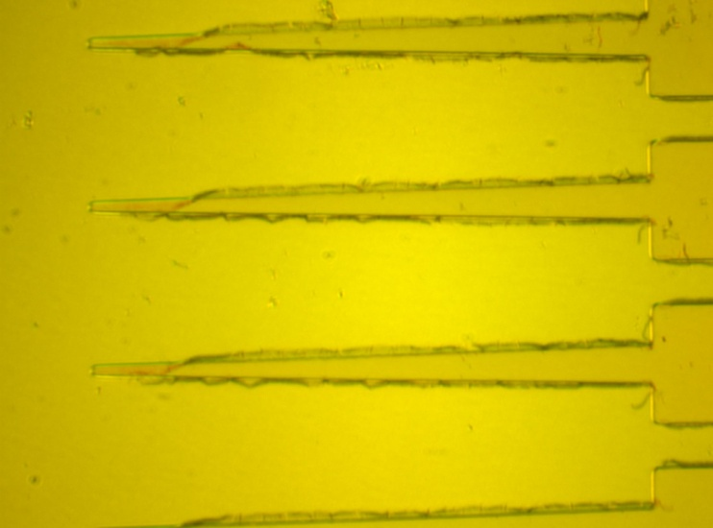
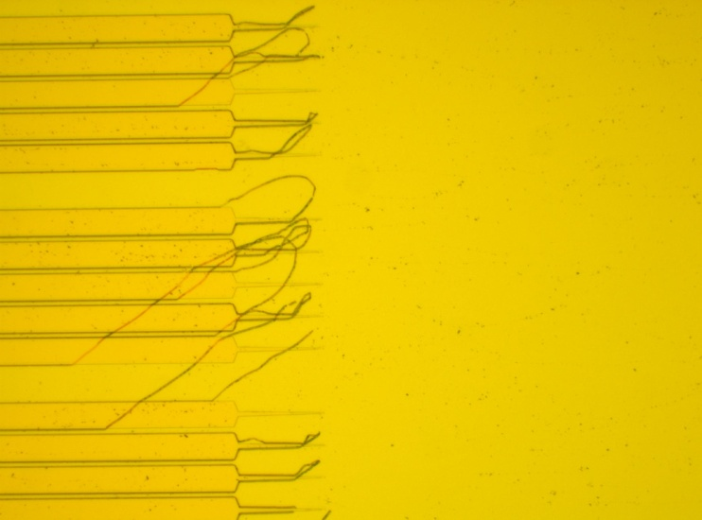
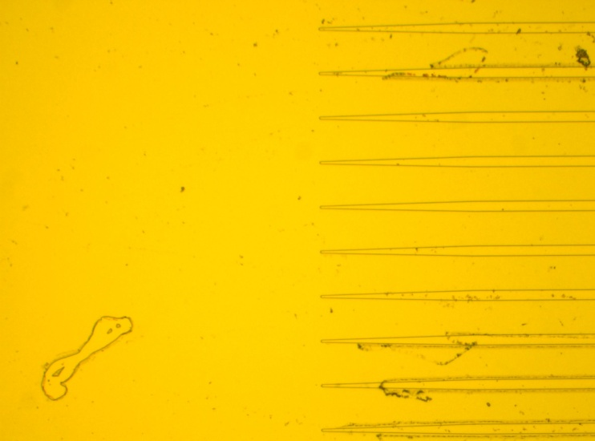
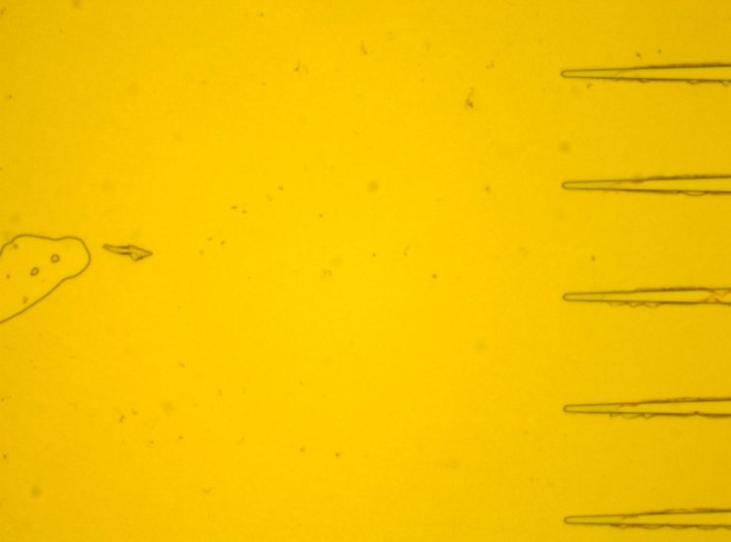
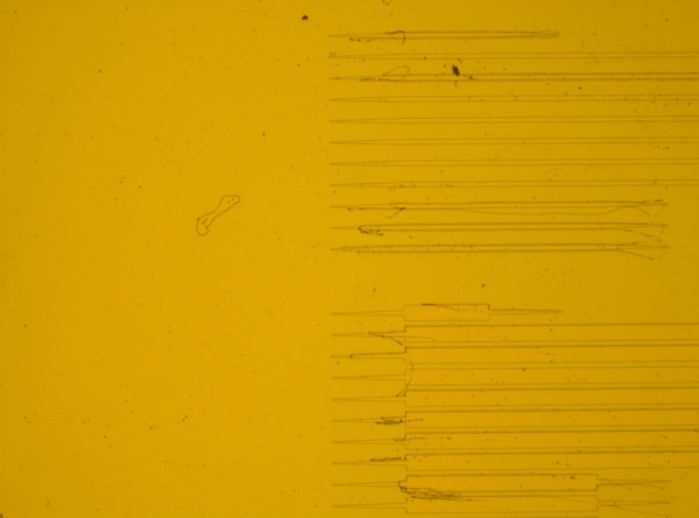
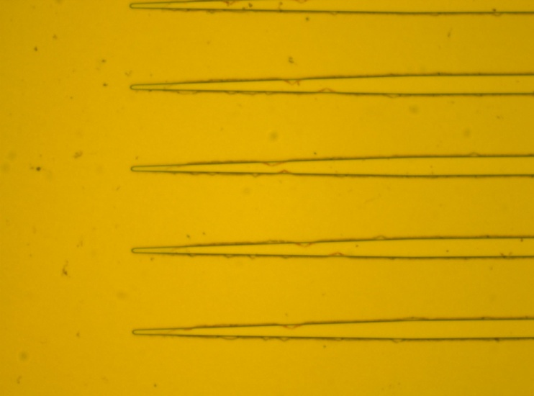
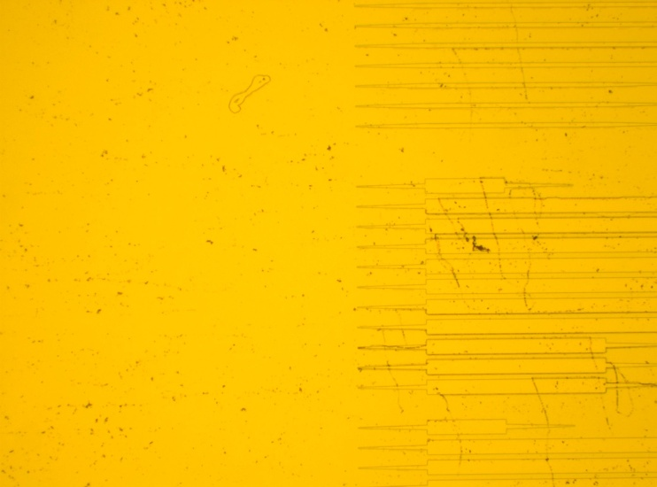
ICP 72 Seconds CF4/O2 SiN Etch
Post 2 hour 80C 1165 Strip
Post 2 hours 80C 1165 Strip and 2 min 200W O2 Plasma
Post 2 hours 80C 1165 Strip, 2 min 200W O2 Plasma, and Acetone-Iso

Slide 15
Notes
Newer Process (DQPSK, MZM, and EAM) has a different ICP etch recipe and stripping process but there is often resist remaining after the strip in this process flow also.
Developer MF726 Time: ~40 sec
Flood exposure Time: 1 min
O2 descum 300 mT/100W Time: 20 sec
ICP2 SiN PATTERNING
SiN etch #181 GC-SiN O2 : 5 sccm, CF4 : 50sccm Pressure: 2 Pa RF Power: 500 W, Bias:25W Time : 2 min 30 sec
Strip PR in AZ726MIF Time: 1 min
ACE/ISO/DI Clean
O2 descum 300 mT/100W
Other Strip/clean processes:
Light swabbing. This was often used in the past but trying to stay away from this due to possible damage to the taper tips. This would get rid of the bulky heavy resist but some would remain near the sidewalls.
Diluted HCL:DI dip for 10-30 sec. This would often clean up residue but underetching of the Mesa metal would be an issue.
Gasonics: This helps but equipment is down often.
Repeating strip process after plasma (solvent soak, plasma, repeat as necessary)

