Slide 1
Isolator update
Jason Tien
12/13/2010

Slide 2
Outline
Material properties
Magnetization
X-ray diffraction
Experimental measurement of asymmetric MZI isolator
IR camera image
Transmission spectra
Temporal response

Slide 3
Magnetization of Ce:YIG
RT sputtered Ce:YIG (0.2um) on GGG (5mm by 5mm) and 900C 10min RTA
Measured by SQUID at room temperature (in-plane direction)
Magnetization of Ce:YIG and GGG substrate
Magnetization of Ce:YIG only (subtract GGG contribution)
Paramagnetic GGG
Ce:YIG thin film saturates at external magnetic field of 10 gauss

Slide 4
Magnetization of Ce:YIG
Measured by SQUID at room temperature (in-plane direction)
0.5um Ce:YIG from Mizumoto’s group
0.2um Ce:YIG grown at UCSB
Saturation H-field ~50 Oe
Saturation H-field ~10 Oe

Slide 5
X-ray Diffraction of Ce:YIG
XRD resolution: 0.01 deg
0.5um Ce:YIG from Mizumoto’s group
0.2um Ce:YIG grown at UCSB
Kα1
Kα2
SGGG (444)
Ce:YIG (444)

Slide 6
Transmission spectra of MZI
Magnetic field direction
Power meter
TL
Lensed fiber
MZI
TM
TE
When input wavelength is fixed, the transmitted power difference between positive and negative magnetic field is about 3~5 dBm
Wavelength split (0.1nm) is much smaller than calculated value (0.4nm).

Slide 7
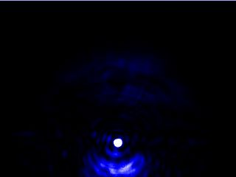
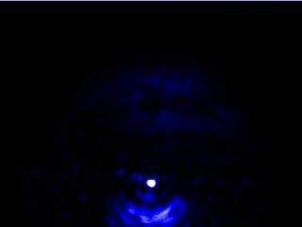
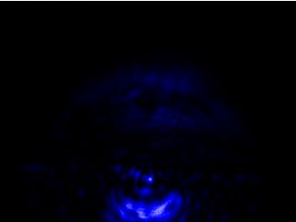
IR image at MZI output
Magnetic field direction
objective
TL
CCD
Lensed fiber
MZI
polarizer
positive magnetic field
No magnetic field
Negative magnetic field

Slide 8
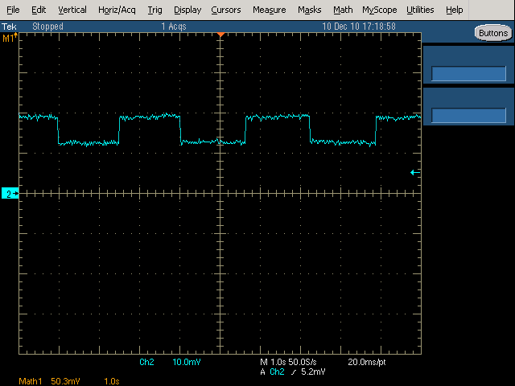
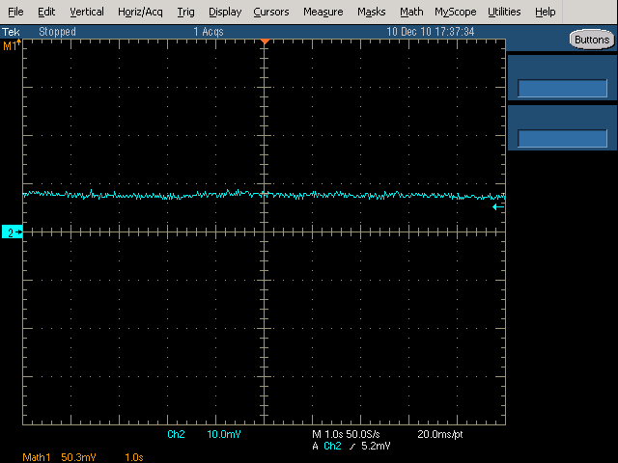
Temporal response of MZI
1520.05 nm
25C
Surface magnetic field of electromagnet: 200~300 Gauss at 3A input current
TM
TE
Positive magnetic field
Negative magnetic field
1 sec

Slide 9
Summary
Asymmetric MZI with bonded Ce:YIG (from Mizumoto) shows nonreciprocal effects
Smaller wavelength shift than expected
Could be air gap between the Ce:YIG and Si waveguides assuming the material is no problem
The ring resonators on the same chip doesn’t show any resonance behavior due to offset Ebeam calibration after replacing the filament.
Next
Recalibrate the gap between the ring and the straight WG
Bond Ce:YIG onto only one arm of the MZI

Slide 10
MZI-type Isolator
ΔL=343um
B field
ΔL=343um
Ce:YIG
Ce:YIG
B field
Comparison is based on the same Faraday coefficient (Δn=1e-4)

