Slide 1
1.3μm Lumped Hybrid Silicon Electroabsorption Modulator under 1Vpp-Operation
Yongbo Tang*, Jonathan D. Peters, and John E. Bowers
Dept. of Electrical and Computer Engineering, UC Santa Barbara, CA, USA
ytang@ece.ucsb.edu
Supported by DARPA MTO EPHI project and Intel
Notes:
Thank you for the Chair’s introduction. At first, we wanna thank the funding support from DARPA and INTEL.You may noticed that I have revised the title since I will focus on the lumped HSEAM.

Slide 2
Outline
Introduction
Structure and Fabrication
  Electrode
  Undercut
  Bonding direction
Characterization in 20˚C to 80˚C
  DC Extinction
  E/O bandwidth
  25Gb/s, 40Gb/s transmission
Conclusions
Notes:
For this presentation, I will give some introduction first and then go through the design, fabrication, and charaterzation. At last, it is the summary.

Slide 3
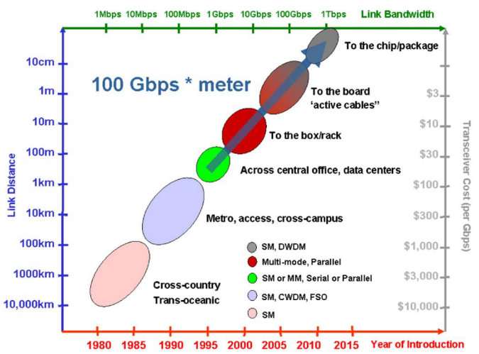
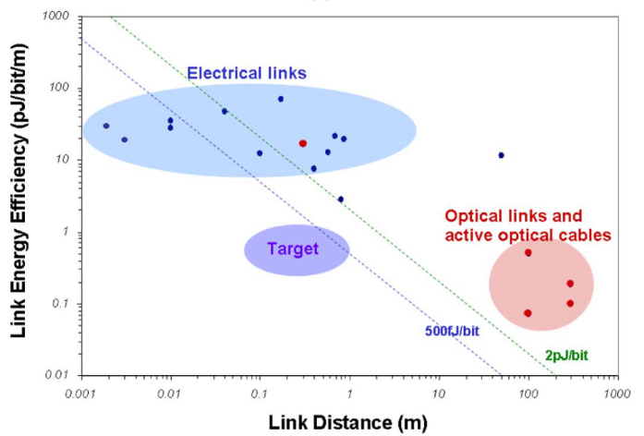
Passing line for optical interconnects
>100Gbps·m
< 1pJ/bit
A. Krishnamoorthy et al., JSTQE 17(2), 2011
Notes:
The topic of this conference is the optical interconnects. I think most of us coming here are working to boost the replacment of the electrical interconnects by optical interconnects. According to the study from Oracle, the passing line for this replacement, can be related to two specs: the bandwidth-length product exceeds 100Gbps m and the power consumption less than 1pJ/bit.

Slide 4
Requirment for modulators
High speed
  upgrade to 25Gb/s, 40Gb/s
Low driving voltage (with suitable ER)
  less than 1Vpp
Less sensitive
Less cost
Less Insertion loss
small footprint
Large optical bandwidth
Notes:
Coming to the modulators, these two specs correspond to two directions: high speed up to 25 or even 40Gb/s and low driving voltage to be less than 1Vpp. Besides, it is also important to push the modulator to have a large tolerance to the environmental fluctuation, less cost, less loss, a small footprint and a large optical bandwidth.

Slide 5
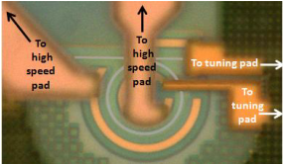
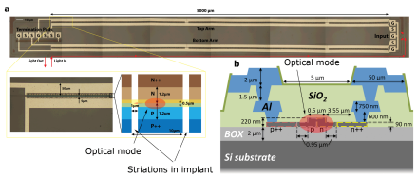
Towards high speed and low drive voltage
Two examples of silicon modulators
G. Li et al. Oracle, 2011
T. Baehr-Jones, et al. UW, 2012
1Vpp , 25Gb/s, >5dB, 7fJ/bit
0.63 Vpp , 20Gb/s, 4dB, 200 fJ/bit
Hard to upgrade the speed further for 1Vpp
Sampled operation wavelenths
Temperature-control required for the current ring /disc modulator
Notes:
A lot of works have been done to develop a high performance silicon modulators. Here are two typical examples for the targets towards high speed and low drive voltage. The left one is the ring modulator developed by Oracle. It has been demonstrated at 25Gb/s with a 1Vpp drive voltage and a 5dB ER. The power consumption, excluding the temperature tuning, is only 7fJ/bit; The other work is the MZM modulator from U W. It reaches 20 Gb/s with a 0.63Vpp and 4dB ER. The power consumption is around 200fJ/bit. These results are very impressive. However, it seems that both designs have touched their speed ceil. It is very difficult to upgrade it to 40Gb/s for 1vpp operation. Secondly, to enhance the extinction, the ring modulator replys on high Q resonance and the MZM needs unbalanced design. They can only be operated at sampled wavelengths if no tuning applied. Specifically for current ring/disc modulator, it can not get rid of the temperature control, which requires additonal power consumption.

Slide 6
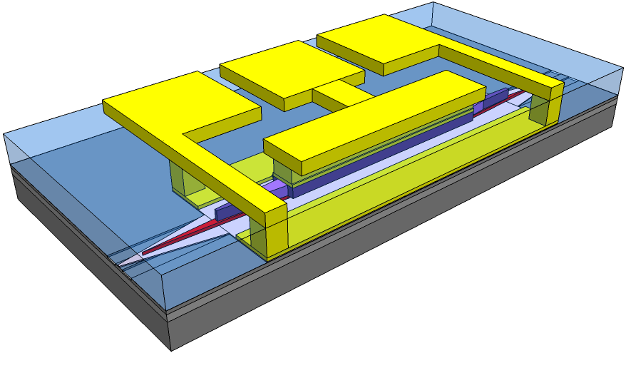
Lumped hybrid silicon EAM
3 μm Au
3.5 μm SU8
1μm SiO2
1.5 μm p-InP
Proton implanted area
411nm SCH/MQW (AlGaInAs)
n-InP/superlattice
400nm Si
Footprint:
150μm x 350μm
2 μm
Notes:
Here is our solution for the optical interconnects, a lumped hybrid silicon EAM. The whole structure is shown here. It has a small footprint with most of the area occupied by the probe pads.
We use AlGaInAs quantum well to have a strong EA effect so that we can use an short modulation length of only 100um. The SEM cross-section and its optical mode profile are shown at bottom.The confinement factor in the quantum-well is 23%, also for a larger EA effect.

Slide 7
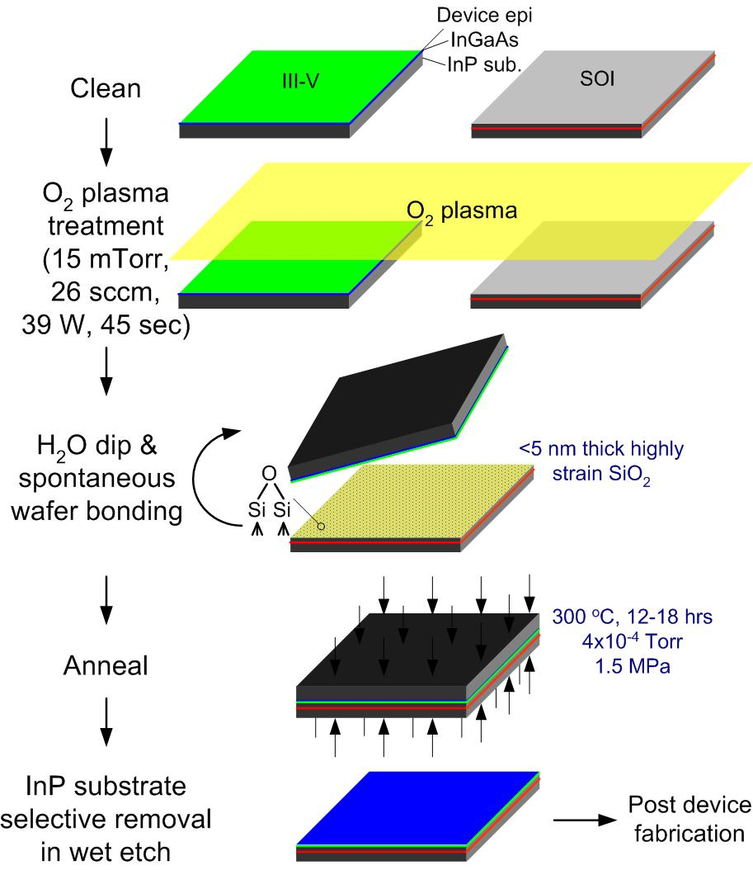
Fabrication
Standard SOI Process
III-V Process
Notes:
The fabrication is started by the standard SOI process, which is CMOS compatible and can be done in any CMOS foundary. After the SOI process, we use the wafer bonding to transfer III-V epitaxy on SOI and then uses the normal III-V process to define the III-V structure and the electrode.

Slide 8
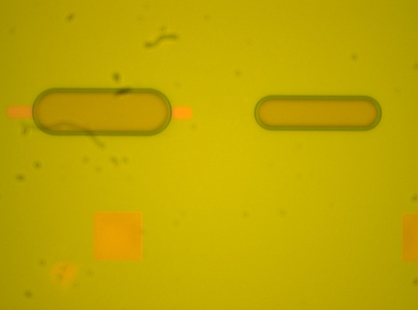
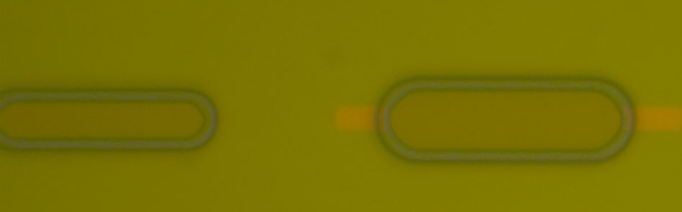
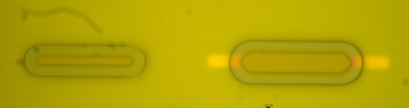
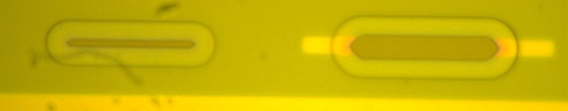
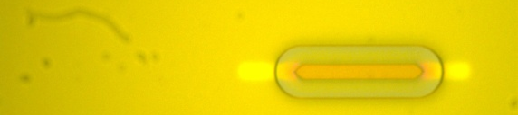
QW undercut
30 Sec
90 Sec
2 μm
150 Sec
Wet Etchant:
H₂O:H₂O₂:H₃PO₄=15:5:1
210 Sec
AlGaInAs
225 Sec
Trench Mark on silicon
SiN Mask
Notes:
Specifically, I want to highlight the QW undercut process. This is used to selectively narrow the intrinsic region but keep a wide mesa so that we can get a small capacitance and also a small serious resistance at the same time. The we etchant is list here and this wet etching process is monitored under microscope based on the indicating pattern as shown on the right. We made the trench mark on silicon underneatch in advance. Once the QW layer overlaps with the mark, we stop the etching.

Slide 9
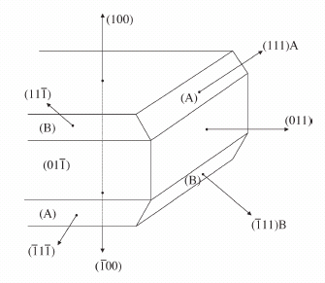
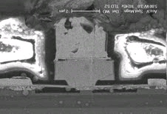
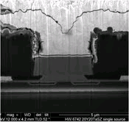
Undercut shape and bonding direction
(111) A, III group element: slower etch speed
(111) B, V group element: faster etch speed
III-V Die
Si Waveguide
III-V Epi
Green
Blue
Major Flat
D. Pasquariello, et al, JLT, 24(3), 2006
Notes:
since we use wet etching, we have to be careful with the bonding direction. There are two 111 crystal planes. In order to get a up-standing trapezoid, the waveguide has to be along the 011 direction. If it is rotated, we might get a fliped shape as shown here. It is not good for mode transition.
trapezoid

Slide 10
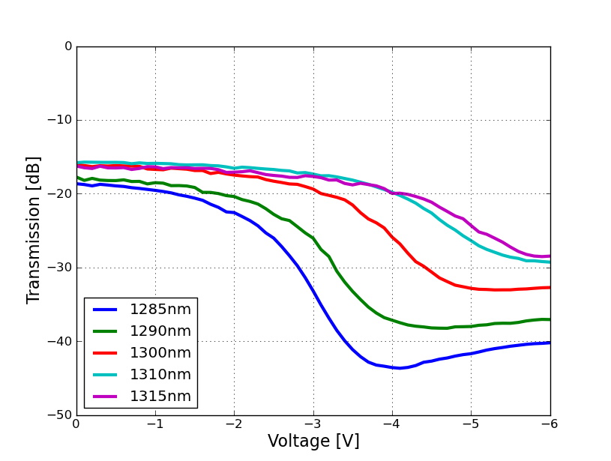
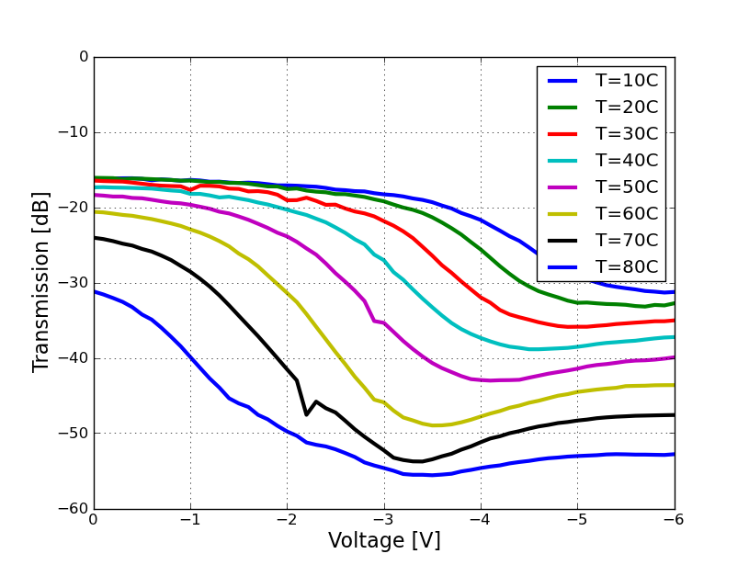
DC Extinction Ratio
T=20˚C
λ=1300nm
Short wavelength
High Temperature
Optical bandwidth: >30nm for 10dB/2V
Red shift rate: 0.5nm/˚C
Notes:
Now let us look at the performance of this modulator. The left figure shows the DC transmission curve at 20C. We can see that the optical window can be more than 30nm for a 10dB extinction over 2V bias change. Then, we check its high temperature performance at 1300nm. As the temperature goes up, similar trend is found as the case when goes to a short wavelength. It means a red shift of the absorption spectrum. Based on the two figures, we can get that the shift rate is around 0.5nm/C. It matches the shift rate of gain peak for an semiconductor amplifer and the laser.

Slide 11
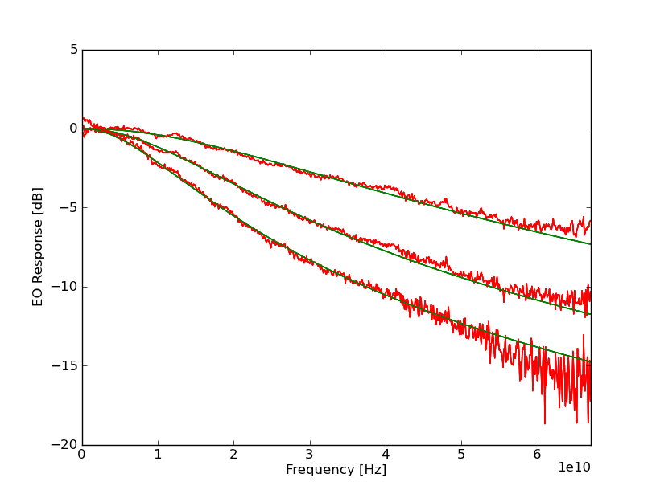
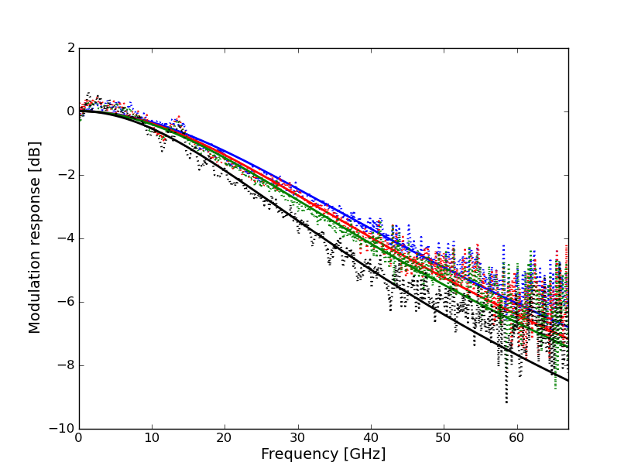
E/O Response
T=20˚C
λ=1300nm
T=20, 40, 60, 80˚C
f_{3dB}>27 GHz
L=100, 200, 300 μm
f_{3dB}=32, 18, 12 GHz
R=1.2Ω·mm, C=790fF/mm
L=100 μm
Notes:
Here is the small signal response for the device with different lengths. We get bandwidth of 32GHz for the 100um device. We also checked the performance at higher temperature for the 100um device. As shown here, the 3dB bandwidth keeps larger than 27GHz.

Slide 12
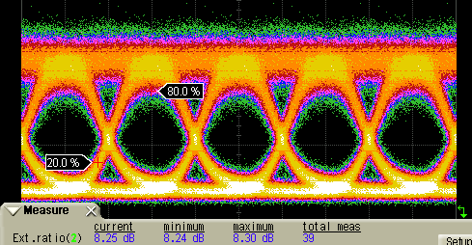
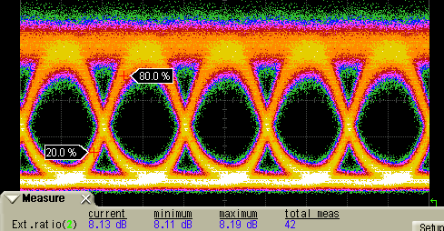
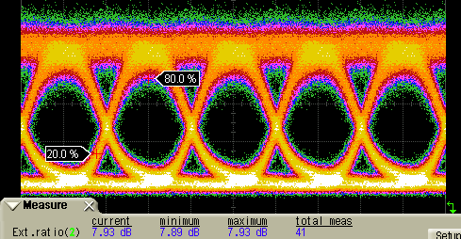
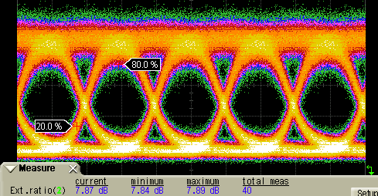
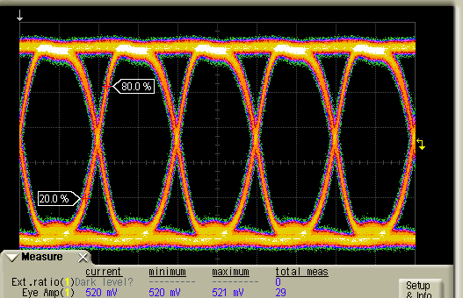
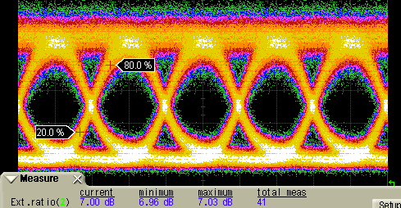
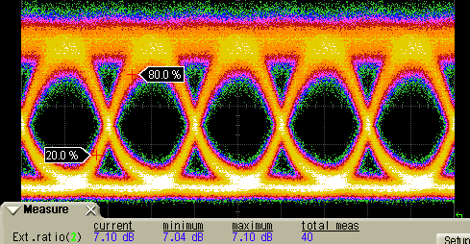
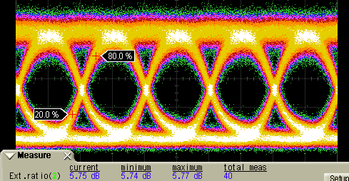

Eye Diagram at 25Gb/s with 1Vpp
T=20˚C
λ=1310nm
ER=8.1dB
Drive voltage @25Gb/s：
T=40˚C
λ=1310nm
ER=7.8dB
T=60˚C
λ=1320nm
ER=7.1dB
Eye height=520mV@DCA
T=80˚C
λ=1330nm
ER=5.7dB
P = 20 fJ/bit (+ 148 fJ/bit)
Back to Back
10.9km SMF
Notes:
This slides show the eye diagram at 25Gb/s with a 1Vpp drive voltage. The left figure shows the capured electrical eye by a 50Ω DCA. The real drive voltage on the modulator is double due to the lumped configuration. The left side two eyes correspond to the back to back transmission and through a 10.9km fiber. They are measured at different temperatures and we can see a range of 6~8dB extinction.

Slide 13
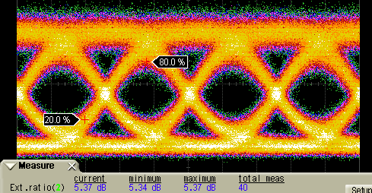
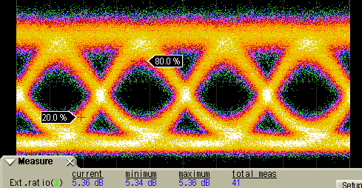
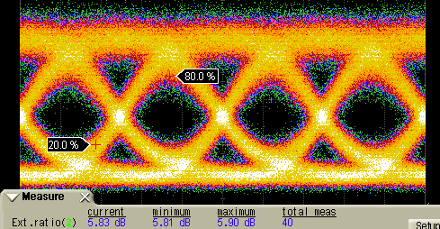
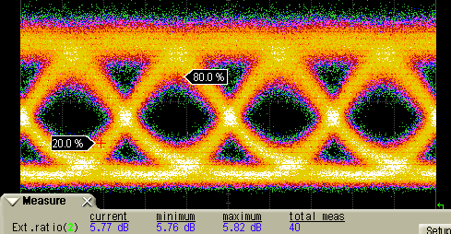
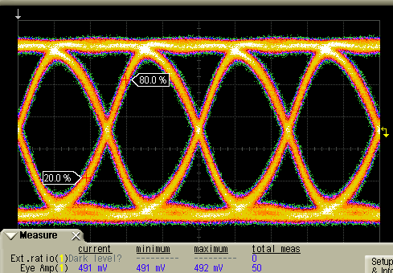
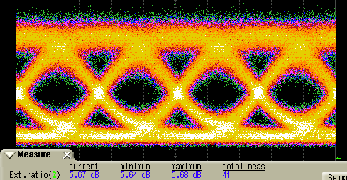

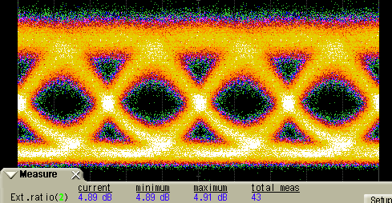

Eye Diagram at 40 Gb/s with 1Vpp
T=20˚C
λ=1310nm
ER=5.3dB
Drive voltage：
T=40˚C
λ=1310nm
ER=5.7dB
T=60˚C
λ=1320nm
ER=5.5dB
Eye height=491mV@DCA
T=80˚C
λ=1330nm
ER=4.6dB
P = 20 fJ/bit (+ 92.5fJ/bit)
Back to Back
10.9km SMF
Notes:
We also measured the eye diagrams at 40 Gb/s with similar setup. The amplitude of the electrical eye is slightly reduced due to the drive circuit. Similary, the eye diagram for B2B and 10.9km transmission are listed on the right. They showed around 5dB extinction ratio. The power consumption due to the capacitor charging is 20fJ/bit. Additional 90fJ/bit comes from the absorption of the optical power, which is usually taken into account by the laser side.

Slide 14
Conclusions
Lumped hybrid silicon EAM
  30GHz bandwidth
  1Vpp
    5.5 dB ER @40Gb/s
    8.1 dB ER @25Gb/s
  20~80˚C operation
  10.9 km transmission
  113 fJ/bit Power consumption (including absorption)
  >30nm optical window

Slide 15

Thank you

Slide 16
Backup

Slide 17
Towards less power consumption for modulators
Open-end configuration (e.g. ring modulator, lumped EAM):
Distributed configuration (e.g. traveling-wave electrode for MZM):

Slide 18
Power consumption
C=0.079 pF;
Vpp=1.00 V;
I_{average} = 1.0mA=I_{d}+I_{p};
V_{bias}=-3.7V;
I_{d} = 0.09μA @-3.7V
B=40Gb/s
P = 20 fJ/bit + 92.5fJ/bit

Slide 19
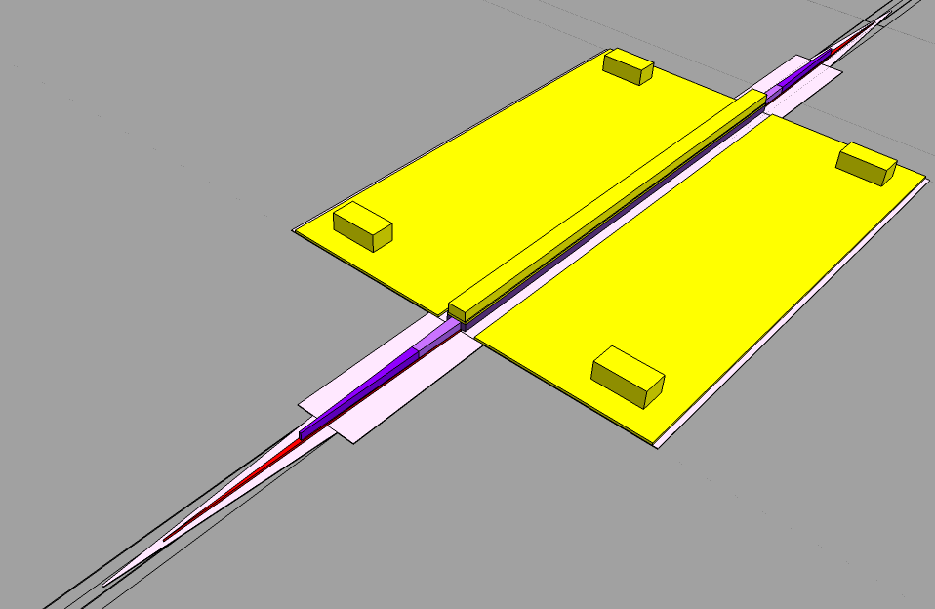
Optical Structure
Si
Ground Via
p-InP/H+
100 μm
p-InP
QW/SCH
60μm
n-InP
Si, n-InP, QW/SCH, p-InP 4-level taper
QW/SCH taper tip is less than 100nm, defined by wet etching
Notes:
Background

Slide 20
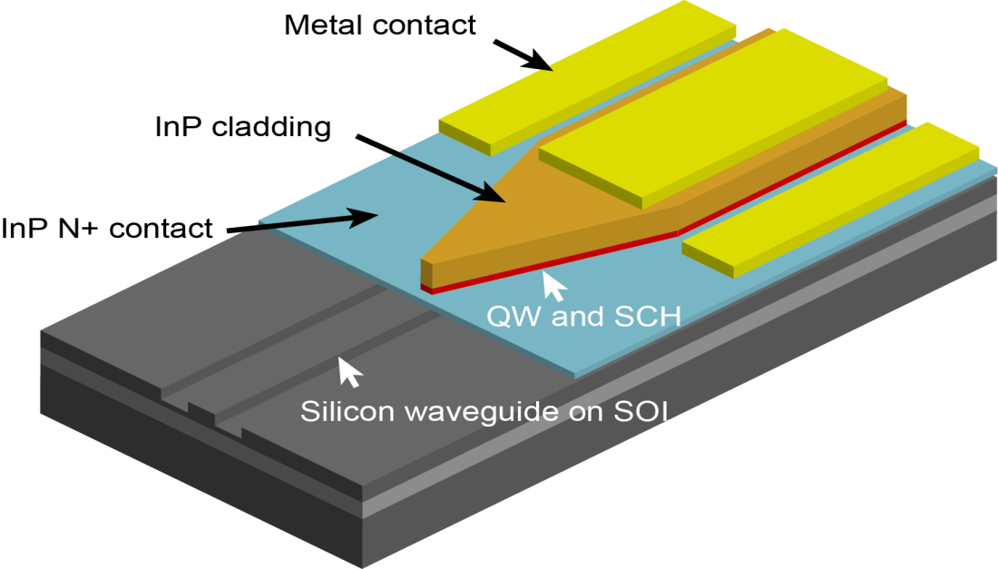
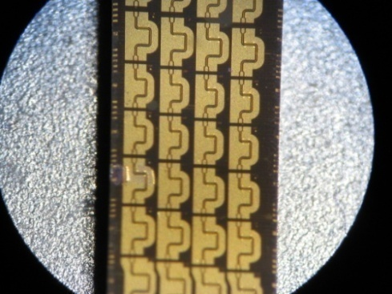
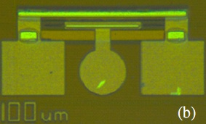
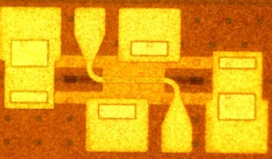
Hybrid Silicon Modulator
Segmented： > 67 GHz
lumped: ~20 GHz
TW: ~42 GHz
Y. Kuo, et al., OE 16(13), 9936 (2008)
Y. Tang, et al., OE 19(7), 5811(2011)
OFC2012 Postdeadline Paper
Notes:
So here is our solution: making a III-V quantum wells modulator on silicon based on the hybrid silicon platform. On 2008, we reported our first demonstration based on lumped electrode. It has a bandwidth of ~20GHz. Then, last year, we developed the distributed modulator based on traditional traveling-wave configuration. The bandwidth has been improved to ~42GHz. And today, we will report our new generation based on segmented electrode. Its bandwdith has exceeded 67GHz.

