Slide 1
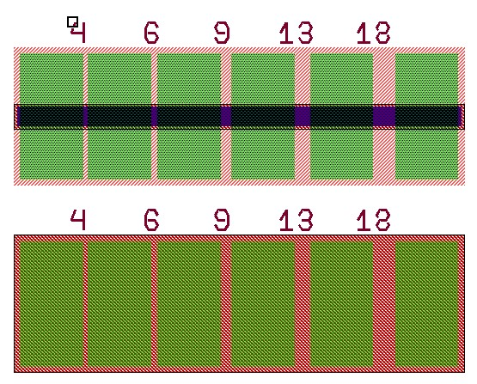
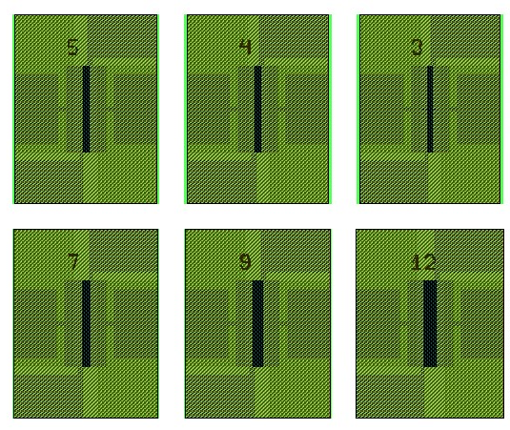
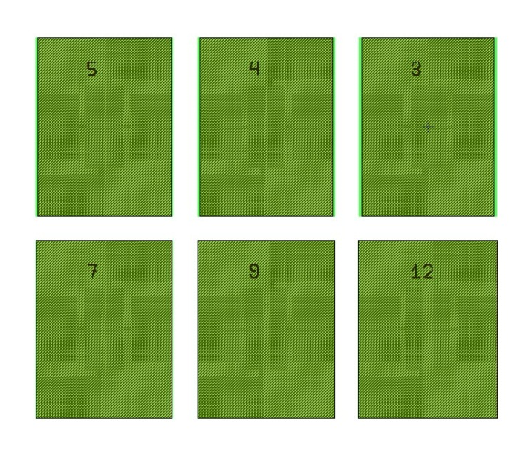
Two type of TLM Pads on POEM r1
I.
PTLM
PADs’ width = 15 μm
PADs’ Distance = 4,6,9,13,18 μm
NTLM
PADs’ width = 100 μm
PADs’ Distance = 4,6,9,13,18 μm
II.
PTLM
NTLM
PADs’ width = 100 μm
PADs’ Distance = 3,4,5,7,9,12 μm
PADs’ width = 100 μm
PADs’ Distance = 3,4,5,7,9,12 μm

Slide 2
Materials:
P: 100nm InGaAs (1e19)
N: 110nm InP (3e18)
Metal stack:
P: Pd/Ti/Pd/Au (10nm/20nm/20nm/1000nm)
N: Pd/Ge/Pd/Au, 10nm/110nm/25nm/1000nm

Slide 3
Chip 2-1
Pads I
P
Rsheet=28.46 Ω
ρ=2e-5 Ωcm2
N
Rsheet=126.46 Ω
ρ=5.6e-5 Ωcm2

Slide 4
Chip 2-2
Pads I
P
Rsheet=21.48 Ω
ρ=7.2e-6 Ωcm2
N
Rsheet=178.29 Ω
ρ=2.5e-5 Ωcm2

