Slide 1
Taper Tip Reduction in the Autostepper Process Development
Jock Bovington

Slide 2
Outline
Goal: The DUV stepper will not be online until next year at the earliest. Therefore, a <200nm taper tip process must be developed with the Autostepper.
Tried 3 process concepts to reduce taper tip width
BHF wet etch of SiO2 hardmask
Dry etch followed by wet etch
Wet etch only
Over exposure of P resist mask
PMGI/SPR bi-layer pattern reduction with DUV flood exposure

Slide 3
Aside: Hard Mask Choice and Thickness
PlasmaTherm PECVD - SiO2
If left after etch will not disturb Si3N4 waveguide mode
Consistent deposition rate
Isotropic wet etch in BHF (~100nm/min)
High selectivity with Cl based dry etch of GaAs
Selectivity to be confirmed in RIE#5
Thickness could be determined to improve line edge roughness due to standing wave patterns.
285nm thick mask in i-line(365nm) Autostepper with single PR layer
t = n* λ /2 (assumes n = 1.56283, check this. Thermal oxide ~1.47454)
Jon Peter says that the post exposure bake smoothes the PR mask pattern more than the oxide thickness

Slide 4
BHF wet etch of SiO2 hardmask

Slide 5
Dry etch plus BHF wet etch of SiO2 hardmask
PR
PR
Hardmask
HM
HM
III-V Epi
Epi
Epi
Epi
Si or SiO2 WG Layer
Si or SiO2 WG Layer
Si or SiO2 WG Layer
Si or SiO2 WG Layer
Si
Si
Si
Si
Bond
PECVD Hardmask
Positive Resist
Std. Lithography
PR
PR
HM
HM
HM
Epi
Epi
Epi
Epi
Si or SiO2 WG Layer
Si or SiO2 WG Layer
Si or SiO2 WG Layer
Si or SiO2 WG Layer
Si
Si
Si
Si
HM Dry Etch
BHF Wet Etch
Strip & III-V Dry Etch
BHF HM Removal

Slide 6
Dry etch plus BHF wet etch of SiO2 hardmask
PR
PR
Hardmask
HM
HM
III-V Epi
Epi
Epi
Epi
Si or SiO2 WG Layer
Si or SiO2 WG Layer
Si or SiO2 WG Layer
Si or SiO2 WG Layer
Si
Si
Si
Si
Bond
PECVD Hardmask
Positive Resist
Std. Lithography
PR
PR
HM
HM
HM
Epi
Epi
Epi
Epi
Si or SiO2 WG Layer
Si or SiO2 WG Layer
Si or SiO2 WG Layer
Si or SiO2 WG Layer
Si
Si
Si
Si
HM Dry Etch
BHF Wet Etch
Strip & III-V Dry Etch
BHF HM Removal

Slide 7
Dry etch plus BHF wet etch of SiO2 hardmask
ACE,ISO,DI,PEII(O2 Plasma)
Deposit oxide hardmask in PlamsaTherm PECVD - 285nm
ACE,ISO,DI,PEII(O2 Plasma)
Dehydration bake 110 1min
Spin HMDS (3krpm, 30sec)
NOTE: Did not wait after pipetting or bake after spinning
Spin SPR955.9 (3krpm, 30sec)
Pre-exposure bake 95C, 90s
Autostepper Exposure=0.424s, Focus=0
Post exposure bake 125C, 90s
40s Develop in MIF726
O2 plasma 30s 300W 100mT to clean surface
ICP#2 (recipe #104)
CF4/CHF3/O2 5/40/5sccm, 400/40W ICP/CCP, 6min 40sec
BHF wet etch (varied etch time)
RIE#5 GaAs Etch
Process abandoned because of poor adhesion of resist
Completed Pending Abandoned

Slide 8
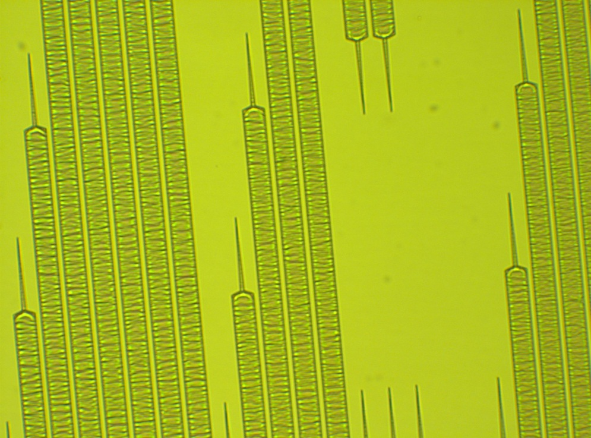
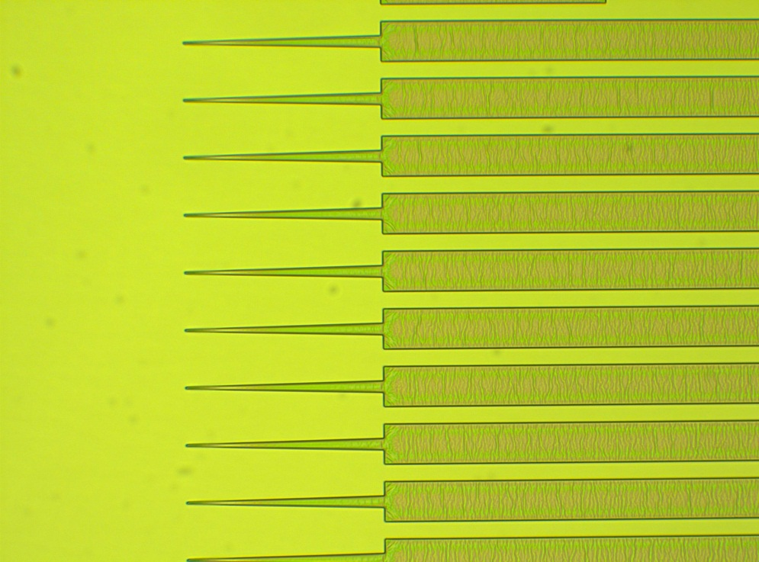
Adhesion Problems
Following oxide dry etch wrinkles appeared in the PR pattern indicative of poor resist adhesion to the oxide hardmask

Slide 9
BHF wet etch only of SiO2 hardmask
PR
PR
Hardmask
HM
HM
III-V Epi
Epi
Epi
Epi
Si or SiO2 WG Layer
Si or SiO2 WG Layer
Si or SiO2 WG Layer
Si or SiO2 WG Layer
Si
Si
Si
Si
Bond
PECVD Hardmask
Positive Resist
Std. Lithography
PR
HM
HM
HM
Epi
Epi
Epi
Epi
Si or SiO2 WG Layer
Si or SiO2 WG Layer
Si or SiO2 WG Layer
Si or SiO2 WG Layer
Si
Si
Si
Si
BHF Wet Etch
Strip
III-V Dry Etch
BHF HM Removal

Slide 10
BHF wet etch only of SiO2 hardmask
PR
PR
Hardmask
HM
HM
III-V Epi
Epi
Epi
Epi
Si or SiO2 WG Layer
Si or SiO2 WG Layer
Si or SiO2 WG Layer
Si or SiO2 WG Layer
Si
Si
Si
Si
Bond
PECVD Hardmask
Positive Resist
Std. Lithography
PR
HM
HM
HM
Epi
Epi
Epi
Epi
Si or SiO2 WG Layer
Si or SiO2 WG Layer
Si or SiO2 WG Layer
Si or SiO2 WG Layer
Si
Si
Si
Si
BHF Wet Etch
Strip
III-V Dry Etch
BHF HM Removal

Slide 11
BHF wet etch only of SiO2 hardmask
ACE,ISO,DI,PEII(O2 Plasma)
Deposit oxide hardmask in PlamsaTherm PECVD - 285nm
ACE,ISO,DI,PEII(O2 Plasma)
Dehydration bake 110 1min
Spin HMDS (3krpm, 30sec)
NOTE: Did not wait after pipetting or bake after spinning
Spin SPR955.9 (3krpm, 30sec)
Pre-exposure bake 95C, 90s
Autostepper Exposure=0.424s, Focus=0
Post exposure bake 125C, 90s
40s Develop in MIF726
O2 plasma 30s 300W 100mT to clean surface
BHF wet etch (varied etch time)
RIE#5 GaAs Etch
Process abandoned because of poor adhesion of resist
Completed Pending Abandoned

Slide 12
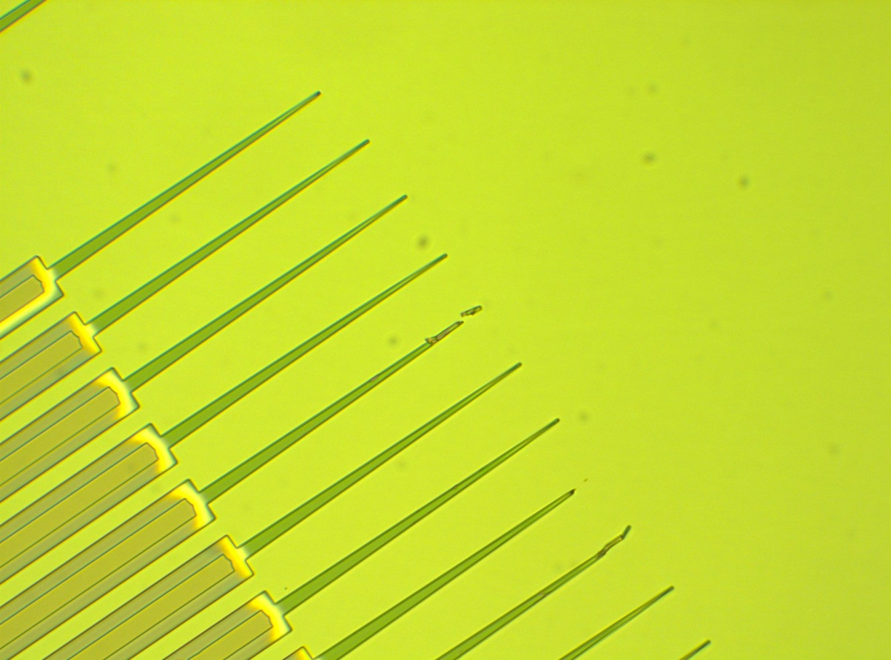
Accelerated Etching
After 6 minute of BHF wet etching the entire taper tip appears undercut and mesa is half gone. This seems rapidly accelerated given the assumed 225nm/min etch rate of PECVD.

Slide 13
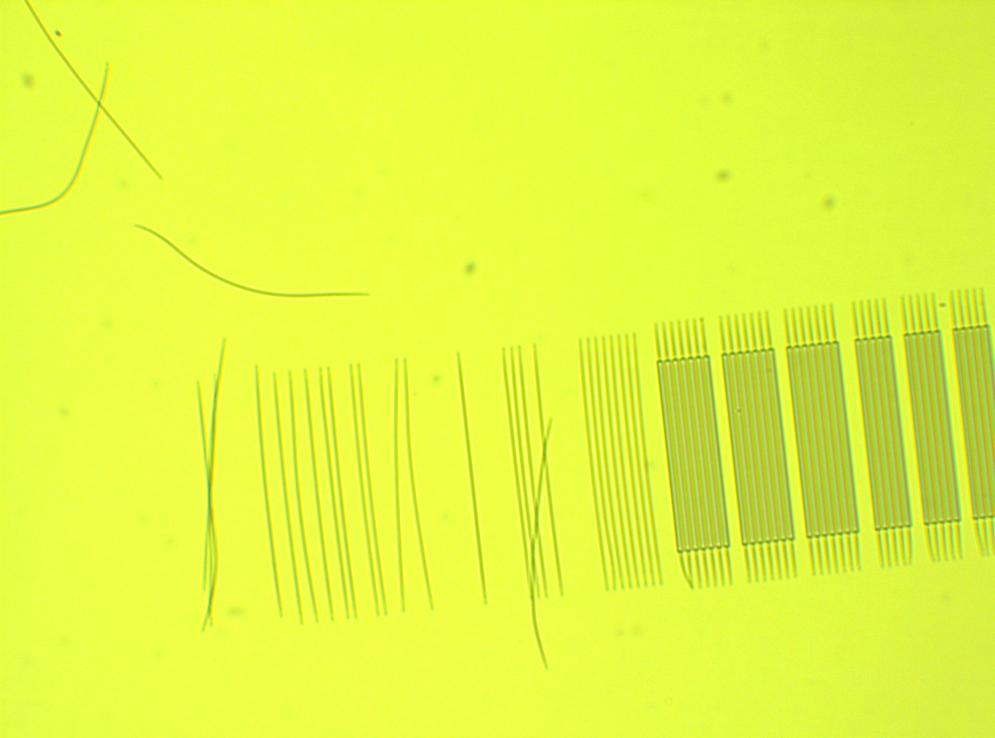
Adhesion Problems
After 3 minute of BHF wet etching entire structures have lifted off indicative of poor adhesion of the resist even without dry etching. Revisiting the HMDS primer process is recommended for future development, however this result caused me to abandon the wet etch reduction process in search for another process.

Slide 14
Conclusions BHF wet etch of SiO2 hardmask
Adhesion is the main issue with the current process.
Future processes should investigate longer wait times after pippetting the HMDS and a post spin bake of the HMDS to increase it’s capacity to act as a primer on top of oxide hardmasks.
Primer adhesion optimization is important many steps in the process not just for tapers and will be investigated.

Slide 15
Over-exposure of positive resist taper pattern

Slide 16
Over-exposure of positive resist taper pattern
PR
PR
Hardmask
HM
HM
III-V Epi
Epi
Epi
Epi
Si or SiO2 WG Layer
Si or SiO2 WG Layer
Si or SiO2 WG Layer
Si or SiO2 WG Layer
Si
Si
Si
Si
Bond
PECVD Hardmask
Positive Resist
Over-exposed Lithography
PR
HM
HM
HM
Epi
Epi
Epi
Epi
Si or SiO2 WG Layer
Si or SiO2 WG Layer
Si or SiO2 WG Layer
Si or SiO2 WG Layer
Si
Si
Si
Si
HM Dry Etch
Strip
III-V Dry Etch
BHF HM Removal

Slide 17
Over-exposure of positive resist taper pattern
PR
PR
Hardmask
HM
HM
III-V Epi
Epi
Epi
Epi
Si or SiO2 WG Layer
Si or SiO2 WG Layer
Si or SiO2 WG Layer
Si or SiO2 WG Layer
Si
Si
Si
Si
Bond
PECVD Hardmask
Positive Resist
Over-exposed Lithography
PR
HM
HM
HM
Epi
Epi
Epi
Epi
Si or SiO2 WG Layer
Si or SiO2 WG Layer
Si or SiO2 WG Layer
Si or SiO2 WG Layer
Si
Si
Si
Si
HM Dry Etch
Strip
III-V Dry Etch
BHF HM Removal

Slide 18
Over-exposure of positive resist taper pattern
ACE,ISO,DI,PEII(O2 Plasma)
Deposit oxide hardmask in PlamsaTherm PECVD – 200nm
ACE,ISO,DI,PEII(O2 Plasma)
Dehydration bake 110 1min
Spin HMDS (3krpm, 30sec)
Wait 60s after pipetting or 105C, 2min bake after spinning (improved adhesion)
Spin SPR955.9 (3krpm, 30sec)
Pre-exposure bake 95C, 90s
Autostepper Exposure=Variable, Focus=0
Post exposure bake 125C, 90s
40s Develop in MIF726
O2 plasma 30s 300W 100mT to clean surface
ICP#2 (recipe #104)
CF4/CHF3/O2 5/35/10sccm, 500/50W ICP/CCP, 0.5Pa, 2min 30sec
RIE#5 GaAs Etch
Completed Pending Abandoned

Slide 19
Over-exposure Focus = 0 100x Visible Microscope
0.4sec
0.55sec
0.7sec
0.85sec
1.0sec
1.6sec
Note the sharpening, retraction, & rainbow thin fill effect that occurs with increased exposure of the pattern.

Slide 20
Over-exposure Focus = 0 100x DUV Microscope
0.4sec
0.55sec
0.7sec
0.85sec
1.0sec
1.6sec
Note the sharpening, retraction, & rainbow thin fill effect that occurs with increased exposure of the pattern.

Slide 21
Over-exposure Focus = 0 100x DUV Microscope
0.4sec
0.55sec
0.7sec
0.85sec
1.0sec
1.6sec
Note the sharpening, retraction, & rainbow thin fill effect that occurs with increased exposure of the pattern.

Slide 22
Residual PR Films at Taper Tip
As the over-exposure is increased the pattern retracts and thins at the tip. This sharpens the tip, however it leaves a film or resist visible in the microscope which is not expected to withstand oxide dry etching.

Slide 23
Conclusions Over-exposure of positive resist taper pattern
Some reduction is clearly visible and should be investigated as a change in the current Si Hybrid process.
I suggest a simulation of 300-500nm taper tips transmission as a function of alignment offset.
<200nm tapers don’t seem possible in this process because of the thinning of the tips into residual PR films which will adversely effect consistency and line edge roughness.
There is also the unmeasured parameter of consistency. This is predicted to decrease with higher over exposure doses.

Slide 24
PMGI/SPR bi-layer pattern reduction with DUV flood exposure

Slide 25
PMGI/SPR bi-layer pattern reduction with DUV flood exposure
PR
PR
PMGI
PMGI
Hardmask
HM
HM
III-V Epi
Epi
Epi
Epi
Si or SiO2 WG Layer
Si or SiO2 WG Layer
Si or SiO2 WG Layer
Si or SiO2 WG Layer
Si
Si
Si
Si
Bond
PECVD Hardmask
PMGI & Positive Resist Bi-layer
Std. Lithography
PR
PMGI
PMGI
HM
HM
HM
Epi
Epi
Epi
Epi
Si or SiO2 WG Layer
Si or SiO2 WG Layer
Si or SiO2 WG Layer
Si or SiO2 WG Layer
Si
Si
Si
Si
DUV Exposure & Develop
Strip
III-V Dry Etch
BHF HM Removal

Slide 26
PMGI/SPR bi-layer pattern reduction with DUV flood exposure
PR
PR
PMGI
PMGI
Hardmask
HM
HM
III-V Epi
Epi
Epi
Epi
Si or SiO2 WG Layer
Si or SiO2 WG Layer
Si or SiO2 WG Layer
Si or SiO2 WG Layer
Si
Si
Si
Si
Bond
PECVD Hardmask
PMGI & Positive Resist Bi-layer
Std. Lithography
PR
PMGI
PMGI
HM
HM
HM
Epi
Epi
Epi
Epi
Si or SiO2 WG Layer
Si or SiO2 WG Layer
Si or SiO2 WG Layer
Si or SiO2 WG Layer
Si
Si
Si
Si
DUV Exposure & Develop
Strip
III-V Dry Etch
BHF HM Removal

Slide 27
PMGI/SPR bi-layer pattern reduction with DUV flood exposure
ACE,ISO,DI,PEII(O2 Plasma)
Deposit oxide hardmask in PlamsaTherm PECVD – 200nm
ACE,ISO,DI,PEII(O2 Plasma)
Dehydration bake 110 1min
Spin SF-11 (4krpm, 30sec)
Reflow Bake (200C, 2min)
Spin SPR955.9 (3krpm, 30sec)
Pre-exposure bake 95C, 90s
Autostepper Exposure = 0.42s, Focus = +10
Post exposure bake 110C, 90s
40s Develop in MIF726 (May be longer)
DUV flood expose (varied time)
Develop (101A, 1min) (repeated variable number of times)
ACE soak 5min - to strip SPR955.9
i-line flood expose and 1-2min Develop in MIF726 was found to attack exposed PMGI
O2 plasma 30s 300W 100mT to clean surface
ICP#2 (recipe #104)
CF4/CHF3/O2 5/35/10sccm, 500/50W ICP/CCP, 0.5Pa, 2min 30sec
RIE#5 GaAs Etch
Completed Pending Abandoned

Slide 28
SPR 955 0.9 pattern before PMGI exposure and development

Slide 29
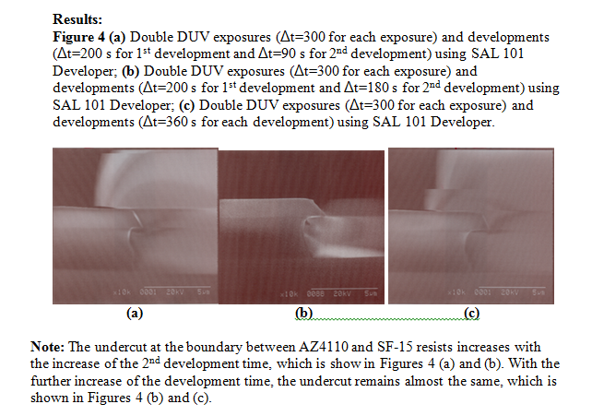
Repeated DUV Exposure/Develop Process

Slide 30
Repeated DUV Exposure/Develop Process
 | 1x | 2x | 3x | 4x | 5x | 6x
2min Exposure 60s Develop | Under developed | Under developed | Under developed | Developed | Developed | Developed
4min Exposure 60s Develop | Under developed | Under developed | Developed
6min Exposure 120s Develop | Under developed
8min Exposure 2min Develop | Under developed
10min Exposure 2min Develop | Under developed
12min Exposure 2min Develop | Under developed
It appears that a single exposure and development is difficult to achieve. Further investigation will be done in this area to improve consistency of the process.

Slide 31
PMGI Taper Tip Patterns
3x4min Exposure, 60s Develop, 5min Acetone, 30s PEII O2 descum
Once the PMGI has been fully exposed and developed, even over exposed and repeatedly developed the patterns show the most significant and repeatable reduction in taper size and have tips <200nm meeting the objective of the PULSAR process requirements.

Slide 32
Residual PR Films at Taper Tip
6x2min Exposure, 60s Develop, 5min Acetone, 30s PEII O2 descum
As with the i-line over-exposure process It is possible with too many repeat exposure development cycles to wear down the tip. However the patter does not seem to suffer as drastic an effect.

Slide 33
Conclusions
BHF hardmask wet etching must overcome adhesion issue to be a viable option.
SPR 955 0.9 over-exposure process seems limited by the wavelength of the i-line lithography tool and the residual films at pattern edge, development will continue as it is a simpler process, however it is a second option at this point.
Currently, the PMGI/SPR bi-layer pattern reduction with DUV flood exposure process appears to show most promise for delivering <200nm taper tips using the Autostepper.
Recommendation: I recommend that the Si hybrid group investigated with simulations taper tip reduction trade-offs with alignment offset to improve taper performance
Acknowledgements: Thanks to Brian Thibeault and Ning Cao for discussions and recommendations to improve these processes.

Slide 34
Next steps
Hard mask etches and III-V etches must be completed to finalize the decision of the taper process most appropriate for PULSAR.
Continuing Development
Thermal study of GaAs bonded epi
PL Study is nearly complete
Contact anneal study is starting this week
Top cladding/via process development
BCB and SOG will be attempted
Ti/Pt/Au P/Probe metal process attempted over the next few weeks
Pulsar Taper Mask
Taped out all but the P/Probe metal and Via mask, which are pending process development

