Slide 1
Isolator update
Jason Tien
11/16/2010

Slide 2
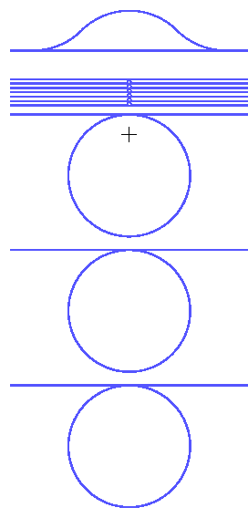
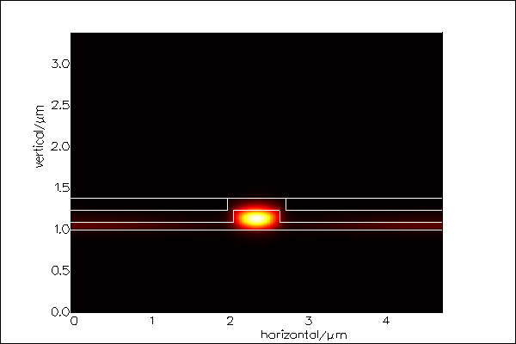
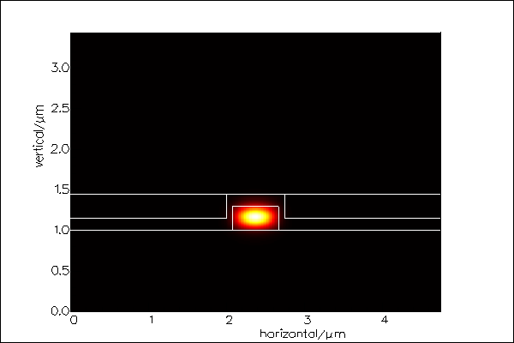
Devices for test
Chip 1
Chip 2
MZI
600 nm
600 nm
20 um rings
150nm
295nm
86nm
ng=3.6
TE/TM
hybrid
ng=4.17
TM
900 um rings
Asymmetric MZI
20um-radius rings
900um-radius rings
Asymmetric MZI
20um-radius rings
900um-radius rings

Slide 3
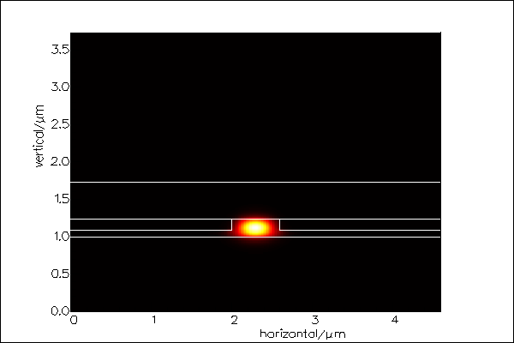
Chip 1 – 20um ring
ng=3.8
150nm
Si rib waveguide
- rib etch 150nm
- WG height: 236 nm
- only TE is found before putting CeYIG on the top
Ring radius: 20um
WG-ring gap: 150 nm
WG Loss=17.7dB/cm
86nm

Slide 4
Chip 1 - 900um ring
Loss=23 dB/cm
WG-ring gap: 200 nm
Loss=10.6 dB/cm
WG-ring gap: 300nm

Slide 5
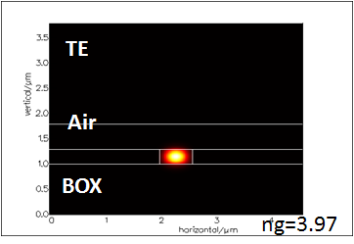
Chip 2 – Asymmetric MZI
Si rectangular waveguide
- WG height: 295 nm
Length difference between 2 arms: 313um
ASE and OSA was used for measurement
No ring resonance spectra was observed because of over-large coupling gap due to over etch
50% TE (n_{g}=4) and 50% TM (n_{g}=4.68)
Calculation
ASE+OSA spectra
Measurement

Slide 6
Chip 2 – Asymmetric MZI
Tunable laser wavelength scanning
TE
TM

Slide 7
With Ce:YIG on the top of rings and MZI

Slide 8
Asymmetric MZI-chip1
ASE+OSA
RB: 60pm
Sensitivity: -90dBm
RB: 60pm
Sensitivity: -92dBm

Slide 9
20um rings –chip1
Only TE-mode resonance was observed even though mode calculation shows TE/TM hybrid mode
TM mode might have higher loss due to larger overlap with Ce:YIG

Slide 10
Asymmetric MZI (TM mode)- chip2
Laser scanning
ng~4.25

Slide 11
Asymmetric MZI- chip2
ASE+OSA

Slide 12
20um rings (TM mode) – chip2

Slide 13
Waveguide Loss
Before Ce:YIG, chip1, TE
gap | 90nm | 120nm | 150nm
Kappa | 0.055 | 0.041 | 0.032
loss | 21dB/cm | 25dB/cm | 31.8dB/cm
After Ce:YIG
Chip1, TE
gap | 60nm | 90nm | 120nm | 150nm
Kappa | 0.42 | 0.1 | 0.06 | 0.05
loss | 60dB/cm | 261dB/cm | 64dB/cm | 68dB/cm
chip2 TM, Г_{YIG}=26.5%
gap | 60nm | 80nm
Kappa | 0.09 | 0.024
loss | 113dB/cm | 56dB/cm

Slide 14
GGG vs SGGG substrates
SGGG peak is closer to that of Ce:YIG ➔ closer lattice constant

Slide 15
Summary
236-nm thick rib waveguide can not support pure TM mode
The waveguide loss with Ce:YIG is ~ 60dB/cm
  Too larger to make a 900um-radius ring resonator
  Poly-crystallinity may have high loss
  Mizumoto’s group has Ce:YIG loss about 10 ~ 15dB/cm
No magnetic effect was observed in asymmetric MZI and 900um-radius rings
  Imply Faraday coefficient less than 1000 deg/cm
  Material property is the major problem to overcome

