Slide 1
Comparison of different hybrid modulator design
Y.B. Tang
Updated on Feb. 3th.

Slide 2
Targets
Integration with hybrid silicon lasers
EML length < 1mm
Voltage < 1Vpp
Loss < 3dB
Extinction ratio > 5dB
Power consumption for modulator < 2mW/Gbit/s

Slide 3
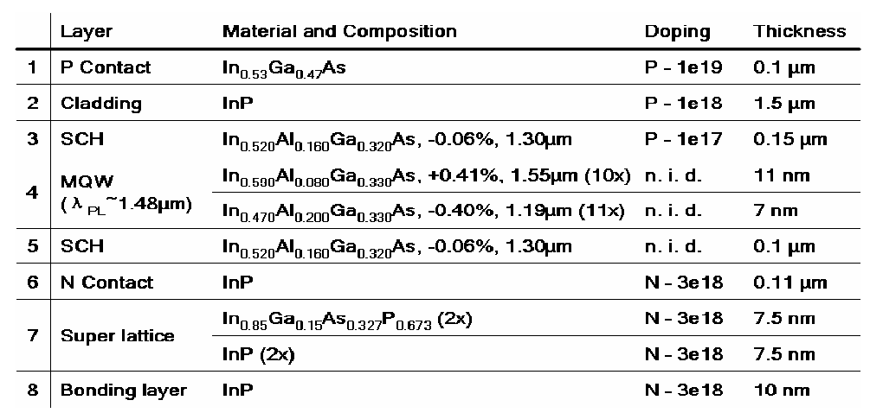
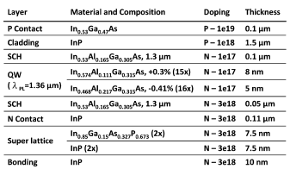
Modulator Structure
LEAM
Metal
SU8
TWEAM
InP
MQW/SCH
SiO₂
Si
Cross section
MZM
RingDrop
epi EAM; PL=1.48μm [2]
epi MZM; PL=1.36μm [3,4]
Due to the static loss, Q factor of the ring can not be very high.
Ring modulator based on phase shift is not good for a high extinction ratio.
The ring modulator refers to an absorptive ring modulator.
RingThrough

Slide 4
Limitation due to hybrid platform
After bonding, the process temperature can not be too high (e.g. <400˚C). Difficult to get a very good ohmic contact.
Typically, passive component (e.g. MMI) is based on silicon due to the low loss. It needs tapers for the transition between silicon and hybrid waveguides.
The III/V epi is bonded upside down, with the substrate being removed then. Epi Regrown can not be done after bonding due to the temperature requirement (>600 ˚C). Epi regrown is possible before the bonding if the bonding surface can be flat.
The III-V material in the bus waveguide for the current hybrid ring [5] is still there. Remove it will do harm to the ring structure.

Slide 5
Concept of the absorptive ring modulator
Drop port
Transmission port
Ring
Ring
1, Index change is positive to the ER but ignored here
2, ER can be enhanced by absorptive ring modulator due to the resonance, compared with a 100 μm EAM (10dB ER)
3, Optical bandwidth is 10x wider than that of a refractive ring modulator.
4, Coupling coefficient is important for the absorptive ring modulator design. A high coupling is not easy.

Slide 6
Definition
Power consumption [1]:
V+
V+
R_{s}
C_{e}
Z_{C}=50
Z_{C}=50
Z_{C}=Z_{tw}(~20)
Z_{C}=50
C_{i}
Lumped
TW
Extinction ratio calculation:

Slide 7
Integration with hybrid lasers
TYPE | QW compatibility | Process compatibility | Coupling | SCORE
LEAM | QWI, SAWB | lithography | Not necessory | 3
TWEAM | QWI,SAWB | lithography | Not necessory | 3
MZM | SAWB | lithography | MMI,tapers | 0
RingDrop | QWI,SAWB | Ebeam | tapers | 1
RingThr | QWI,SAWB | Ebeam | tapers | 1
1: Integration path with different QWs, (To be compatible with the bonding,
the bonding surface should be flat and clean.)
QWI: compatible with the hybrid platform, good for EAMs,
whose PL is not too far from the LD’s PL.
Selective area wafer bonding(SAWB): possible for any wafers, but need some space
between different epis and need pay attention to the coupling between the passive and active part.
Epitaxial regrouth: difficult for the hybrid platform.
2: Process compatibility:
The ring structure has to be defined by Ebeam lithography.
3: Coupling structure:
If using QWI, EAM and LD can be bridged by hybrid waveguide, where the PL should be shifted greatly to reduce the loss
If using SAWB，tapers are required for both the LD and the modulator.
Couplers e.g. MMI are necessary for MZM.
The ring to the bus coupling will be another issue：
A. asymmetric coupling will limit the choice of the coupling efficiency and need tapers between the LD and modulator
B. symmetric coupling will lead to additional loss contributed by the hybrid waveguide near the ring.
4: Wavelength compatiblity
It would be bad for ring and need tuning unit (typical thermic control).

Slide 8
EML length<1mm
TYPE | Active length | Device length | SCORE
LEAM | ~100 | >150 | 3
TWEAM | >200 | >300 | 2
MZM | >500 | >1500 | 0
RingDrop | 20~30 | >100 | 3
RingThr | 20~30 | >100 | 3
1: MZM is hard to achieve an EML length less than 1mm: (Over 500μm long active length, MZI (MMI, S-waveguide), tapers (LD to Si waveguide, Si waveguide to Active part)
2: Segmented TW EAM can be a possible choice but the passive optical segment should not be too long. More than 2 active segments design can not reach this goal.
3: Although the ring itself can be very small, e.g. a radius of 10μm or less is possible. But taking into account the electric pad (typically, 200 μm x50 μm), the footprint would be much larger than the ring itself.

Slide 9
Voltage <1Vpp; extinction ratio>5dB
TYPE | feasibility | Note | SCORE
LEAM | ++ [2] |  | 2
TWEAM | +++ | Allow a long active segment | 2
MZM | ++ [3] |  | 2
RingDrop | ++ | resonance enhance | 2
RingThr | * | resonance enhance | 3
[2]: 0.82Vpp|-2.2V|5dB|100μm|10Gb/s, lumped EAM.
[3]: 4Vpp|-5V|11dB|500 μm|25Gb/s, CLTWE MZM,
1.5Vpp|-3.8V|6.4dB|500um|10Gb/s, TW MZM.
*: very high coupling coefficient is still challenging. MMI may be a solution.
Note that the QWI will degenerate the exciton peak and the QCSE effect.

Slide 10
Loss<3dB
TYPE | Active loss | Taper loss | Passive WG | SCORE
LEAM | 1~2 | 1x1 | <0.5 | 1
TWEAM | 1~2 | 1x1 | <0.5 | 1
MZM | 1~2 | 1x2 | 1 | 0
RingDrop | 1~2 | >1x1 | <0.5 | 1
RingThr | <1 | >1x1 | <0.5 | 2
Only the loss related to the modulator is included here.
E.g. the taper loss in the LD side is not included.
The output of the modulator is assumed to have a taper
to guide the light from III/V to Si waveguide
Passive loss includs the MMI loss for MZM,
and the loss from the passive hybrid waveguide.

Slide 11
Power consumption <2mW/Gbps
TYPE | C [pF] | Vpp [V] | RF Power [mW/Gbps] | Bias [V] | Bit rate [Gb/s] | Static P [mW/Gbps] | SCORE
LEAM | 0.1~0.2 | 1 | <0.1 |  | 10 | <0.1 | 3
TWEAM | 0.2~0.3 | 1 | <0.2 | -2 | 40 | <0.1* | 3
MZM | >0.5 | 1 | >0.3 | -4 | 25 | <0.1* | 3
RingDrop | 0.1 | 1 | <0.1 |  | 10 | <0.1 | 2
RingThr | 0.1 | 1 | <0.1 |  | 10 | <0.1 | 2
TWEAM and MZM, assuming a 50Ω load.
* A bias tee is required between the device and the load.
Note that the ring structure would typically need thermo-electric set to tune the wavelength. This set may increase the pow consumption greatly, although they are excluded here.
I1=0.01mA; I0 = 0.1mA for LEAM, Ring;

Slide 12
Other concerns
EO bandwidth:
TWEAM(40GHz)>MZM(25GHz)>Ring(?)>LEAM(20GHz)
Optical bandwidth :
MZM (>50nm)> EAM (>30nm)> Ring (<1nm)

Slide 13
Summary
 | LEAM | TWEAM | MZM | Ring Drop | Ring thr.
Integration with lasers | 3 | 3 | 0 | 1 | 1
EML Length(size) | 3 | 2 | 0 | 3 | 3
Voltage/ER | 3 | 2 | 2 | 3 | 3
Insertion Loss | 1 | 1 | 0 | 1 | 2
Power concumption | 3 | 3 | 3 | 2 | 2
Bandwidth/speed | 1 | 3 | 3 | 2 | 2
Feasibility | 3 | 3 | 3 | 1 | 0
Cost/Process | 3 | 3 | 3 | 2 | 1
3, good, 2, possible, 1, difficult, 0, critical
TWEAM/LEAM is the best choice for this project. Need pay attention to the loss.
MZM is not good for this project.
Absorptive ring using the drop port is worthy of a try.
It is still questionable whether a high coupling point can be achieved
for an absorptive ring using the through port.

Slide 14
Challenges
Insertion Loss:
Especially the taper loss.
How to reduce the “1” level loss?
QWI:
Degradation of QCSE effect for the modulators
The comprise of the EAM and the LD epis (well number).
Process.
How to reduce the contact resistance and capacitance, due to the low temperature operation and difficulty in doping control?
How to optimize the MQW to have a small bias but a sharp absorption curve related to the reverse voltage but keep low loss at symbol ‘1’?
The fabrication of a low loss hybrid ring (sidewall roughness etc)?
Before QWI
After QWI
P
V

Slide 15
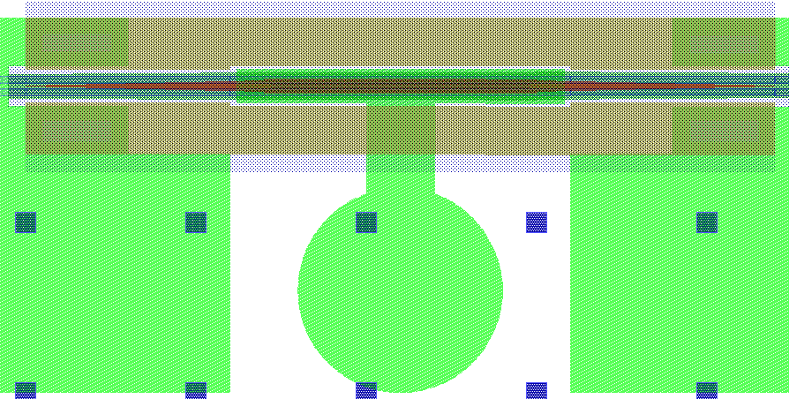
Challenge: Voltage and ER
Degradation of QCSE due to QWI
Using tensed wells to increase the absorption
Large contact resistance and capacitance, due to low temperature operation and difficulty in doping control.
ρs~5e-5 Ω cm^2, => Rs =1~2Ω mm,
C~1pF/mm
Increase the active length but sacrify the bandwidth. TW/1-segmented design is preferred.
Isolate taper part
Increase the doping in p-cladding
Increase top SCH layer

Slide 16
References
[1] | J. Liu, M. Beals, A. Pomerene, S. Bernardis, R. Sun, J. Cheng, L. Kimerling, and J. Michel, “Waveguide-integrated, ultralow-energy GeSi electro-absorption modulators,” Nature Photonics, vol. 2, 2008, pp. 433-437.
[2] | Y. Kuo, H. Chen, and J.E. Bowers, “High speed hybrid silicon evanescent electroabsorption modulator,” Optics Express, vol. 16, Jun. 2008, pp. 9936-9941.
[3] | H. Chen, Y. Kuo, and J. Bowers, “25Gb/s hybrid silicon switch using a capacitively loaded traveling wave electrode,” Opt. Express, vol. 18, 2010, pp. 1070-1075.
[4] | H. Chen, Y. Kuo, and J. Bowers, “High speed hybrid silicon evanescent Mach-Zehnder modulator and switch,” Optics Express, vol. 16, 2008, pp. 20571-20576.
[5] | D. Liang et al., “Electrically-pumped compact hybrid silicon microring lasers for optical interconnects,” Optics Express, vol. 17, no. 22, pp. 20355-20364, 2009.

