Slide 1
Rainbow 2.1 Micron Laser
Update 2013-07-16

Slide 2
Update
Mask set selected and modified masks ordered
Waveguides fabricated in 500nm SOI with 1µm BOX
Vertical channels completed
Bonding 4 pieces completed with reasonable yield
Mesa etch completed on 3 chips
Lead chip had issue, will now be used as look ahead
Lower p-InP etch in progress
Planning to get first test results in mid-August, a few weeks before the review.

Slide 3
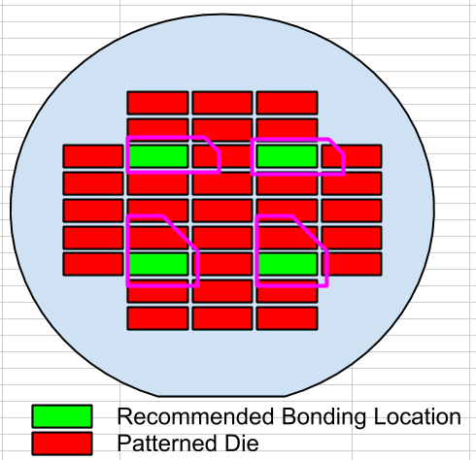
2.1 micron laser processing
(2) 4” SOI wafers have waveguides and VCs
WG etch = 285-339 nm “WLG-B”
WG etch = 250-281 nm “WLG-T”
WLG-T has had 4 ~16x8mm pieces of epi
Yield though not perfect, was workable
Oxide hard mask was patterned
Wafer was diced into quarters
Q1-4
1 2
3 4

Slide 4
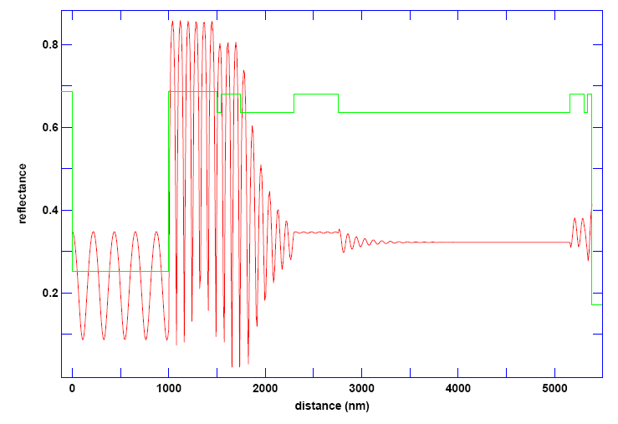
n-mesa and QW etch
Laser Monitor Simulation
Stop Here
UCSB ‘Standard’
Narrow QW / taper
Passive silicon

Slide 5
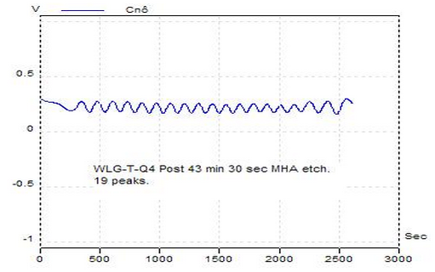
n-mesa and QW etch
Laser Monitor Actual
UCSB ‘Standard’
Narrow QW / taper
Passive silicon

Slide 6
lower p-InP etch
NEXT STEP:
Pos. PR Mask
Controlled Wet Etch
UCSB ‘Standard’
Narrow QW / taper
Passive silicon

Slide 7
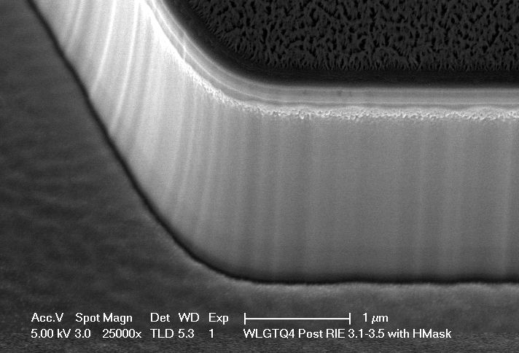
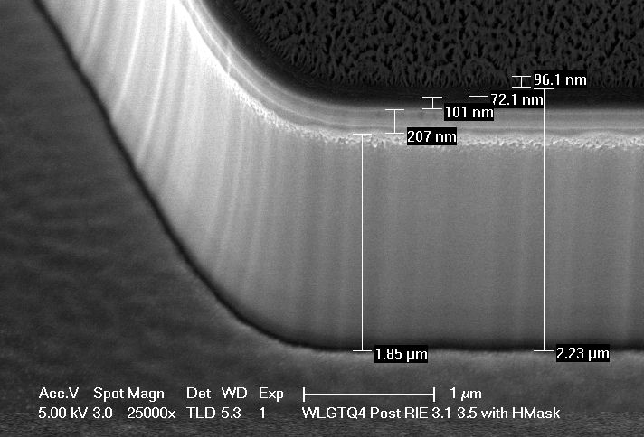
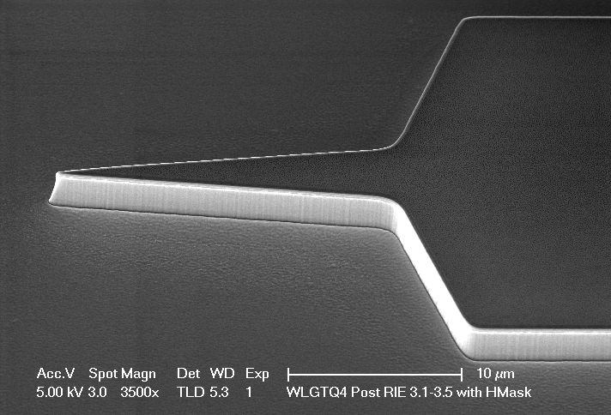
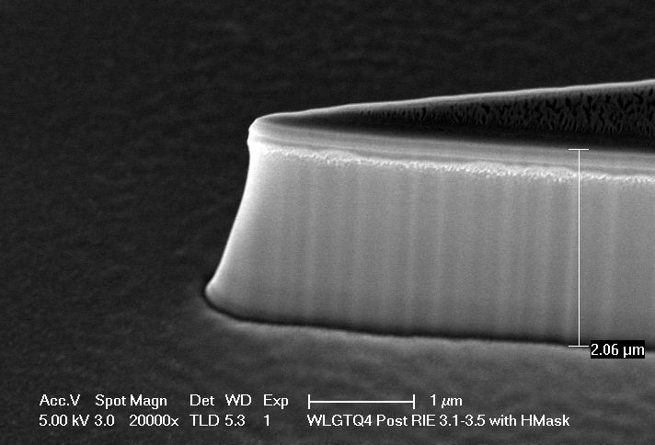
2.1 micron laser processing
Q4
Std P-mesa process (repeated etches and dektaks followed by a long O2 clean)
Etched into the lower InP “SCH”
Etch layout (µm) with ~120nm hard mask, no polymer
Target: >3.05+.120, < 3.59+.120
PLAN:
Needs more dry etching to hit target
3.58 |  | 3.65
 | 3.34
3.48 |  | 3.57

Slide 8
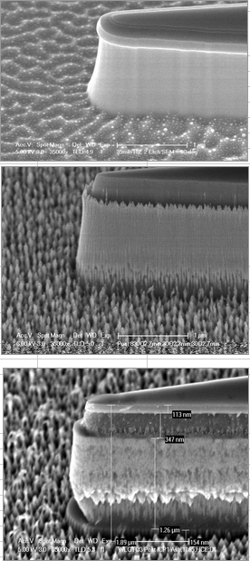
2.1 micron laser processing
Q3
(7/6)
Std. Clean and coat chamber w/o sample
Partial Etch (14 min etch, with laser monitor)
Simulation and actual monitor don’t agree
Dektak – 1.4-1.6µm (partially through the cladding)
Partial Etch (14 min etch, with laser monitor)
Dektak – 2.3-2.5µm (mostly through the cladding)
SEM a)
THIS SAMPLE WAS NOT O2 CLEANED! POSSIBLE GRASSING SOURCE!
(7/7)
Std. Clean and coat chamber w/o sample
3min 30sec O2 Clean with sample inside
7 min RIE2 MHA etch (LASER MONITOR SHOWS VERY SLOW RATE!)
Open chamber. Inspect and dektak. Chip slightly discolored in center. Etch went from 2.4 to 2.6 um
30 sec 02, 7 min etch, 30 sec O2, 7 min etch.
Open chamber. Inspect and dektak. Very discolored (brown). Etch went from 2.6 to 2.75 um. (RIGHT TO THE TOP OF SCH)
SEM b)
O2 300V 10 min 125mT
No change in color
(7/8)
2:1 H2O:HCl for 2min
Inspect
The very corners looked better after 30 sec but no change to 95% of the bonded area.
SEM c)
Conclusion: It is believed that the InP is etched however, the InGaAs(P) was not impacted by the wet etch, therefore the grass remains.
PLAN: Use a dilute etch of the InGaAs(P)
2min - 38:1:1 H2O:H2O2:H3PO4 for etching InGaAs (~50nm/min)
Rinse 5min with repeated cycles of fresh DI water to make sure the acid doesn’t remain in the cracks.
a)
b)
c)

Slide 9
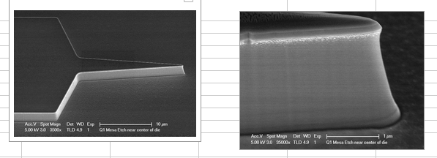
2.1 micron laser processing
Q1
Std P-mesa process (repeated etches and dektaks followed by a long O2 clean)
Etched into the lower InP “SCH”
Etch layout (µm) with ~120nm hard mask, no polymer
Target: >3.05+.120, < 3.59+.120
PLAN:
SEM and Proceed
Q2
HOLD as safety sample or to do a split on the mesa etch
3.48 |  | 3.6
 | 3.32
3.62 |  | 3.61

Slide 10
n-mesa and QW etch
Stop dry etch in the active/InGaAsP SCH layers
UCSB ‘Standard’
Narrow QW / taper
Passive silicon

Slide 11
n-mesa and QW etch
Wet etch the InGaAs/InGaAsP ~200nm
Stops on the lower p-InP cladding
UCSB ‘Standard’
Narrow QW / taper
Passive silicon

Slide 12
lower p-InP etch
Pos. PR Mask (OPEN Question: Does this work in MHA, or will we need a hard mask?)
400nm dry etch in MHA
200nm InP wet etch
UCSB ‘Standard’
Narrow QW / taper
Passive silicon

