Slide 1
Summary ICP#2 Nano Etch Recipe 104 CF₄/CHF₃/O₂ – Oxide or Nitride Etch
Jock Bovington

Slide 2
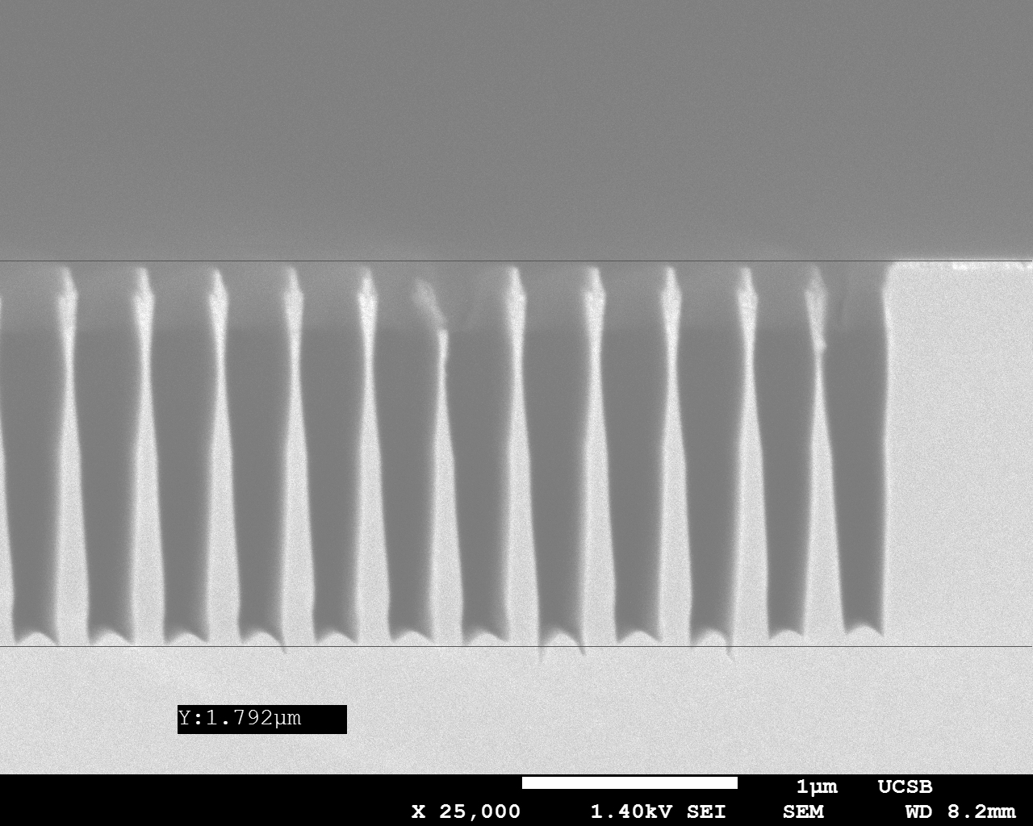
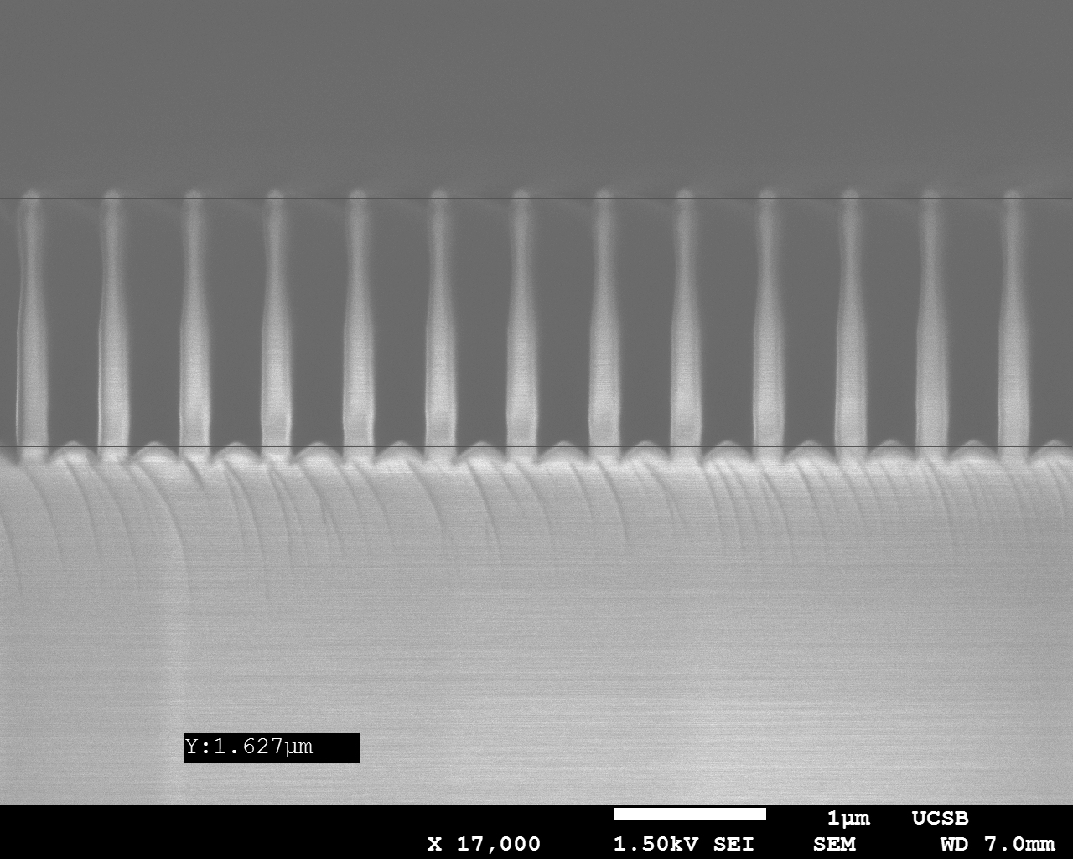
SEM Results – DEEP Gratings
DBR – Au coated for SEM
(~350nm Period)
GADC (560nm Period)
ICP#2 - CF₄/CHF₃/O₂ 5/35/10sccm 500/50W 0.5Pa
21min

Slide 3
Approximate Etch Rates
AV PECVD, Thermal SiO2 - ~80nm/min
AV or PlasmaTherm PECVD Si3N4 - ~80nm/min
100% ZEP - ~142nm/min
2:1 ZEP - ~143nm/min
UV-6 - ~120nm/min
DSK101 - ~142nm/min
Cr - Negligible etching
SPR220-7 - ~123.5nm/min

