Slide 1
UCSB-E-Phi-dev-1
SOI only: test litho and bonding uniformity

Slide 2
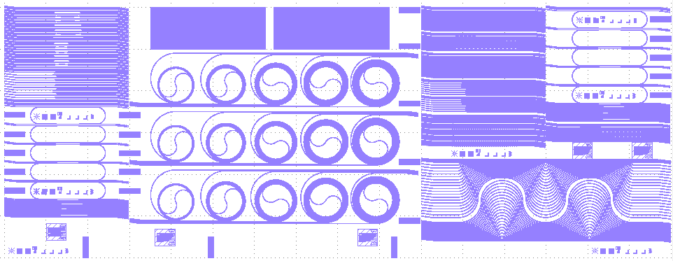
EPHI – SOI Mask Details – WG Layer

Slide 3
2X2 and 1X2 MMI

Slide 4
Directional Couplers and 1X4 MMI
2 sets: DC- 700nm gap, different length
Constant length, gap: 900,800,700,600,500nm

Slide 5
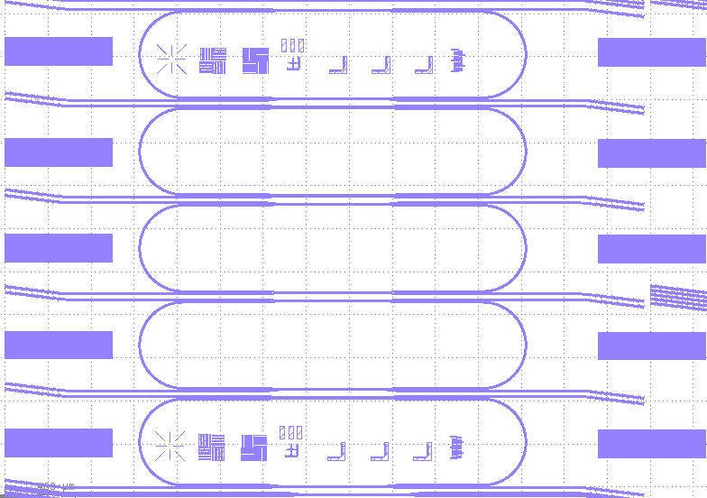
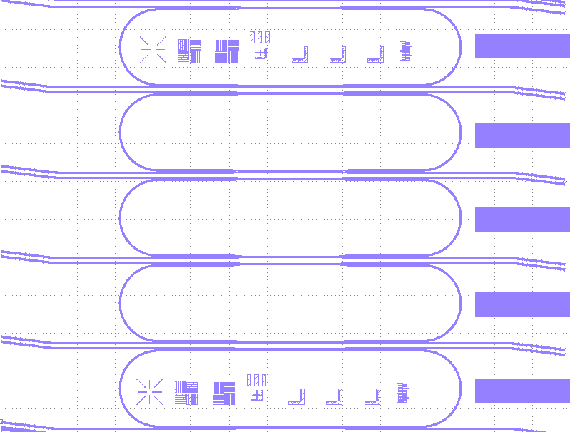
20GHz Ring resonators
Symmetric design- 500nm spacing.
Resolution markers for loading effect.
Trench and WG widths – 0.7,1,1.5,2 um

Slide 6
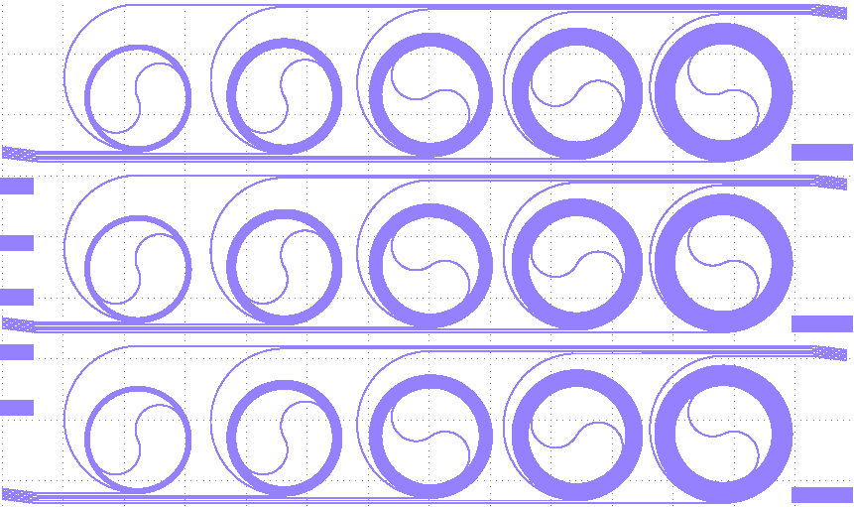
Waveguide Loss cutback structures
3 sets: 1,2,3,4,5 cm?
WG width 0.8,1,2 um

Slide 7
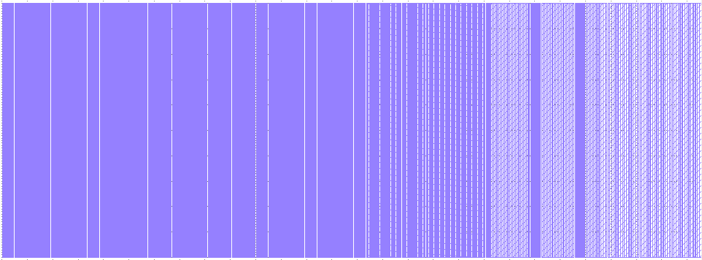
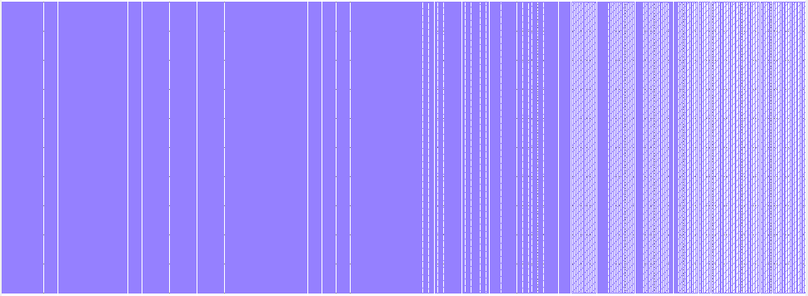
Bonding Test structures

Slide 8
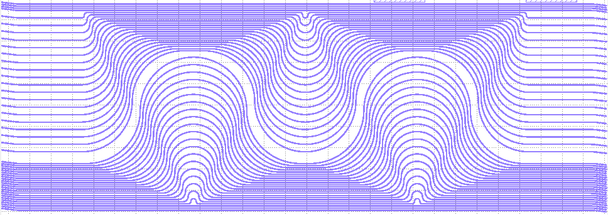
90° Bend Loss test structures
Bend radii – 25um→ 500um – 20 splits

Slide 9
Mode filters

Slide 10
Waveguide crossings
No. of crossing – 1,2,4,8,16,32
90°, 75°, 60°, 45°, 30°

Slide 11
Transitions to Nano-strip waveguide
Si etch – 400nm tip, 800nm strip width

Slide 12
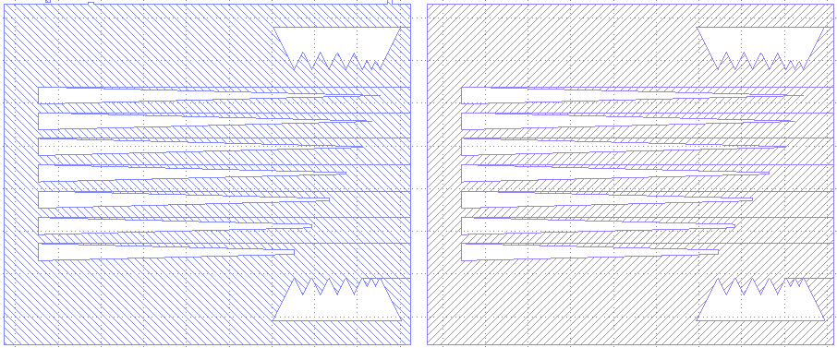
Taper tips resolution markers
Tip width – 5, 4, 3, 2, 1, 0.5, 0 um

Slide 13
Straight to bend transition

